Slide 1
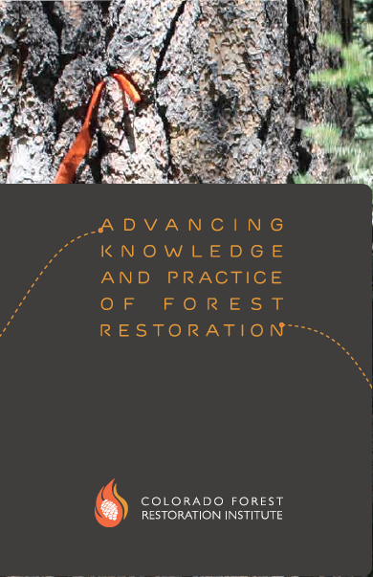
The Colorado Forest Restoration Institute
Authorized by Congress, 2004
Located at Colorado State University (also in AZ & NM)
Develop, compile, and apply scientific knowledge to help define and achieve forest restoration and wildfire hazard reduction goals
Work collaboratively with scientists, managers, and a broad range of stakeholder interests
Why, when, where, and how to do the most effective forest restoration with limited resources?

Slide 2
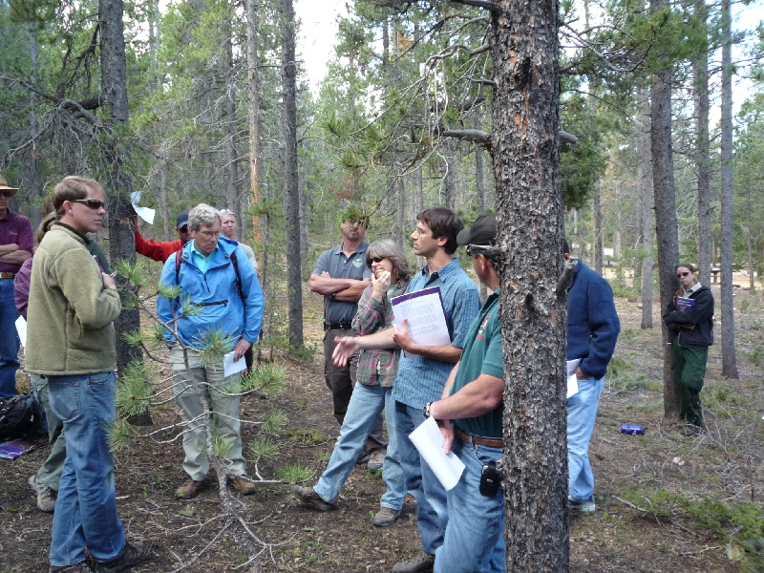
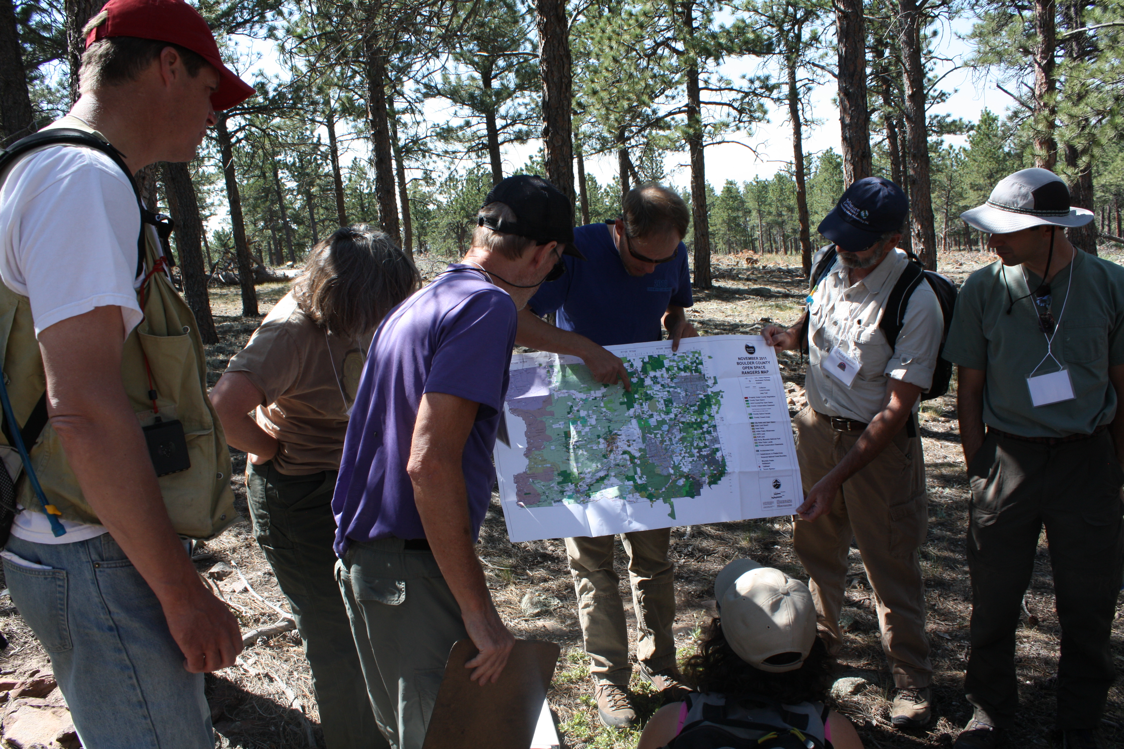
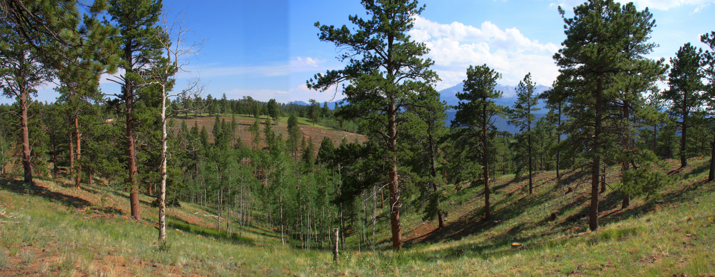
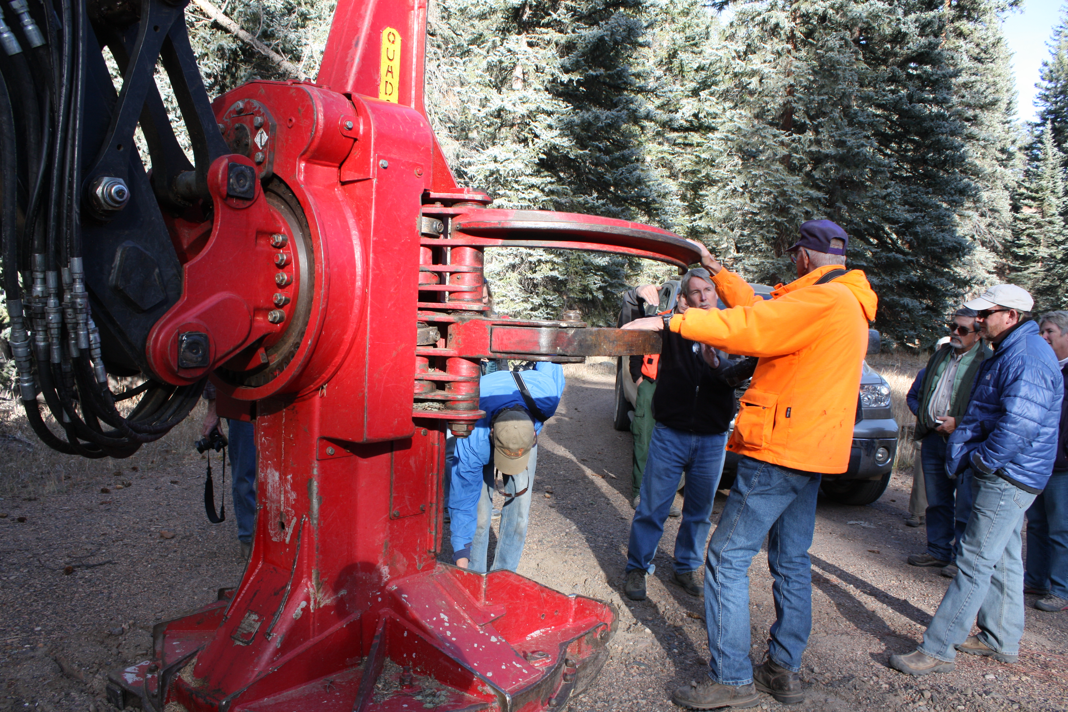
COLLABORATIVE FORESTRY IN COLORADO
Non-government and government organizations, diverse range of interests
Motivated by concerns over wildfires and insect outbreaks
Action-focused to achieve ecological, economic, and community social goals through best available science and consensus

Slide 3
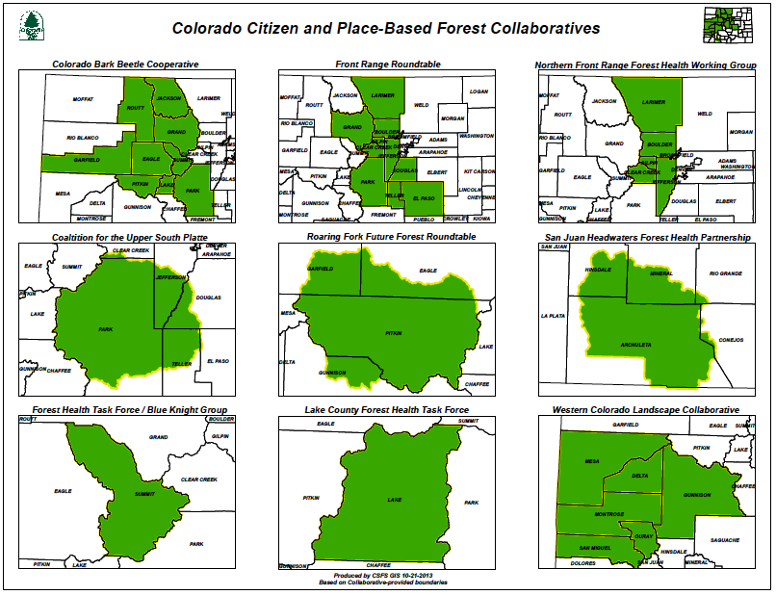

Slide 4
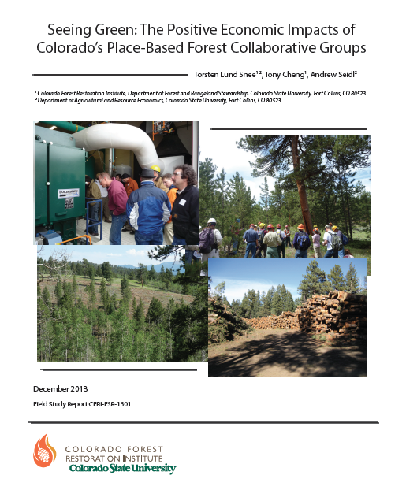
Quantifying the Regional Economic Impacts of Colorado’s Place-Based Forest Collaboratives
• The change in economic activity in a region resulting from a change in expenditures within that region
• Composed of:
⬥ Employment Impacts – Jobs created
⬥ Output Impacts – Value of all goods and services produced
⬥ Macroeconomic Multipliers – Represent total output generated from a level of expenditures
• Return on investment to collaborative funding

Slide 5
Table 1: Annual Funding Reported by Each Organization
 | 2008 | 2009 | 2010 | 2011 | 2012 | 2008-2012
Colorado Bark Beetle Cooperative |  | $52,735 | $13,210 | $23,702 | $105 | $89,752
Colorado Tree Farmers (Annual Average) | $3,000 | $3,000 | $3,000 | $3,000 | $3,000 | $15,000
Coalition for the Upper South Platte | $205,700 | $547,315 | $1,305,006 | $2,019,252 | N/A | $4,077,273
Forest Health Task Force (Annual Average) | $97,220 | $97,220 | $97,220 | $97,220 | $97,220 | $486,100
Front Range Roundtable | $40,000 | $40,000 | $40,000 | $40,000 | $40,000 | $200,000
San Juan Headwaters Forest Health Partnership | N/A | N/A | $13,100 | $7,500 | $5,000 | $25,600
Uncompaghre Partnership | $728,927 | $711,744 | $856,840 | $673,968 | $402,840 | $3,374,319
Total | $1,074,847 | $1,452,014 | $2,328,376 | $2,864,642 | $548,165 | $8,268,044

Slide 6
Economic Impacts: Output, Employment, and Multipliers
Table 2: Total Employment and Dollar Impacts for All Organizations
 | 2008 | 2009 | 2010 | 2011 | 2012
Total Annual Employment Impacts | 39.1 | 63.6 | 100.2 | 114.4 | 21.6
Total Annual Dollar (Output) Impacts | $1,896,301 | $3,005,210 | $4,288,939 | $4,826,230 | $1,093,157
Table 3: Annual SAM Multipliers for Each Organization
 | 2008 | 2009 | 2010 | 2011 | 2012
Colorado Bark Beetle Cooperative | N/A | 2.95 | 2.00 | 1.56 | 1.43
Colorado Tree Farmers | 1.21 | 1.20 | 1.20 | 1.20 | 1.20
Coalition for the Upper South Platte | 1.42 | 1.50 | 1.52 | 1.56 | N/A
Forest Health Task Force | 2.38 | 1.62 | 1.49 | 1.50 | 1.47
Front Range Roundtable | 1.96 | 1.95 | 1.95 | 1.96 | 1.46
San Juan Headwaters Forest Health Partnership | N/A | N/A | 1.60 | 1.60 | 1.60
Uncompaghre Partnership | 1.78 | 1.77 | 1.79 | 1.80 | 1.83

Slide 7
Conclusions
Colorado’s forest collaboratives
Create jobs
Stimulate growth in regional economies
Have positive return on investment
Economic impact analysis does not measure the total value of an organization
Doesn’t capture benefits from reduced wildfire risk
Doesn’t capture value from improved recreational activities
Total value of a collaborative is higher than its economic impacts

Slide 8
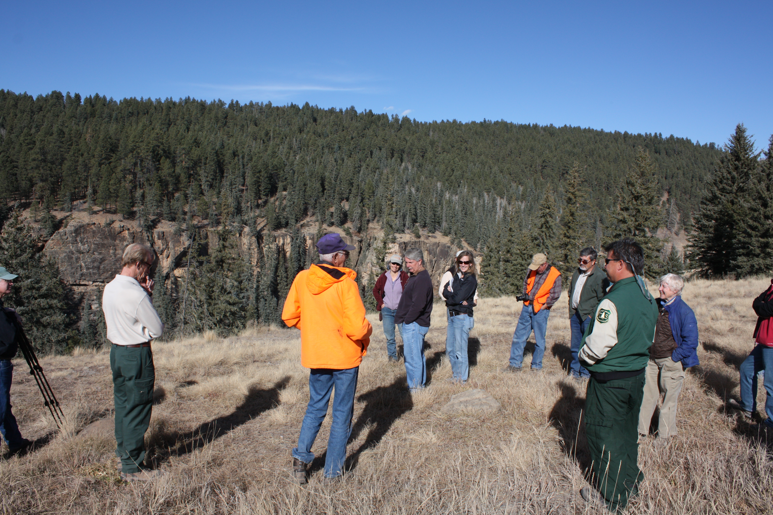
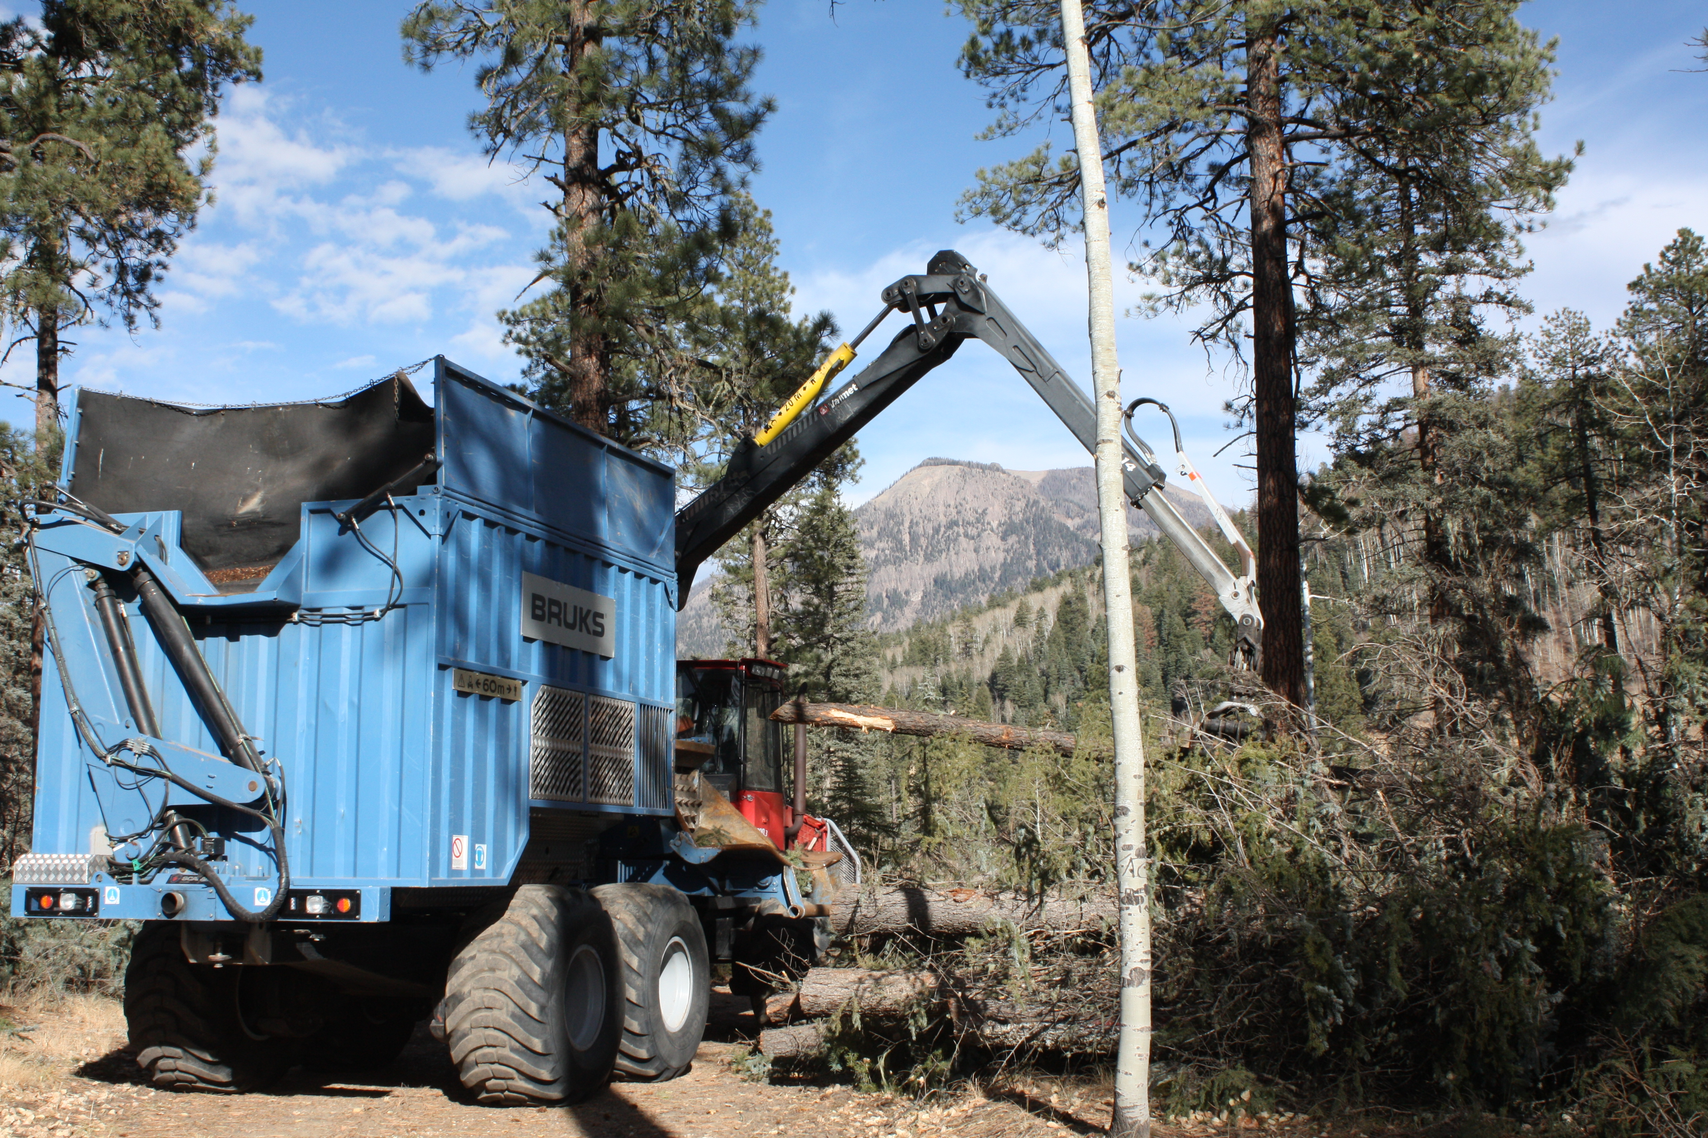
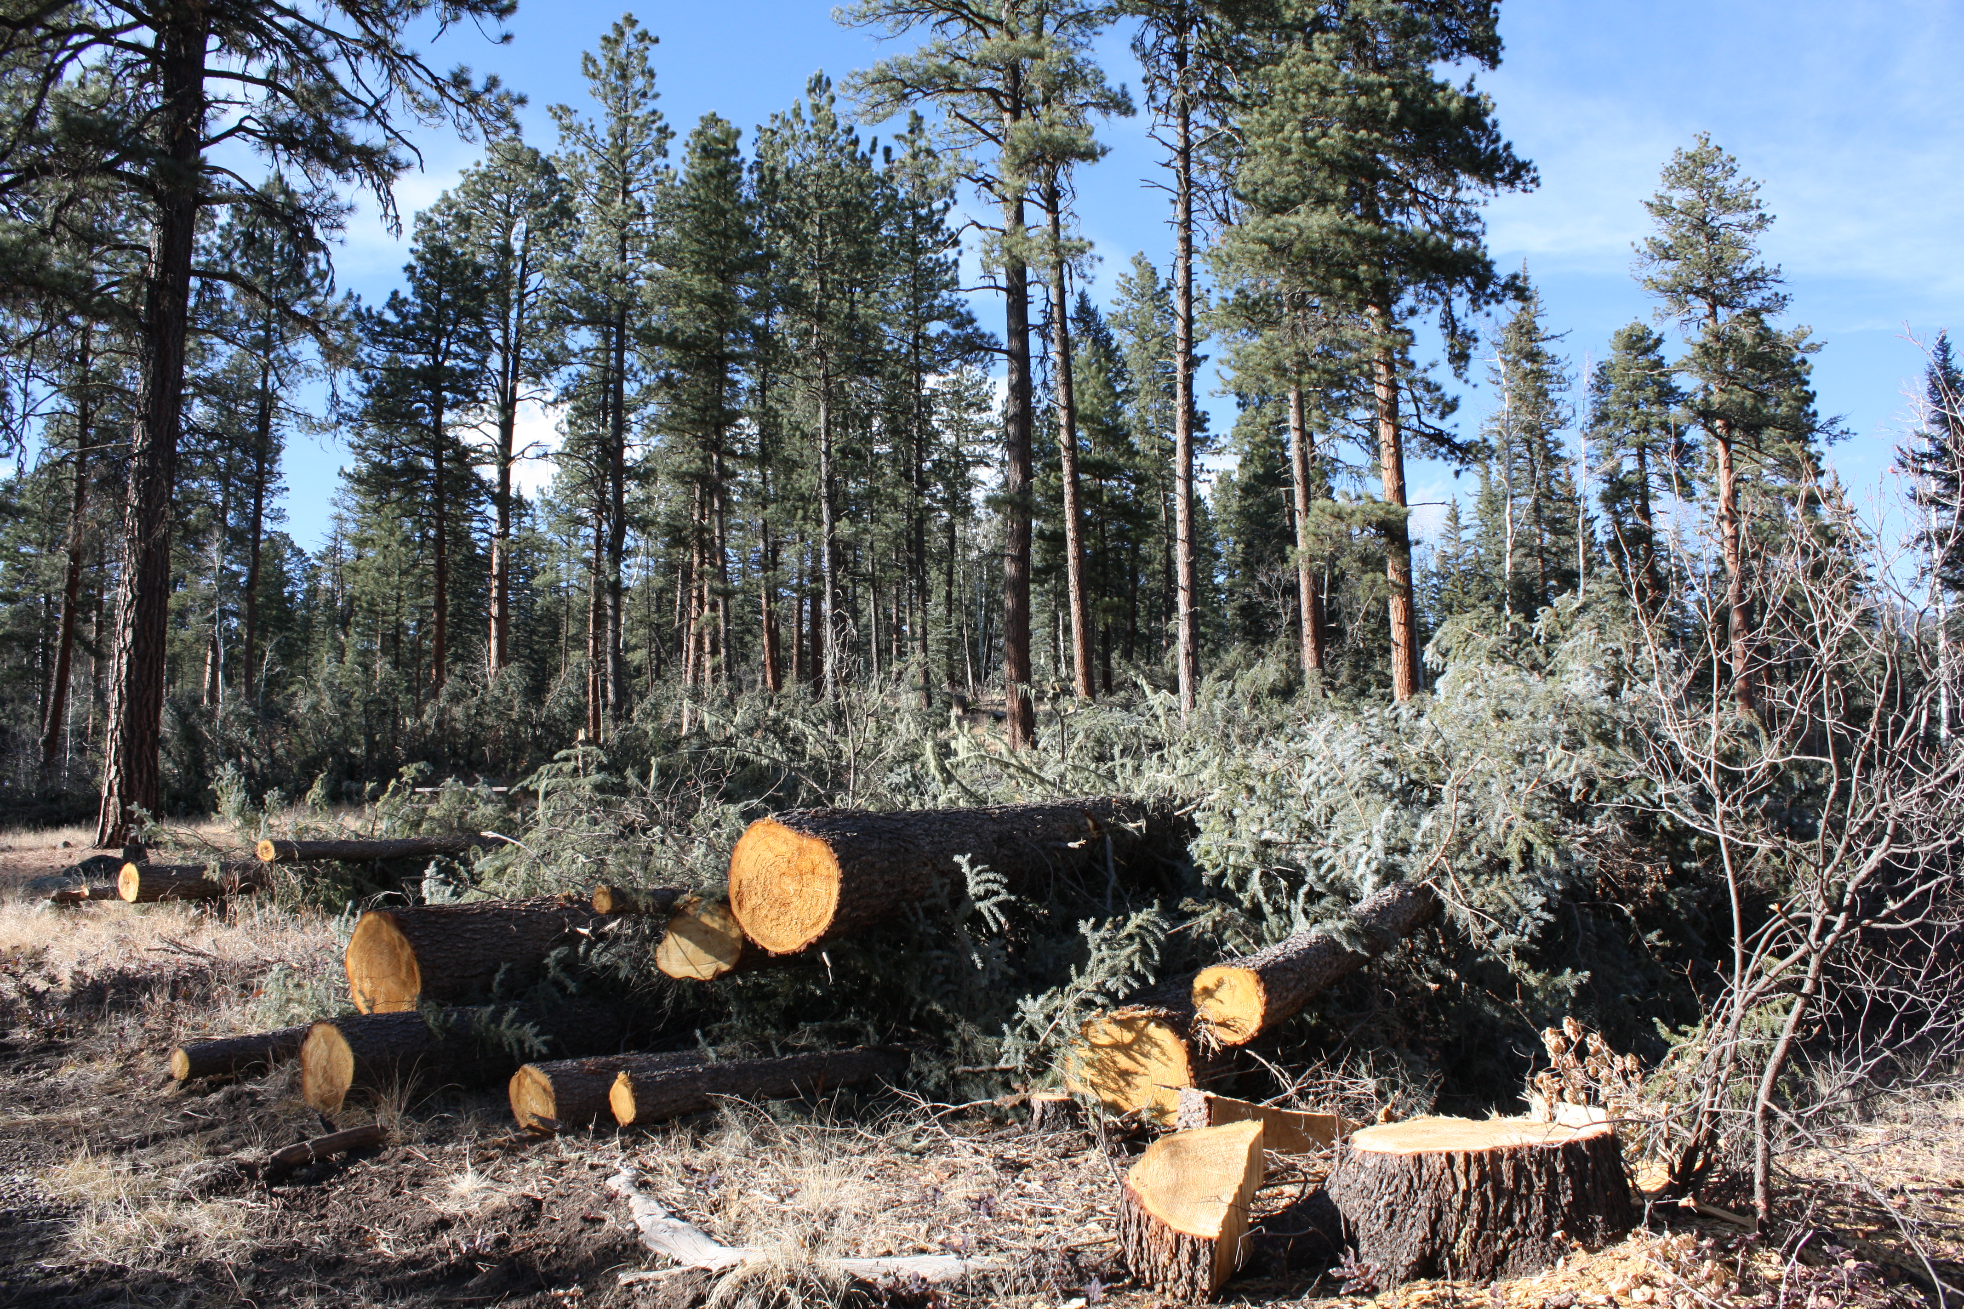
SAN JUAN HEADWATERS FOREST HEALTH PARTNERSHIP
Raised public awareness about the need for forest restoration and pro-active fire management
Helped contribute to positive agency-community communication during the Little Sand Fire
Secured over $50,000 in grant funds to support collaboration and community education
Instrumental in securing long-term stewardship contract
The contract is currently getting treatments done on the ground contributing to local jobs and woody biomass for 5MW bioenergy unit.

Slide 9
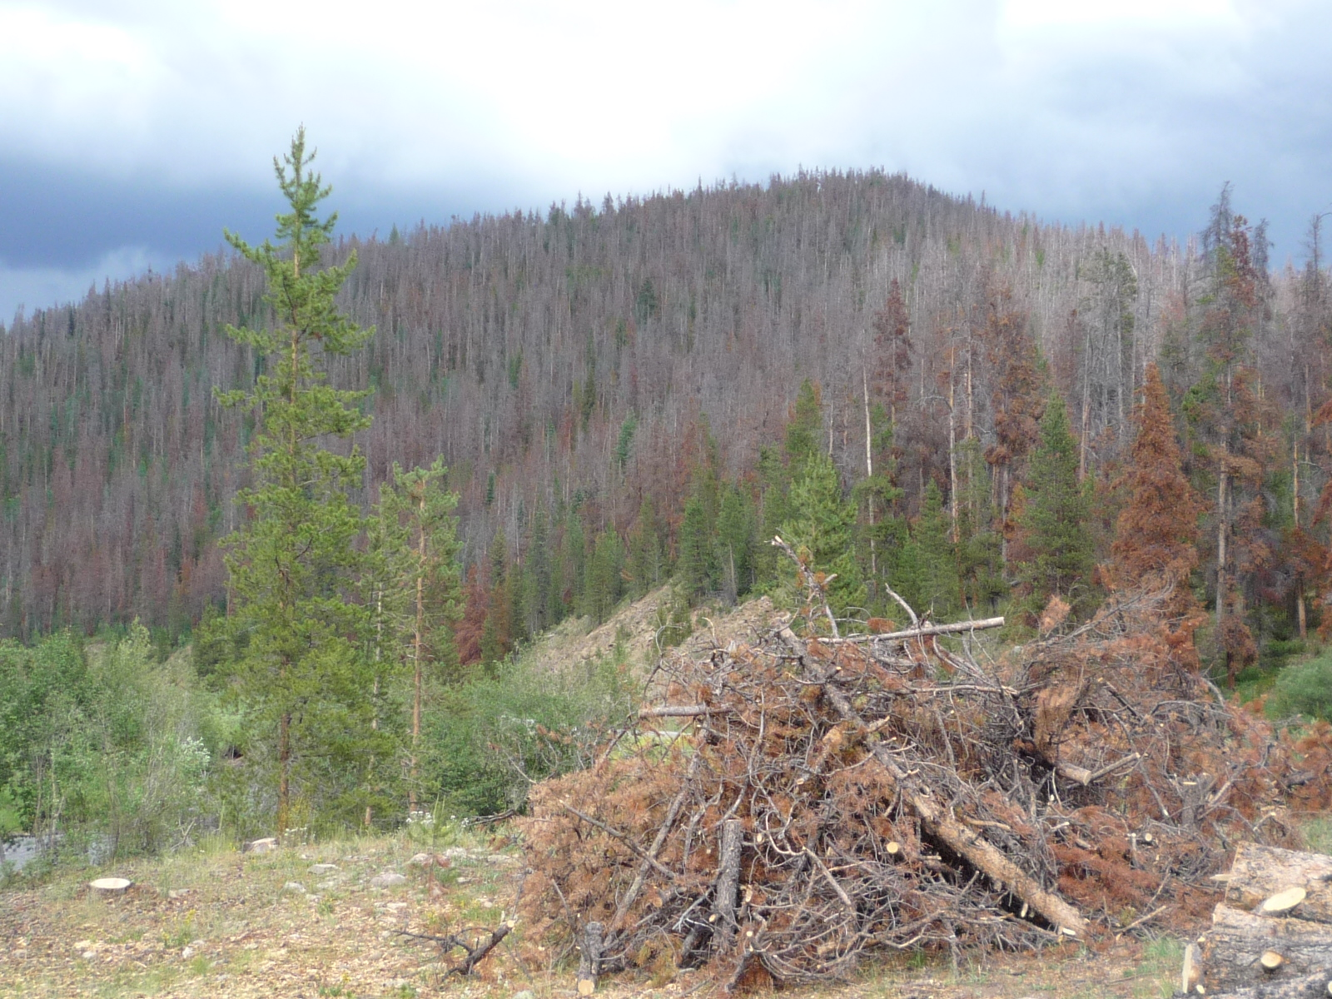
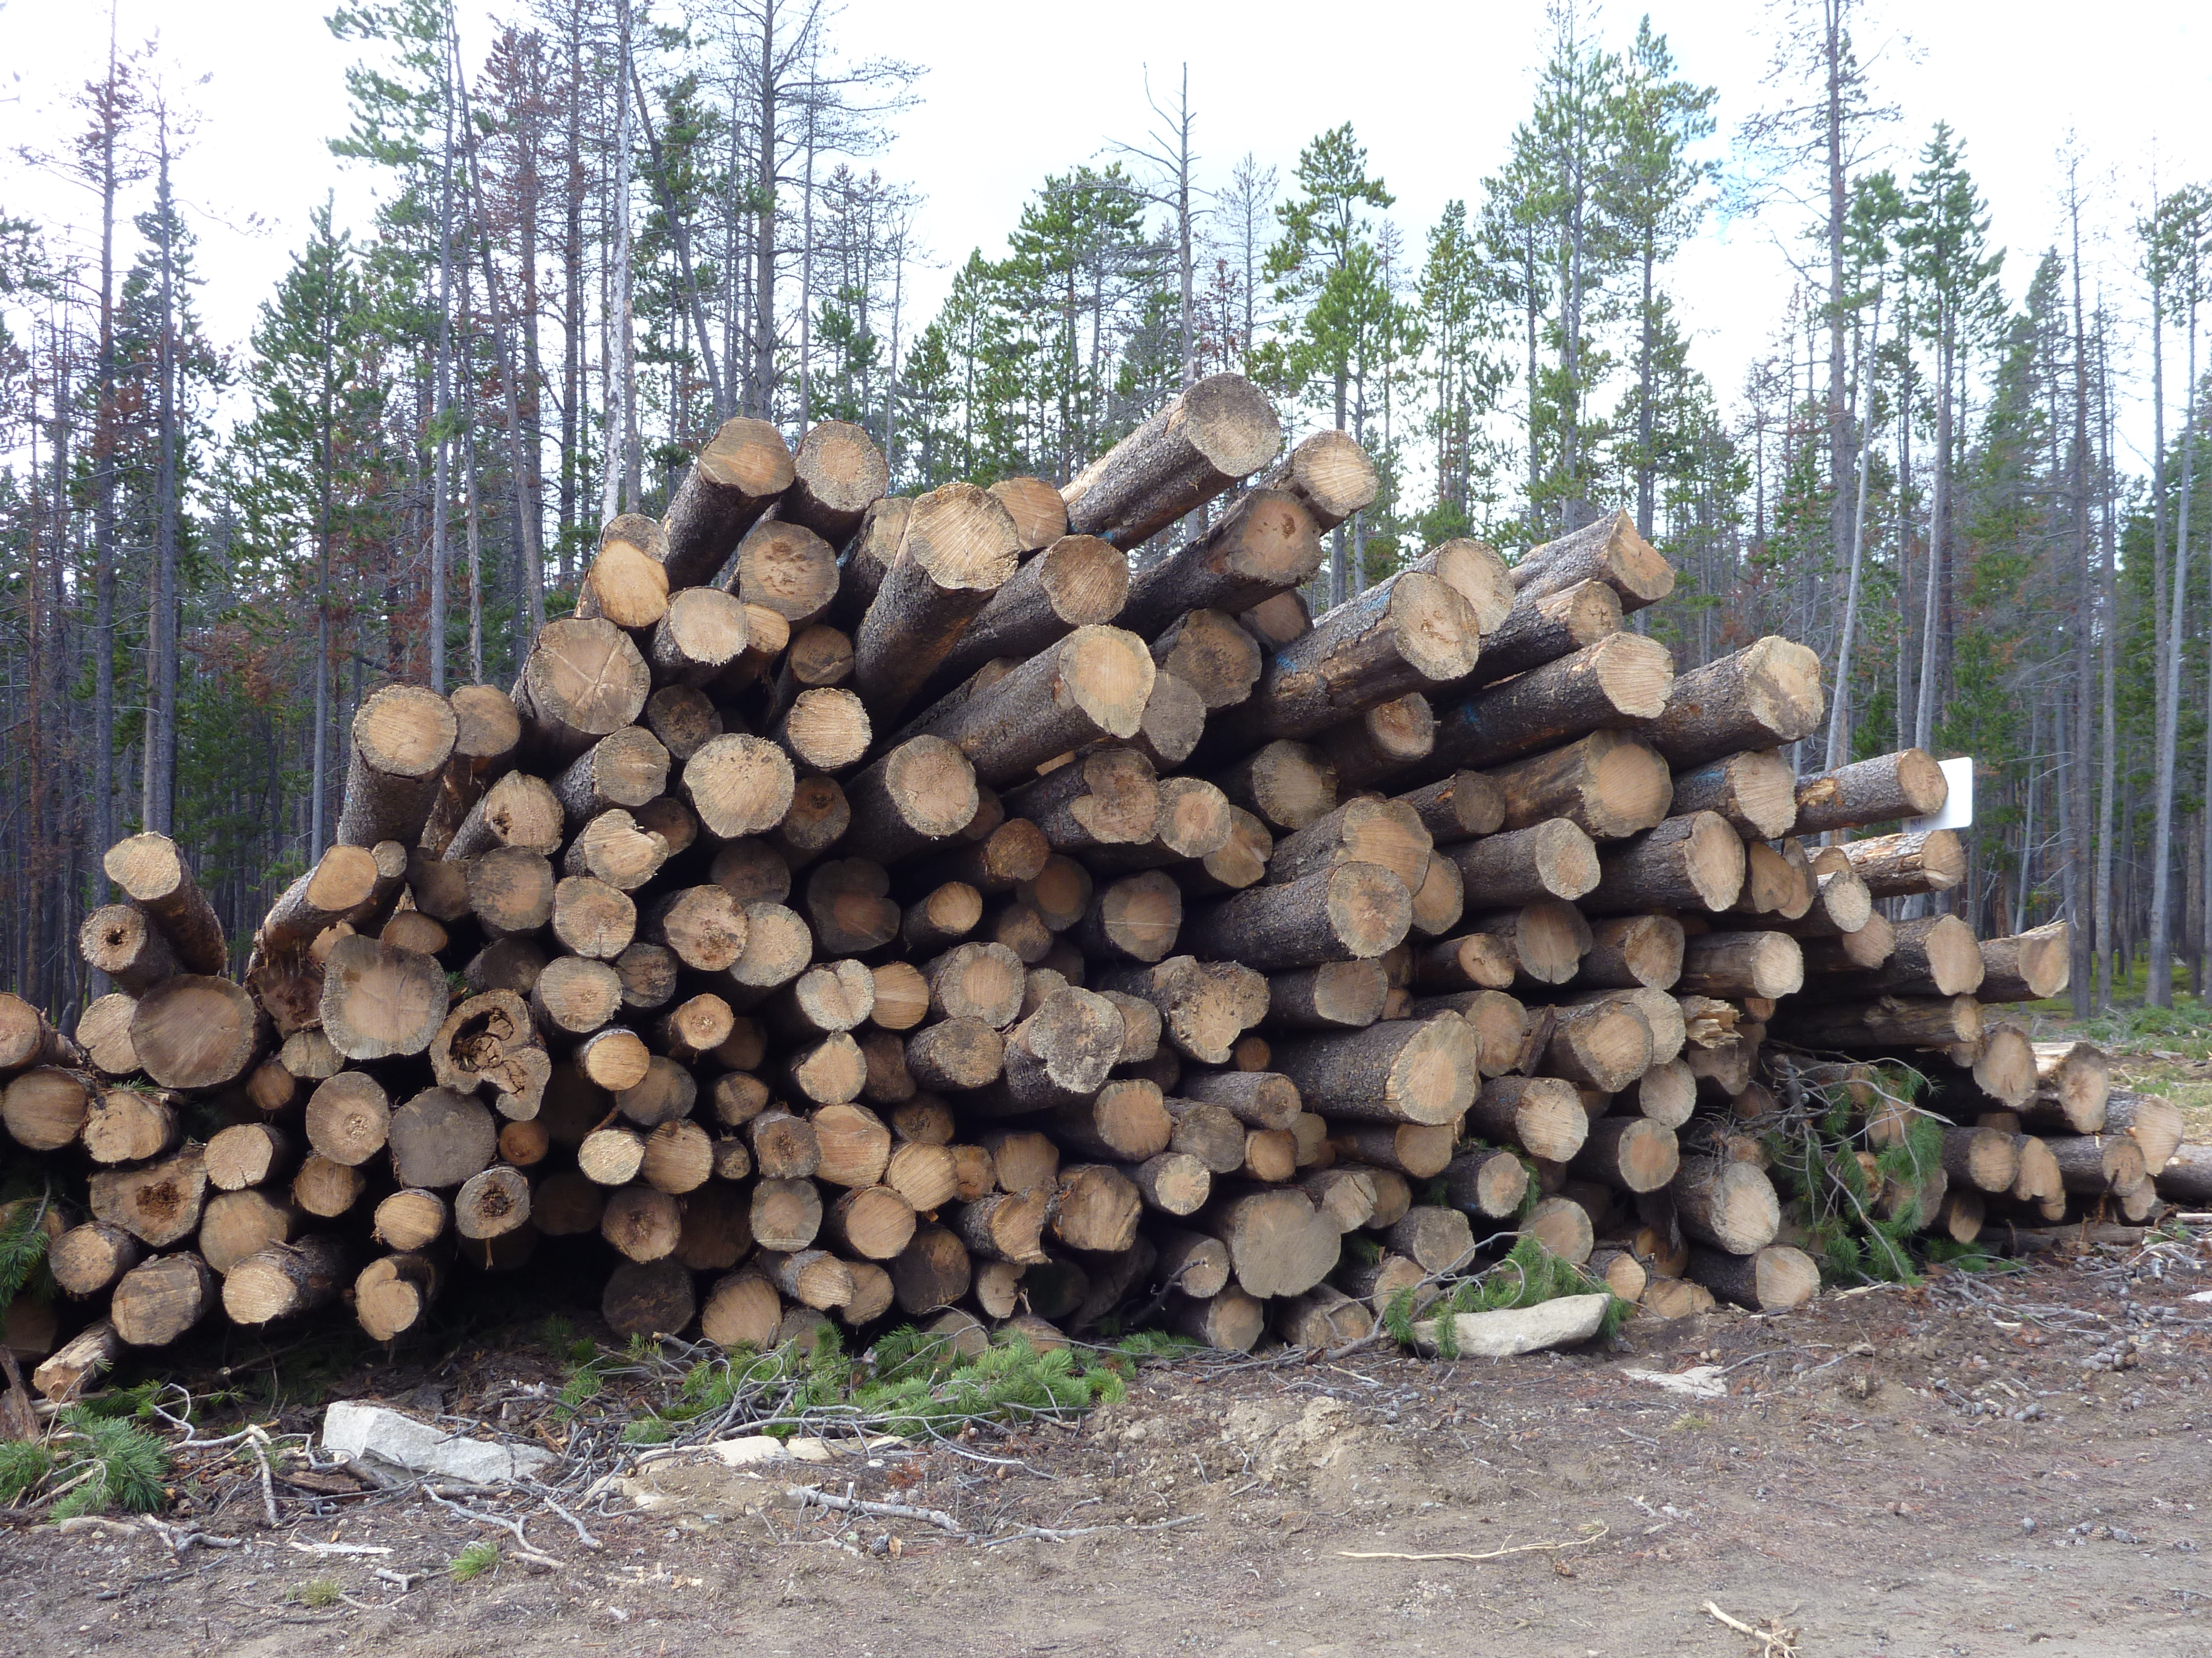
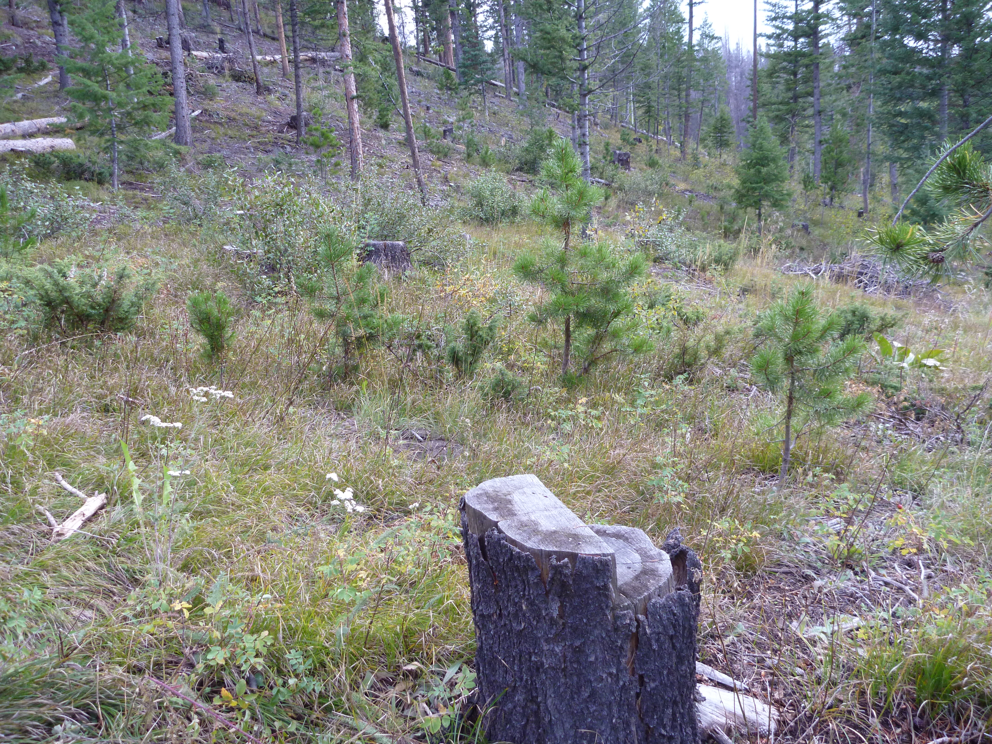
COLORADO BARK BEETLE COOPERATIVE
Raised public, agency, and congressional awareness about the extensive impacts from the Bark Beetle epidemic
Secured over $50 million for beetle mitigation in CO.
Tens of thousands of acres mitigated, protecting lives and infrastructure
Built consensus from a broad diverse set of stakeholders on mitigation priorities
Increased public understanding of the epidemic and the importance of applying limited funds to address highest priority needs while simultaneously fostering public acceptance of management limits.

Slide 10
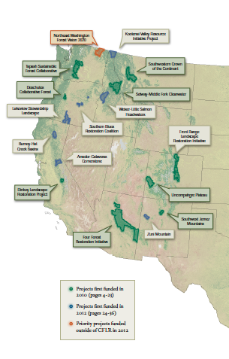
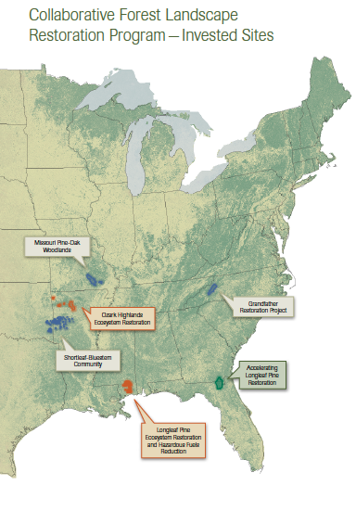
COLLABORATIVE FOREST LANDSCAPE RESTORATION PROGRAM
Federal Landscape Restoration Act (2009) & Collaborative Forest Landscape Restoration Program (CFLR):
Competitive funding program thru USFS
Collaboratively-developed restoration strategy
Solid scientific basis
>50,000 acres ready to implement over 10 years
Local economic benefits from jobs and wood utliz.
Multi-Party Monitoring
$40 million annually

Slide 11
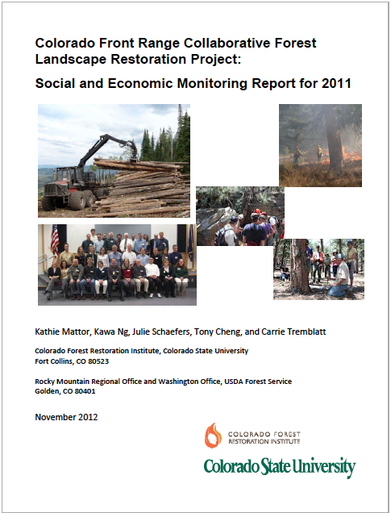
Front Range CFLRP 2011 Economic Impacts
Total of 6 task orders initiated
$1.8 million in labor income
$1.6 million in GDP to the local economy
Total of 38 full- and part-time jobs estimated
All company employees reside within CO
Contractor was responsible for 70% of the total number of hours billed
Notes:
The FR-CFLRP is contributing to the local economy through labor, expenditures, and wood utilization
Six task orders associated with the FR-CFLR were initiated in 2011, with three of these task orders fulfilled and three partially completed by the year’s end.
**Caveat:
The goal of this analysis was to estimate the economic impacts of the task orders used to implement forest treatments only. So it does not account for all of the CFLR funds
We used a newly developed model focusing on the CFLRP task orders.
Our analysis estimates the restoration activities contributed approximately $1.8 million in labor income and $1.6 million in GDP to the local economy.
(Counties: Adams, Delta, Jefferson, Larimer, Boulder, El Paso, Fremont, Teller, Broomfield, Grand, Jackson, Weld)
*These contributions to the local economy were stimulated by the contractors’ operation expenditures as well as labor income.
In addition, a total of 38 full- and part-time jobs were calculated.
All company employees reside within Colorado and are able to commute to work.
The contractor was responsible for 70% of the total number of hours billed, with all mechanical work being completed by the contractor
A majority of the manual work (92%) completed by out-of-state subcontractors based in Florida and Oregon.
The FR-CFLR contractor subcontracts with other companies to assist with manual forest management operations and to conduct all trucking operations.

Slide 12
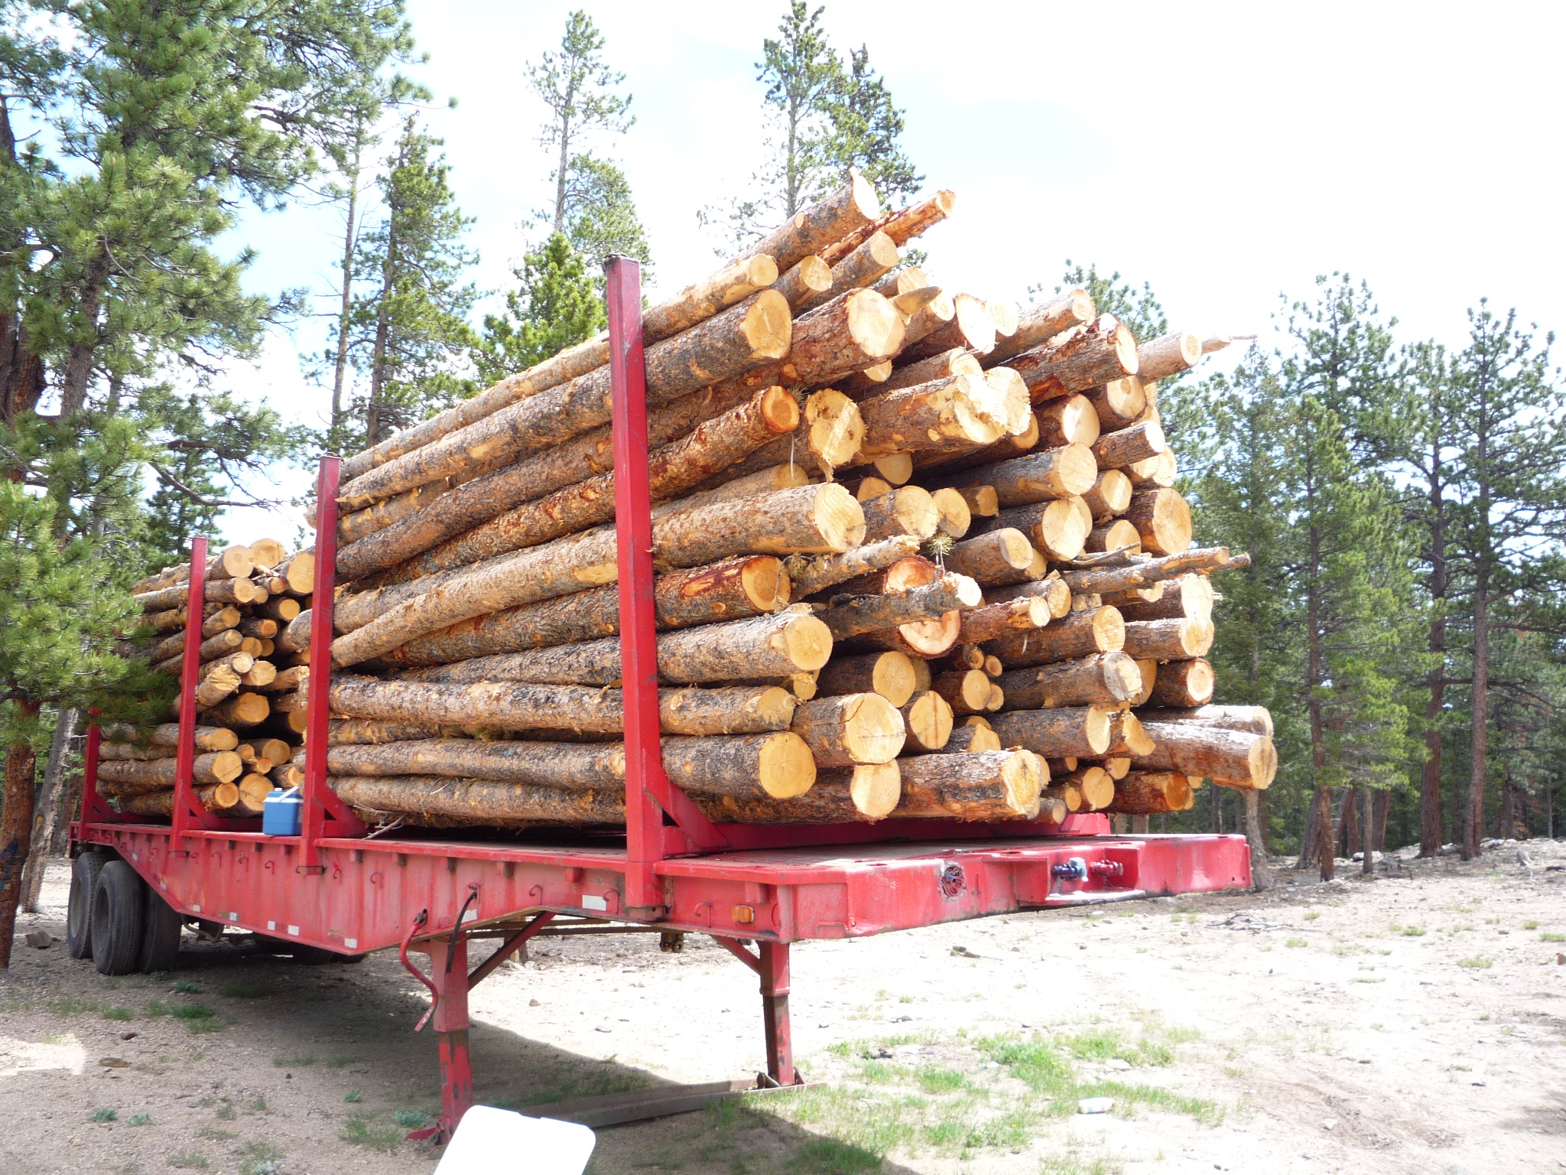
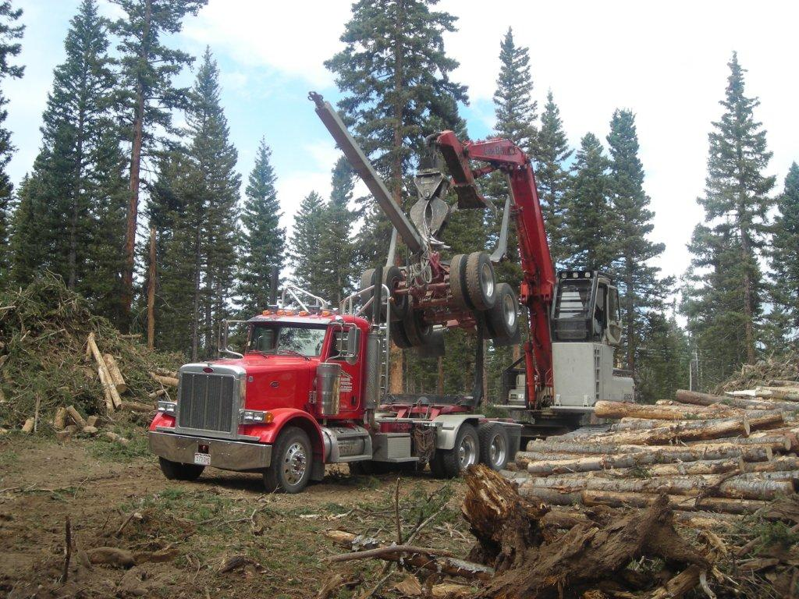
Front Range CFLRP 2011 Economic Impacts
3,170 acres were treated under the FR-CFLR project in 2011
99% mechanical treatment materials available for value-added uses
All CFLR value-added materials purchased by 12 Colorado businesses in 2011
Notes:
*The goal of this analysis was to measure the types and amounts of wood utilization that occurred as a result of the FR-CFLR funded task orders;
A total of 3,170 acres were treated under the FR-CFLR project in 2011, roughly split between the PSI and AR NFs
99% of the material harvested mechanically was available for value-added uses,
*The mixture of treatments (mechanical and manual) affects the availability of value-added materials
The majority (93%) of the materials removed on the PSI were through mechanical treatments, whereas 75% of the treatments on the AR were completed manually. (1,468 acres on the PSI; 1,592 acres on the AR)
All of the value-added materials were purchased by twelve Colorado businesses, either in the same county or a county neighboring where the work was being done.
This included saw timber, blue stain wood, small diameter timber, products other than logs, limbs and brush, and bark fines.

Slide 13
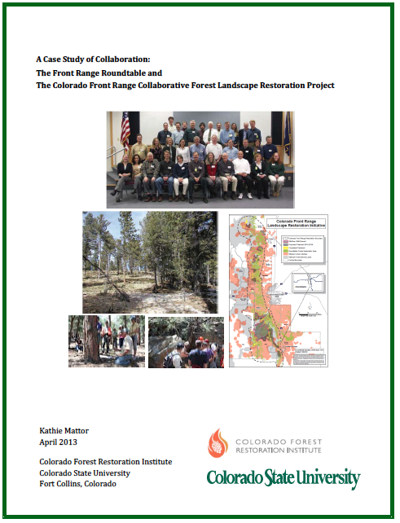
Front Range CFLRP Collaboration
Achievements:
Diverse representation of interests
Positive effect on relations
High levels of trust and strong commitment to project
Provides feedback and resources to CFLRP implementation
Challenges:
Some missing interests
Developing clear roles for collaborative in implementation
Less influence on initial CFLRP projects
Members are optimistic about the collaborative effort and regard the FR-CFLRP as a significant opportunity to achieve common objectives across diverse interests
Notes:
* The fourth goal was to (identify the levels of collaboration) **in the development and implementation of the FR-CFLR.
(*Findings were based off of a collaboration case study conducted by CFRI in 2012)
Collaboration is a key component of the Front Range Roundtable.
Interviews with several members indicated there has been a diverse representation of interests in the larger FRR and the CFLR science and monitoring team and that no interested parties have intentionally been excluded from the process.
Most have found the FR-CFLR project has had a positive effect on relations among members as well as relations between the FRR and other organizations.
The members interviewed reported relatively high levels of trust and strong commitments to work toward agreement on important decisions related to the project.
Many partners agreed the collaborative was having an influence on the current implementation of the FRCFLR project by providing feedback and additional resources, as well as helping to shape future FR-CFLRP forest treatments.
**The FRR has also faced some key challenges to their FR-CFLR collaborative efforts.
Although the FRR membership is not restricted many members identified missing interests,
(including the forest industry, local citizens, local government, insurance industry, and additional conservation organizations)
(Some also felt the monitoring team needed greater representation of technical experts focused on watershed science, understory vegetation, social science, or wildlife biology.)
Another challenge is that many members of the FRR science and monitoring team expressed they did not have a clear sense of their roles or responsibilities.
Currently being addressed through the development of the adaptive management process
Some members felt the FRR collaborative had little influence on the implementation of the initial projects because these had gone through the required planning processes prior to the FRR’s involvement in the CFLR project.
Regardless of these challenges, members were optimistic about the collaborative effort and regard the FR-CFLRP as a significant opportunity to achieve common objectives across diverse interests

Slide 14
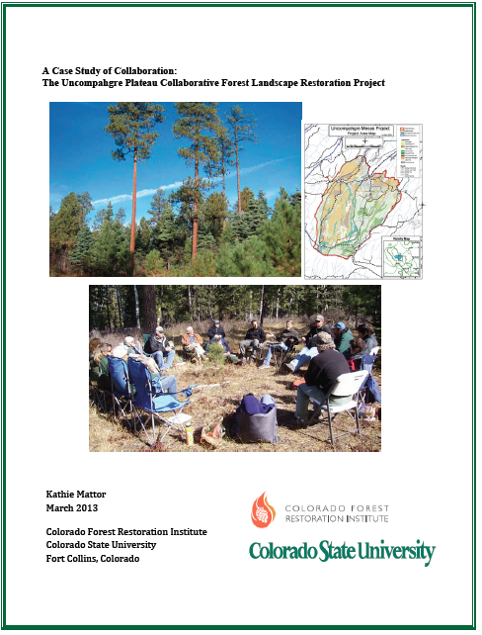
Upcoming Monitoring
2012 monitoring for the FR-CFLRP is underway
Jobs and wood utilization monitoring for the Uncompahgre CFLRP is in progress (collaboration case study completed)
Potential exists to expand on this work
http://coloradoforestrestoration.org

Slide 15
THANK YOU!!
Socio-Economic Monitoring Team:
Kathie Mattor (CFRI) Tony Cheng (CFRI)
Torston Lund Snee (CFRI) Julie Schaefers (US Forest Service)
Kawa Ng (US Forest Service) Carrie Tremblatt (Univ of Colorado)
Thanks to:
All forest collaboratives who contributed data and information!!
Front Range Roundtable Uncompahgre Partnership
Pam Motley (West Range Reclamation) Tammy Randall-Parker (USFS)
Hal Gibbs (US Forest Service) Carmine Lockwood (USFS)
Sara Mayben (US Forest Service) Clay Speas (USFS)
Jeff Underhill (US Forest Service) Matt Tuten (USFS)
http://coloradoforestrestoration.org

