Slide 1
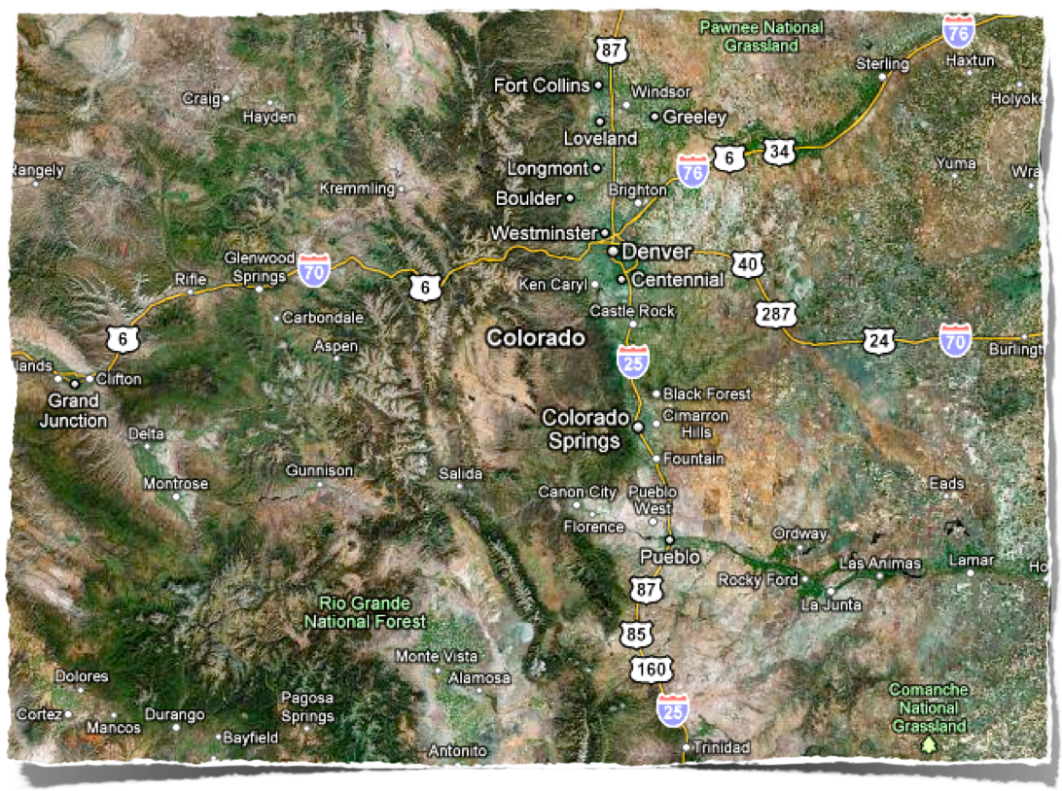
Wildfire/Watershed Assessments in Colorado

Slide 2
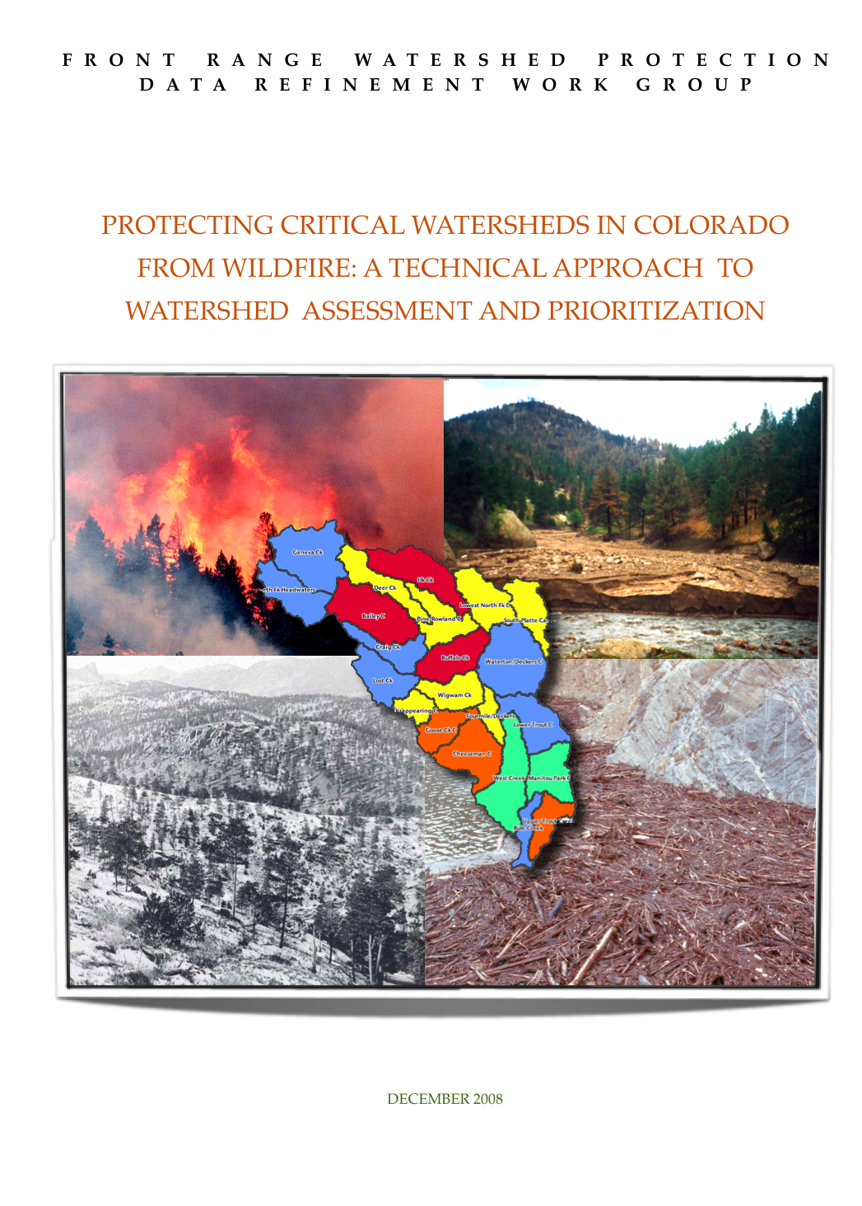
Wildfire Watershed Protection Group

Slide 3
Wildfire Watershed Protection Group

Slide 4
Wildfire/Watershed Assessment Status
10 completed through stakeholder process
15 Phase 1 Assessments done

Slide 5
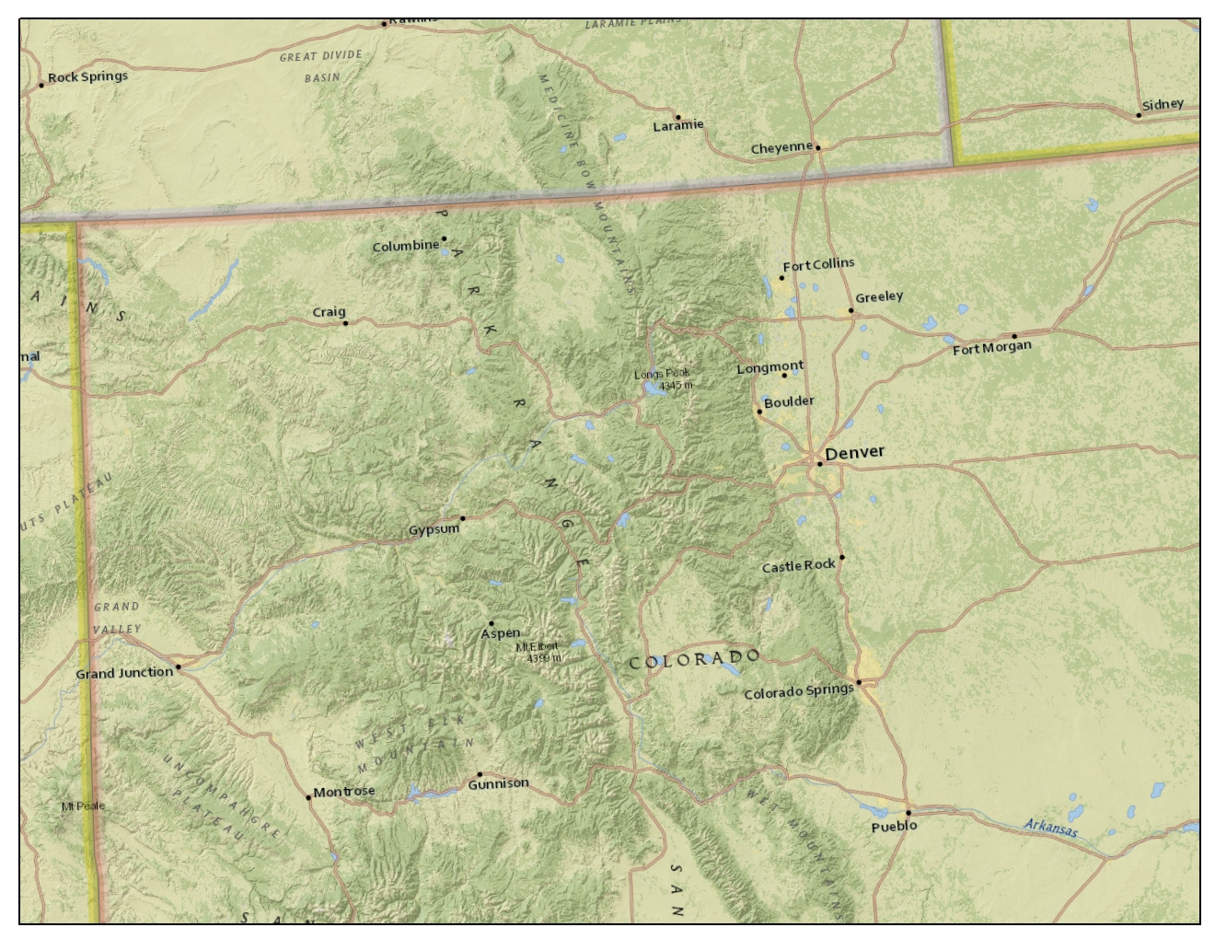

Slide 6
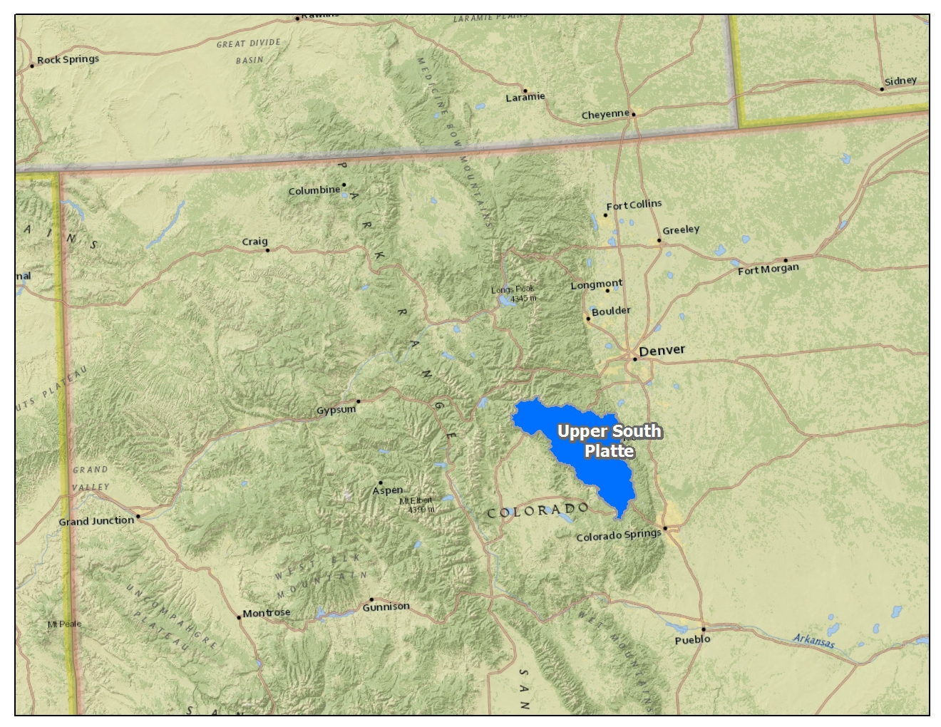
Test Case

Slide 7
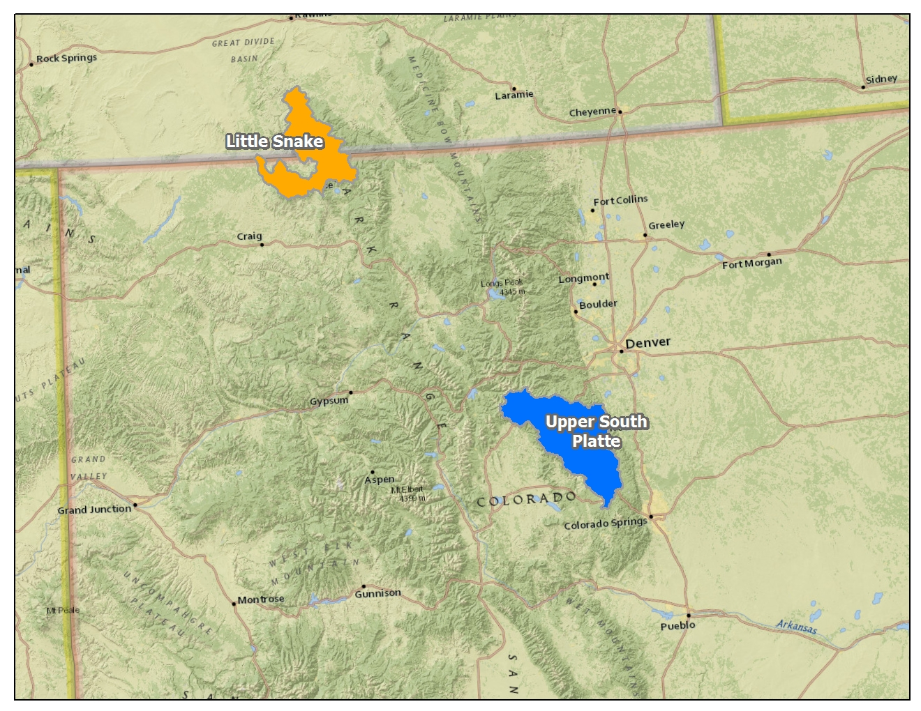
Phase 1 - Assessments

Slide 8
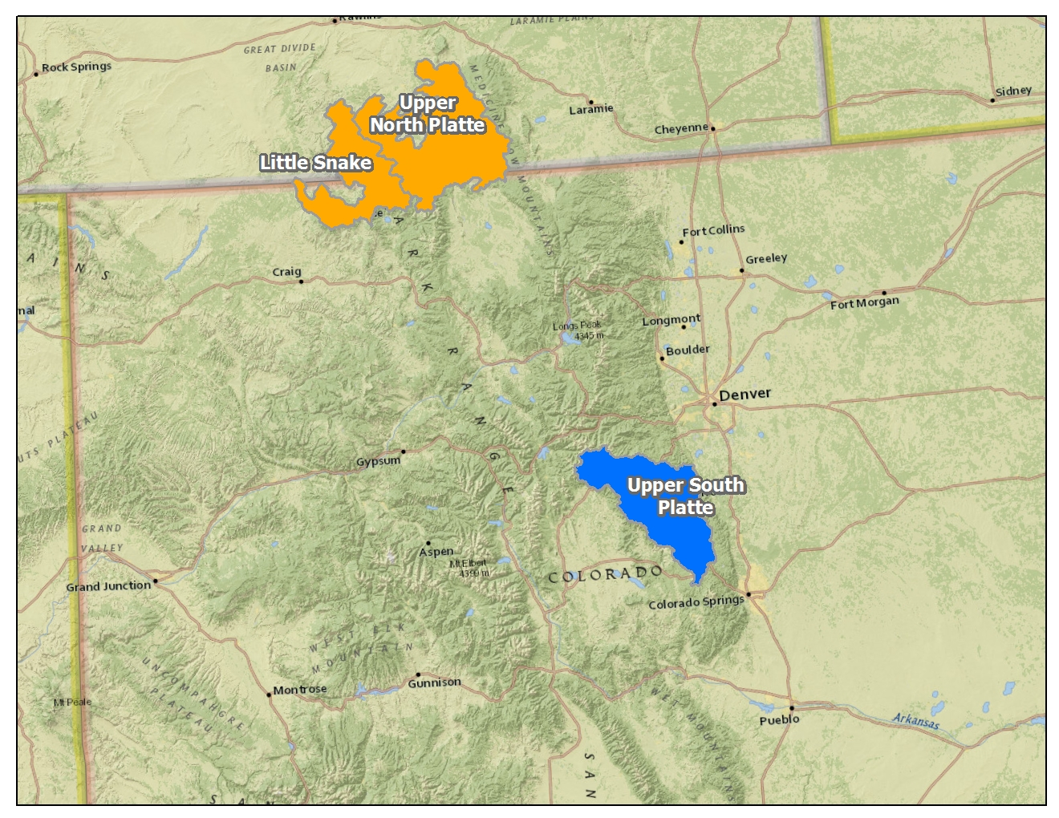
Phase 1 - Assessments

Slide 9
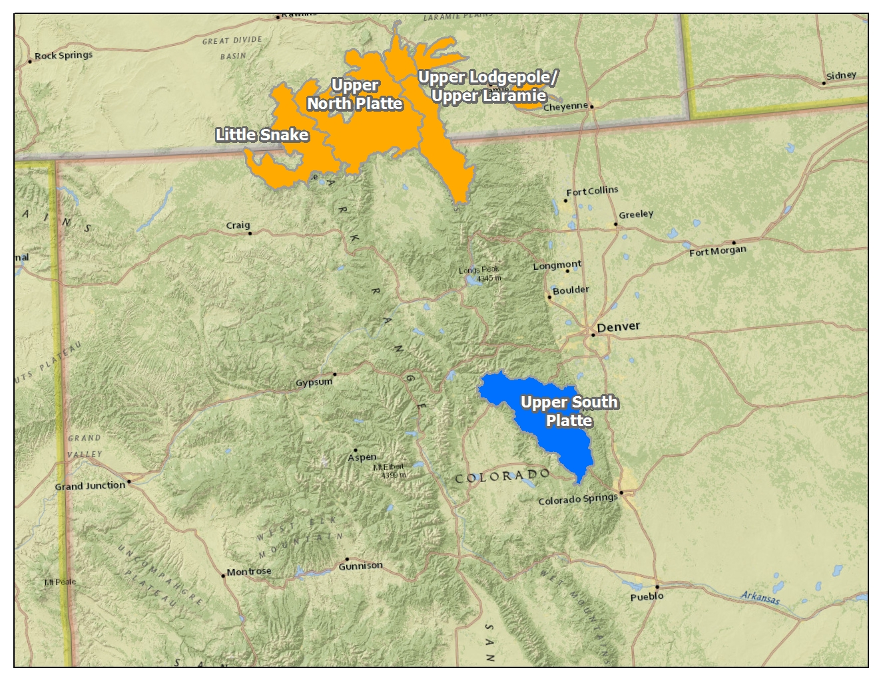
Phase 1 - Assessments

Slide 10
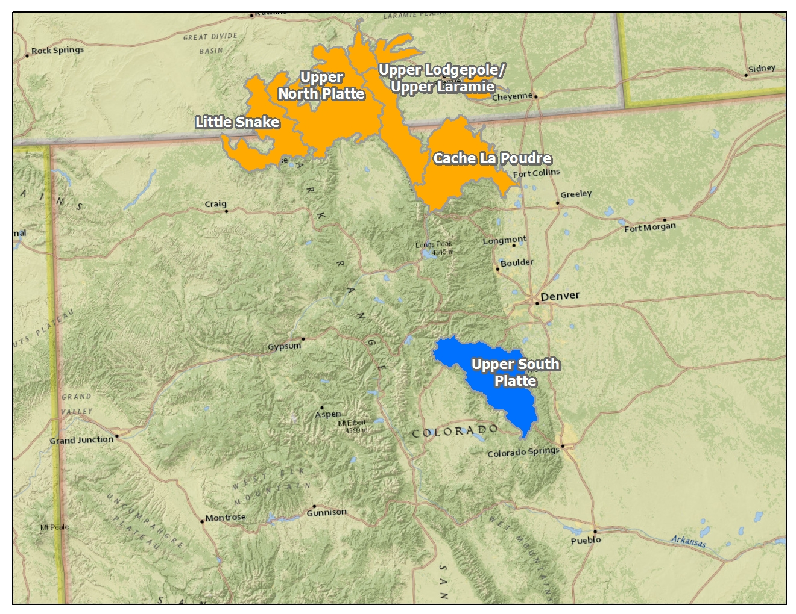
Phase 1 - Assessments

Slide 11
Phase 1 - Assessments

Slide 12
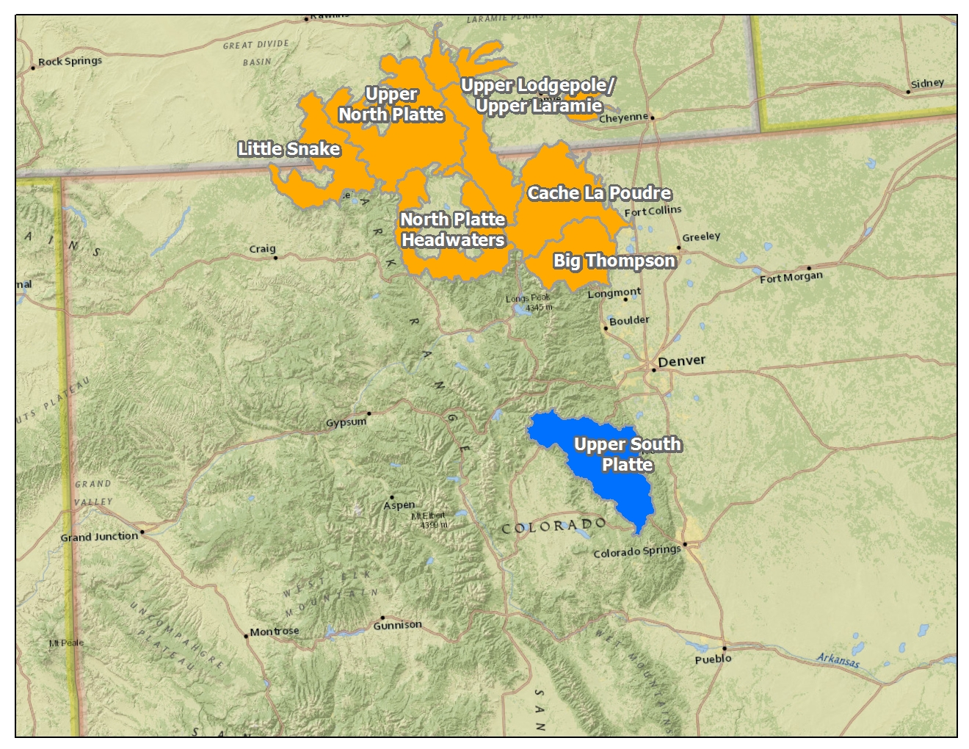
Phase 1 - Assessments

Slide 13
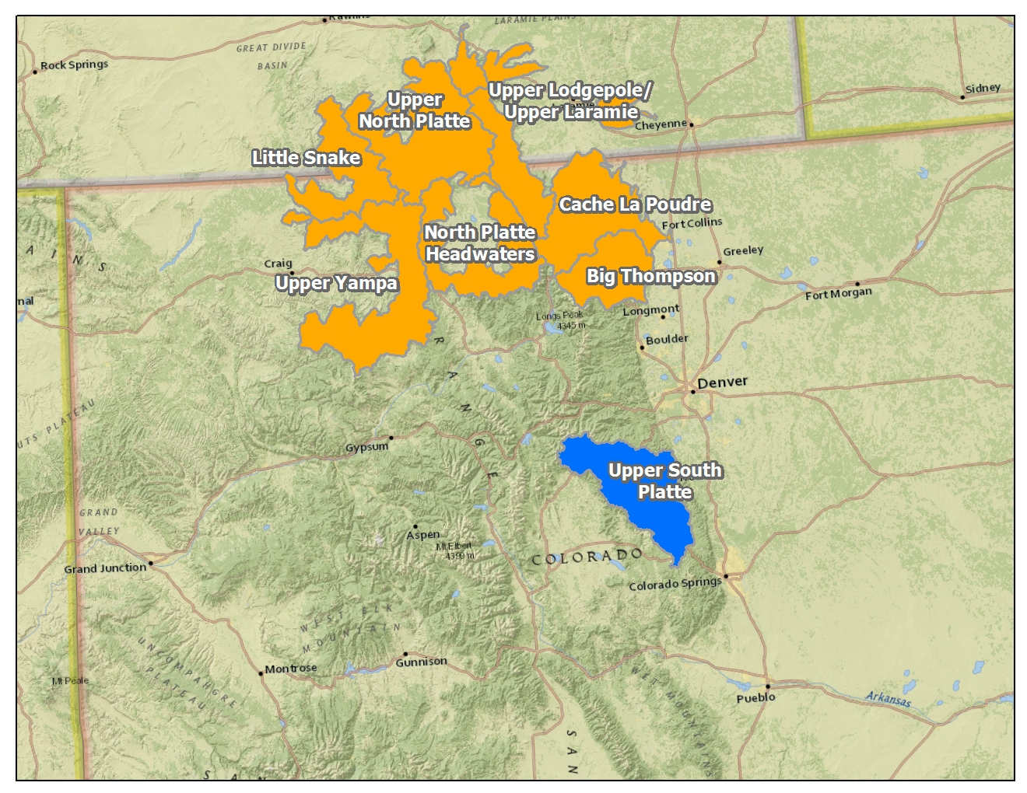
Phase 1 - Assessments

Slide 14
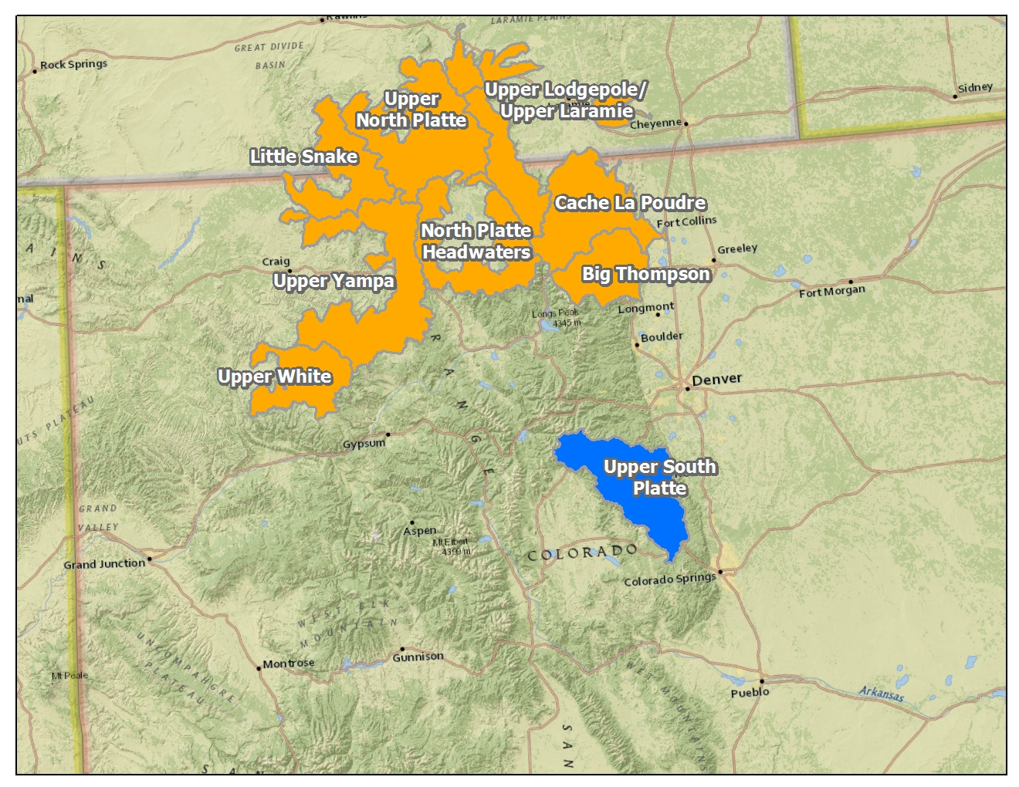
Phase 1 - Assessments

Slide 15
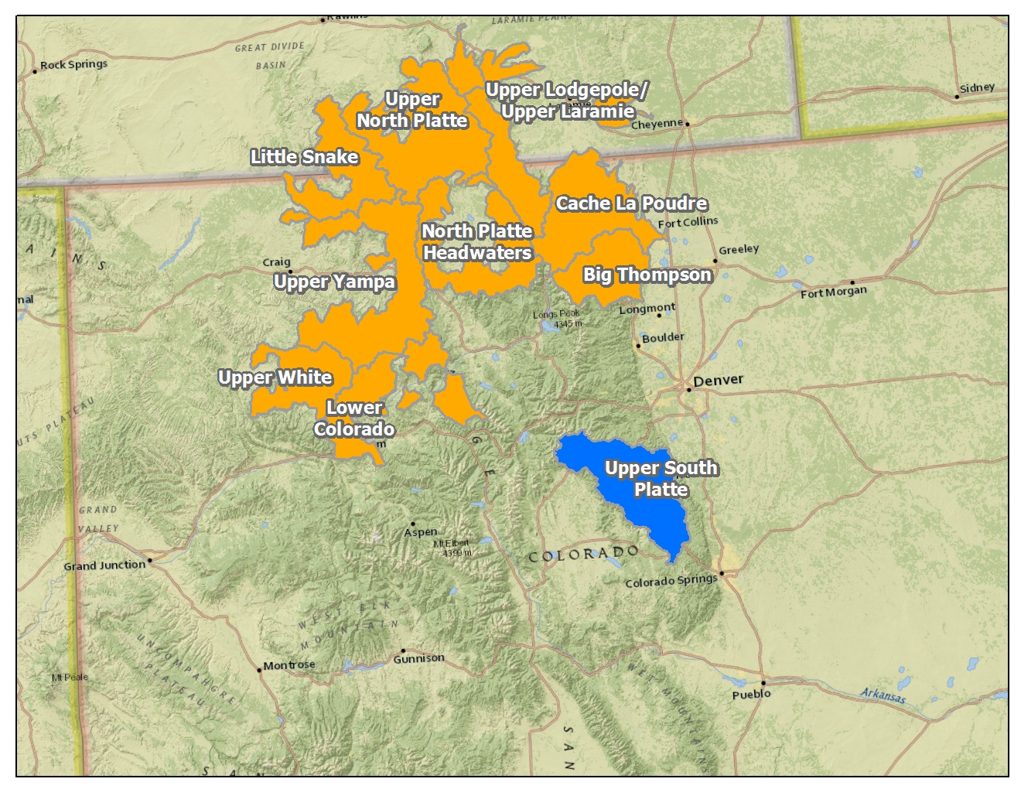
Phase 1 - Assessments

Slide 16
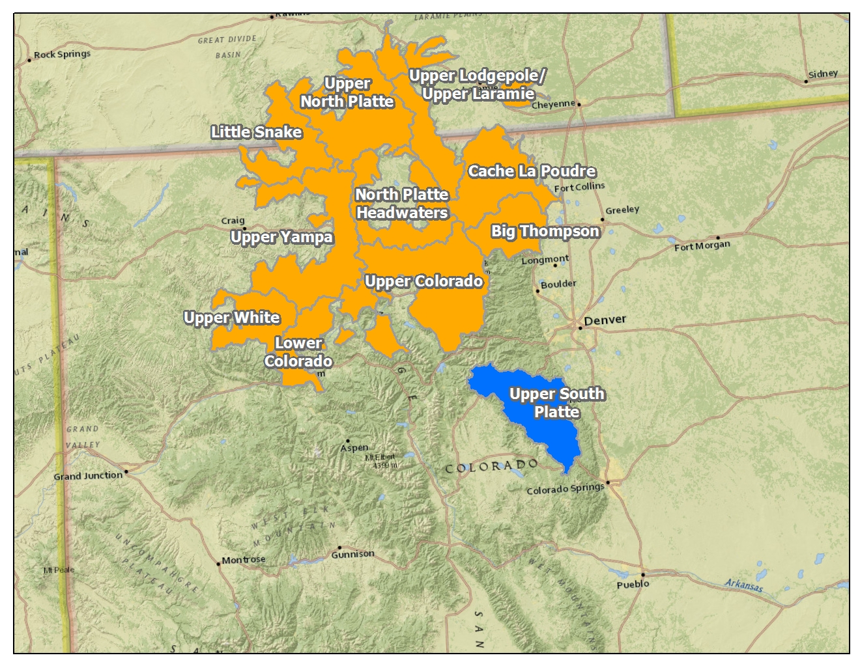
Phase 1 - Assessments

Slide 17
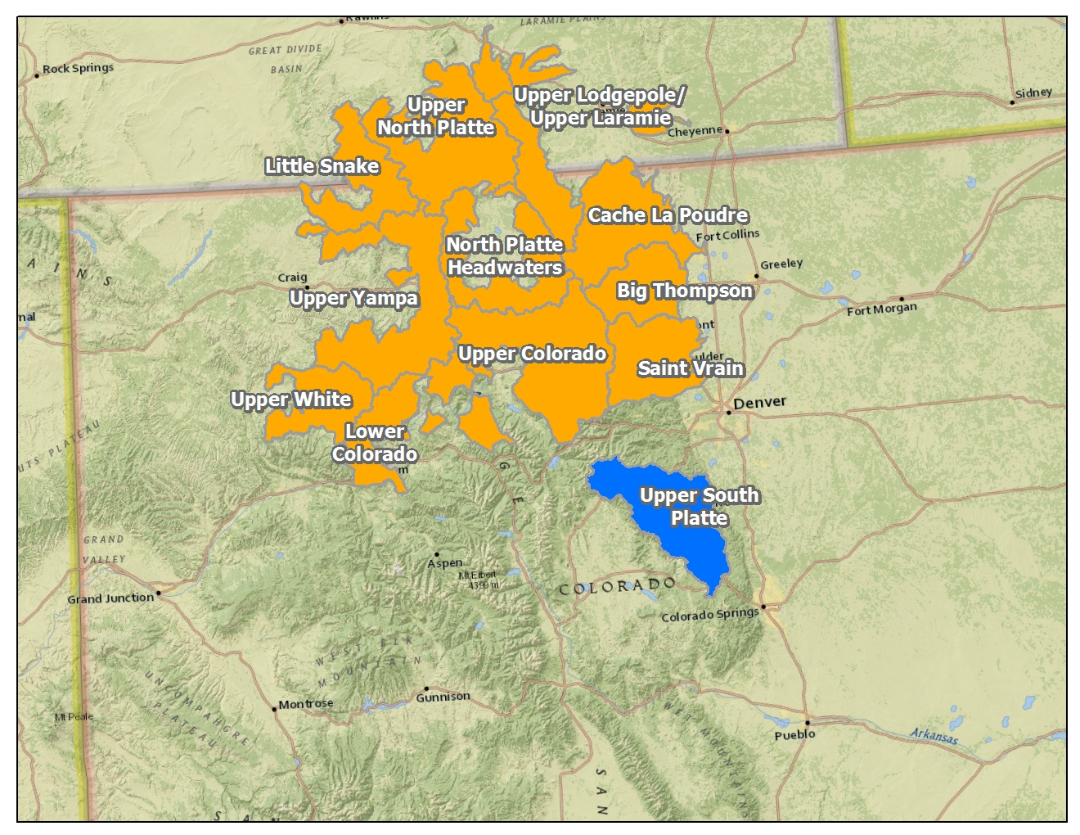
Phase 1 - Assessments

Slide 18
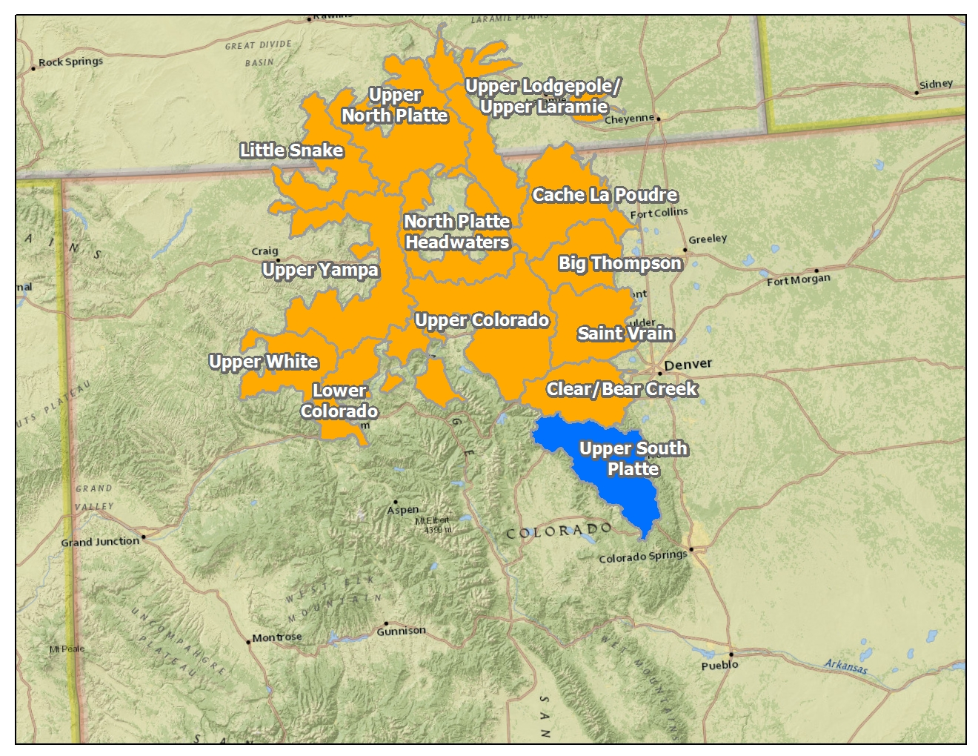
Phase 1 - Assessments

Slide 19
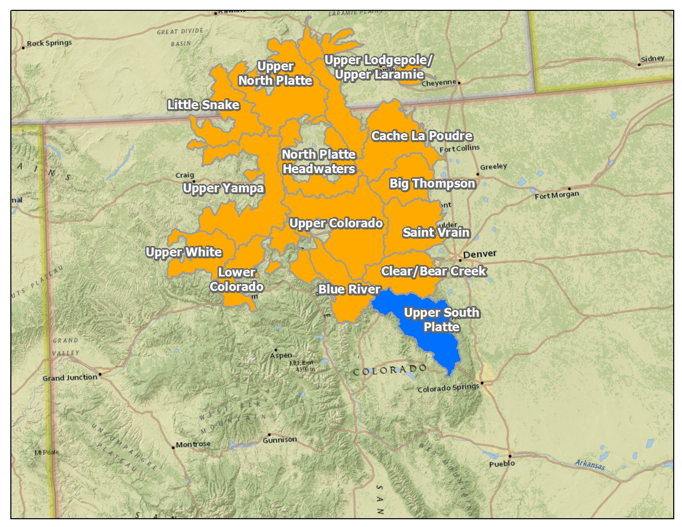
Phase 1 - Assessments

Slide 20
Phase 1 - Assessments

Slide 21
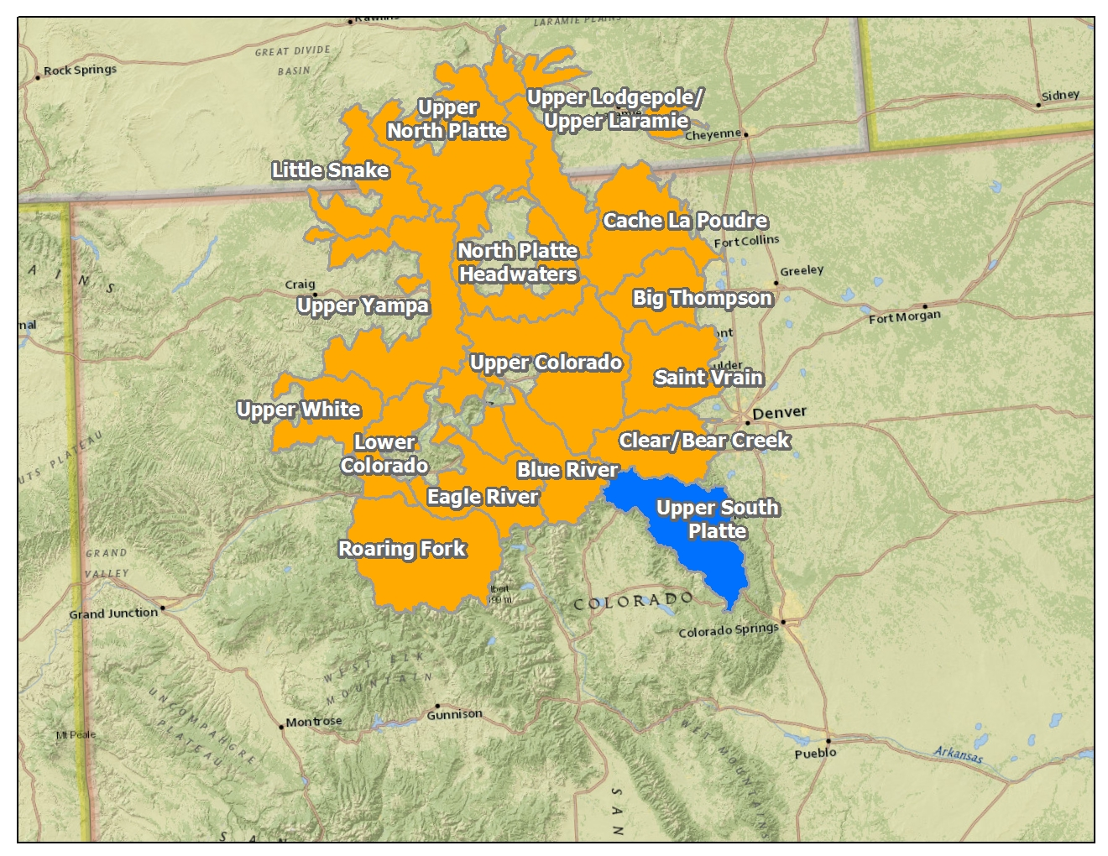
Phase 1 - Assessments

Slide 22
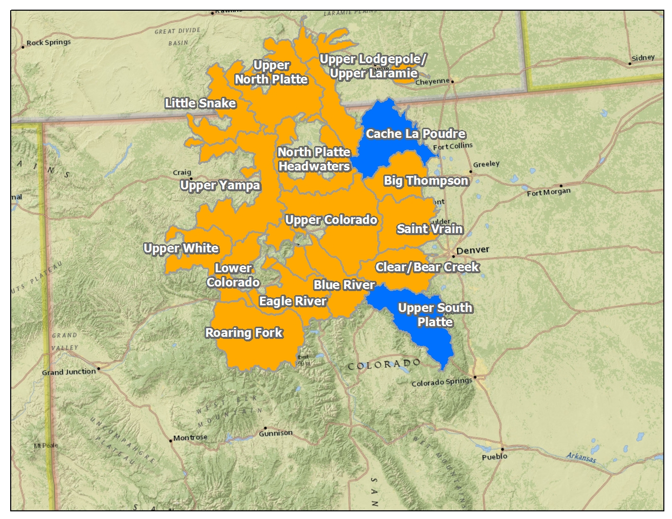
Assessments Completed with Stakeholders

Slide 23
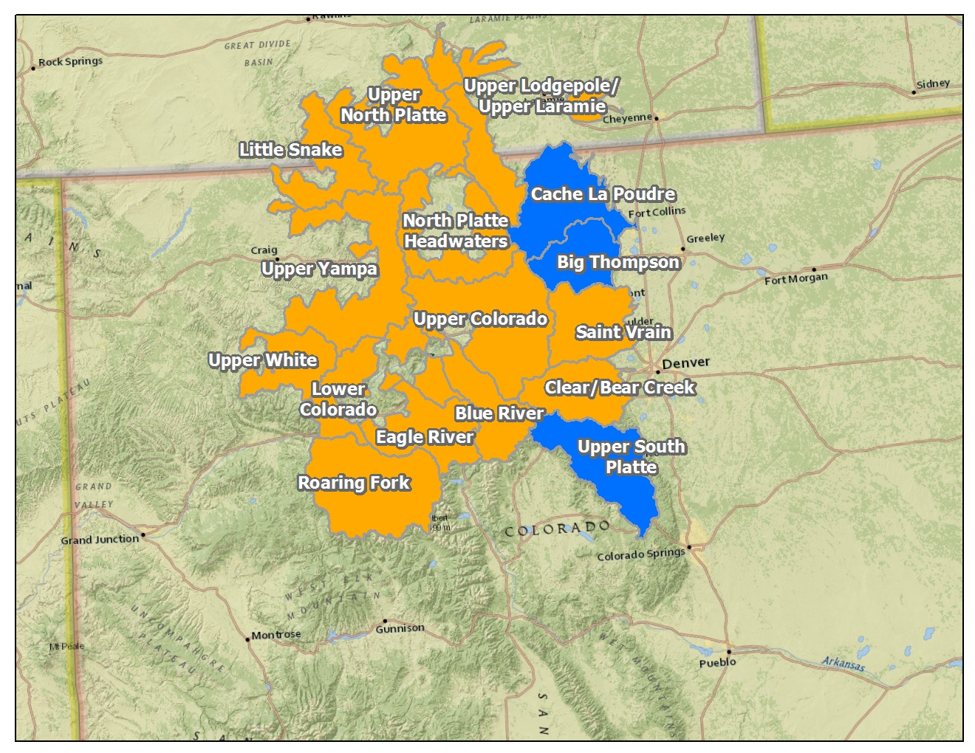
Assessments Completed with Stakeholders

Slide 24
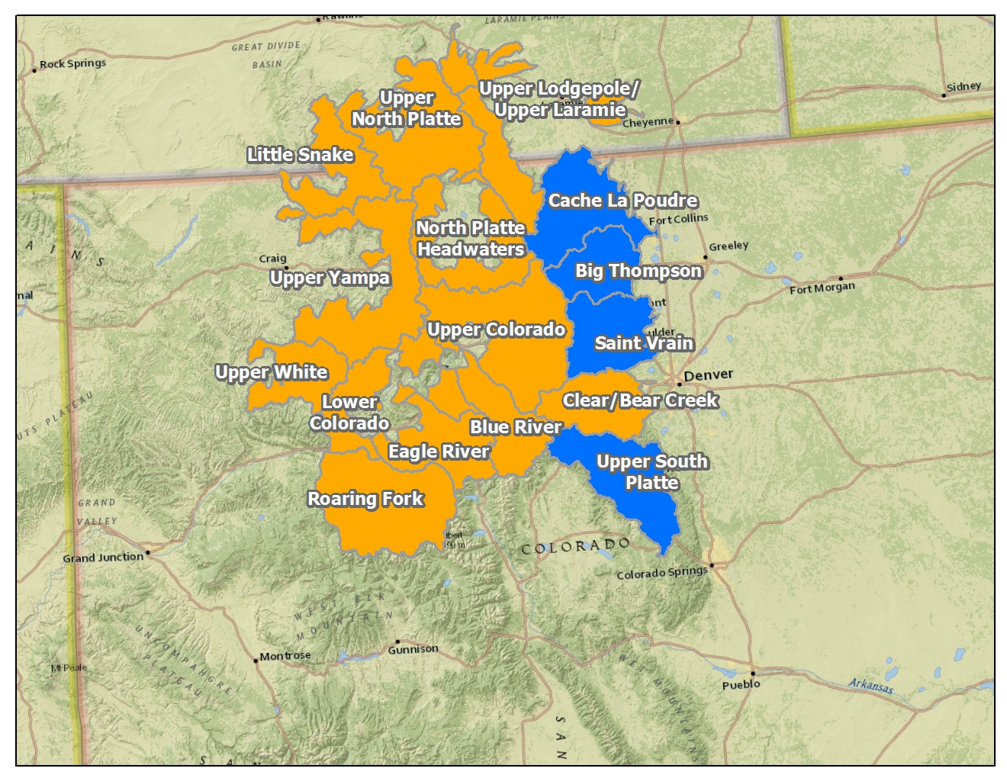
Assessments Completed with Stakeholders

Slide 25
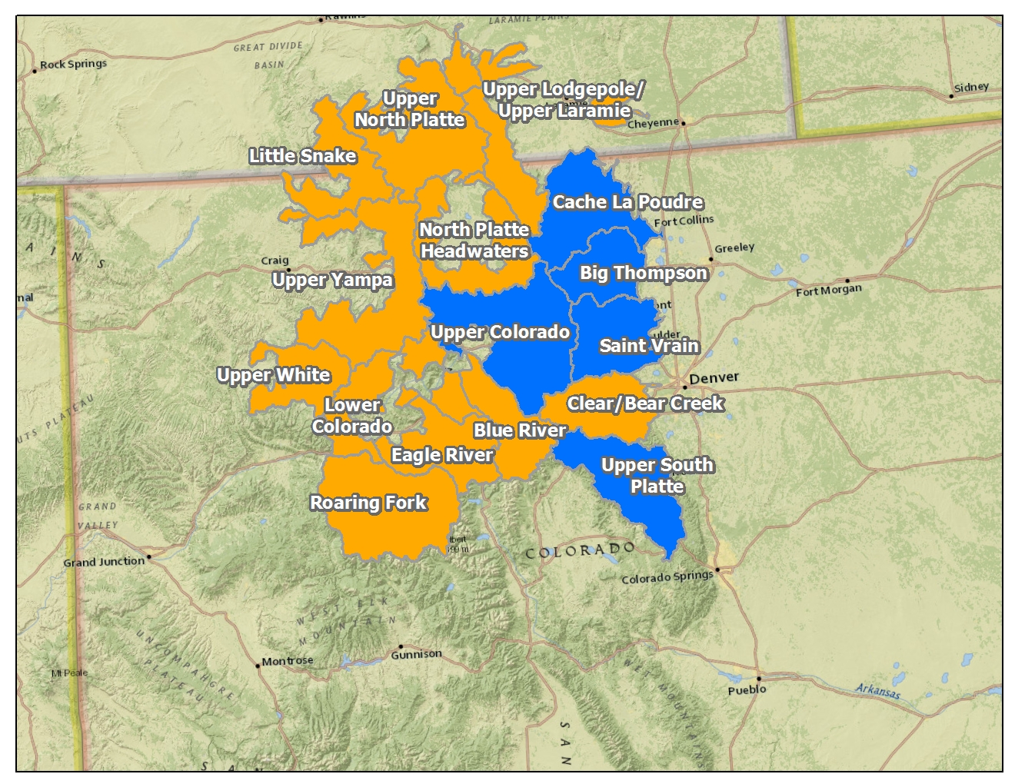
Assessments Completed with Stakeholders

Slide 26
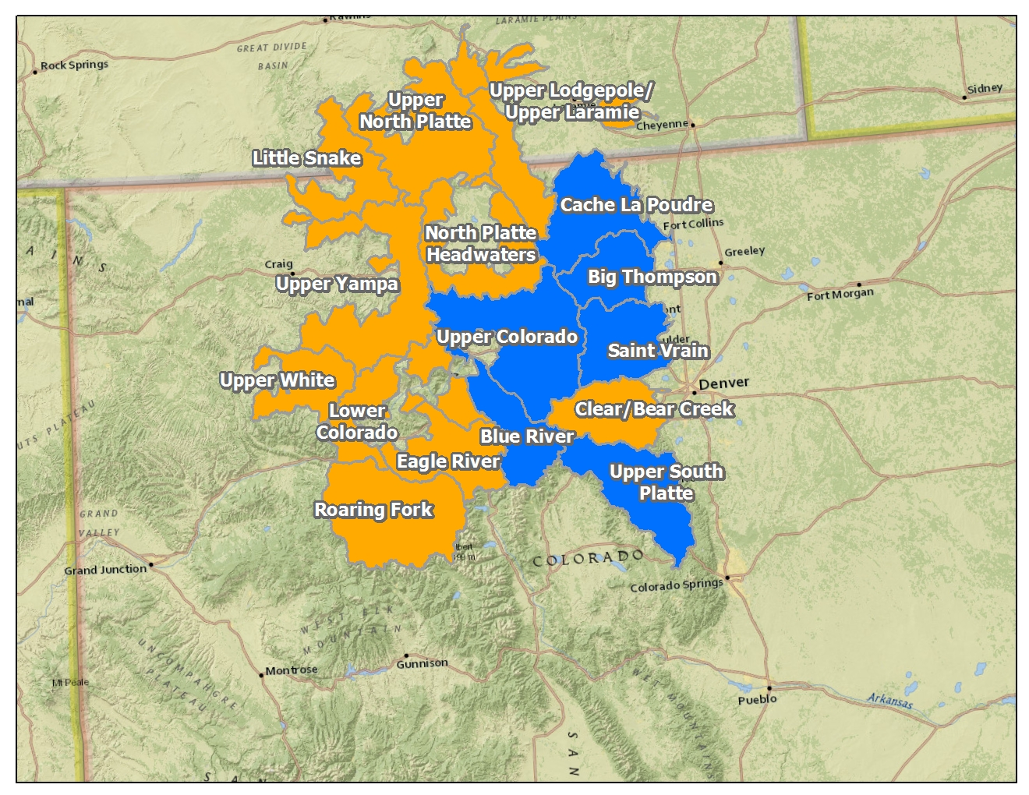
Assessments Completed with Stakeholders

Slide 27
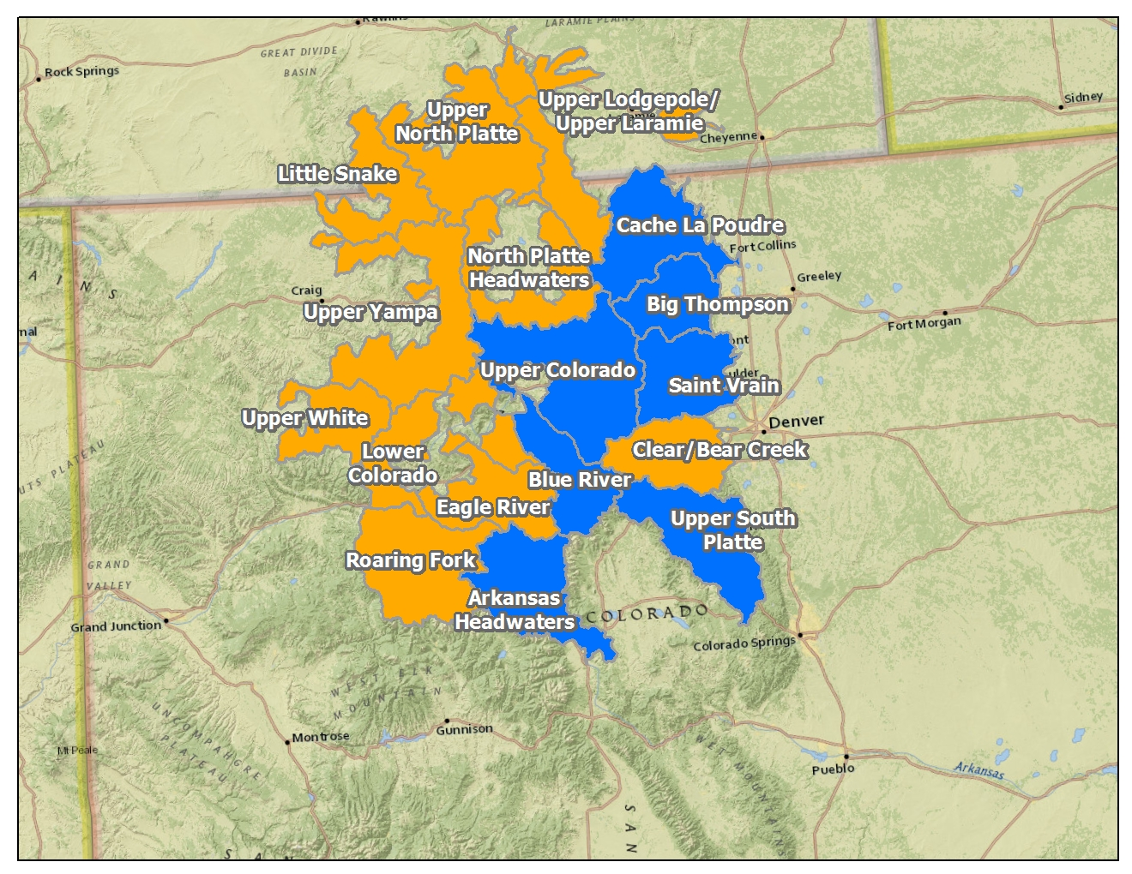
Assessments Completed with Stakeholders

Slide 28
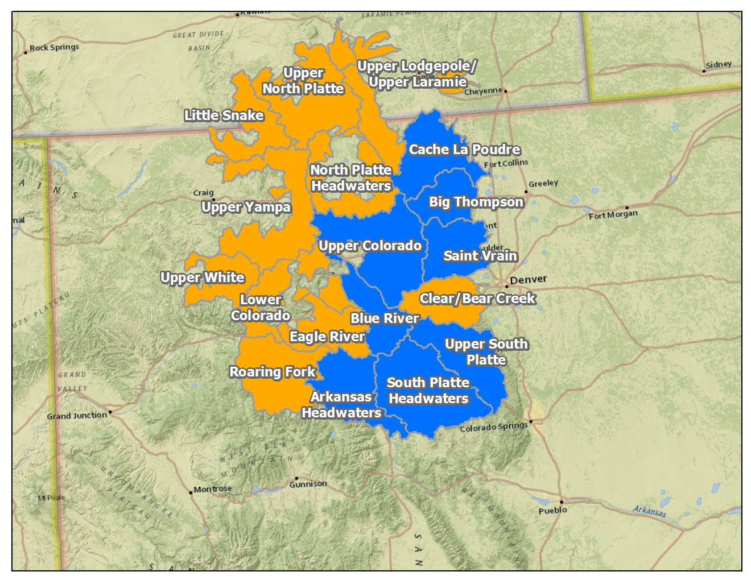
Assessments Completed with Stakeholders

Slide 29
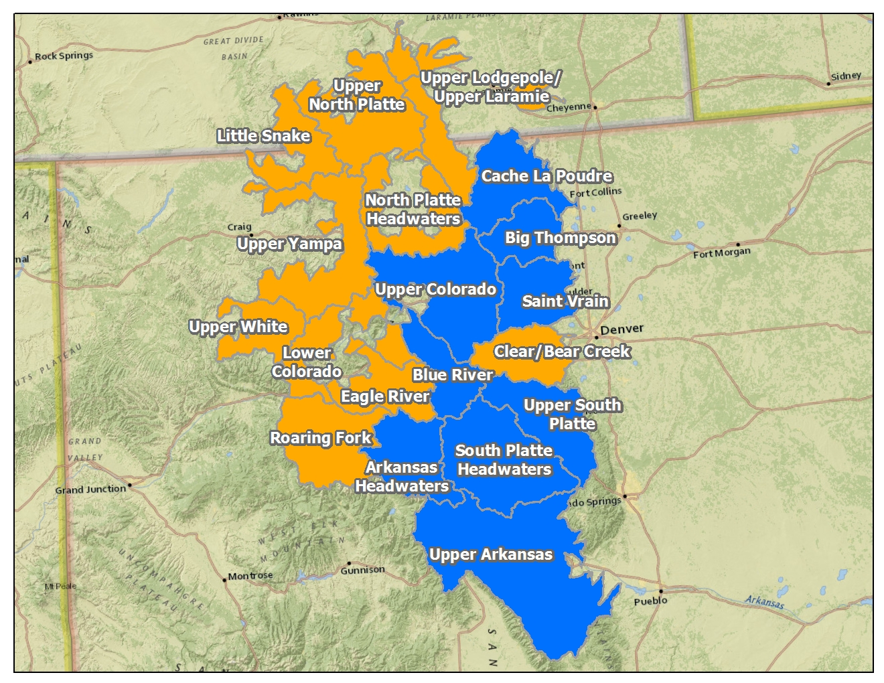
Assessments Completed with Stakeholders

Slide 30
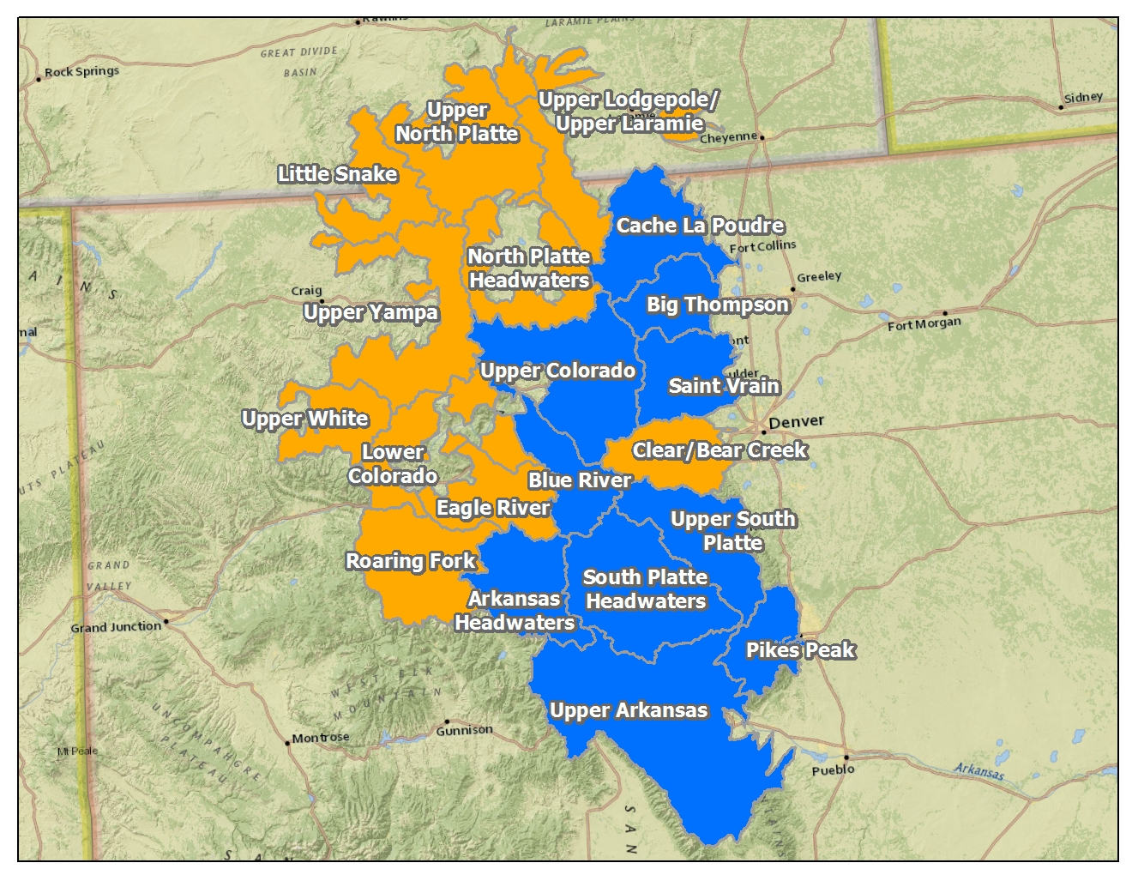
Assessments Completed with Stakeholders

Slide 31
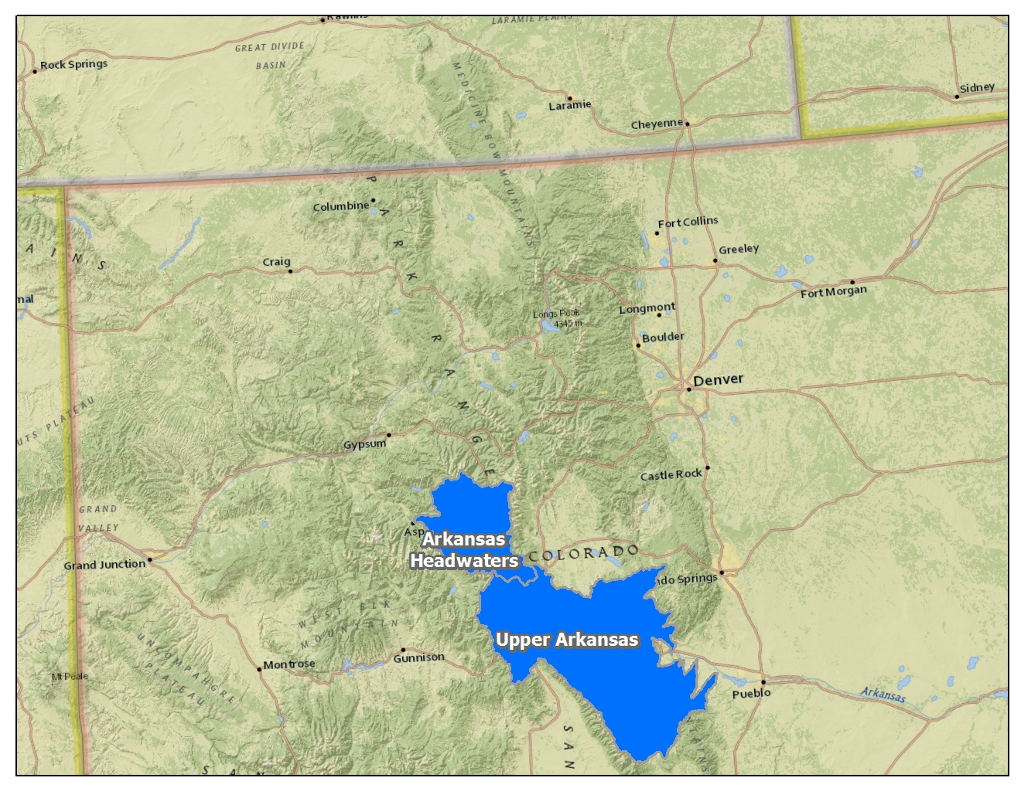
Assessments in Arkansas Basin

Slide 32
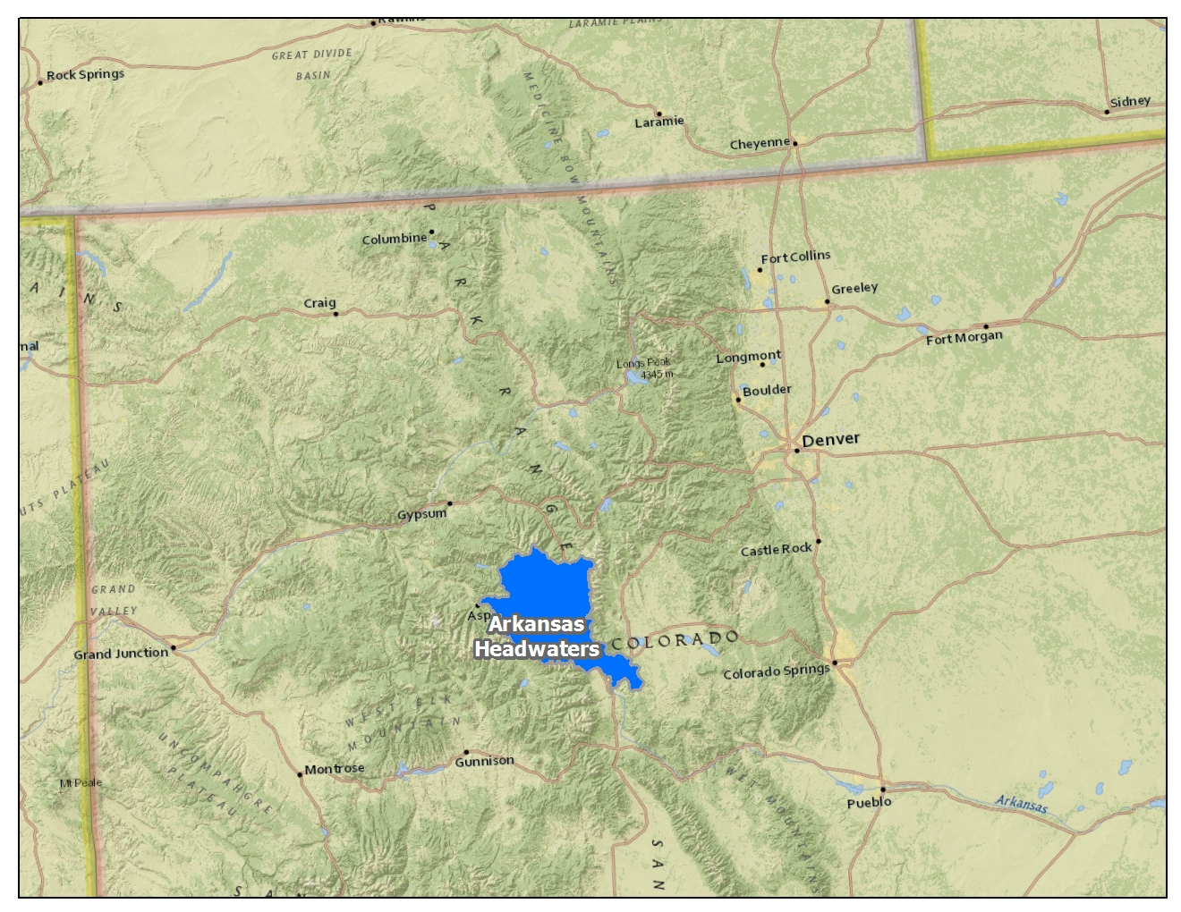
Arkansas Headwaters Wildfire/ Watershed Assessment

Slide 33
Arkansas Headwaters Wildfire/ Watershed Assessment

Slide 34
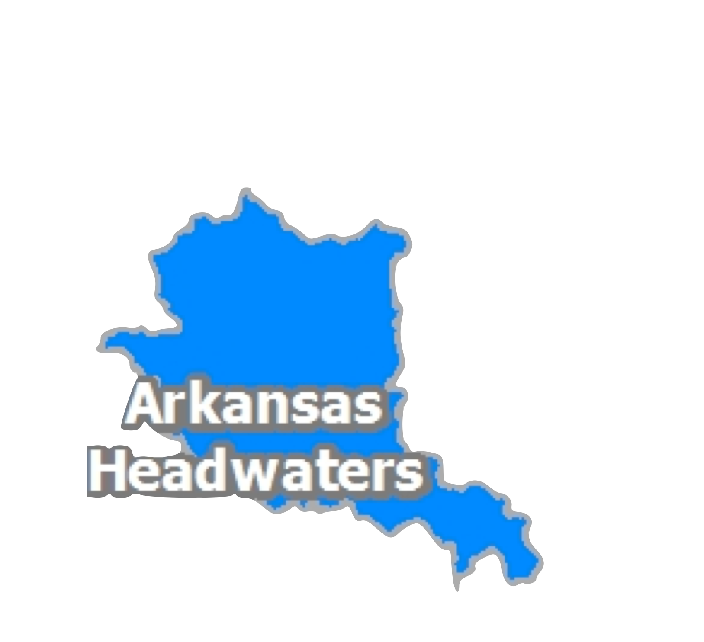
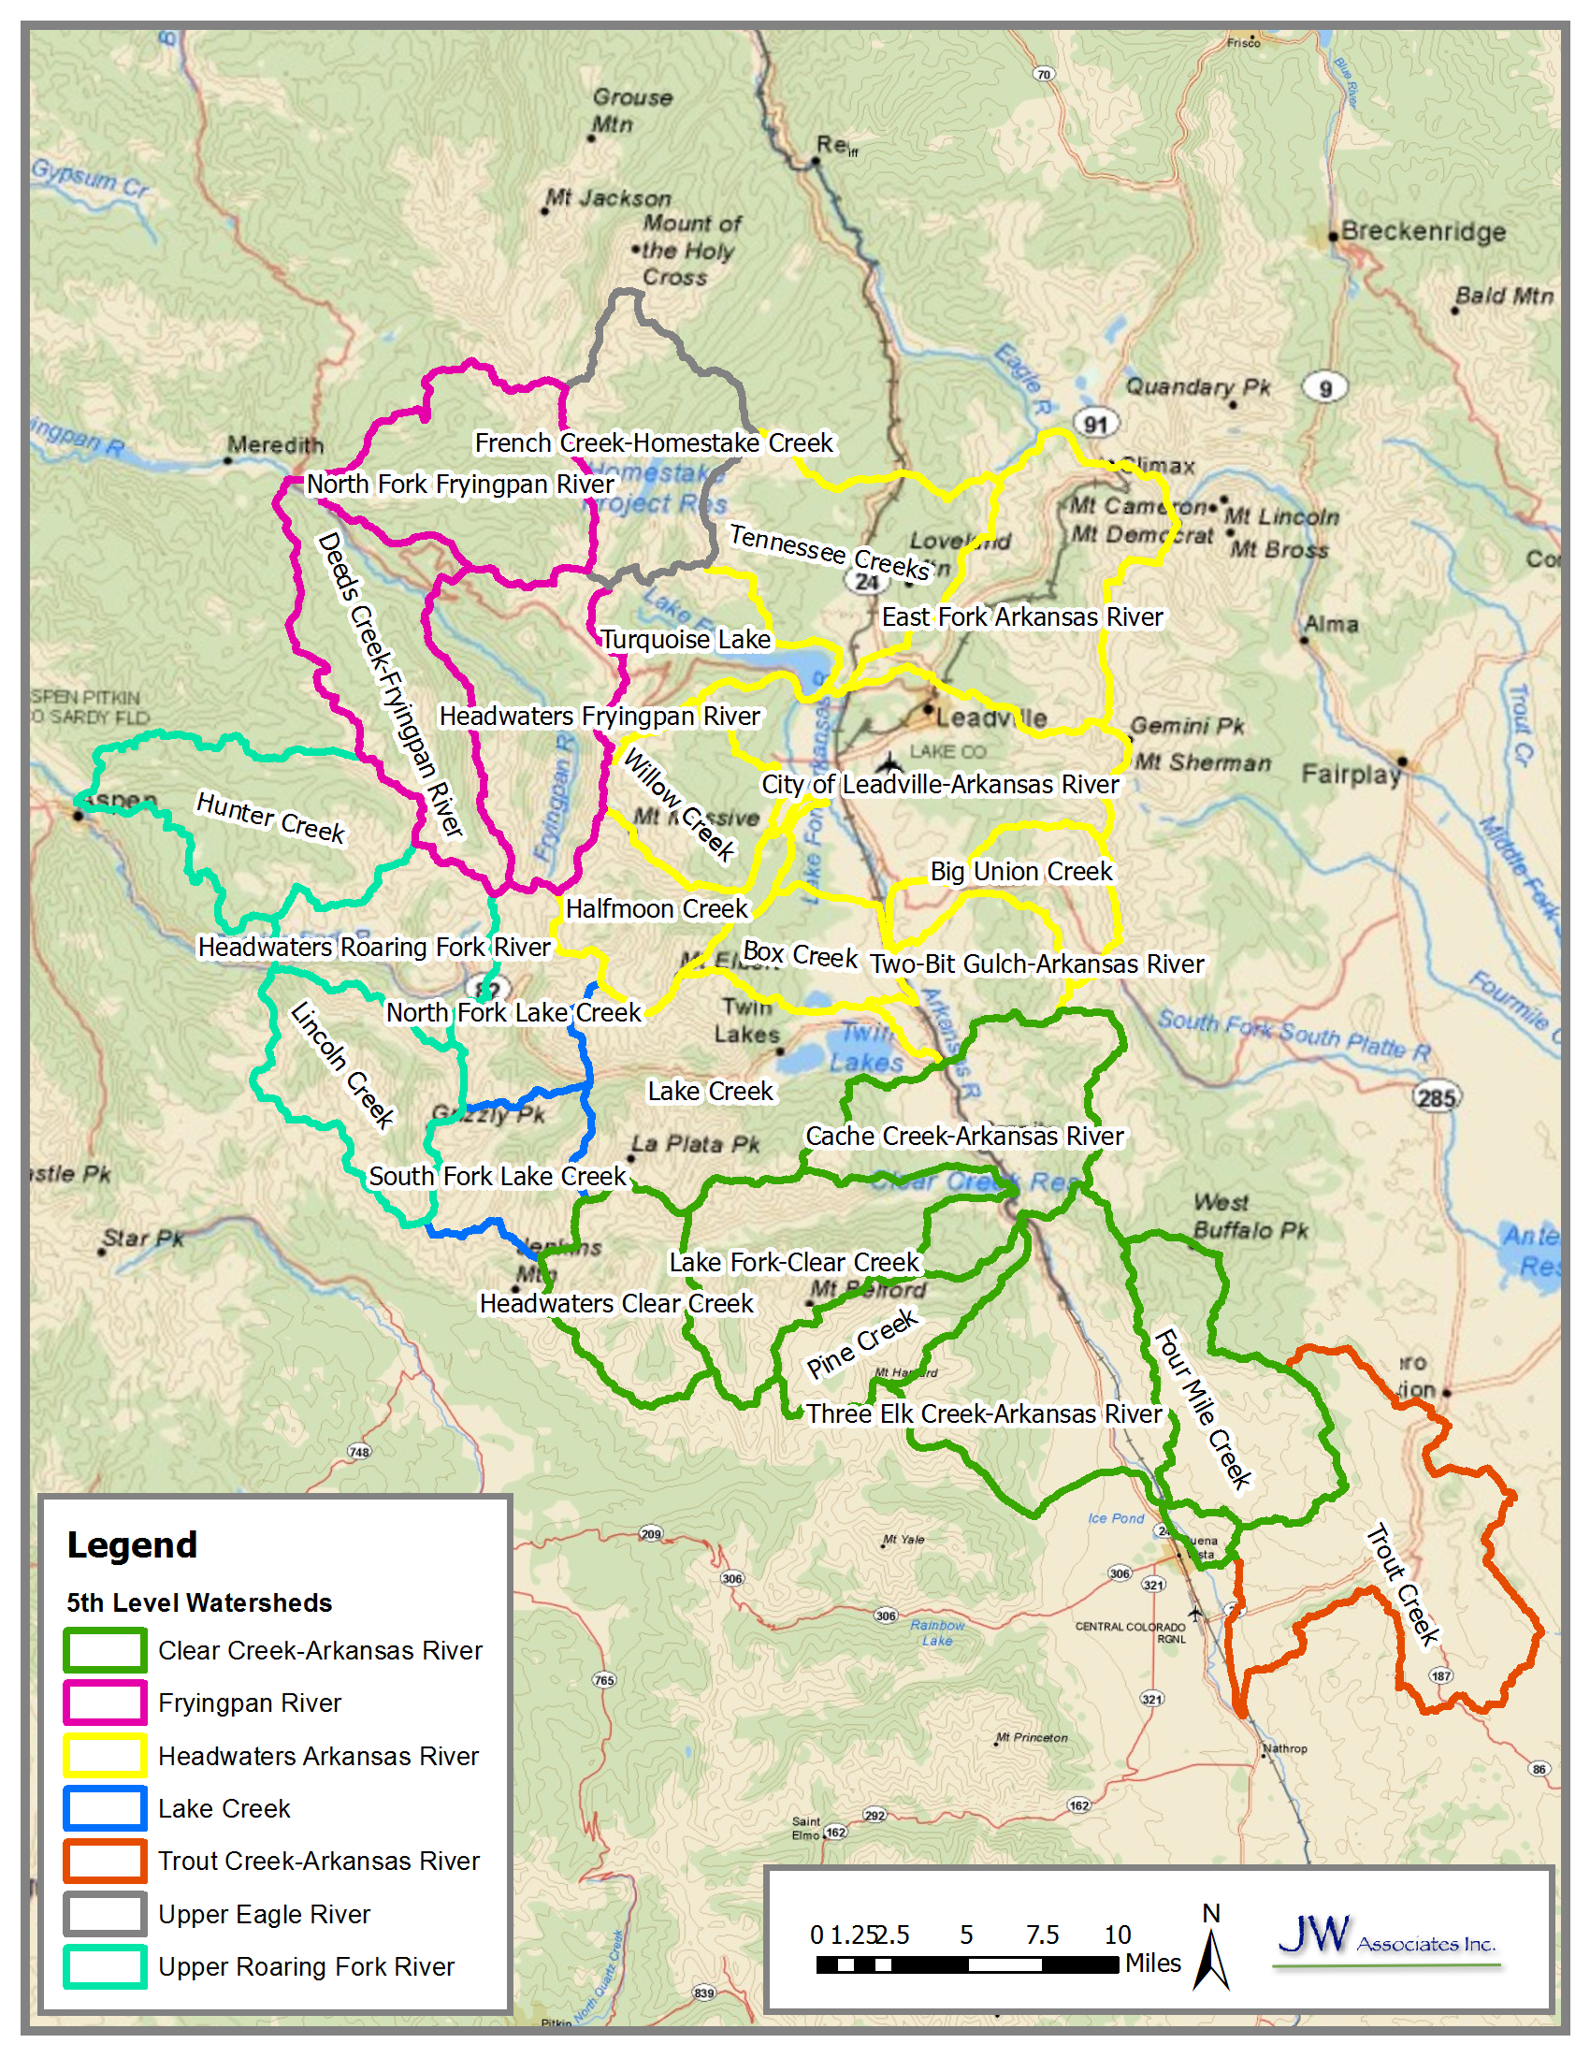
Arkansas Headwaters Watershed
632,000 acres in size
26 sixth-level watersheds

Slide 35
Watershed Assessment Components
Wildfire Hazard
Flooding or Debris Flow Hazard
Soil Erodibility
Water Supply

Slide 36
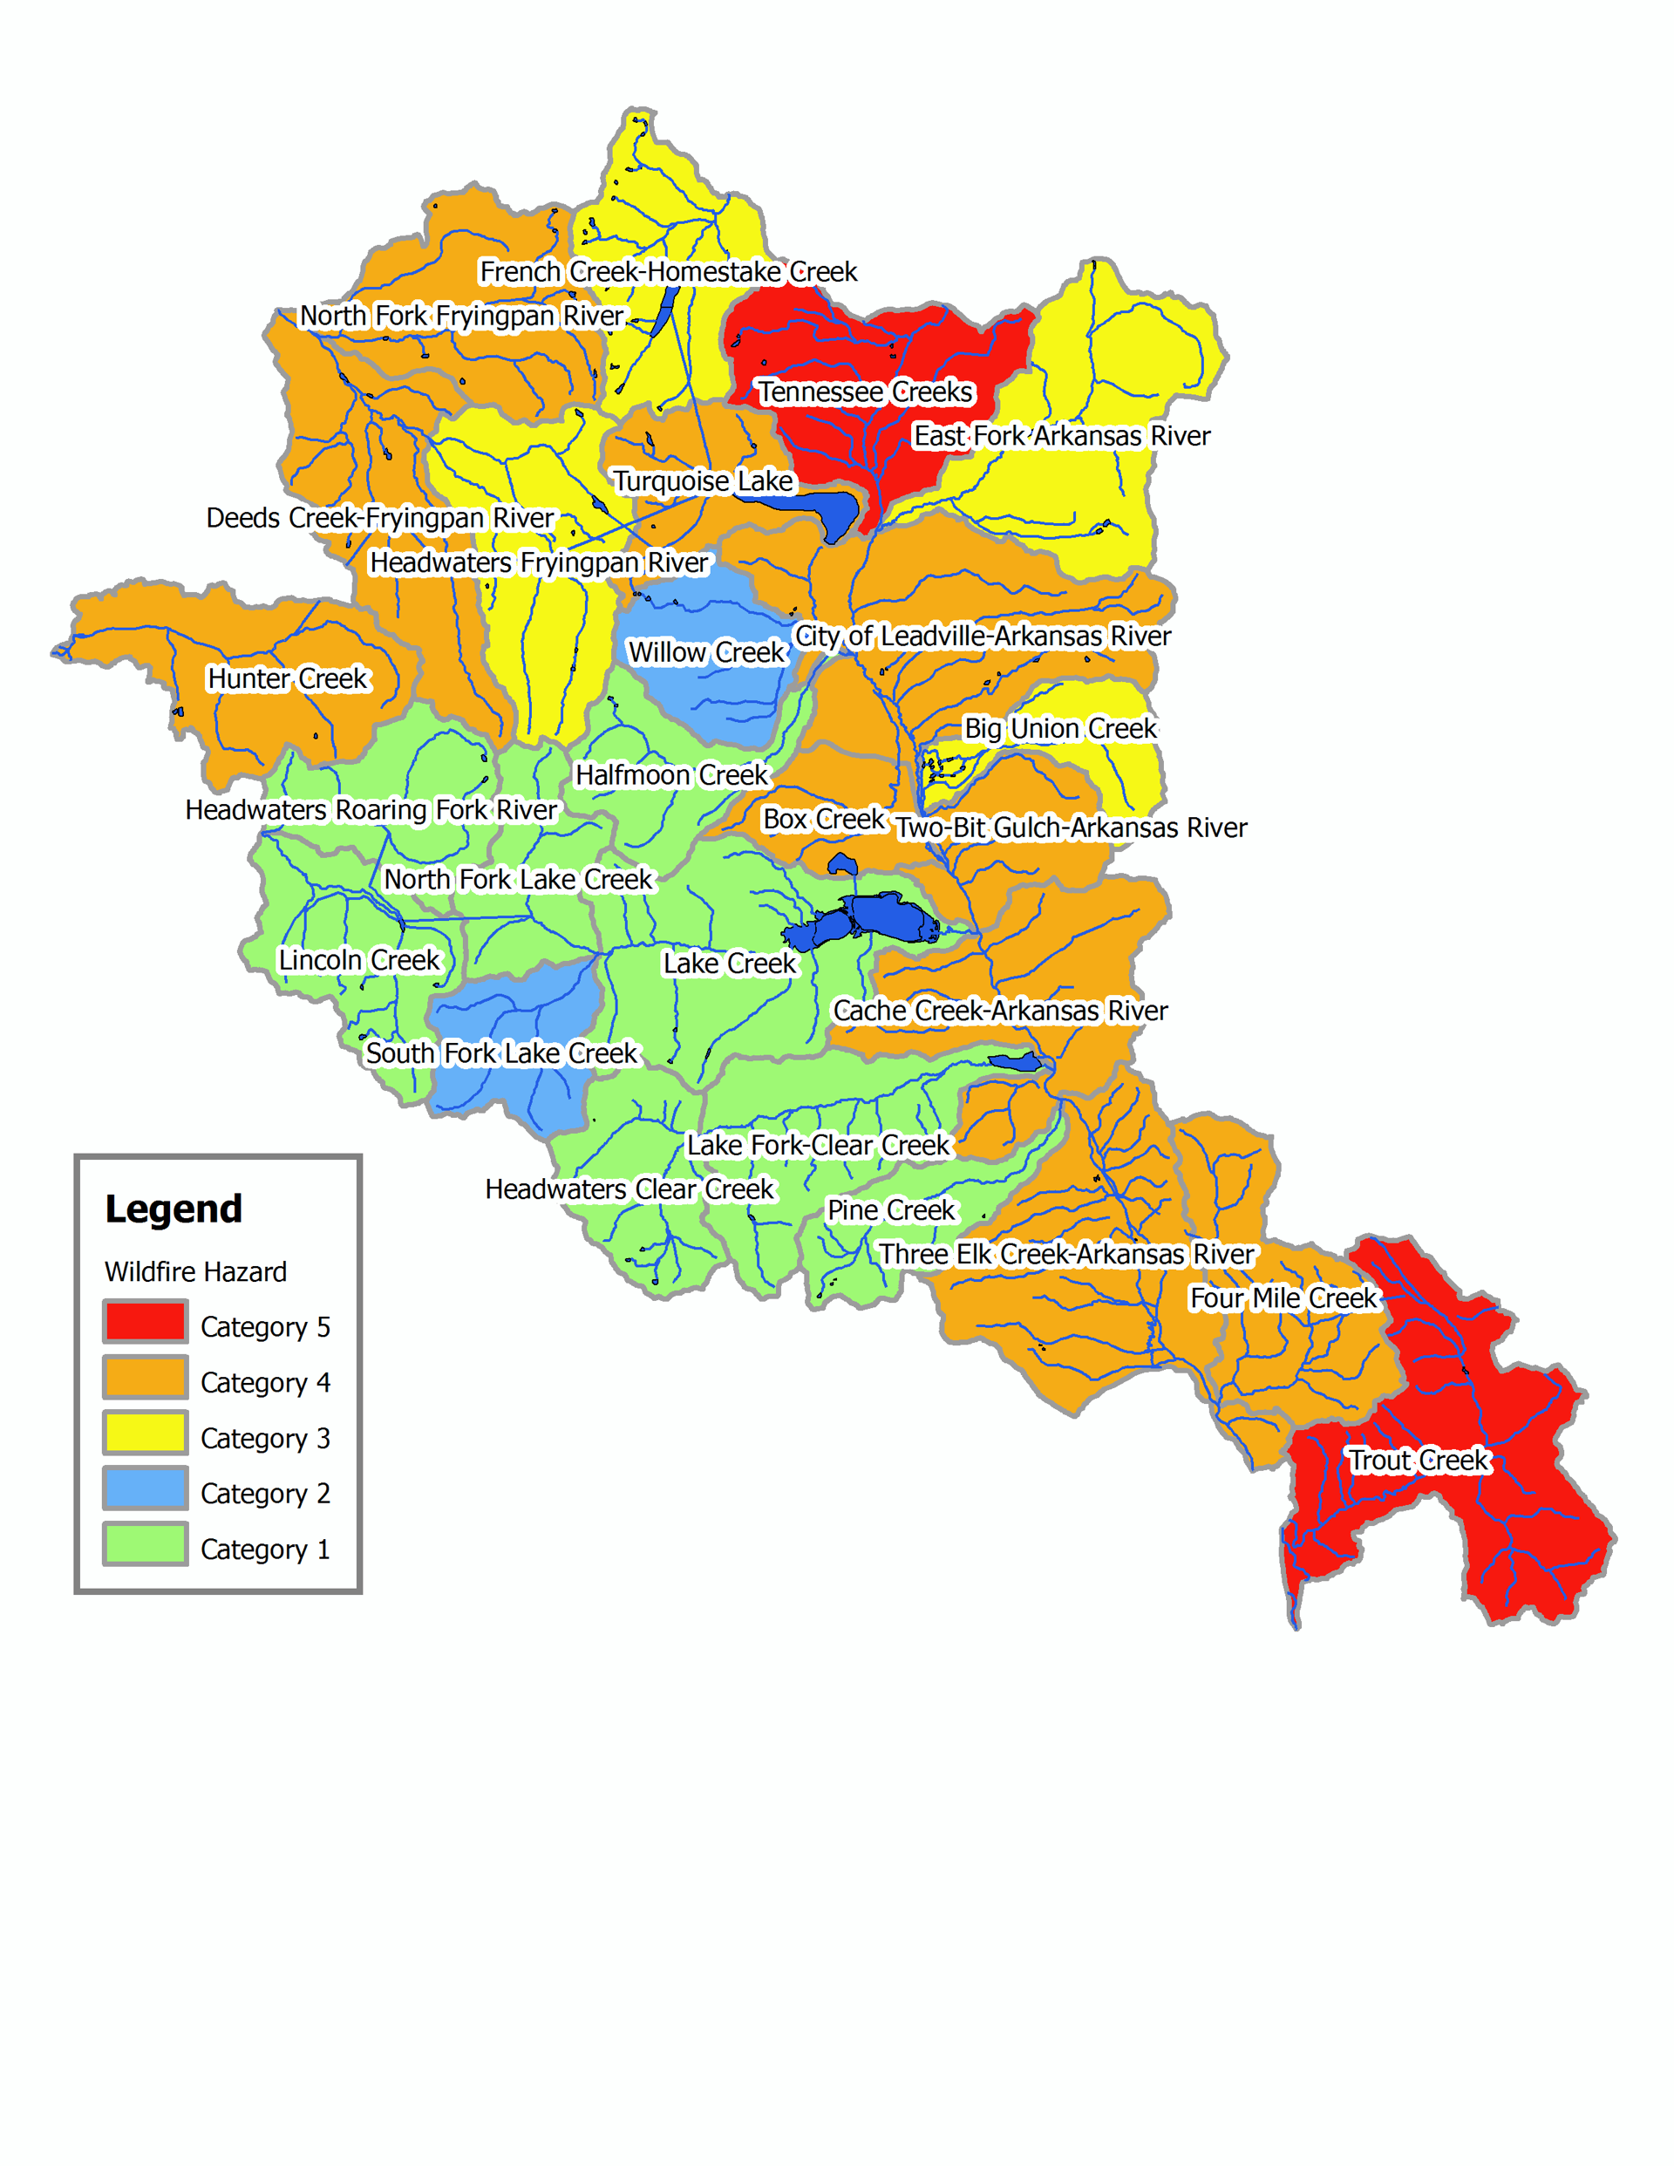
Wildfire Hazard Map
Arkansas Headwaters Watershed

Slide 37
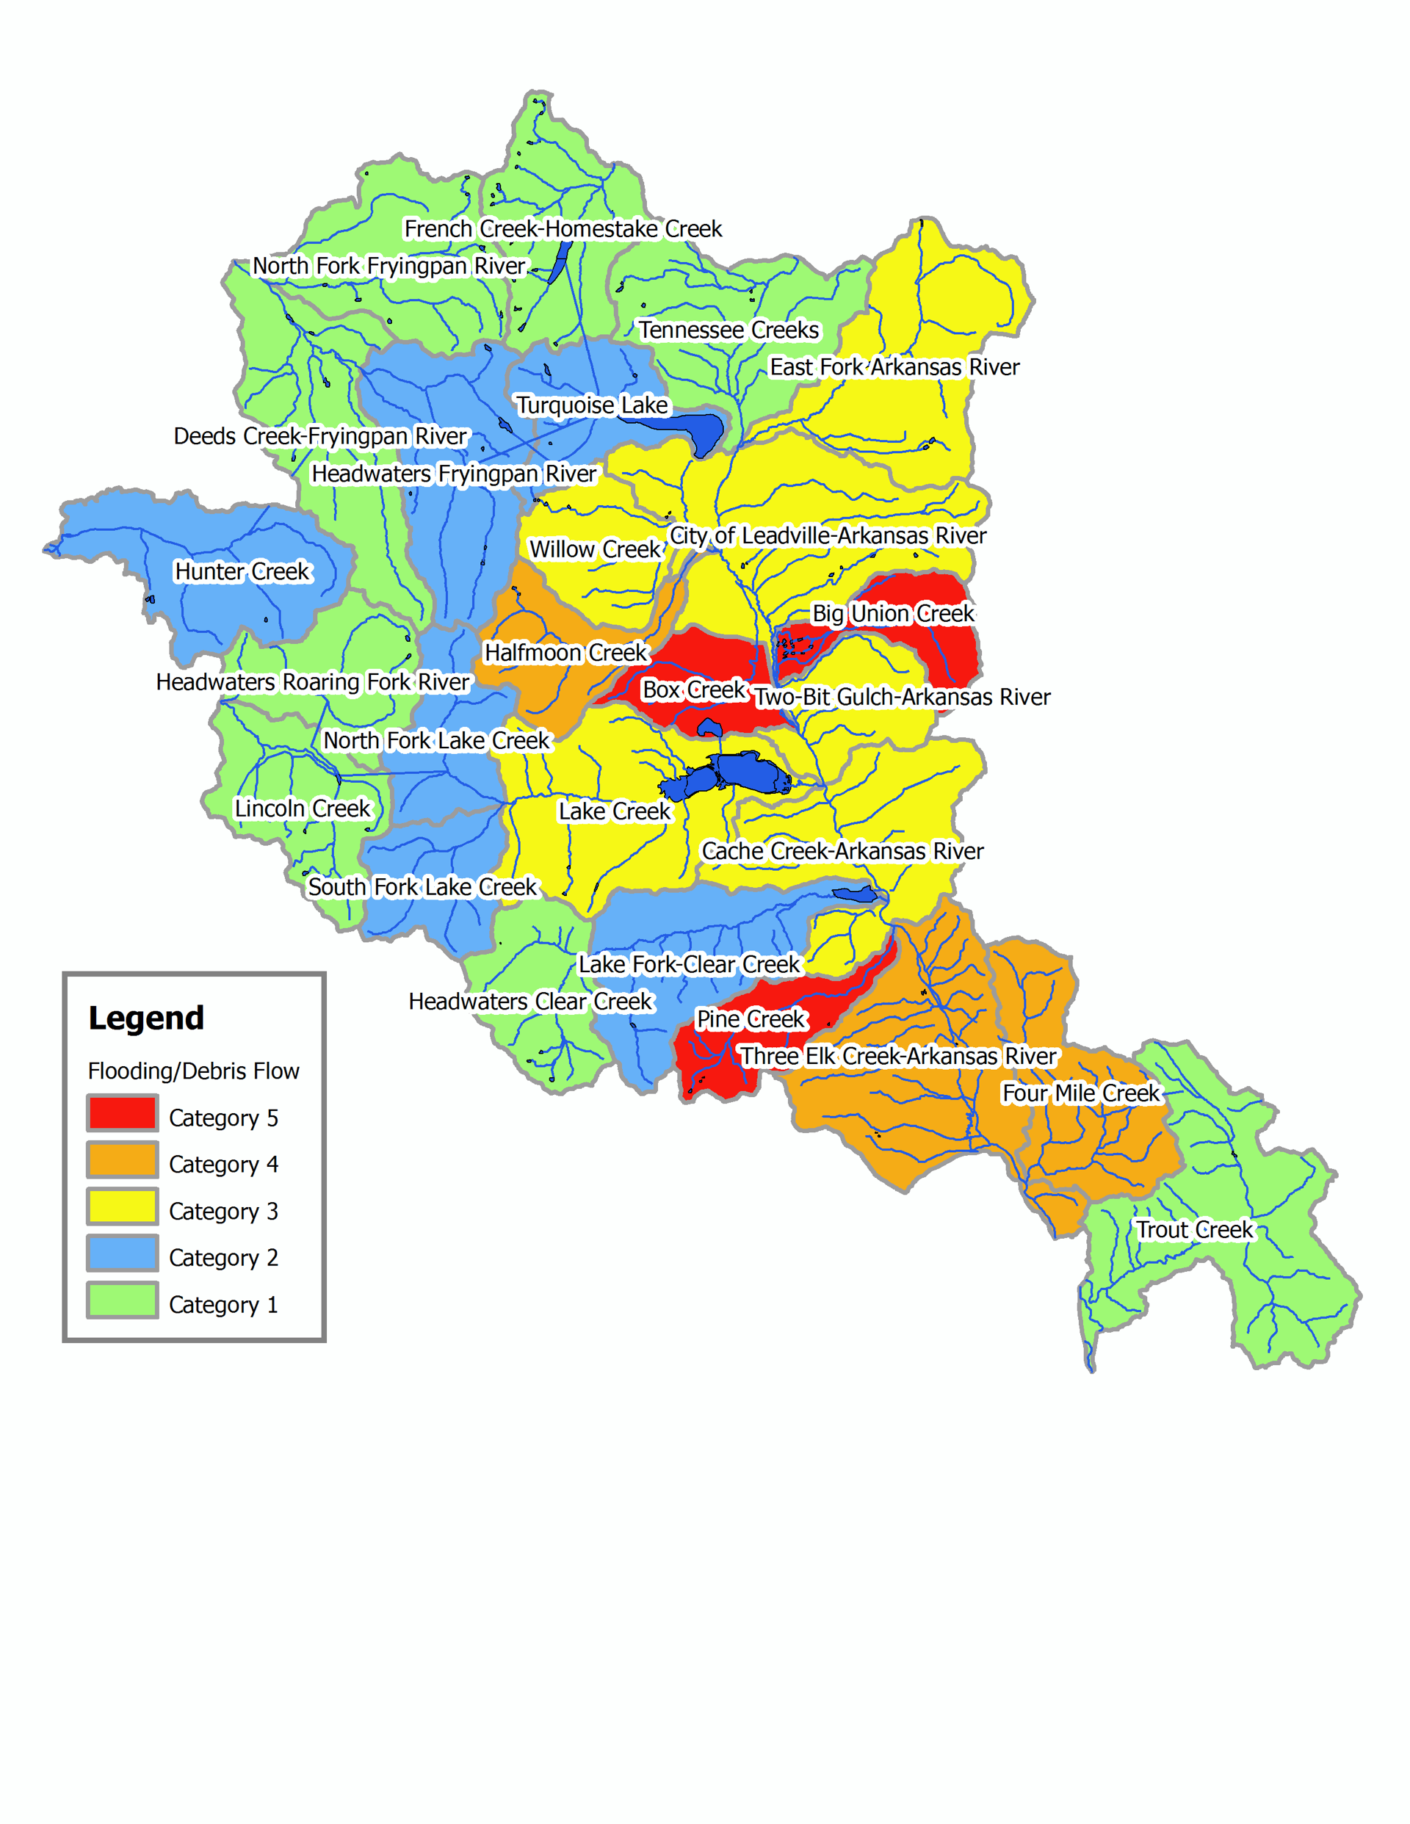
Flooding/Debris Flow Hazard Map
Arkansas Headwaters Watershed

Slide 38
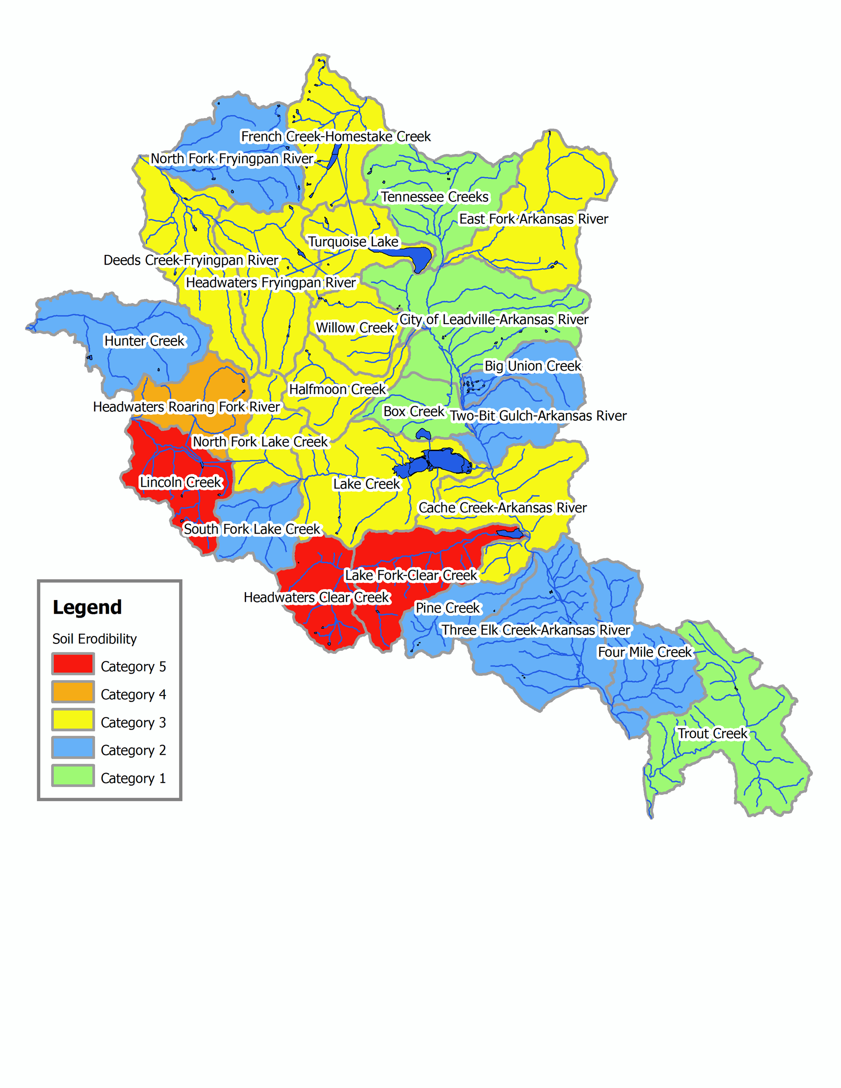
Soil Erodibility Ranking Map
Arkansas Headwaters Watershed

Slide 39
Composite Hazard
Wildfire Hazard
Composite Hazard Ranking
Flooding or Debris Flow Hazard
Soil Conditions

Slide 40
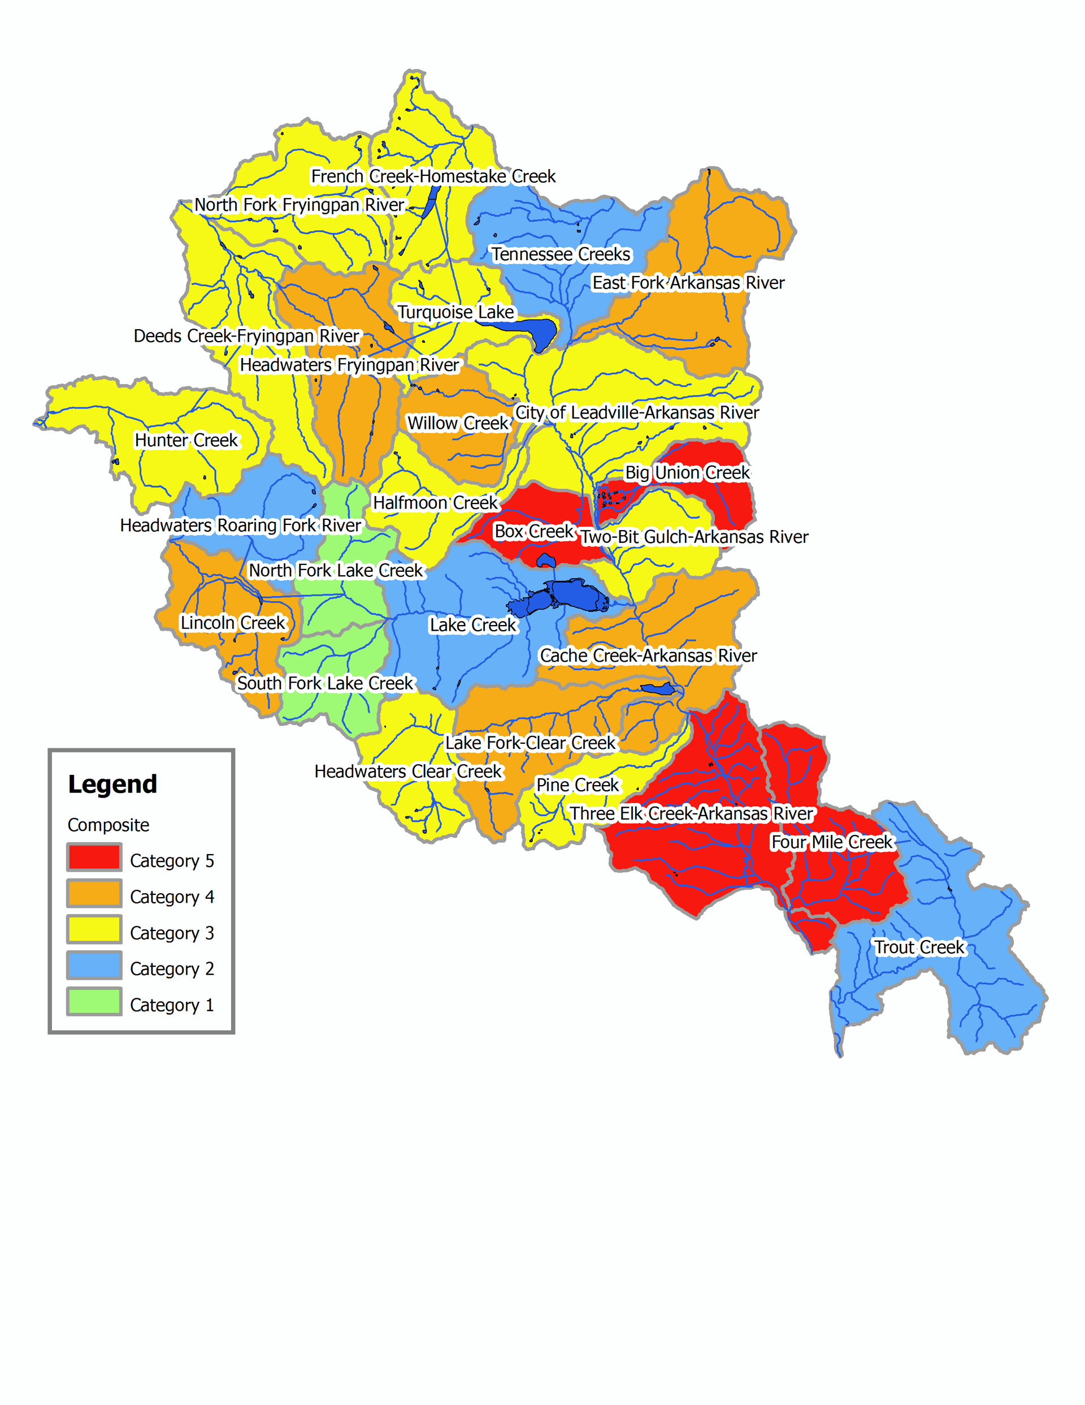
Composite Hazard Ranking Map
Arkansas Headwaters Watershed

Slide 41
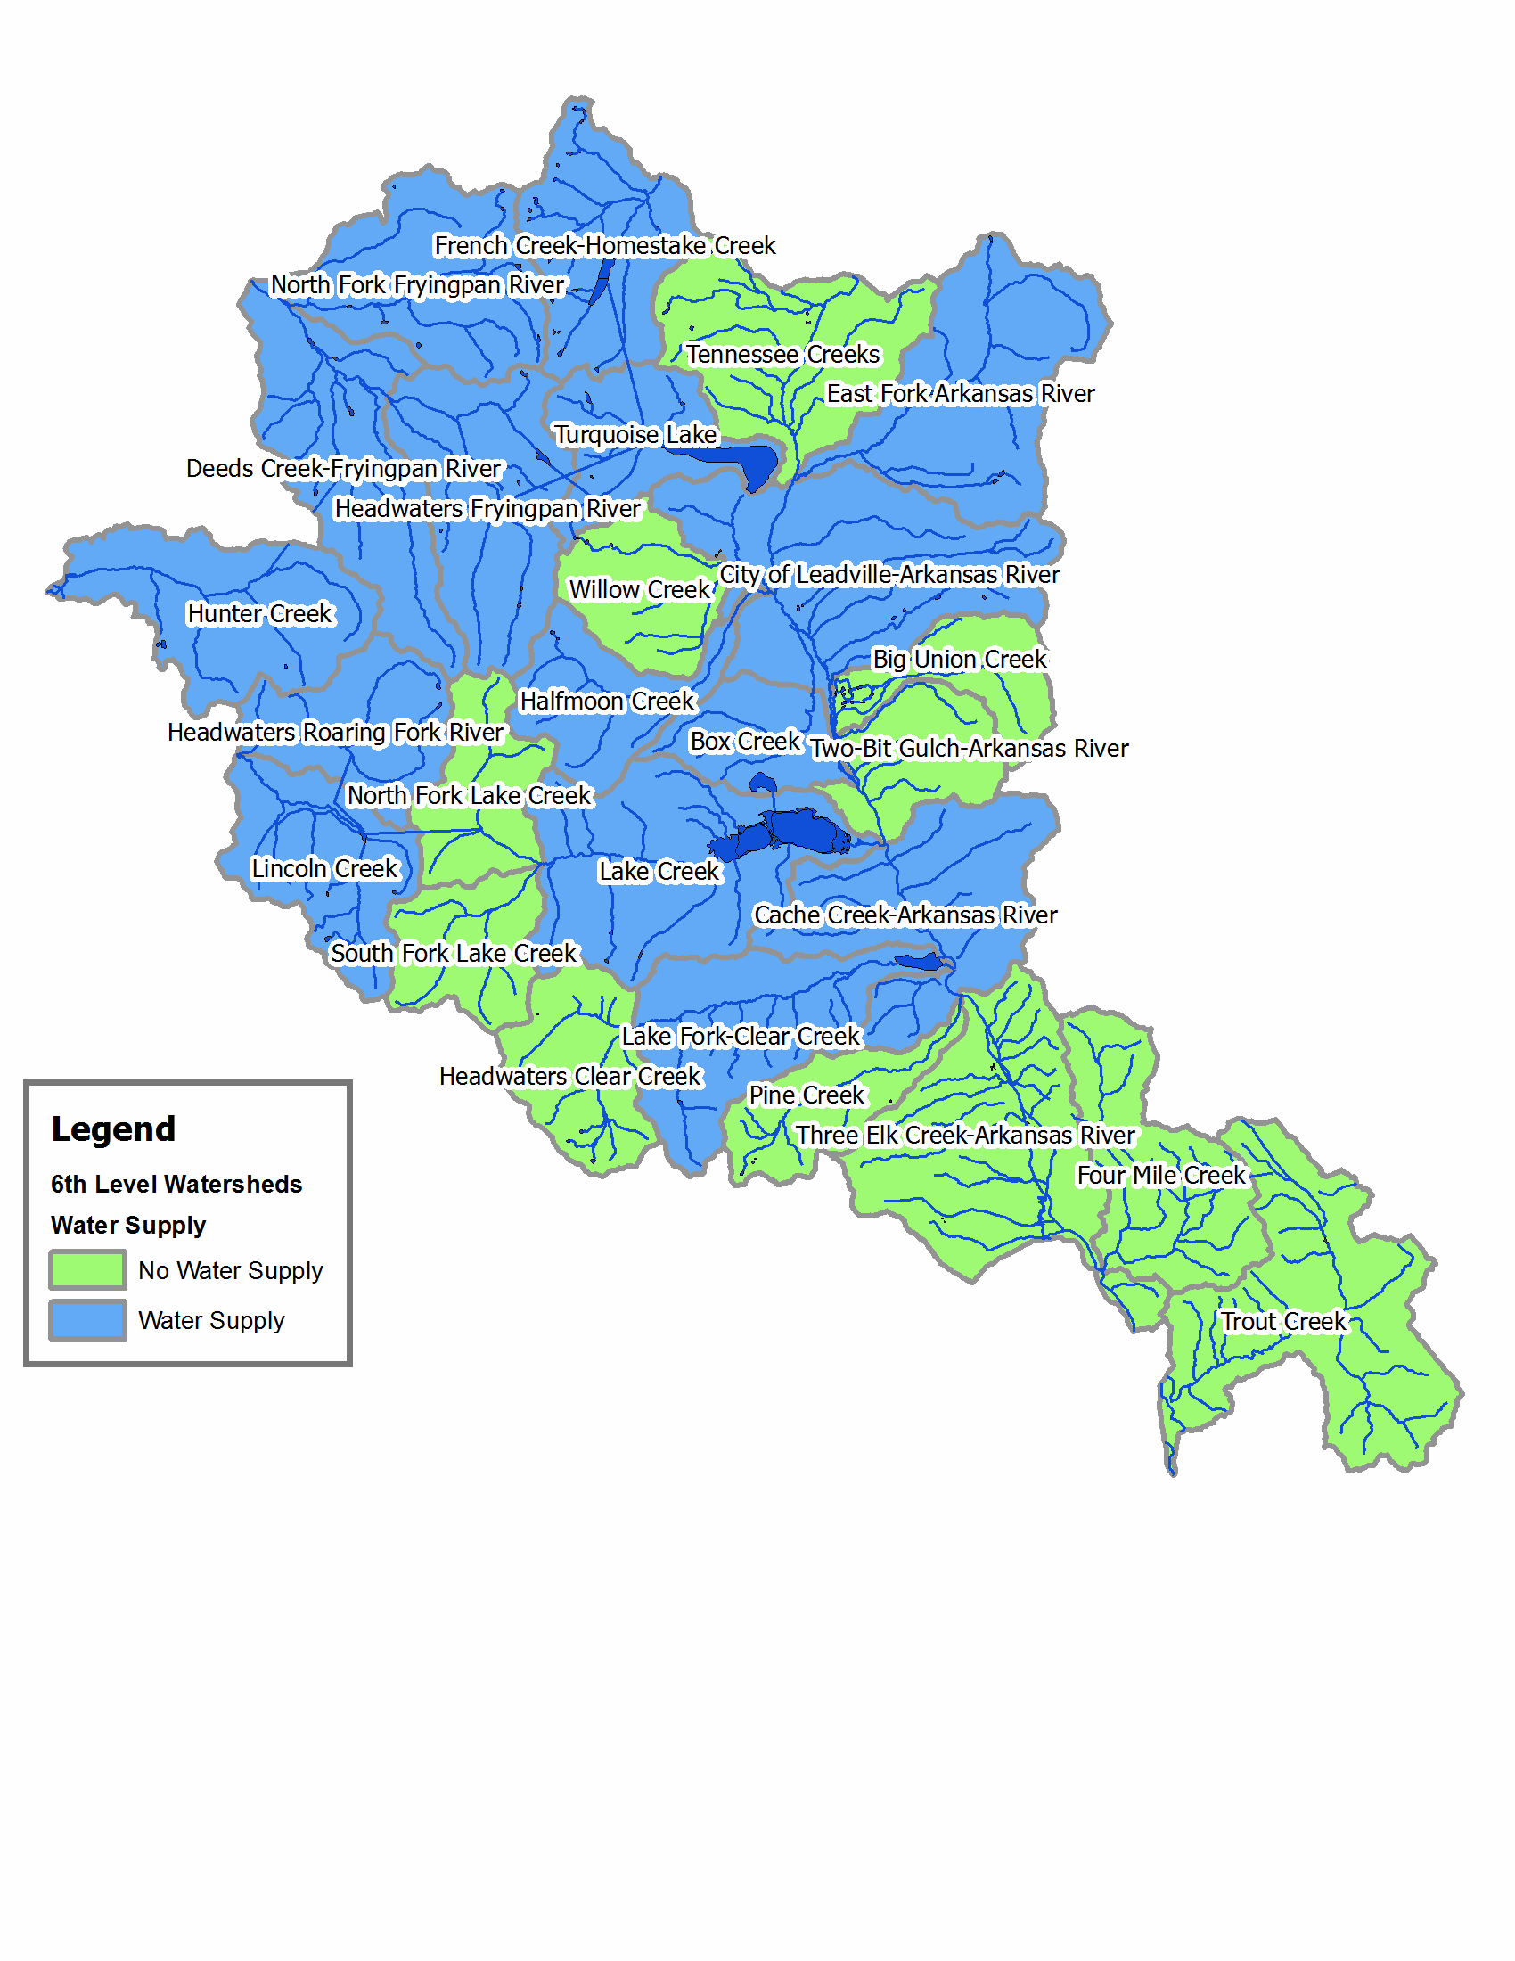
Water Supply Map
Arkansas Headwaters Watershed

Slide 42
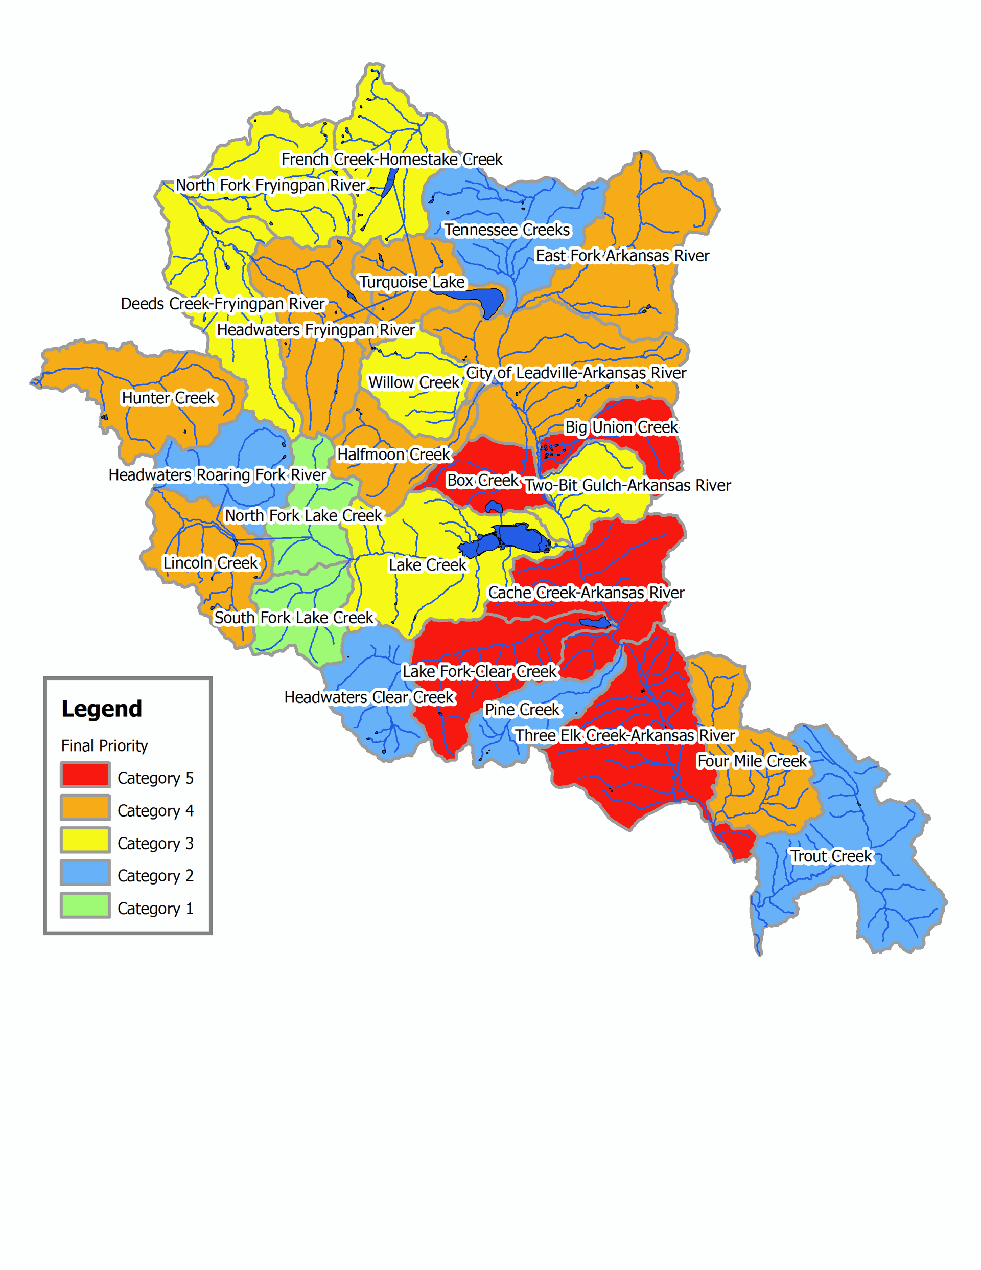
Final Priority Map
Arkansas Headwaters Watershed

Slide 43
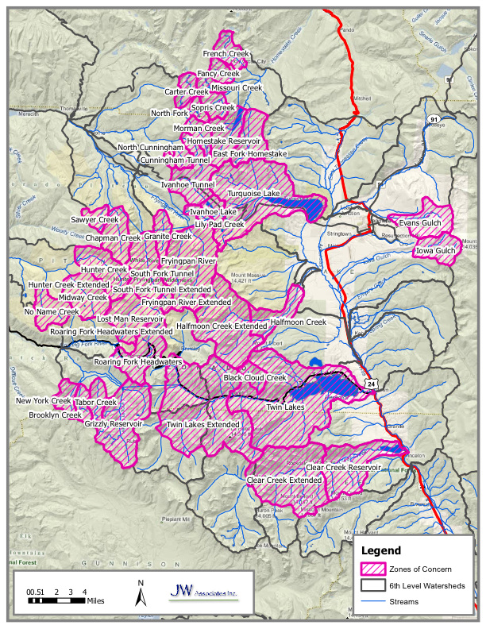
Zones of Concern Map

Slide 44
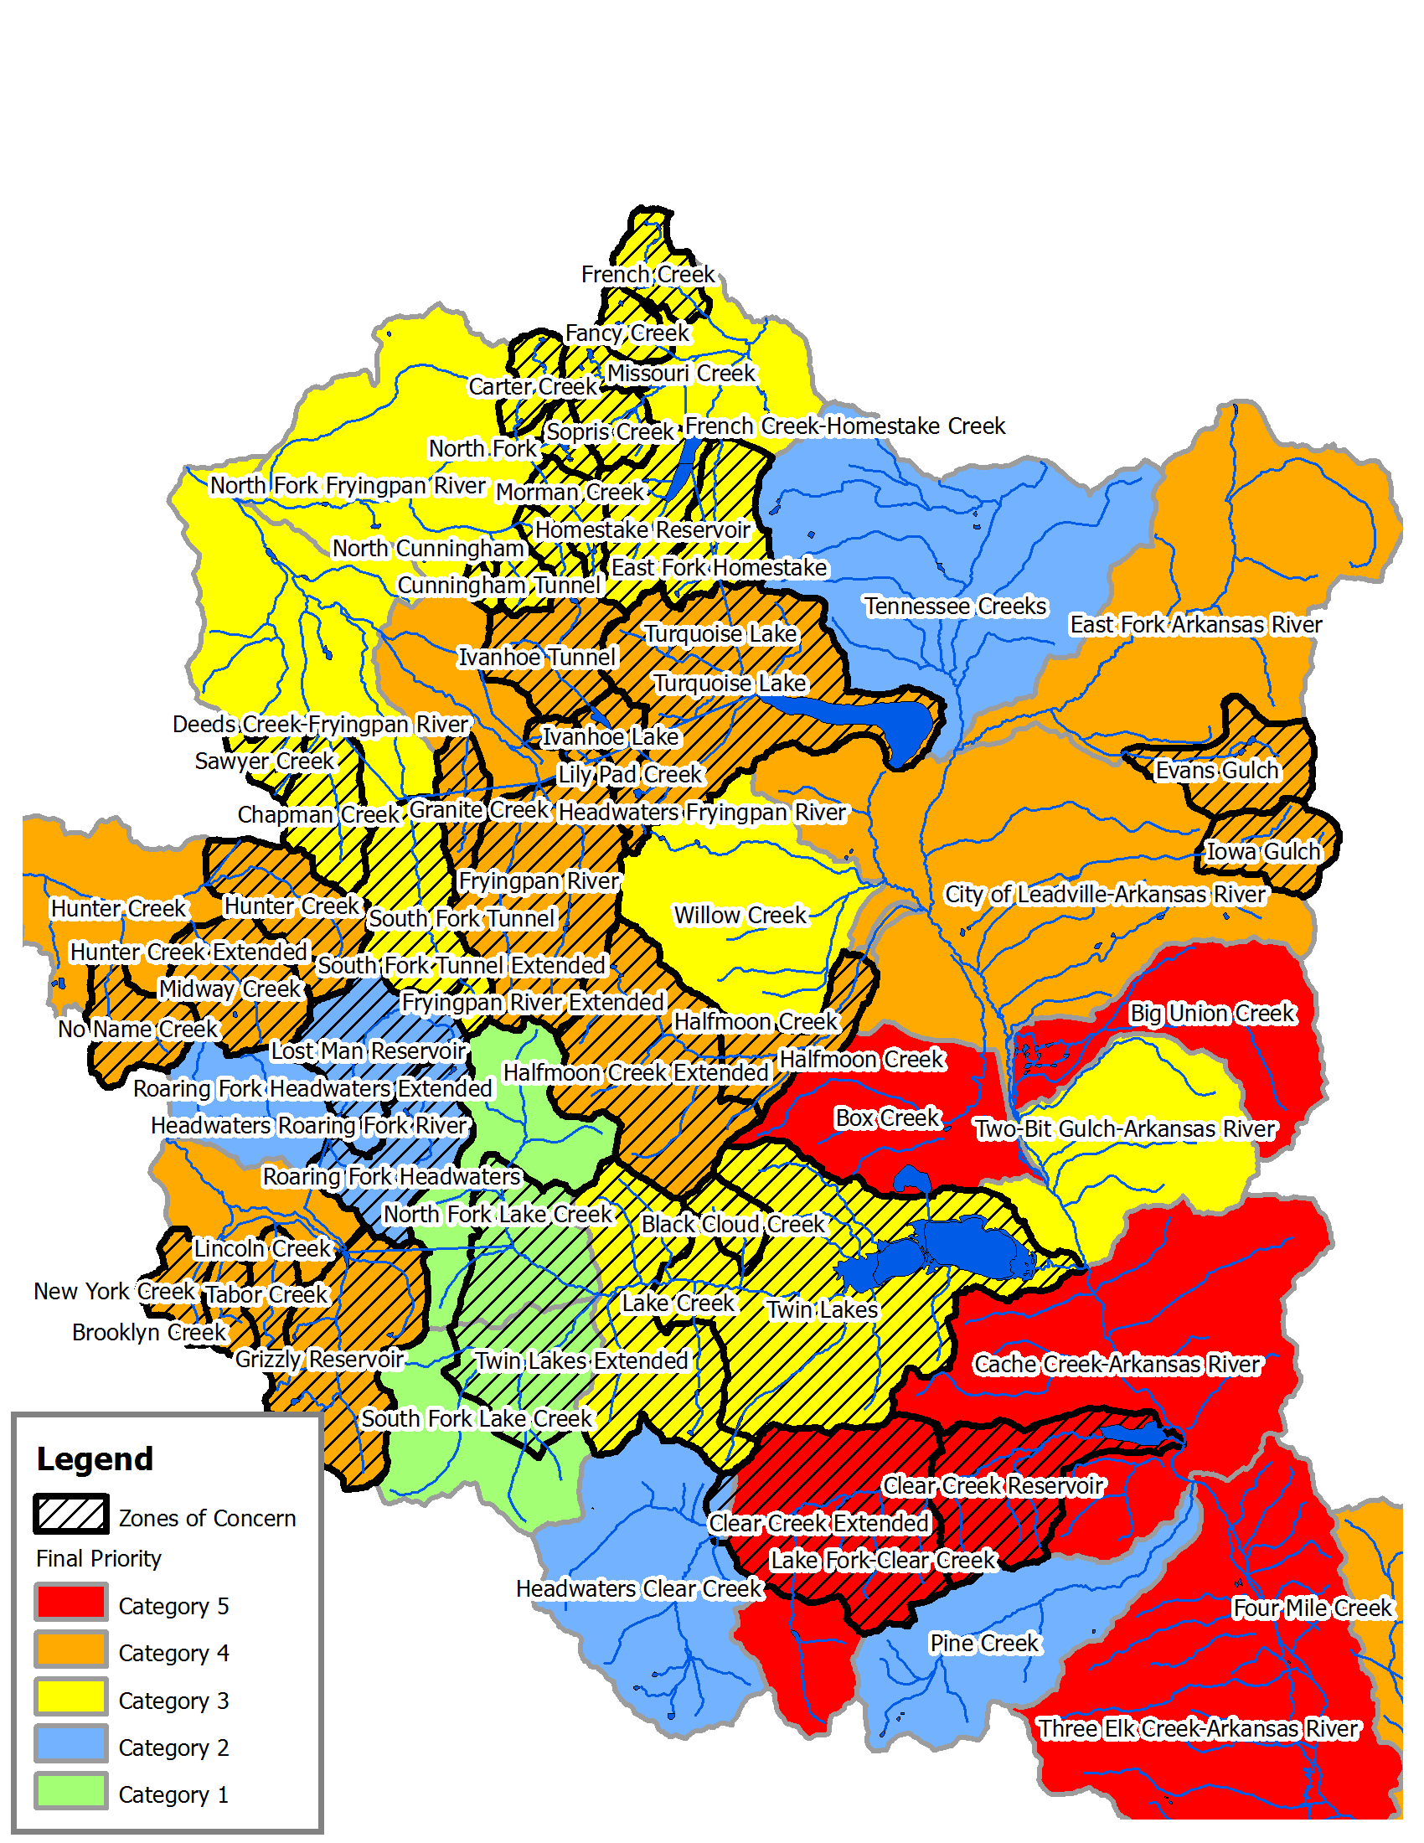
Final Priority with Zones of Concern
Arkansas Headwaters Watershed with 5-mile upstream distance

Slide 45
Zones of Concern Map

Slide 47
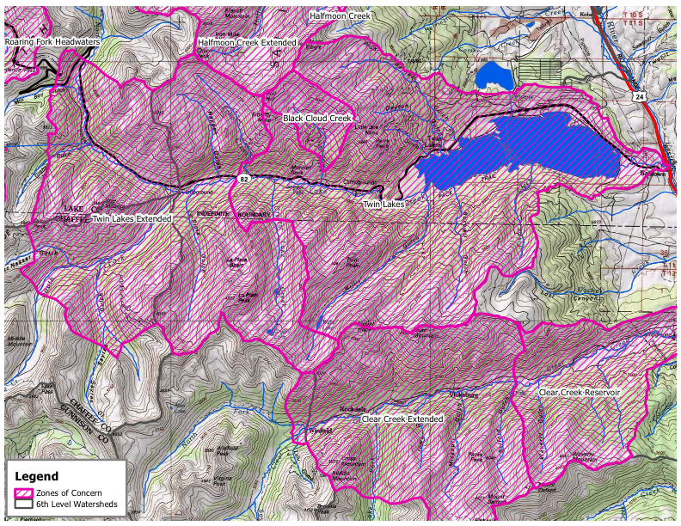

Slide 48
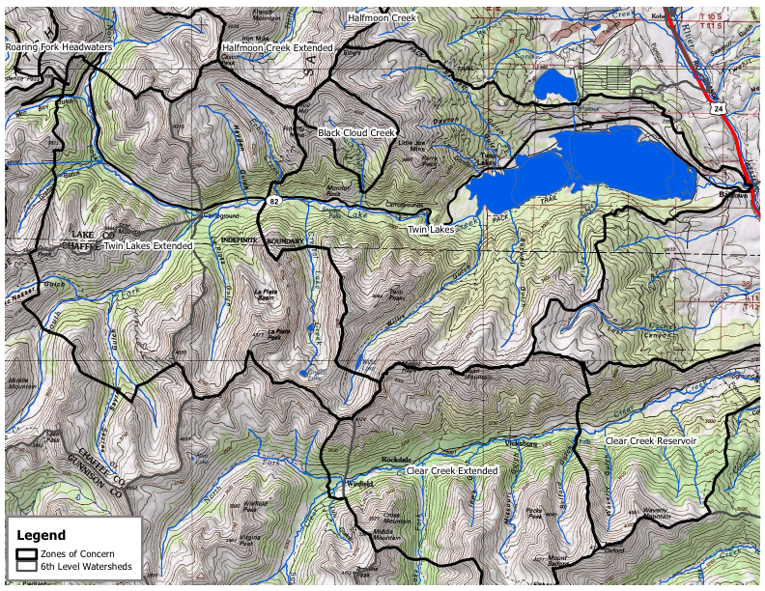

Slide 49
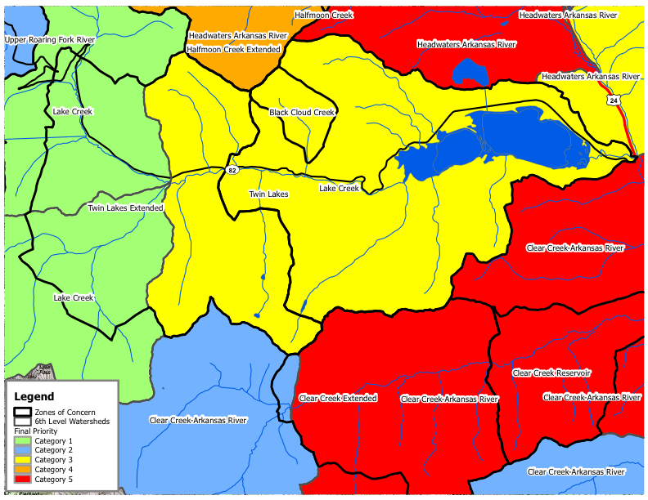

Slide 50
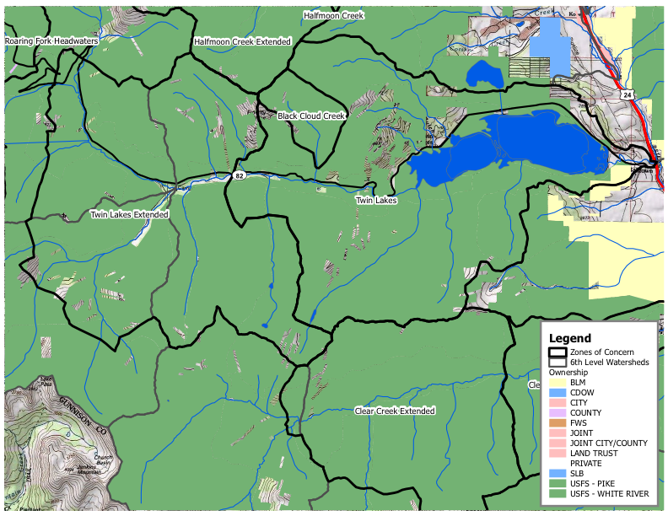

Slide 51
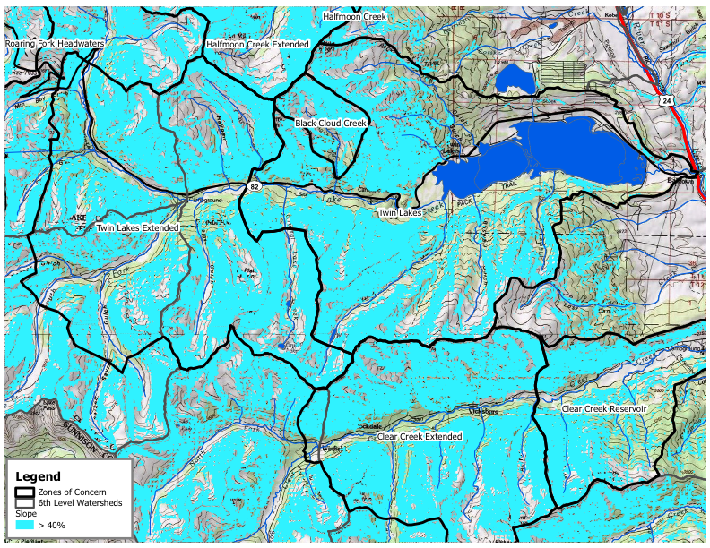

Slide 52
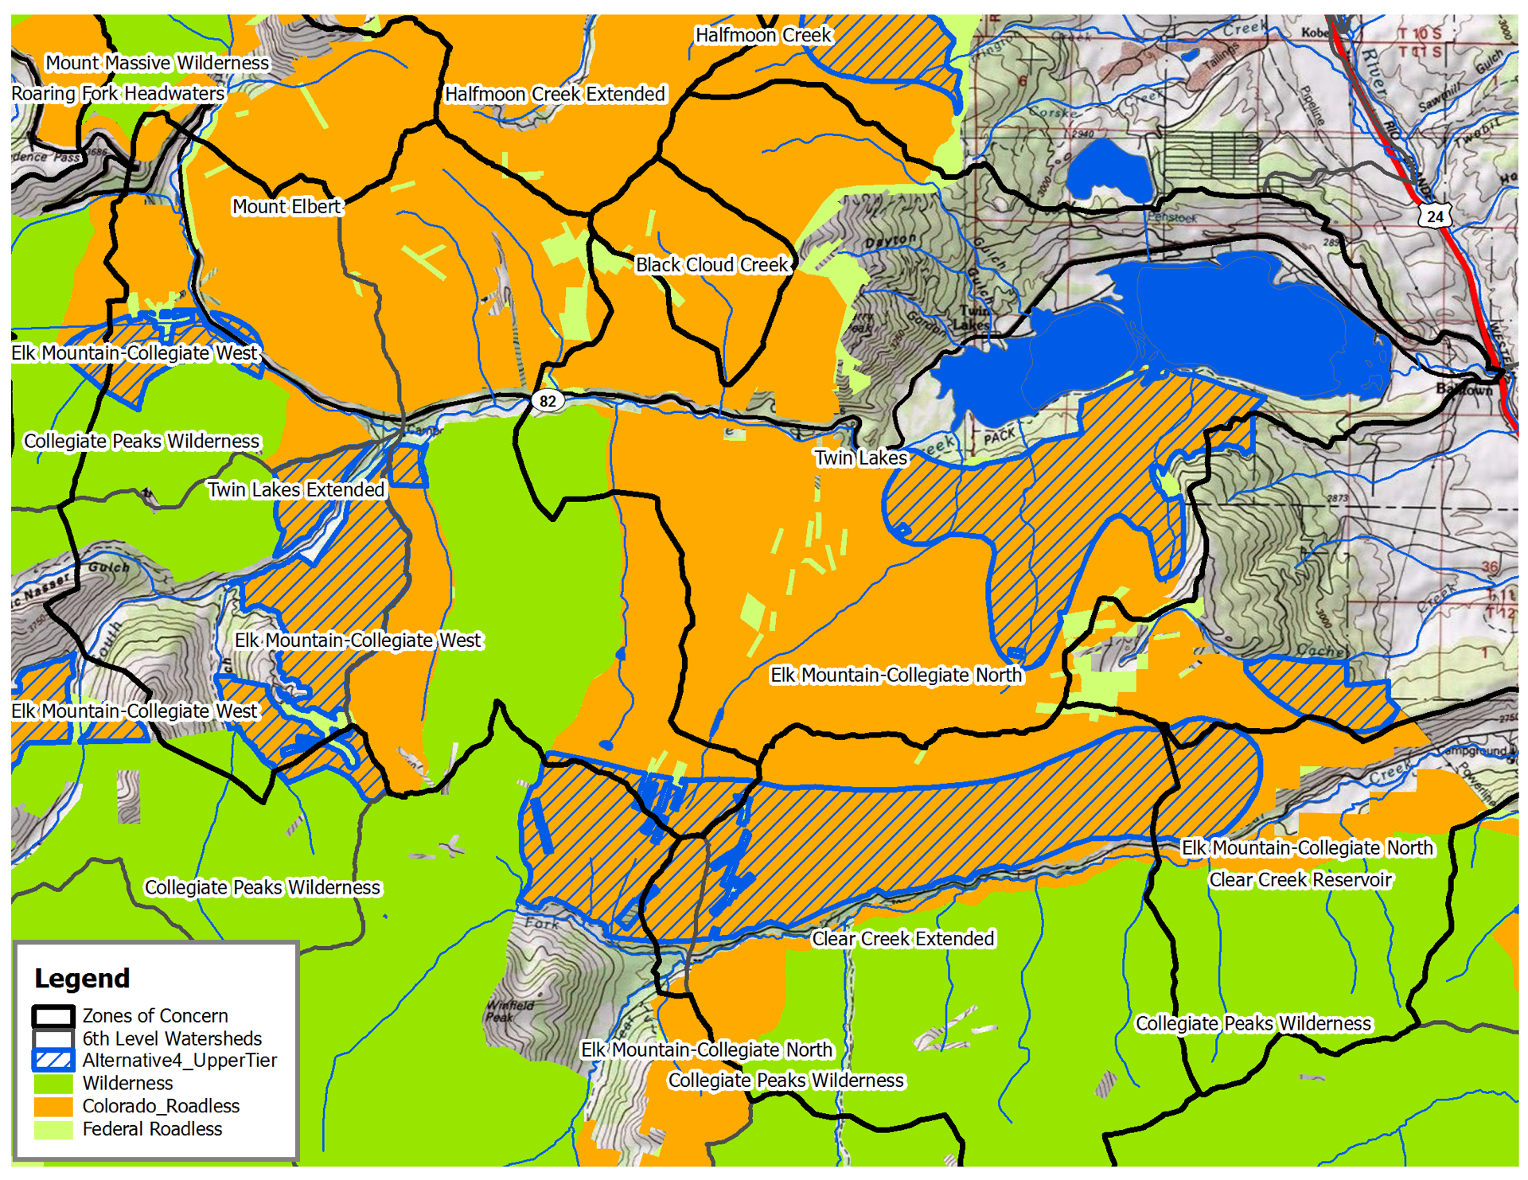

Slide 53
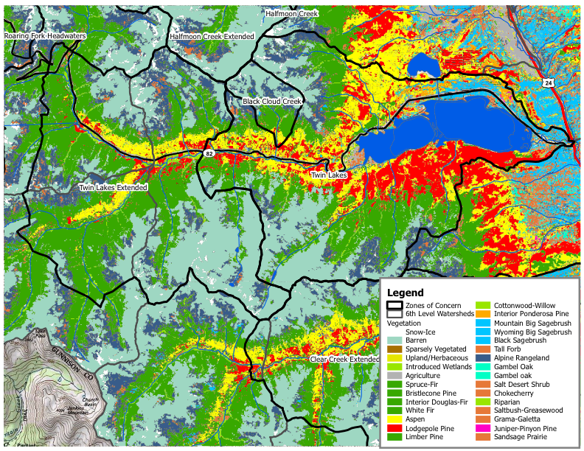

Slide 54
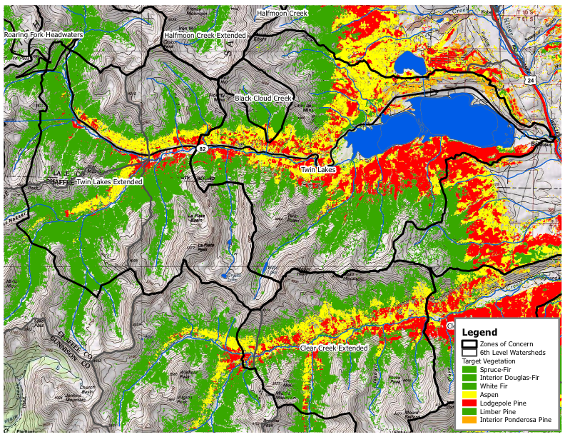

Slide 55
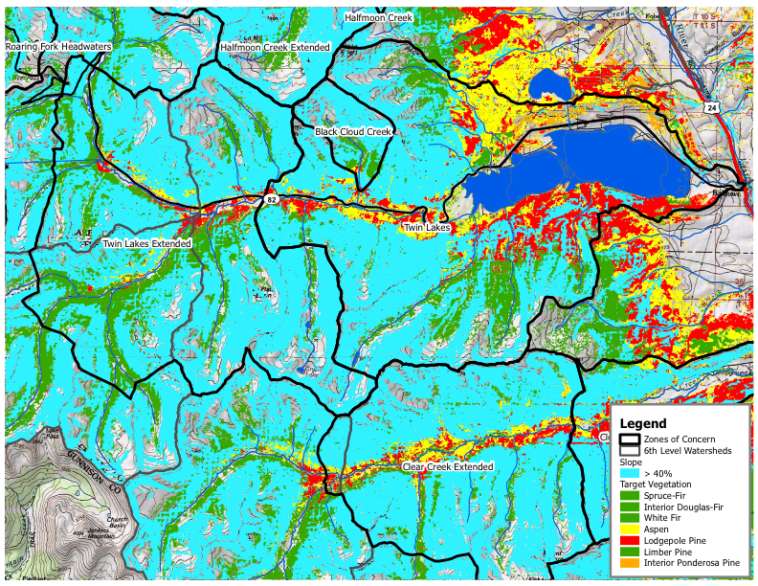

Slide 56
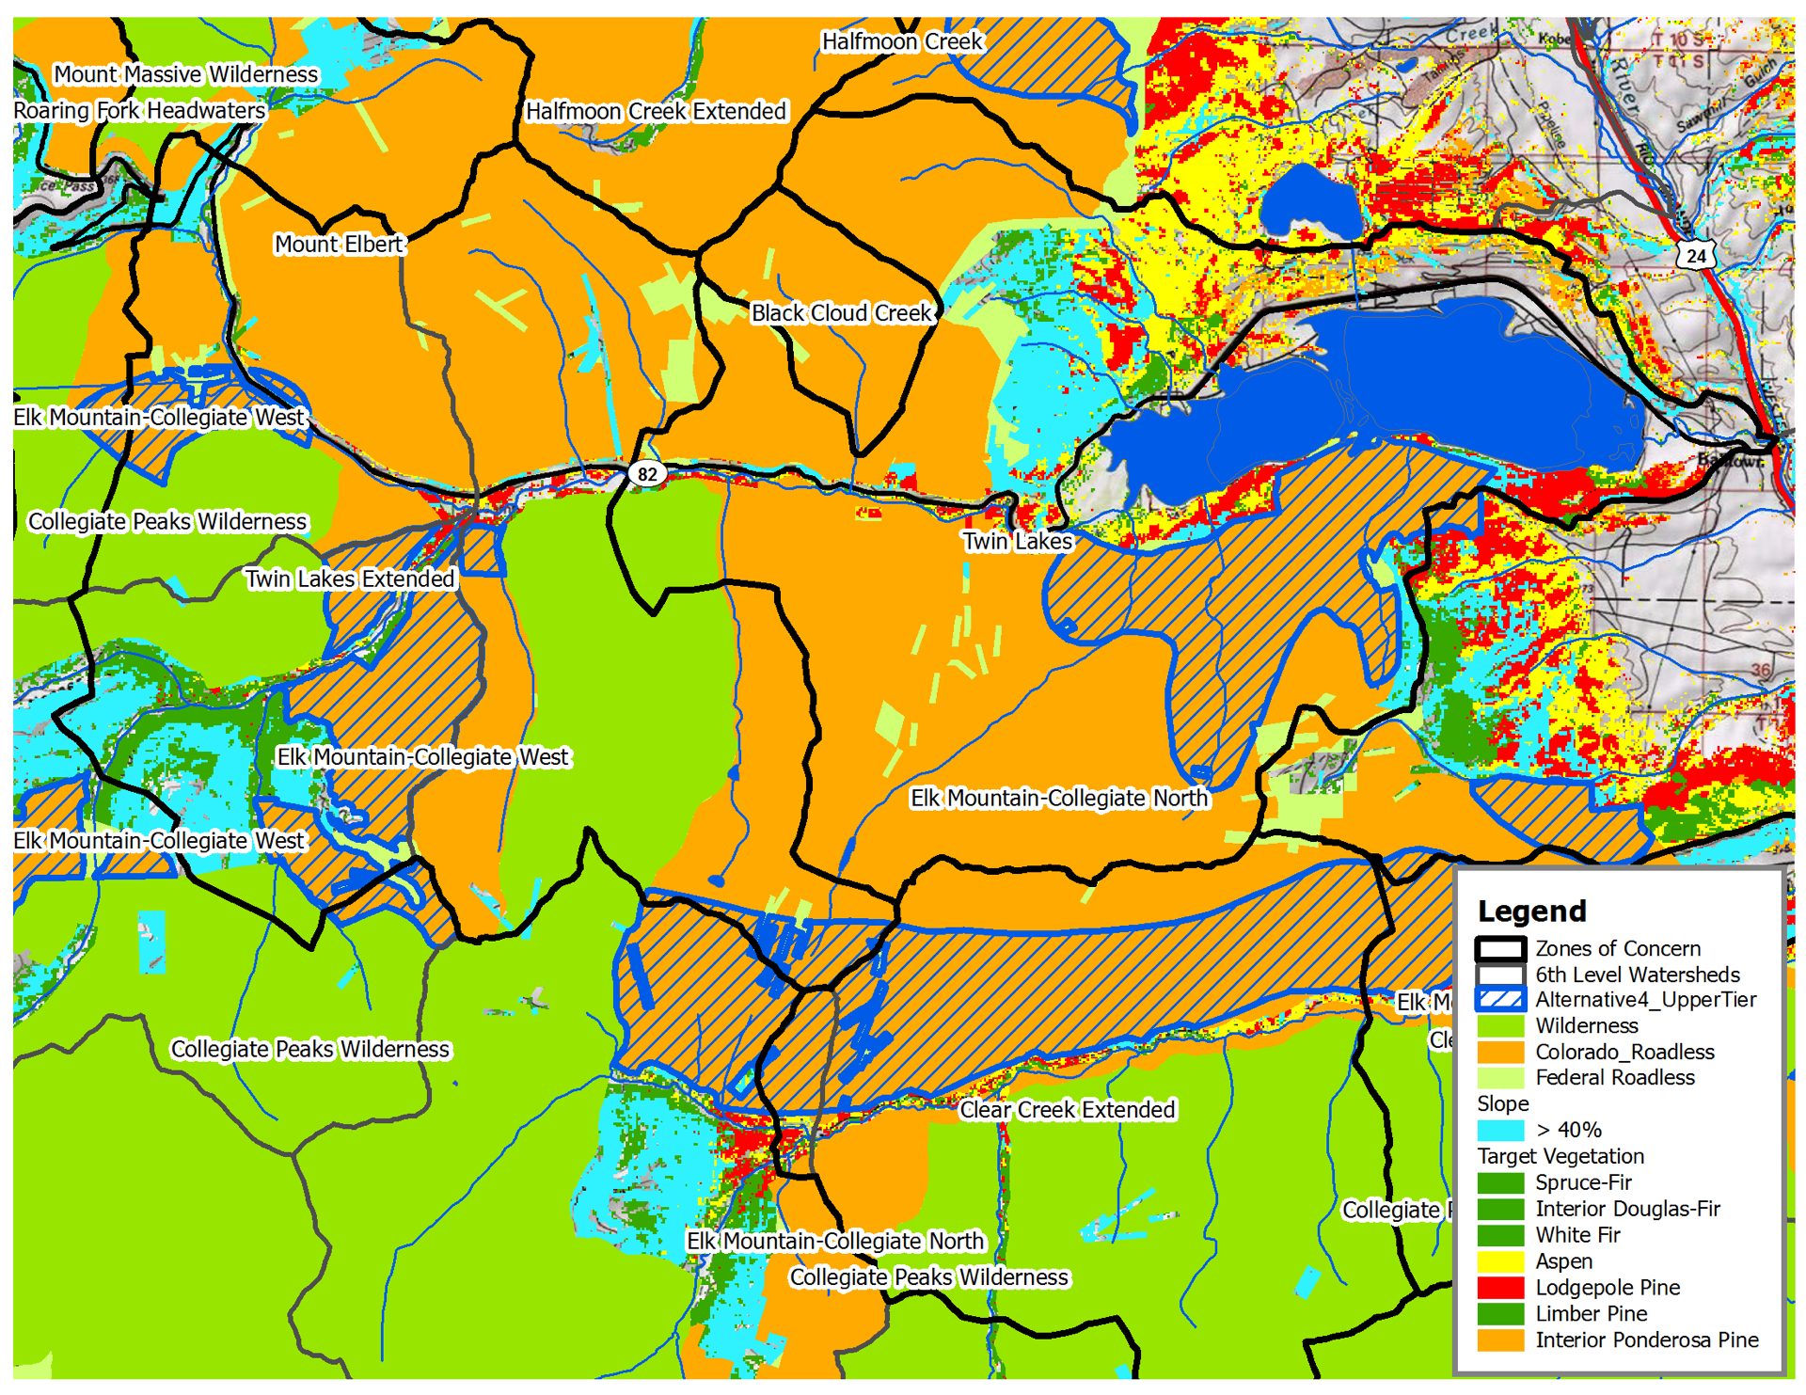

Slide 57
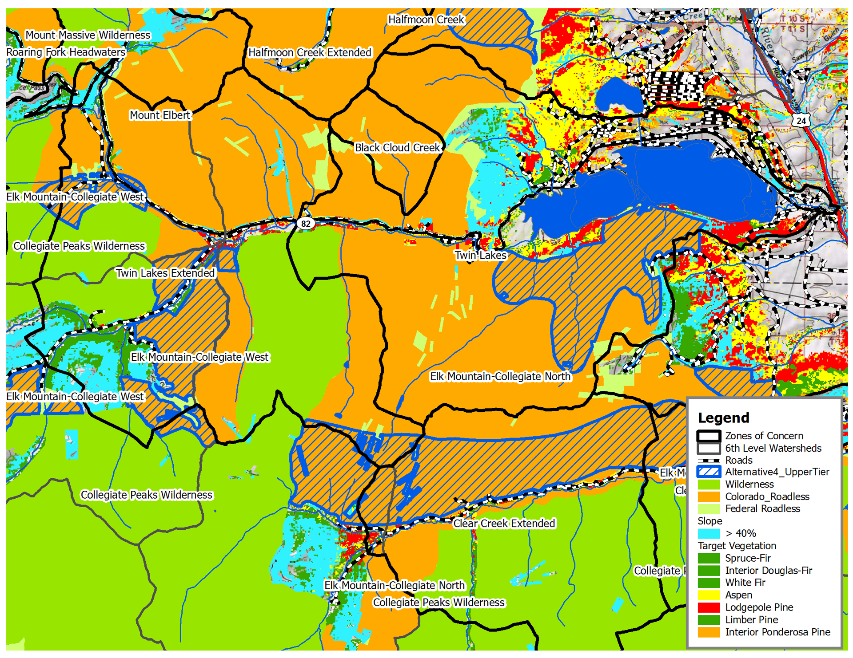

Slide 58
Wildfire/Watershed Assessment Upcoming?
Saint Vrain
Adding opportunities and constraints analysis
Clear/Bear Creek
Take the Phase 1 assessment through the stakeholder process

Slide 59
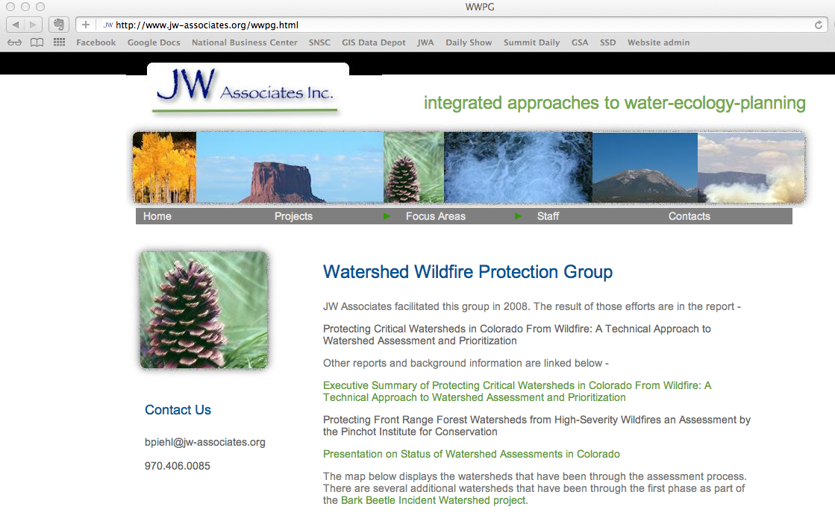
jw-associates.org

