Slide 1
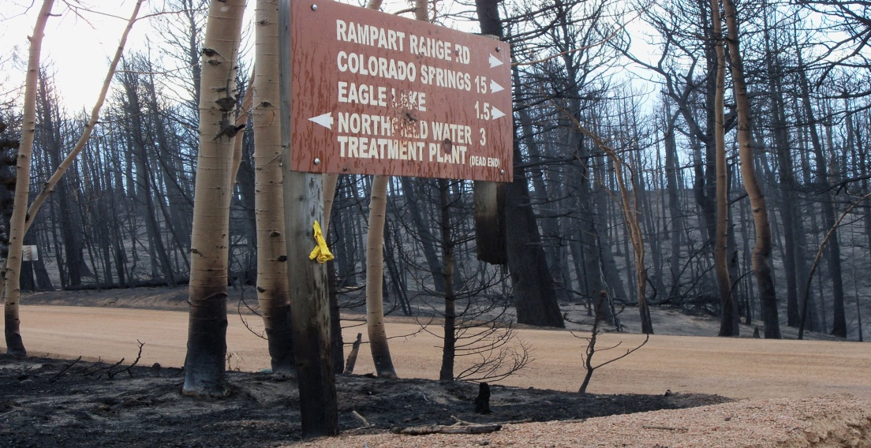
Lessons From the
Waldo Canyon Fire
Colorado Springs Utilities - Watershed Planning

Slide 2
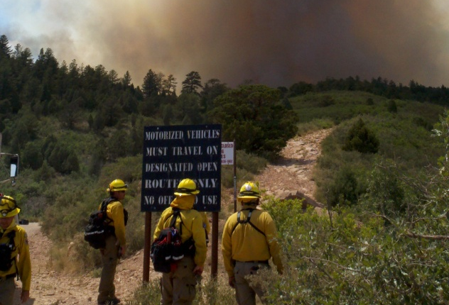
Fire Started: Saturday June 23, 2012
Notes:
The Waldo Canyon Fire burned approximately 18,247 acres within the foothills and mountains of the
Rampart Range immediately northwest of Colorado Springs, Colorado in El Paso County. The fire
perimeter in a general sense can be delineated by State Highway 24 on the southwest, Rampart Reservoir
and West Monument Creek on the north and the foothills (in and around Centennial Expressway) along the
east flank of the burned area.
Unfortunately, 346 private residences were destroyed in the fire. Fire ignition occurred on June 23, 2012,
and it was contained on July 10, 2012. The fire burned primarily Ponderosa Pine and mixed-conifer stands.
The burn area covers multiple tributaries to the Fountain Creek and Monument Creek watersheds that are
tributary to the Arkansas River drainage.

Slide 3
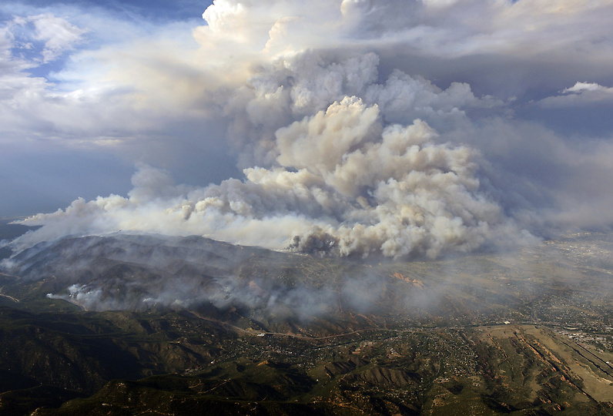
Notes:
On Tuesday, June 26th , the winds intensified and changed direction to be out of the west. The fire responds by more than tripling in size toward Colorado Springs.

Slide 4
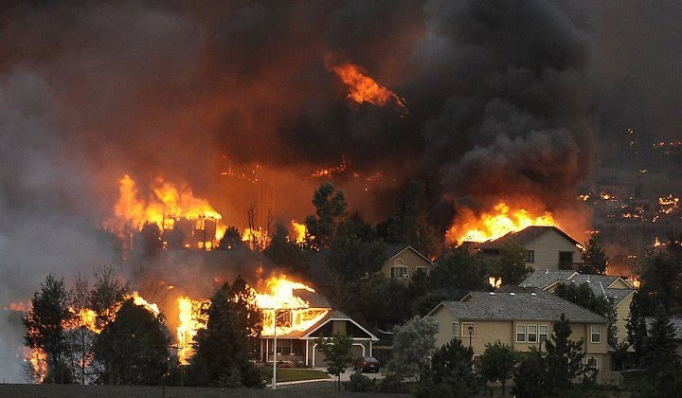
Notes:
On Tuesday, June 26th, the fire attacked western neighborhoods in Colorado Springs burning 346 homes and killing two people becoming the most destructive wildfire in the state of Colorado.

Slide 5
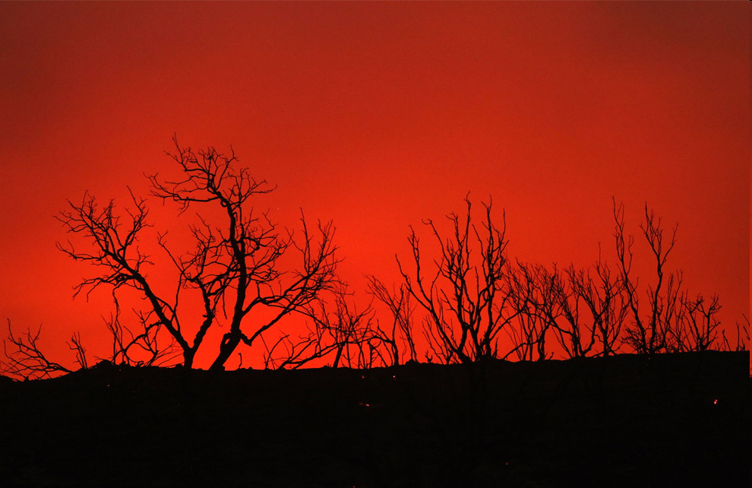
Fire Contained: Tuesday July 10, 2012
Total Acres Burned: 18,247
Land Ownership
National Forest – 14,422 acres
Department of Defense – 147 acres
Private – 3,678 acres
Notes:
The Waldo Canyon Fire burned approximately 18,247 acres within the foothills and mountains of the
Rampart Range immediately northwest of Colorado Springs, Colorado in El Paso County. The fire
perimeter in a general sense can be delineated by State Highway 24 on the southwest, Rampart Reservoir
and West Monument Creek on the north and the foothills (in and around Centennial Expressway) along the
east flank of the burned area.
Unfortunately, 346 private residences were destroyed in the fire. Fire ignition occurred on June 23, 2012,
and it was contained on July 10, 2012. The fire burned primarily Ponderosa Pine and mixed-conifer stands.
The burn area covers multiple tributaries to the Fountain Creek and Monument Creek watersheds that are
tributary to the Arkansas River drainage.

Slide 6
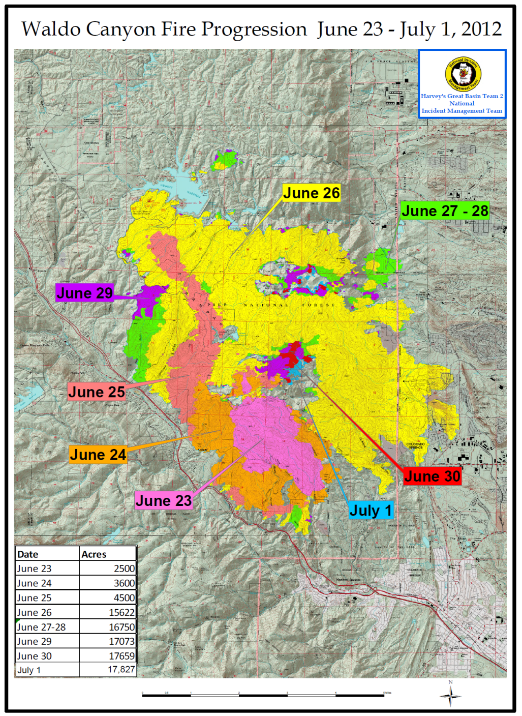
Fire Progression
June 23 – 2500 acres
June 24 – 3600 acres
June 25 – 4500 acres
June 26 – 15622 acres
June 27-28 – 16750 acres
June 29 – 17073 acres
June 30 – 17650 acres
July 1-6 – 18247 acres
Notes:
Lesson #1 – Wildfire progression in general is variable and can be unpredictable and can become catastrophic in the the wildland-urban interface (WUI).

Slide 7
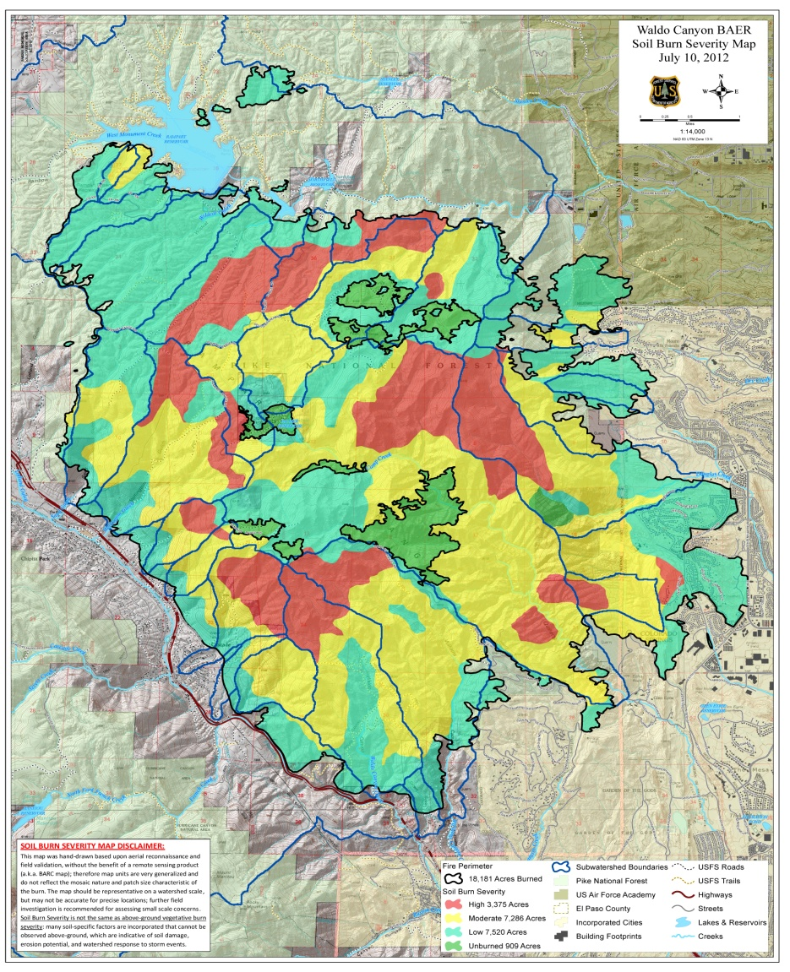
United States Forest Service
Burned Area Emergency Response
Soil Burn Severity
Low – 7,856 acres
Moderate – 7,286 acres
High – 3,375 acres
Unburned – 842 acres

Slide 8
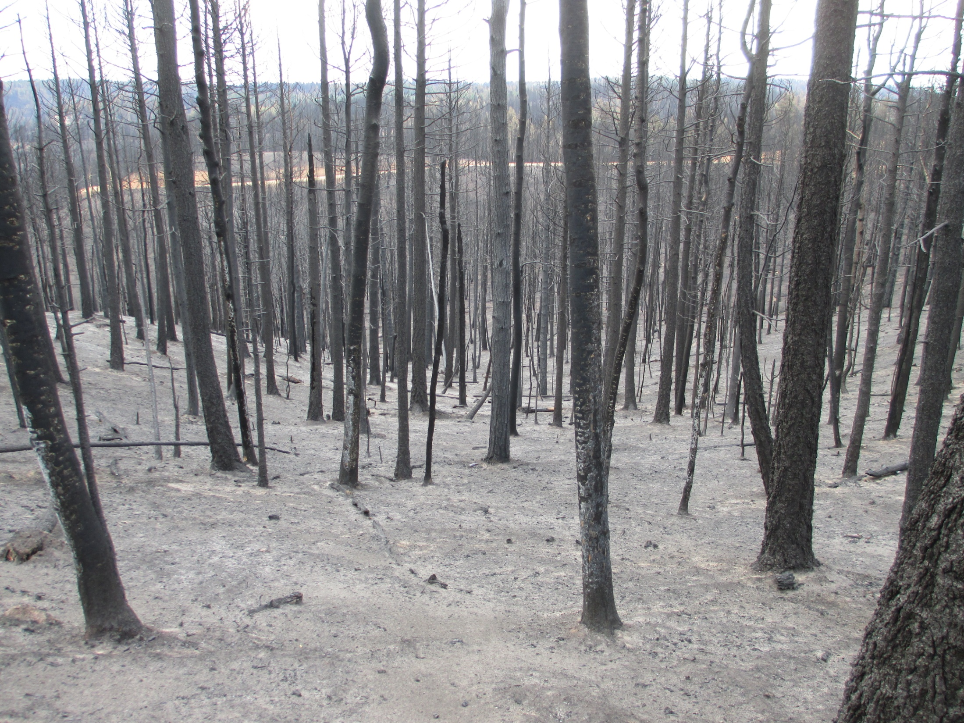
High Soil Burn Severity

Slide 9
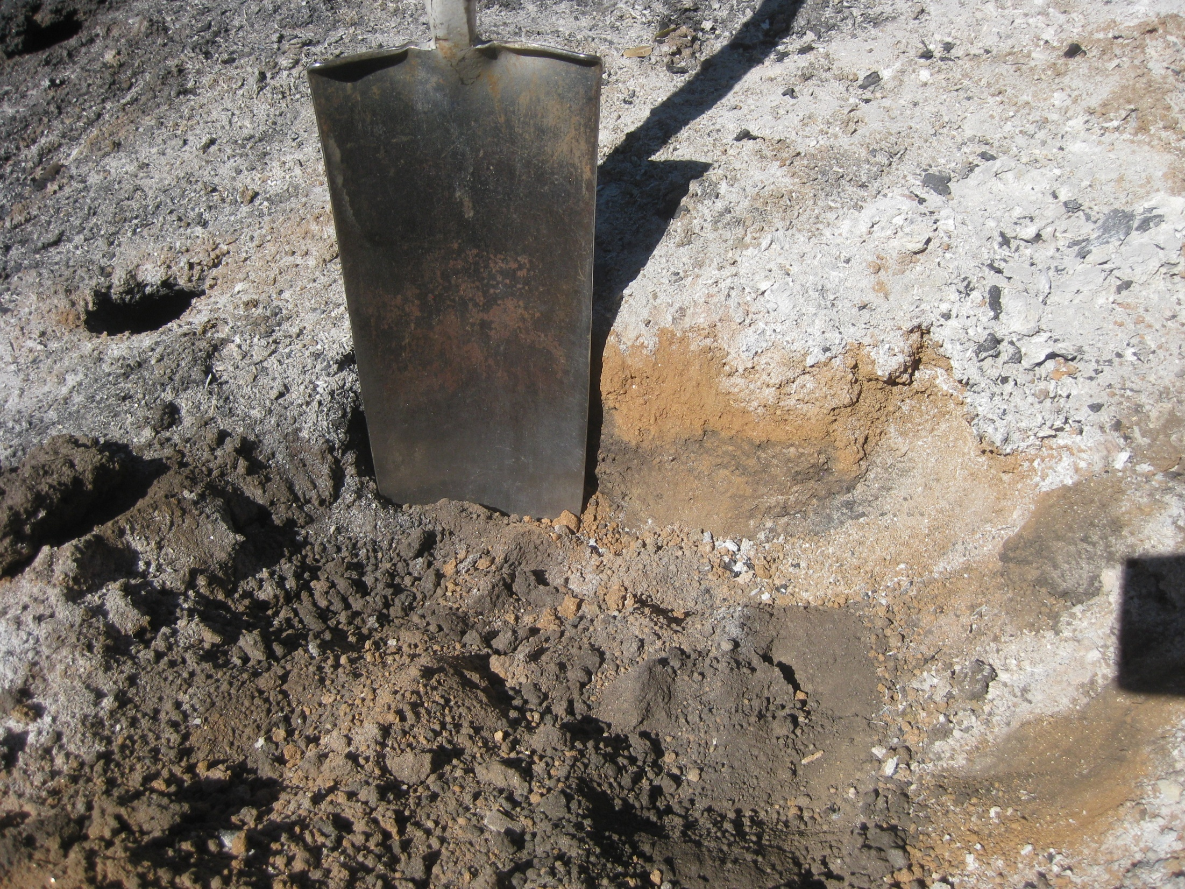
High – 3,375 acres (19%)

Slide 10
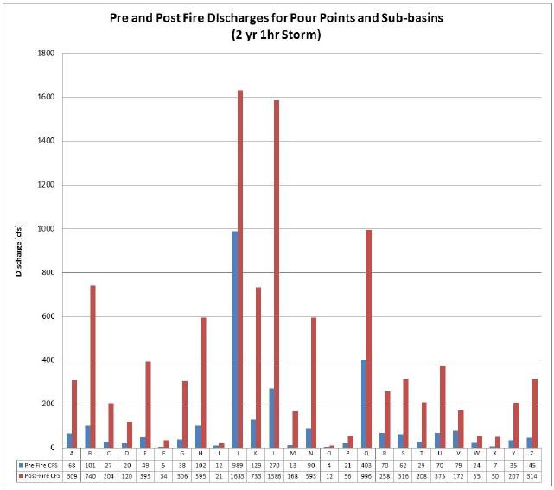
USFS Post-fire Hydrology
Notes:
More water is problematic when most of it comes off so quickly!
Increases in 2-year storm flows.
ID watersheds:
Douglas Creek
L - Camp Cr (Queens Canyon)(8.07mi2); pre-fire: 270.3 c.f.s.; post-fire: 1586.3 c.f.s.
486.8%
5.9x
J - Fountain Creek above Manitou Spgs*(68.3mi2); pre-fire: 988.7 c.f.s.; post-fire: 1632.7 c.f.s.; 65.1% increase; magnitude of increase 1.7x

Slide 11
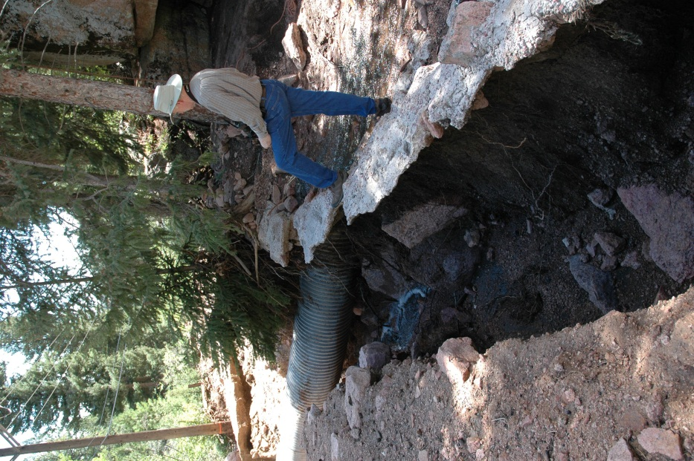
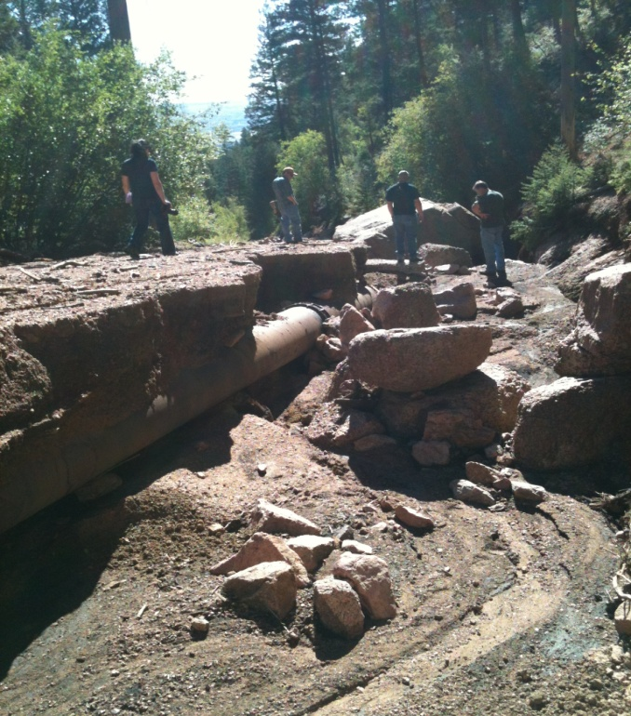
Post-fire Erosion
After the Waldo Canyon Fire
Increased flows erode
hill slopes, roads &
stream channels

Slide 12
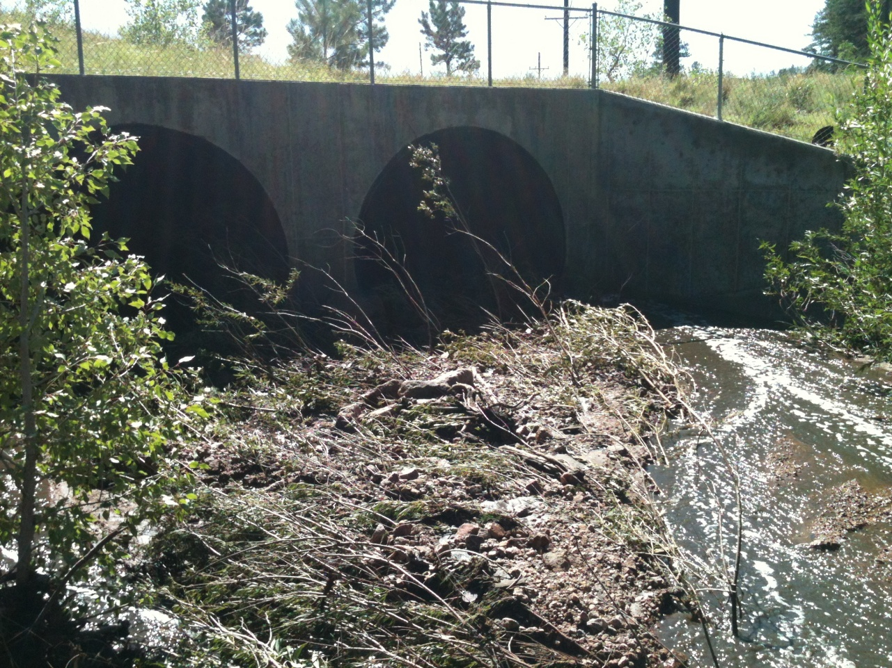
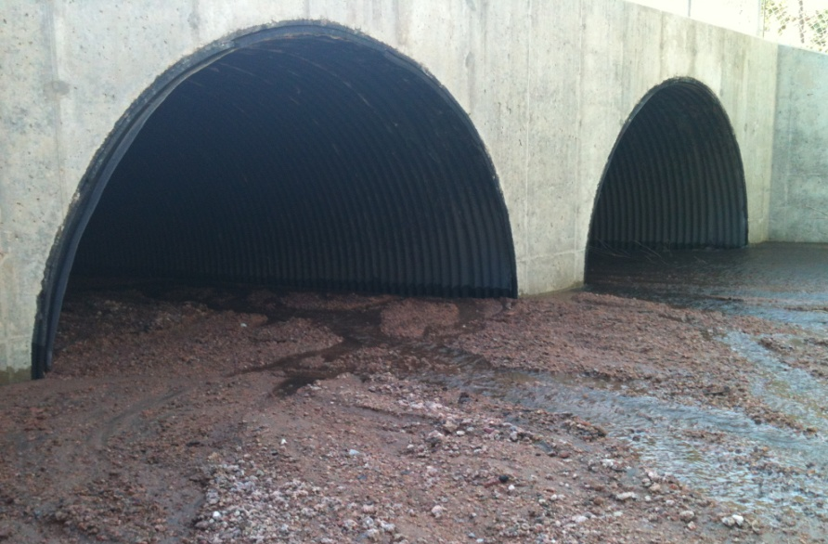
Sedimentation Impacts
Waldo Canyon Fire
Culverts
Creek Crossings

Slide 13
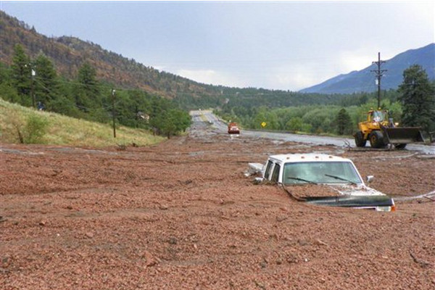
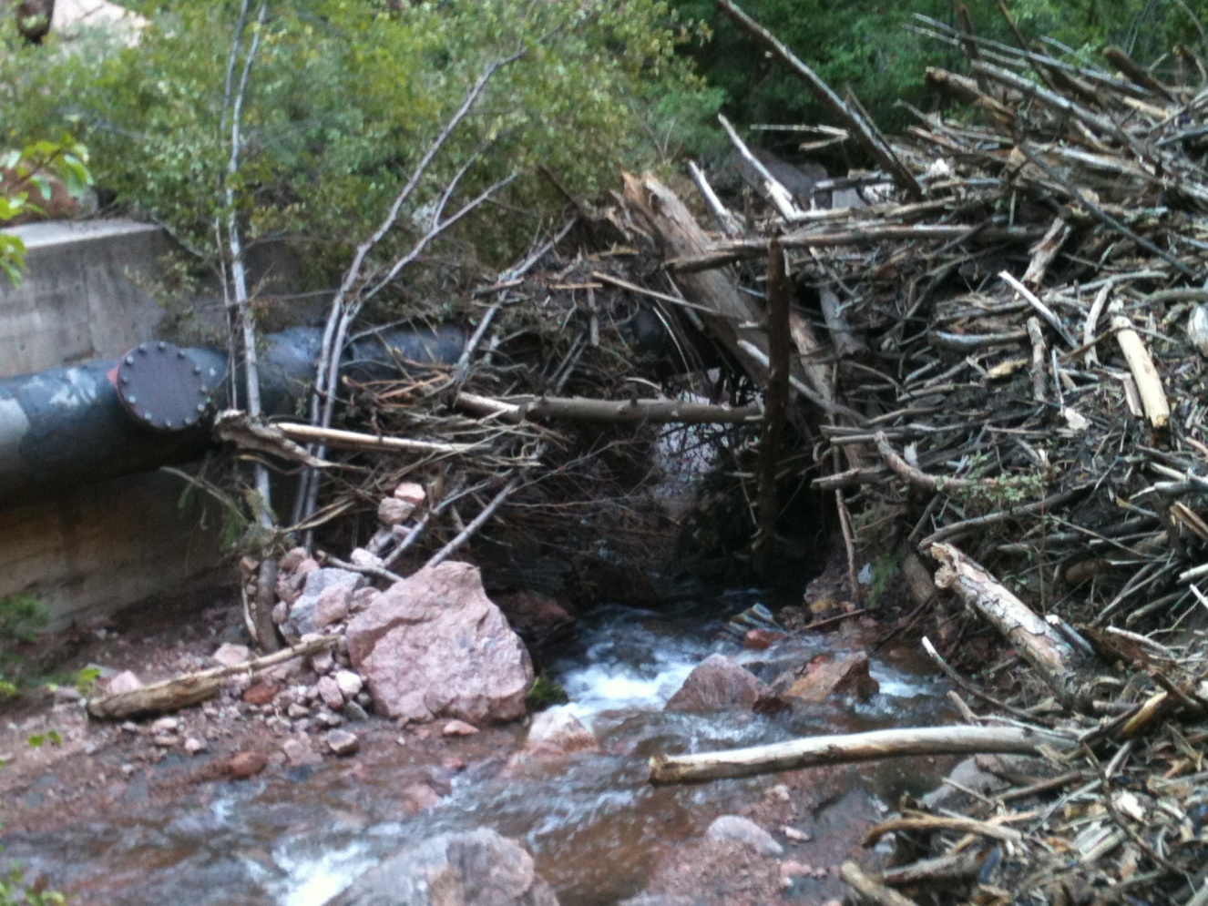
Debris Flows
Increased probability
Significant volumes
Notes:
On average, there is a 350-450% increase in post-fire flows over pre-fire flows. In some drainages, increases in flood flows for smaller, more frequent storms is more than 7 fold.

Slide 14
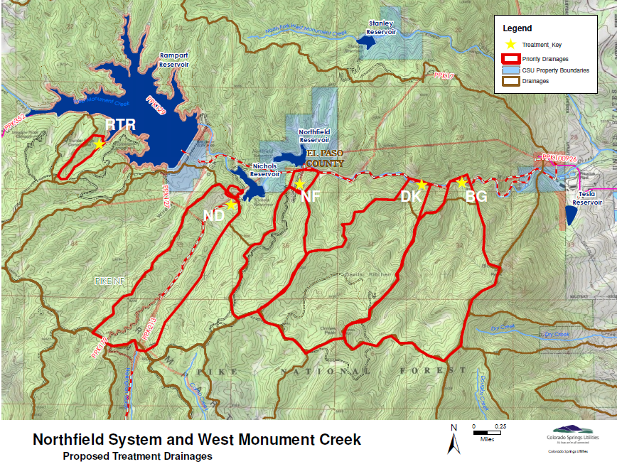
After the Waldo Canyon Fire
July 30th Storm & Flood
Notes:
NF = #5
DK = #10
BG = #6
Storm event (at Rampart Reservoir): 1.67 in

Slide 15
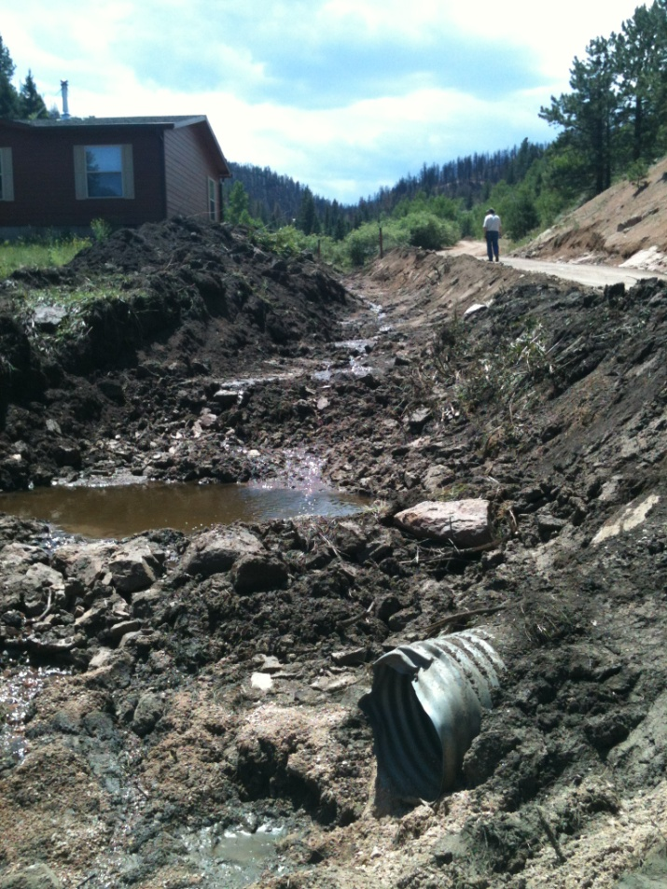
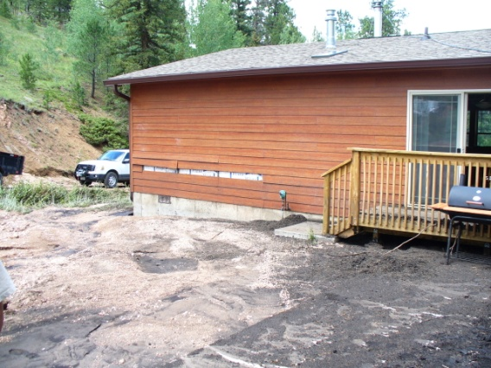
Northfield Flood Damage
After the Waldo Canyon Fire
Caretaker’s House
Access Road
Notes:
Northfield – T (#5): pre-fire 2yr = 29.3 c.f.s.; post-fire = 207.7 c.f.s.
On Monday, July 30th between 6 and 8 p.m., the Northfield Water System was significantly impacted by post-fire flash flooding. The Northfield Water System, located within the drainage area of West Monument Creek (northern portion of the Waldo Canyon Fire burn area), includes Rampart, Nichols, and Northfield reservoirs, Stanley Canyon Tunnel, and the Pine Valley Pipeline. The Stanley Canyon Tunnel is the primary delivery system of water from Rampart Reservoir to the Pine Valley and McCullough Treatment plants, which typically supply between 75-80% of the City’s water supply. The Stanley Canyon tunnel was not affected by this flood event, and impacts to Rampart Reservoir appear to be relatively minimal. However, lower in the West Monument Creek drainage, the Pine Valley Pipeline, a secondary yet critical delivery system to the Pine Valley and McCullough Treatment plants, was impacted by a wall of water and debris that flowed at approximately 800 cubic feet per second. This post-fire flood event, generated by a relatively low-severity storm, washed out significant portions of the road that covered the Pine Valley Pipeline and compromised appurtenant infrastructure. The pipeline was damaged in some areas, and exposed and undermined in other areas. Staff has been rapidly assessing the condition of the pipeline and other infrastructure, as well as the ability to backfill washed-out areas with suitable material that will protect the pipeline and not wash away causing additional problems in future post-fire storm flood flow events. Additionally, work on the hill-slopes and drainage channels upstream within the West Monument Creek watershed is also being pursued, although much of this land is within the Pike National Forest and managed by the United States Forest Service.

Slide 16
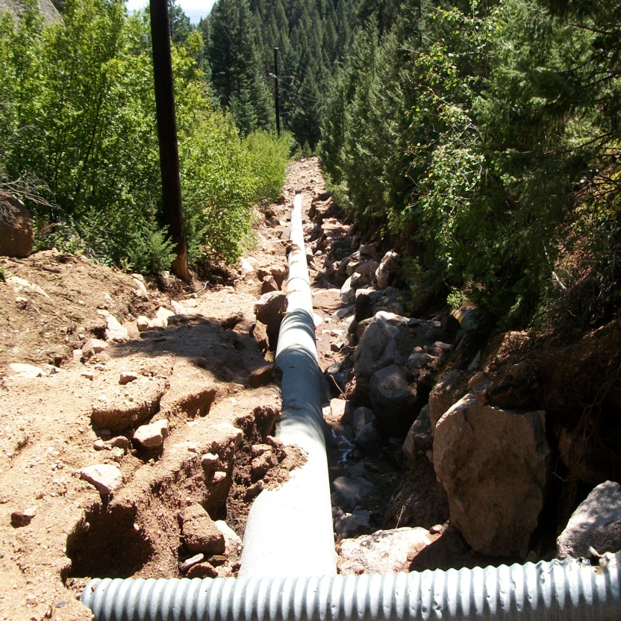
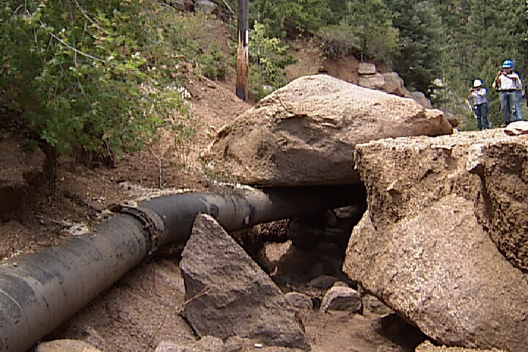
Devil’s Kitchen Flood Damage
After the Waldo Canyon Fire
Northfield Pipeline
Pine Valley Pipeline
Notes:
Devils Kitchen – S (#10): pre-fire = 61.6 c.f.s.; post-fire = 316.4 c.f.s.

Slide 17
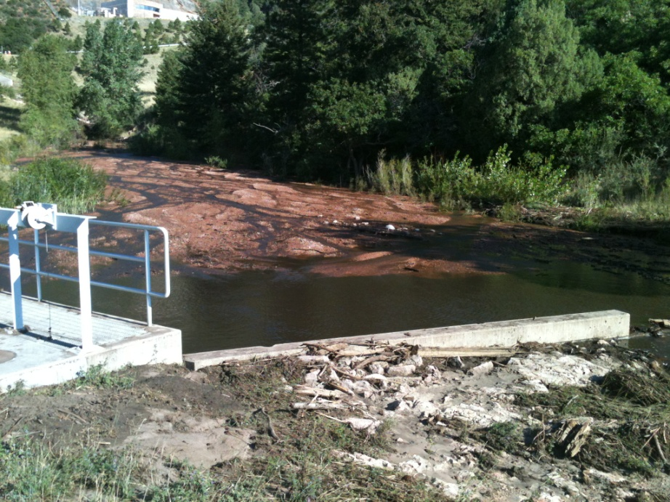
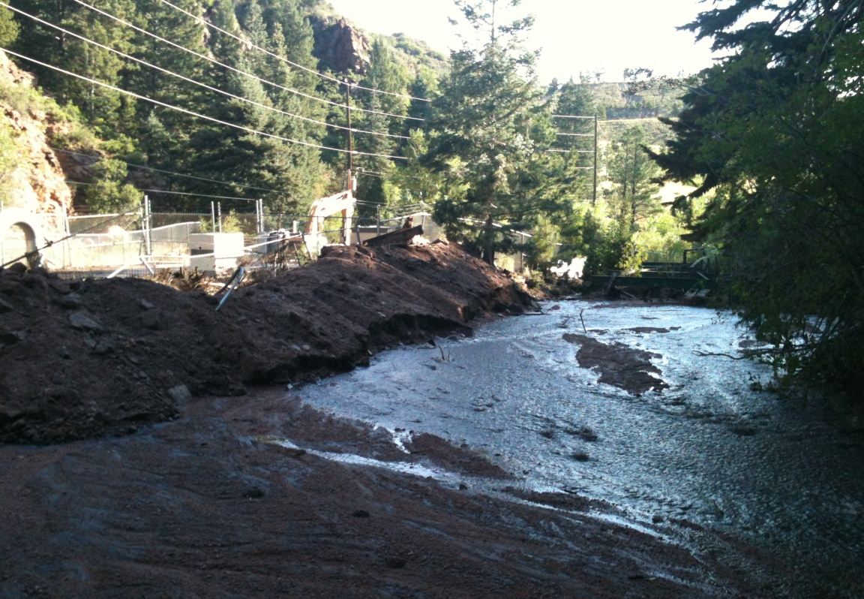
Pine Valley/McCullough Damage
After the Waldo Canyon Fire
Flood & debris flows
Erosion & sedimentation
Pipeline vaults
Diversion dam
Notes:
W. Monument Creek above Filtration Plant – Q: pre-fire = 403.4; post-fire = 996.1 c.f.s. (146.9% increase)

Slide 18
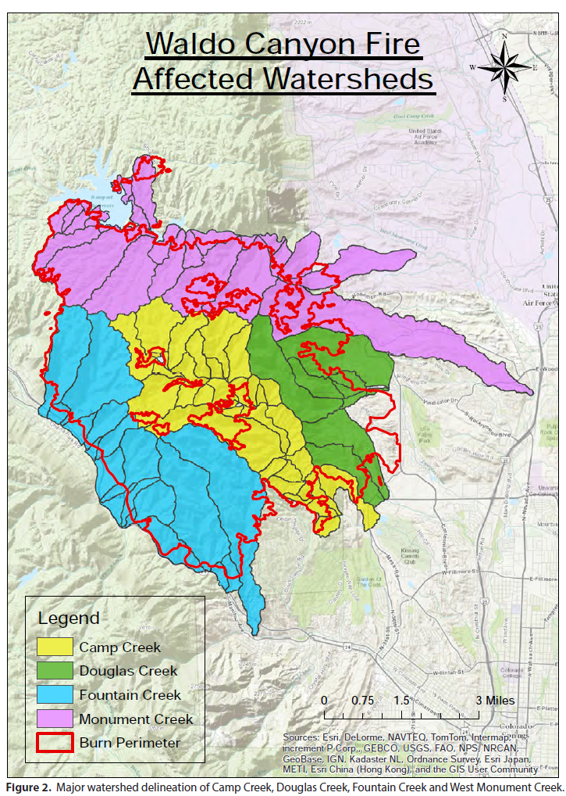
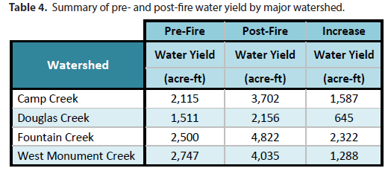
Watershed Assessment of River Stability and Sediment Supply – Rosgen, et al.
WARSSS – Post-fire Water Yield
Total increased water yield = 5,842 AF/yr (66% increase)
Notes:
Intro WARSSS.
ID 4 main watersheds.
Explain increase in water yield.
Pre-fire total: 8,873 AF/yr
Post-fire: 14,715 AF/yr

Slide 19
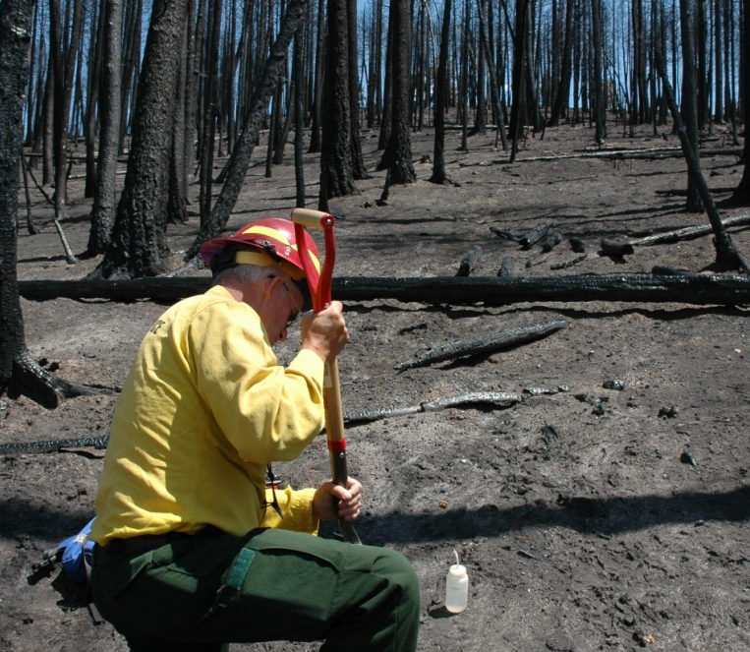
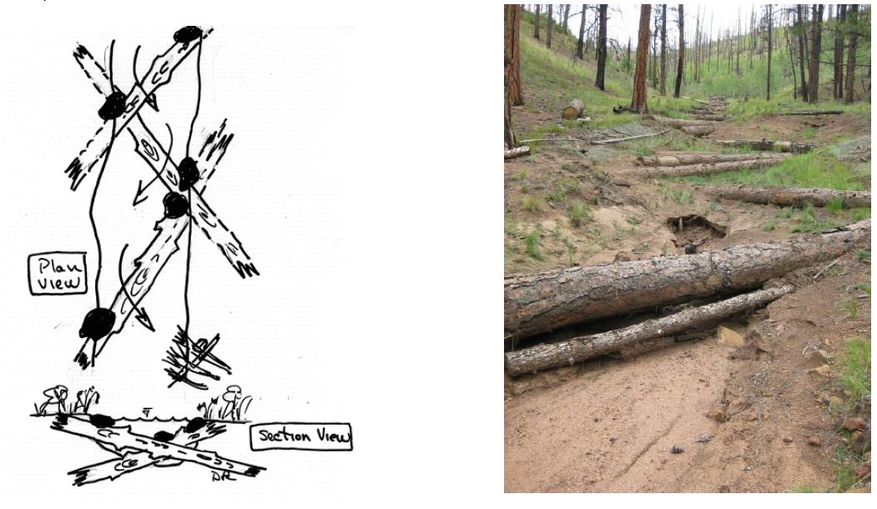
Protecting Water System =
Flood Mitigation + Watershed Stabilization
After the Waldo Canyon Fire
Partnered with
Experienced Agencies
Obtained Approvals for
Work on US Forest Lands
Implement Emergency Protections Immediately
Assess & Repair Infrastructure
Stabilize Watersheds
Pursue Funding

Slide 20
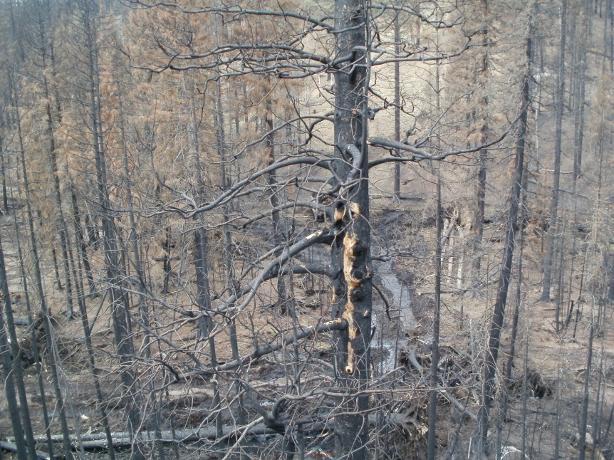
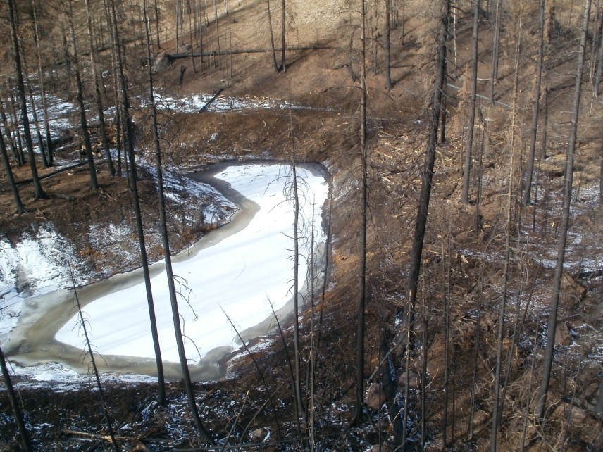
Waldo Canyon Fire Remediation and Recovery Initiative
Sediment Detention Basins
Before
After
Notes:
Sediment basin one is the largest and farthest south in the drainage.
It captures flows from two 2nd order channels.

Slide 21
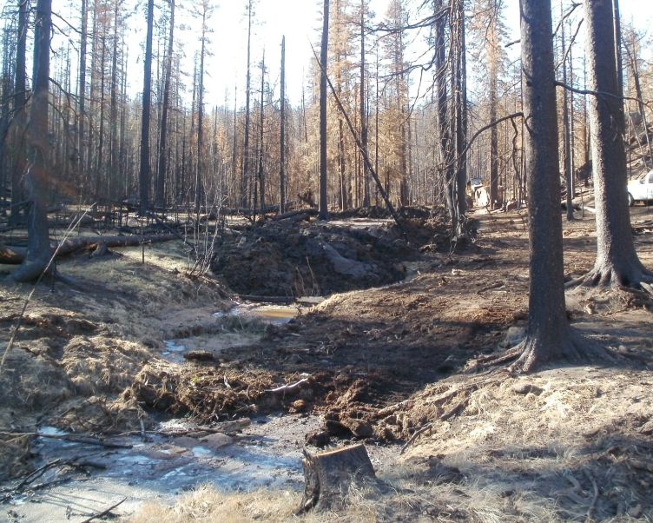
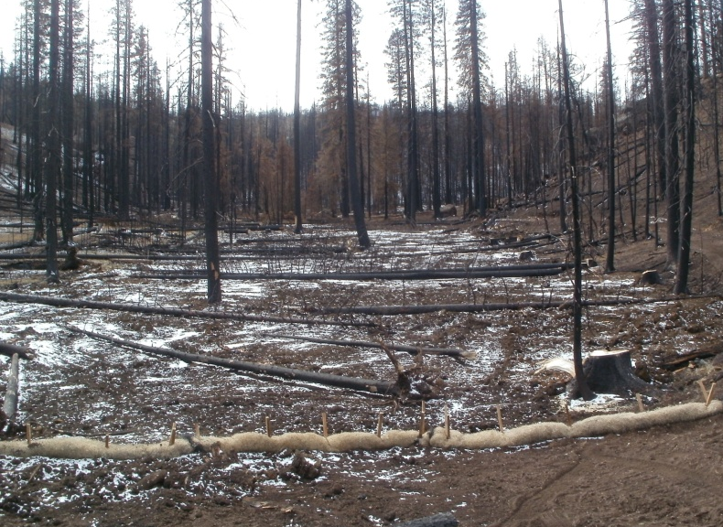
Waldo Canyon Fire Remediation and Recovery Initiative
Filling and Silling
Notes:
The log is then buried just below the surface to prevent head-cuts from forming.

Slide 22
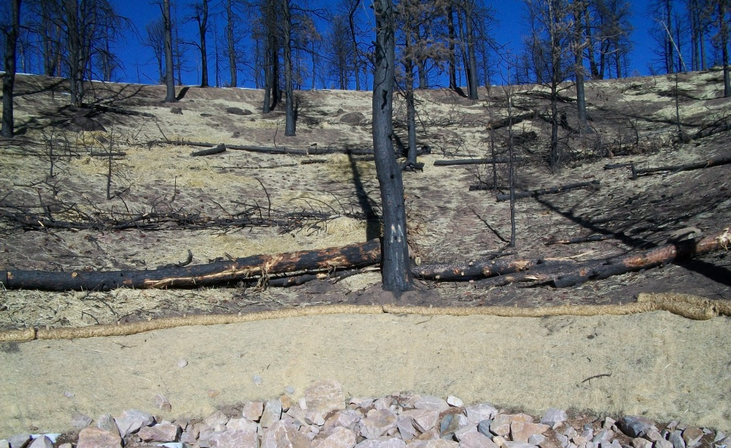
Waldo Canyon Fire Remediation and Recovery Initiative
Log Erosion Barriers
Notes:
Lastly, reveg work with willows will add the final bit of roughness to the channel bottom and help stabilize soils

Slide 23
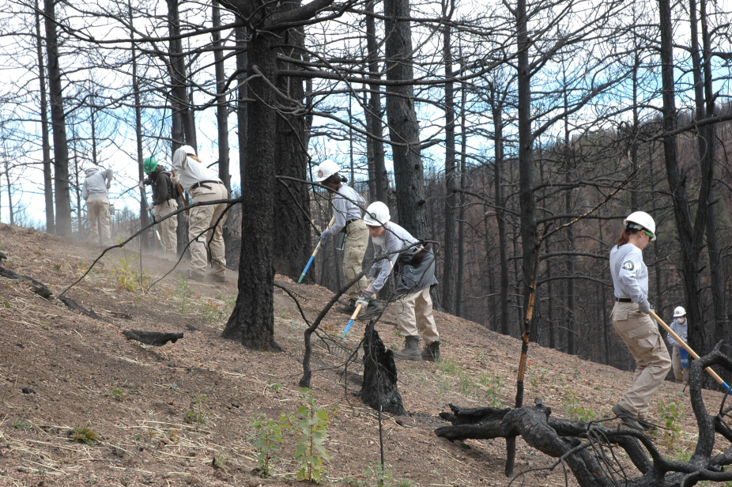
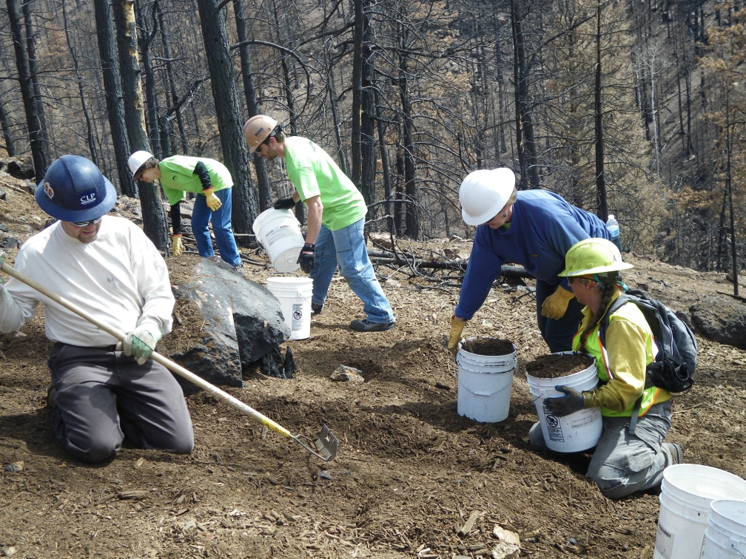
Hillslope Raking and Seeding
Waldo Canyon Fire Remediation and Recovery Initiative
Coalition for the Upper South Platte
Colorado Springs Utilities Volunteers
Notes:
CUSP completed 24 acres of raking and seeding, Approx. 7 acres of contour erosion control, 63 Volunteers or 598.5 volunteer hours, Cost to date: $ 126k
April 6th CFF – 1-12 person crews installed 40 log erosion barriers, raked and seeded Bio-Solids Compost.

Slide 24
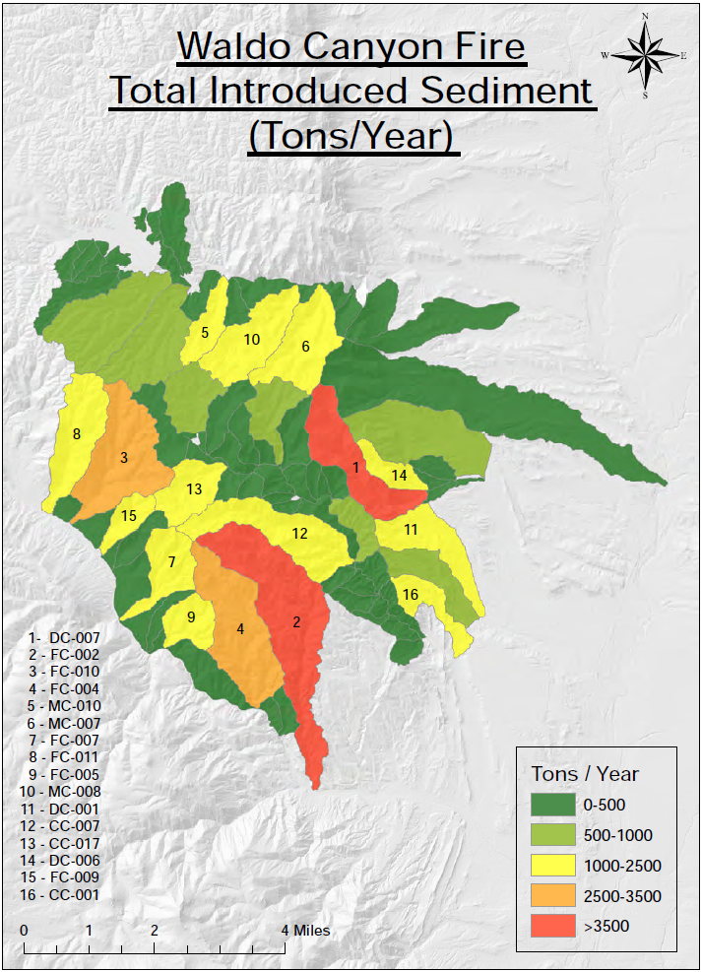
Watershed Assessment of River Stability and Sediment Supply – Rosgen, et al.
WARSSS – Post-fire Introduced Sediment
Watershed | Tons/year
Camp Creek | 11,694
Douglas Creek | 10,401
Fountain Creek | 19,241
West Monument Creek | 10,144
Total introduced sediment = 51,480 tons/year

Slide 25
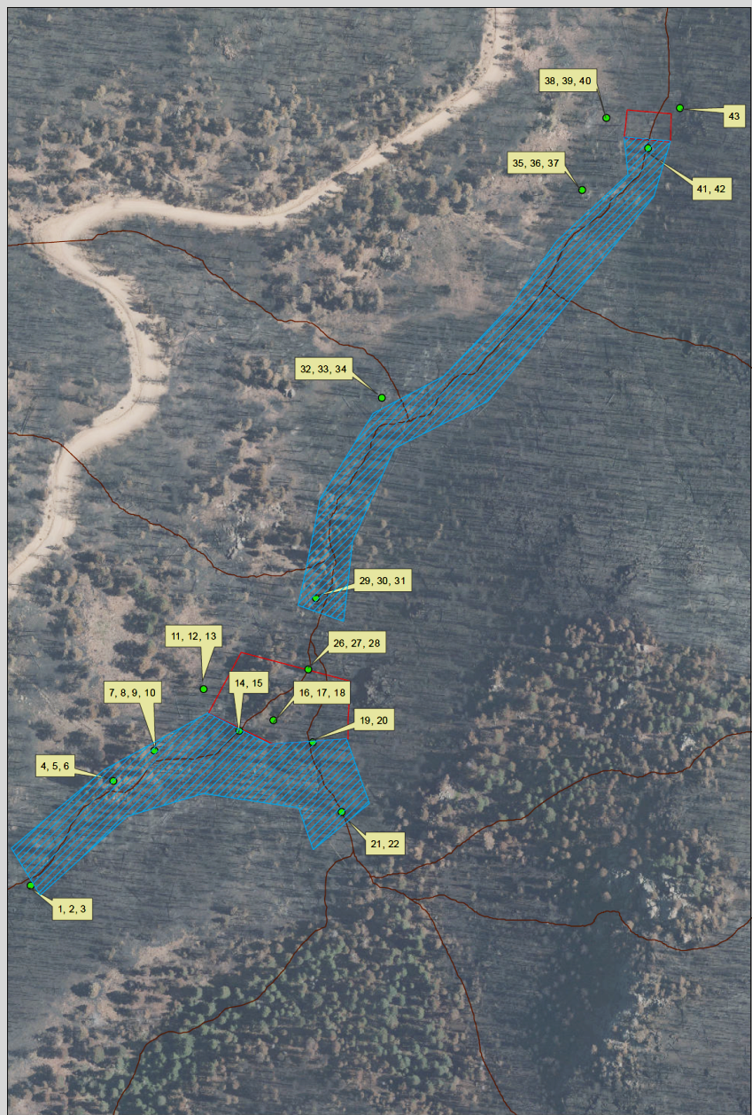
New “Asset” Management
Notes:
Two Sedimentation Basins (Approximately 7000 cubic yard capacity) Outlined in Red
“Filling and Silling” drainages entering Basin 1 (Approximately 750 ft) Hashed Blue Area
“Filling and Silling” drainage between Basins 1 and 2 (Approximately 1200 ft) Hashed Blue Area
Contour logs where applicable
Cost to date: $189k

Slide 26
Other Actions:
After the Waldo Canyon Fire
Increased Forestry Management/
Pre-fire Mitigation Program
Increased CSU Wildland Fire Team
Size & Capacity
Participate in Regional Recovery Efforts
  Emergency Watershed Protection Funds
Regional Flash Flood Preparations
Cost accounting

Slide 27
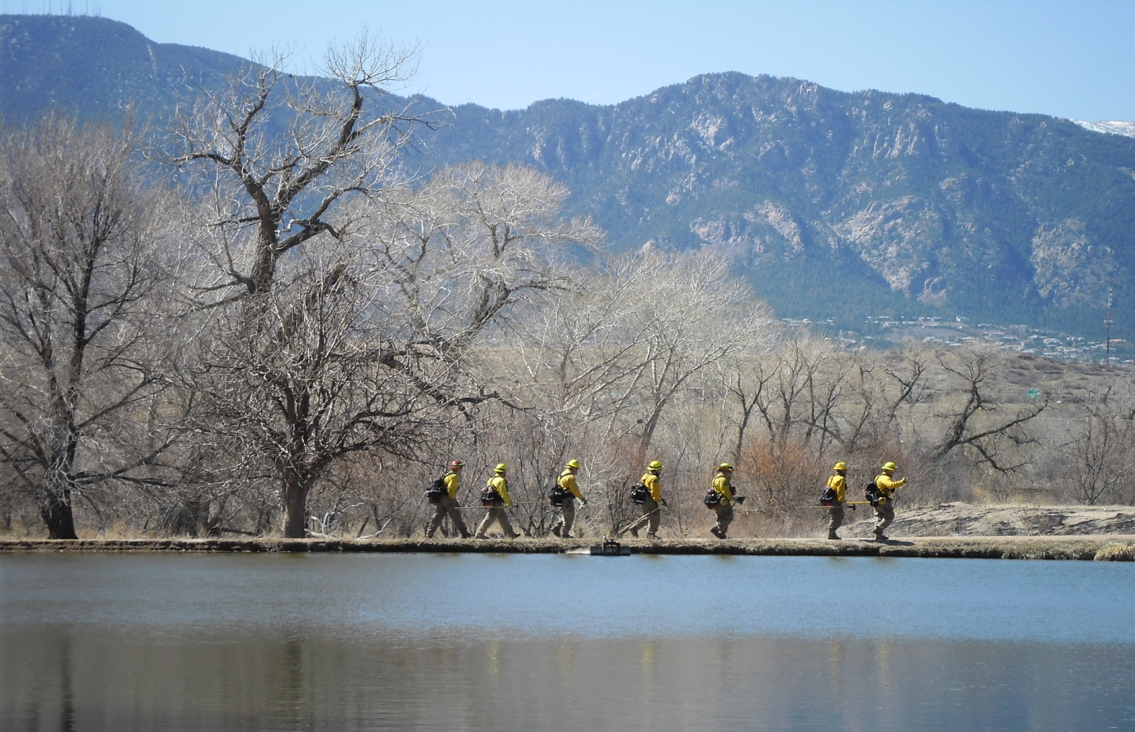
Questions?
After the Waldo Canyon Fire
Colorado Springs Utilities
Catamount Wildland Fire Team
“Making a Difference in the Community”

