Slide 1
“Hat Trick” Project
Black Forest
Colorado Springs, Colorado
October to December, 2013

Slide 2
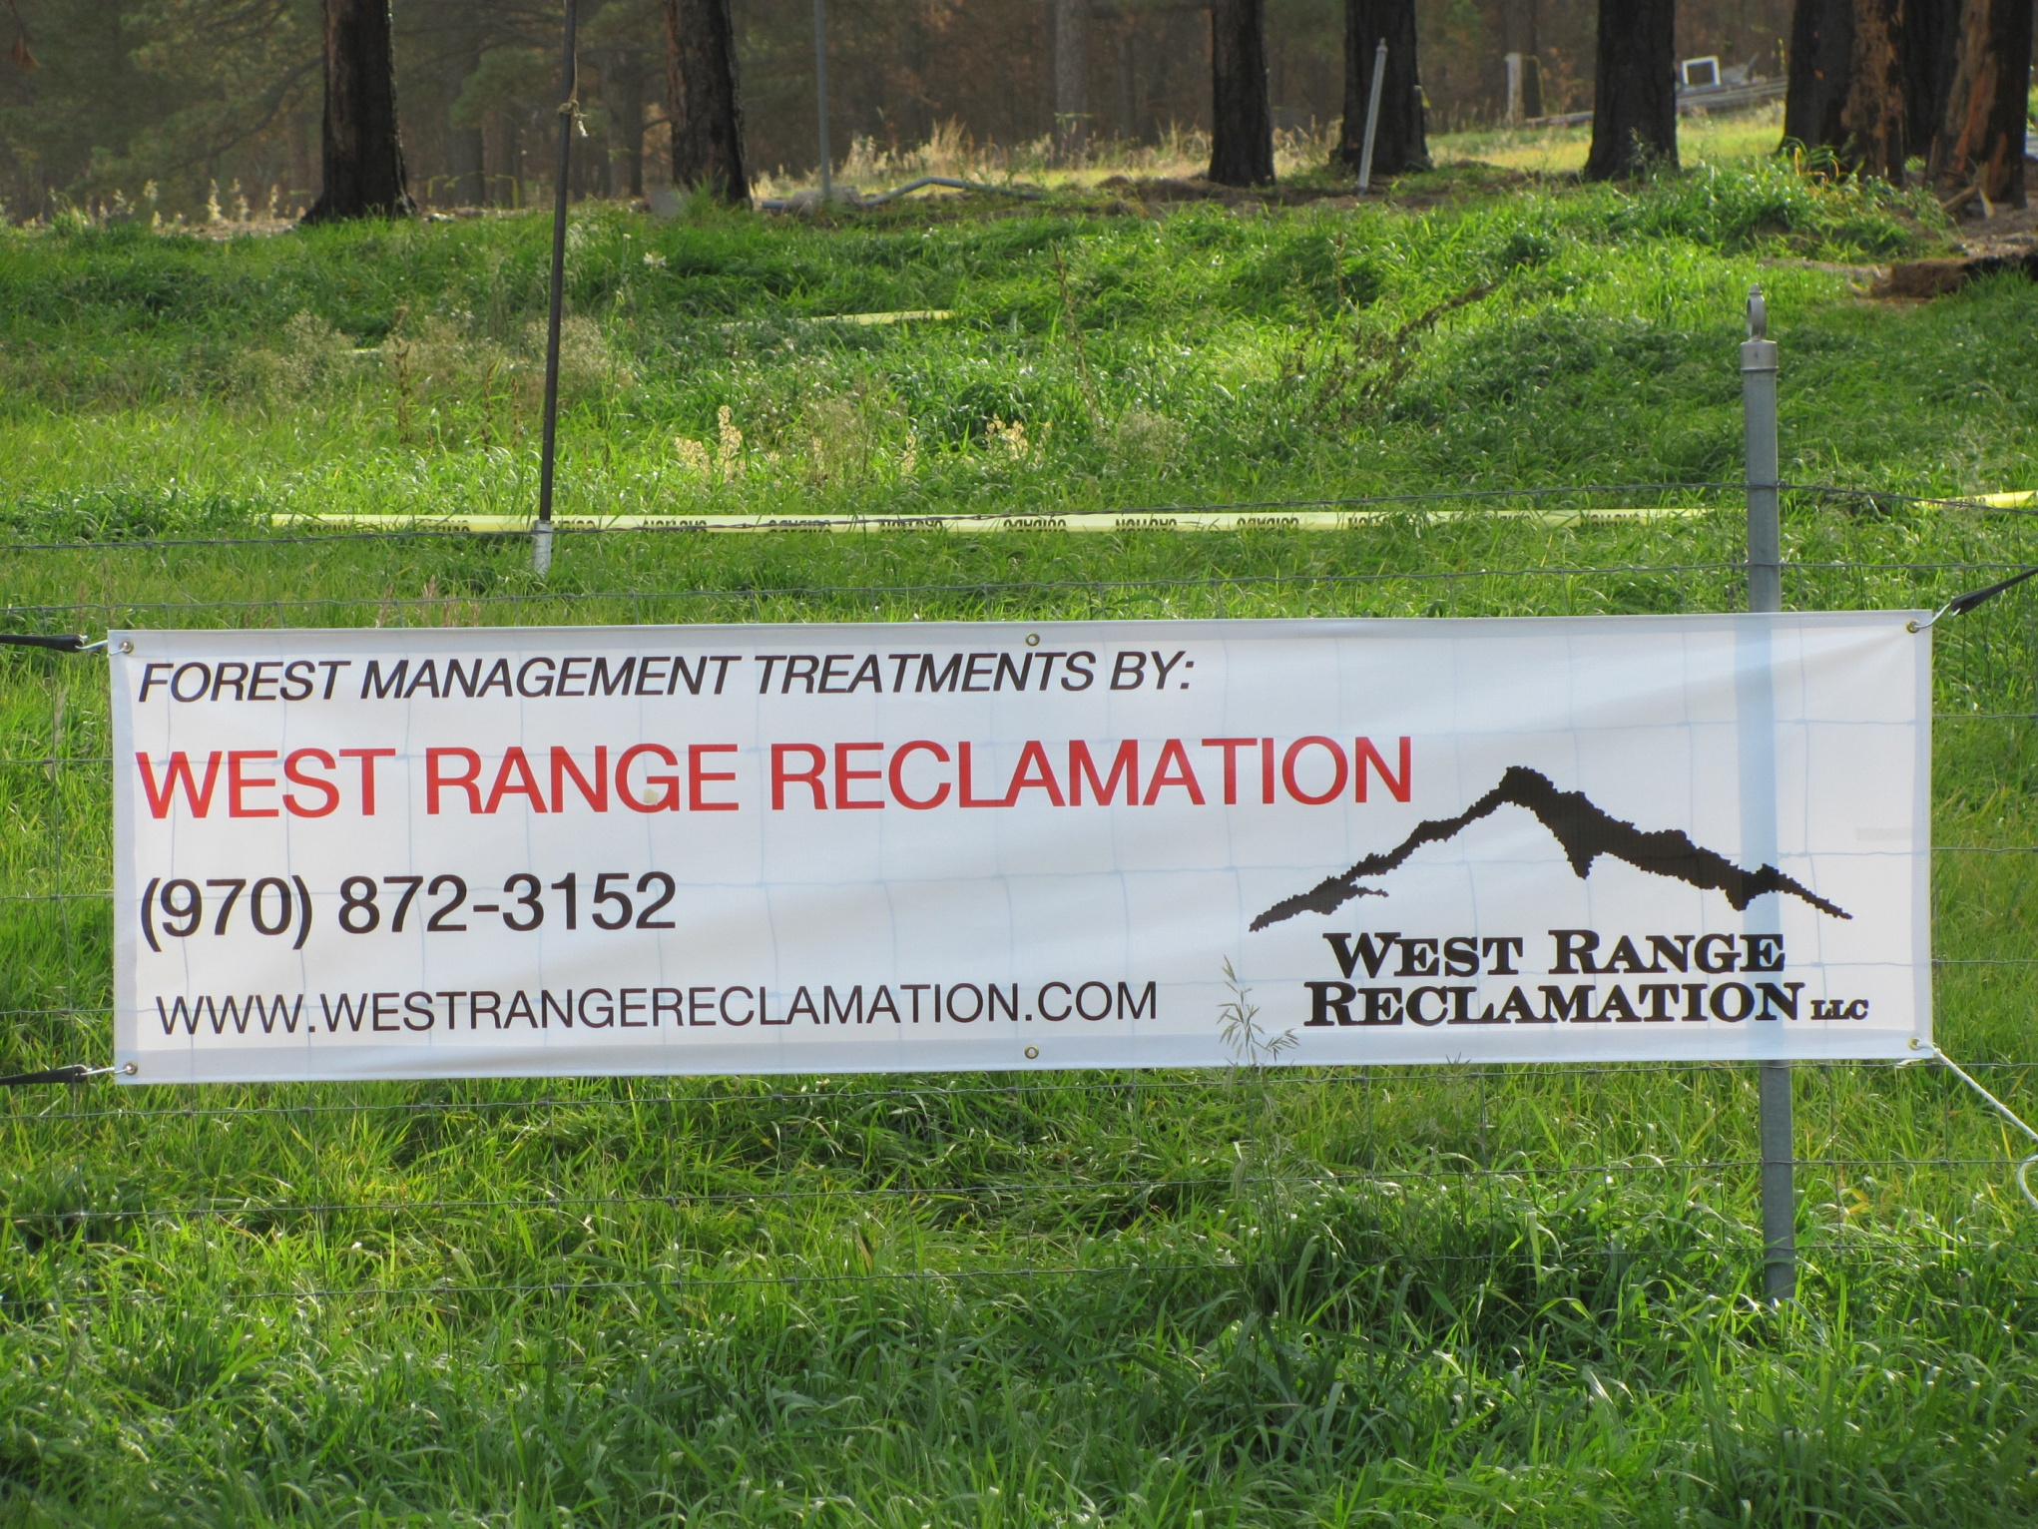

Slide 3
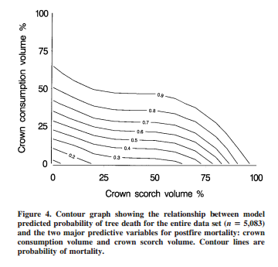
Best Predictors for Postfire Mortality of Ponderosa Pine Trees in the Intermountain West
Carolyn Hull Sieg, Joel D. McMillin, James F. Fowler, Kurt K. Allen, Jose´ F. Negron,
Linda L. Wadleigh, John A. Anhold, and Ken E. Gibson
0.9
0.8
0.7
0.6
0.5
0.4
0.2
0.3

Slide 4
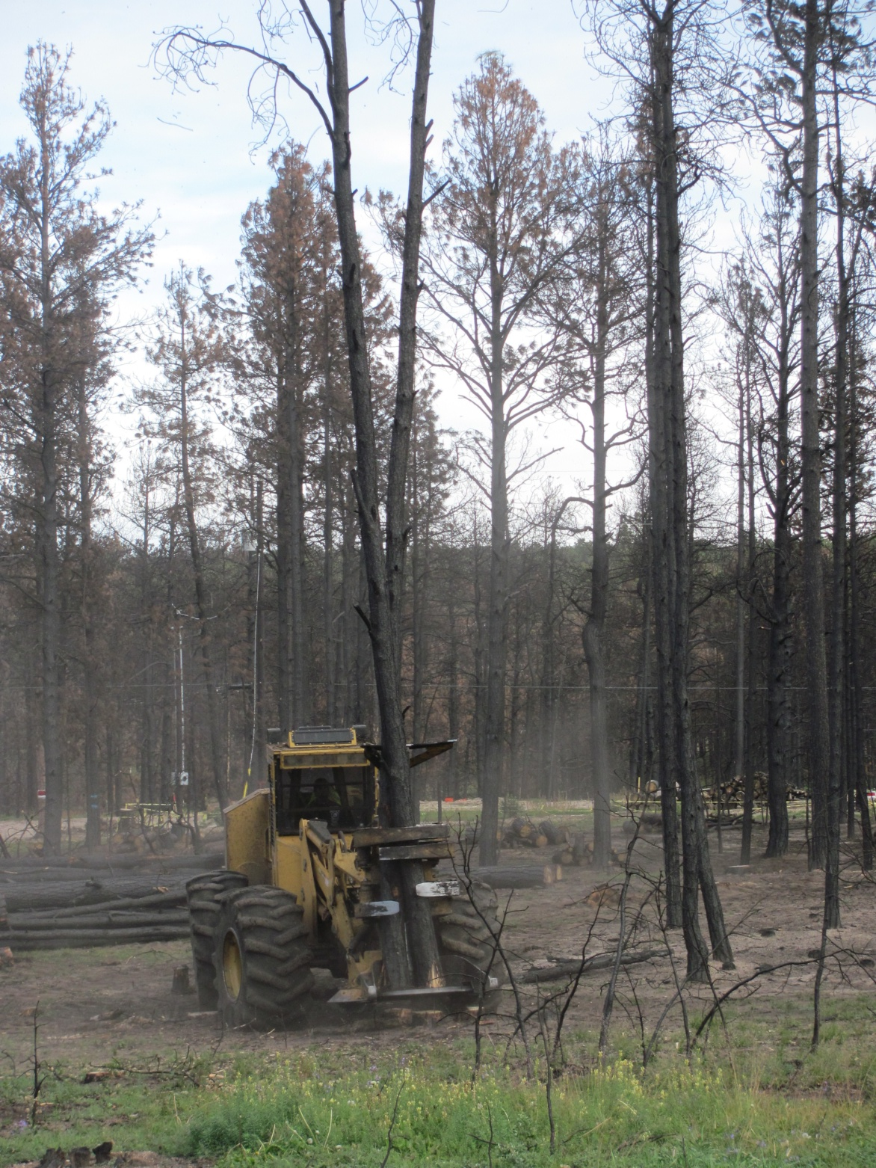
Following the 2013 Black Forest Fire,
a rubber-tired feller/buncher
cuts burned and damaged ponderosa pine.

Slide 5
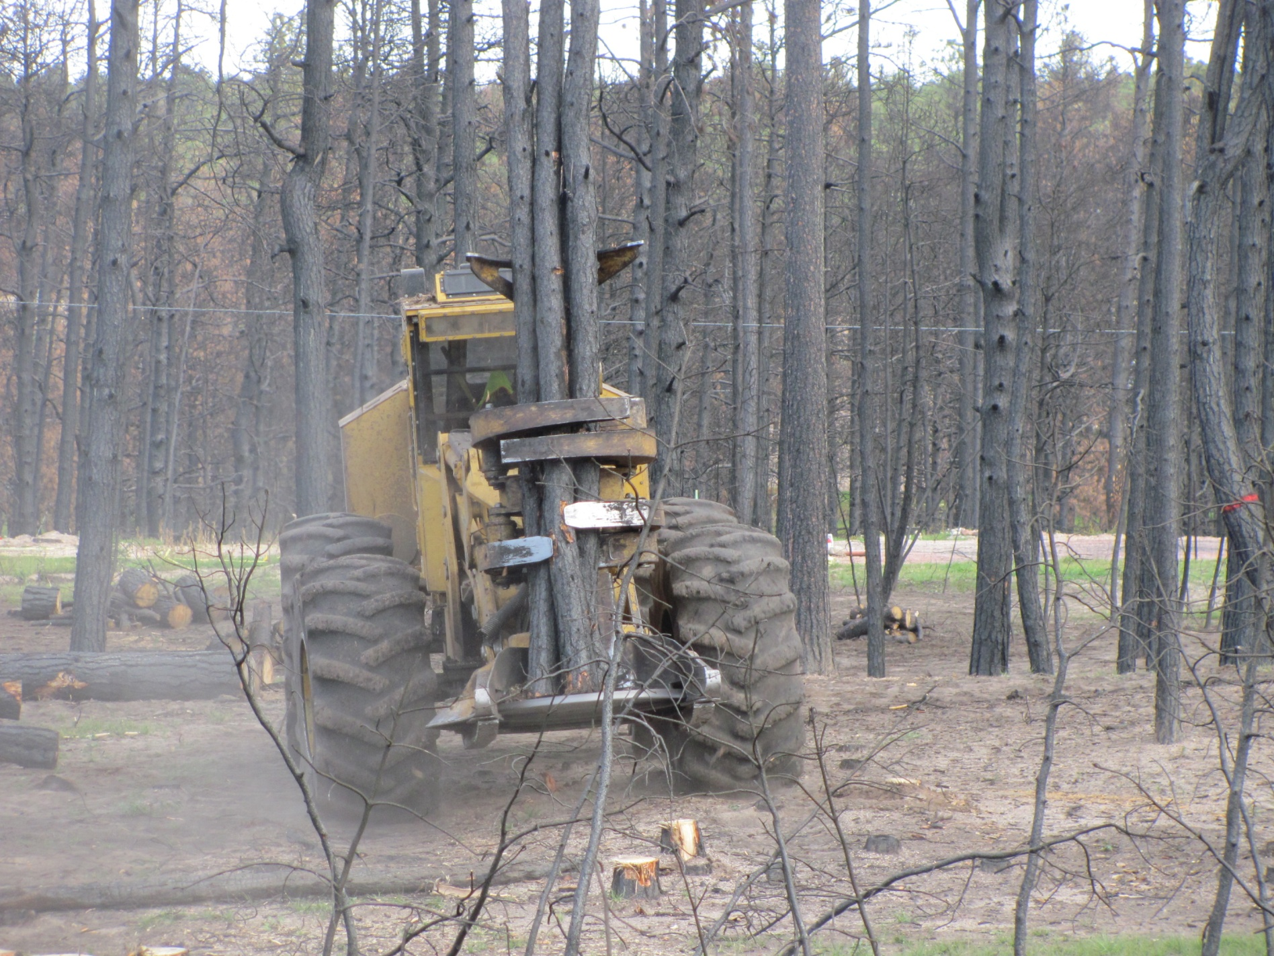
The machine can accumulate
several smaller trees at one time

Slide 6
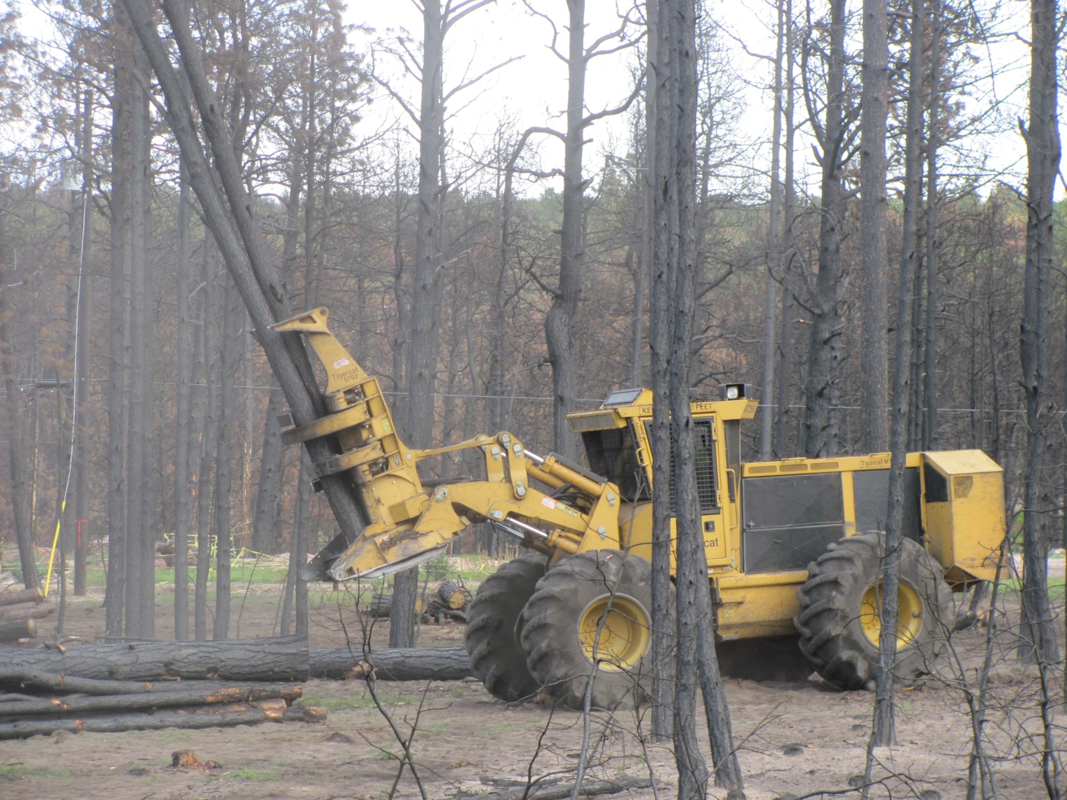
Felled trees are carried to where a bundle
is being built for removal by a skidder

Slide 7
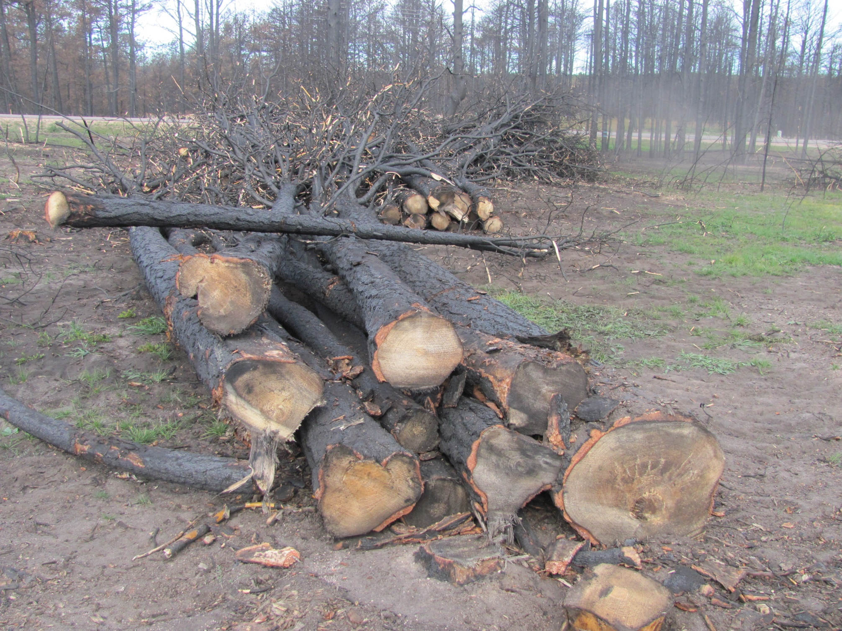
A skidder “bundle” ready to
be skidded to the landing

Slide 8
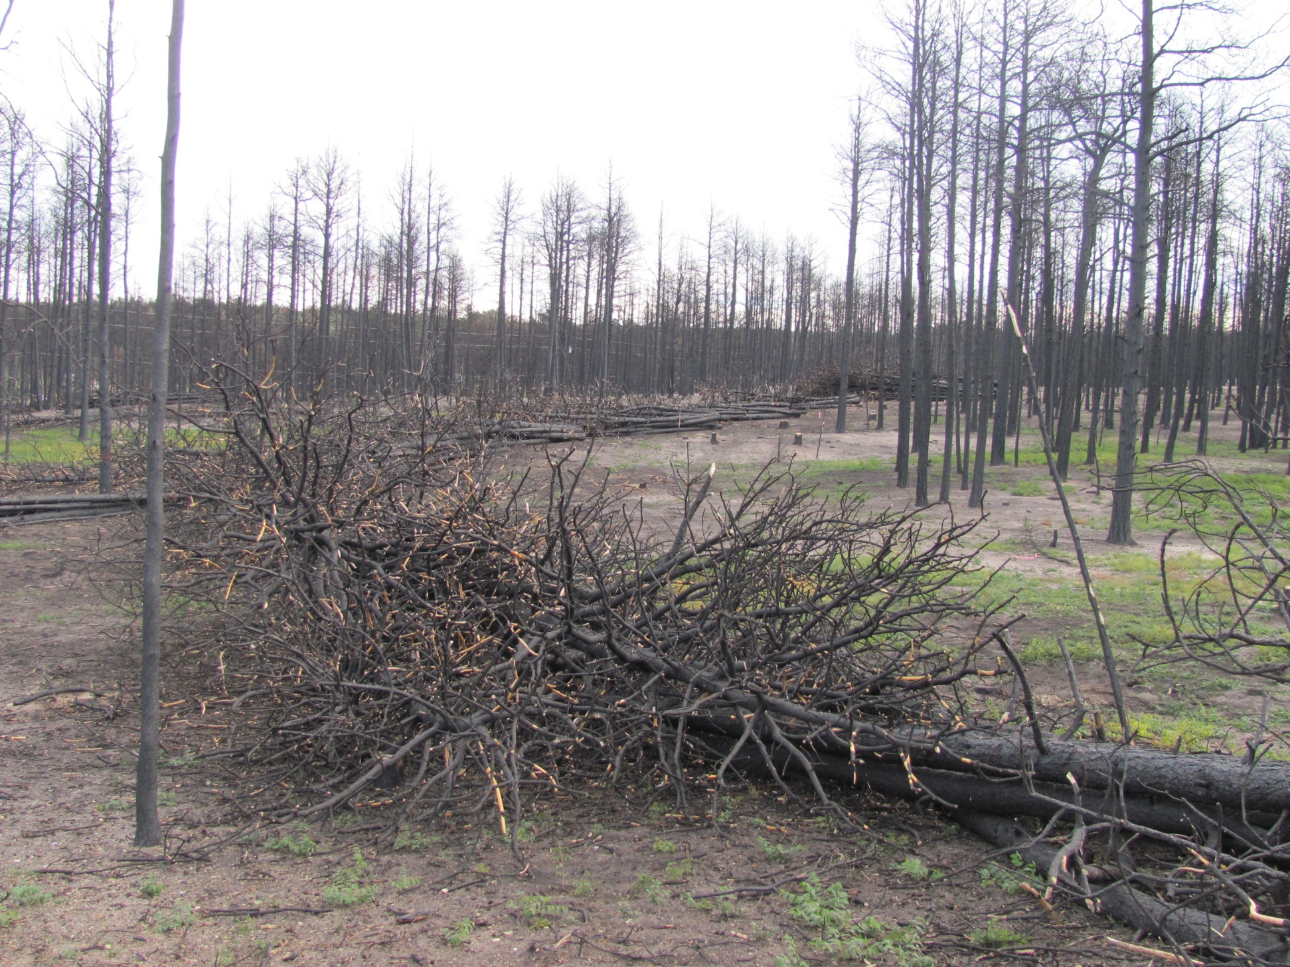
Trees felled and bunched along temporary road corridor
Maggie Adam’s Property

Slide 9
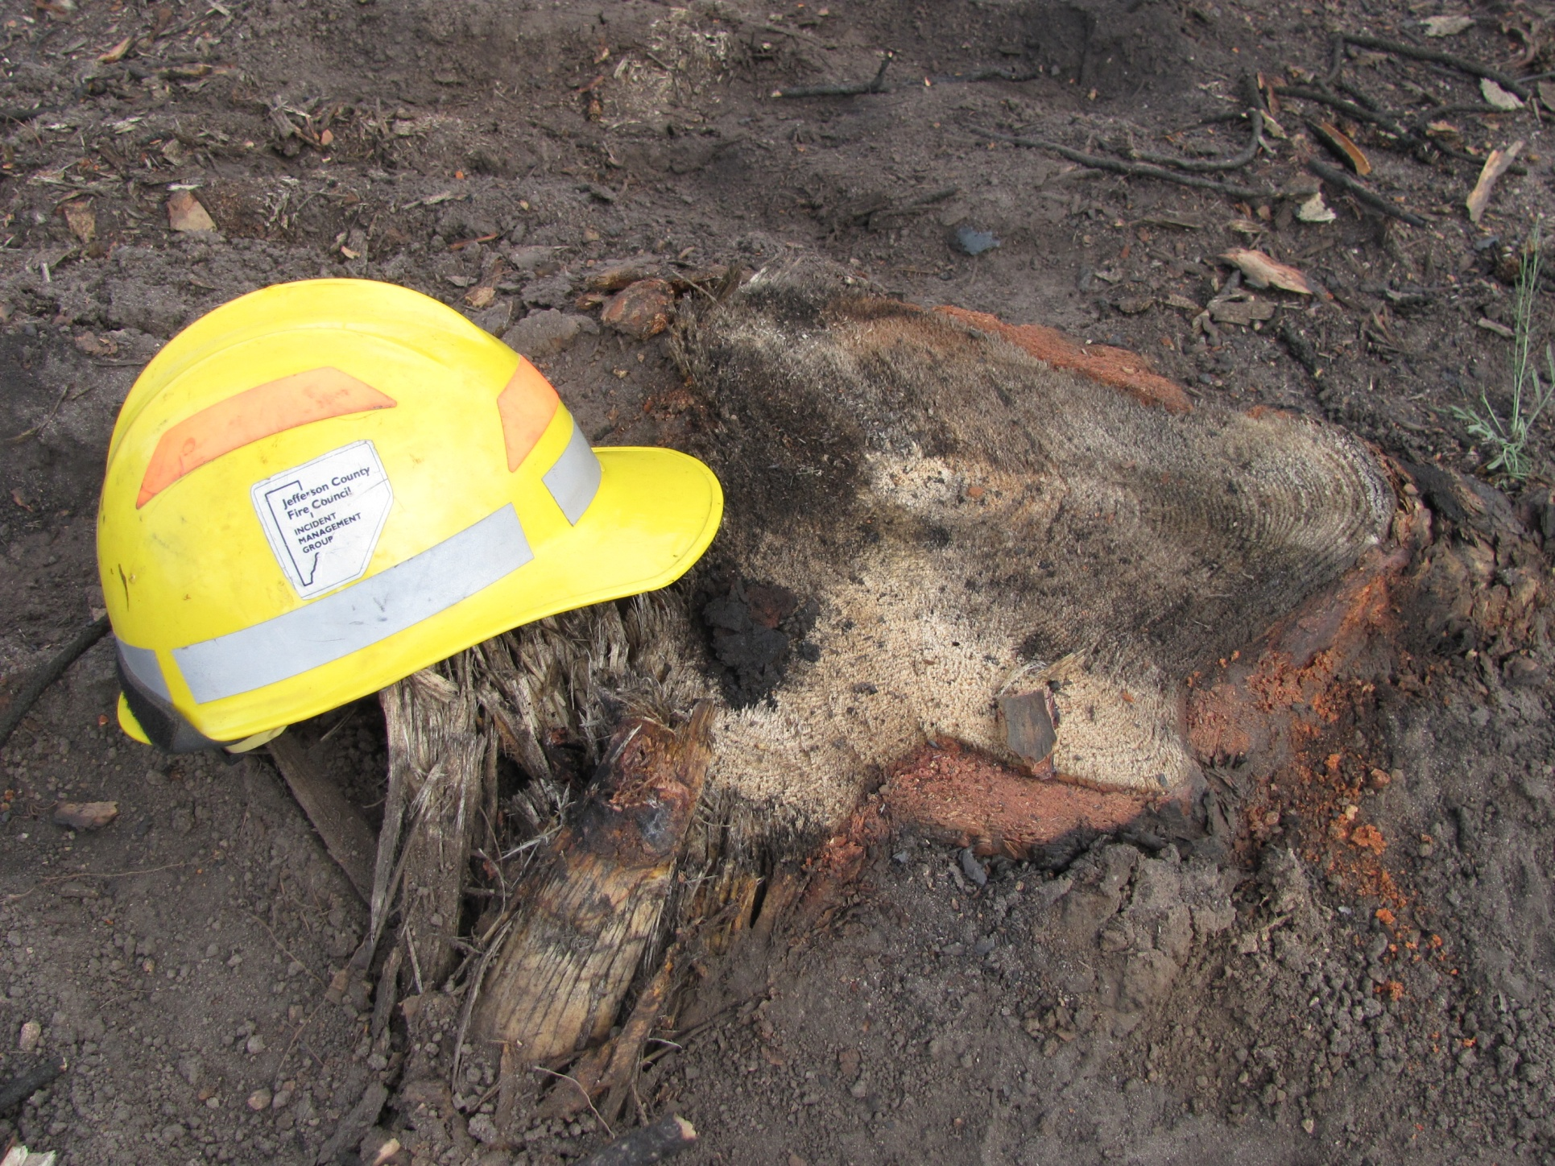
Very low stumps cut with the
rubber-tired feller-buncher

Slide 10
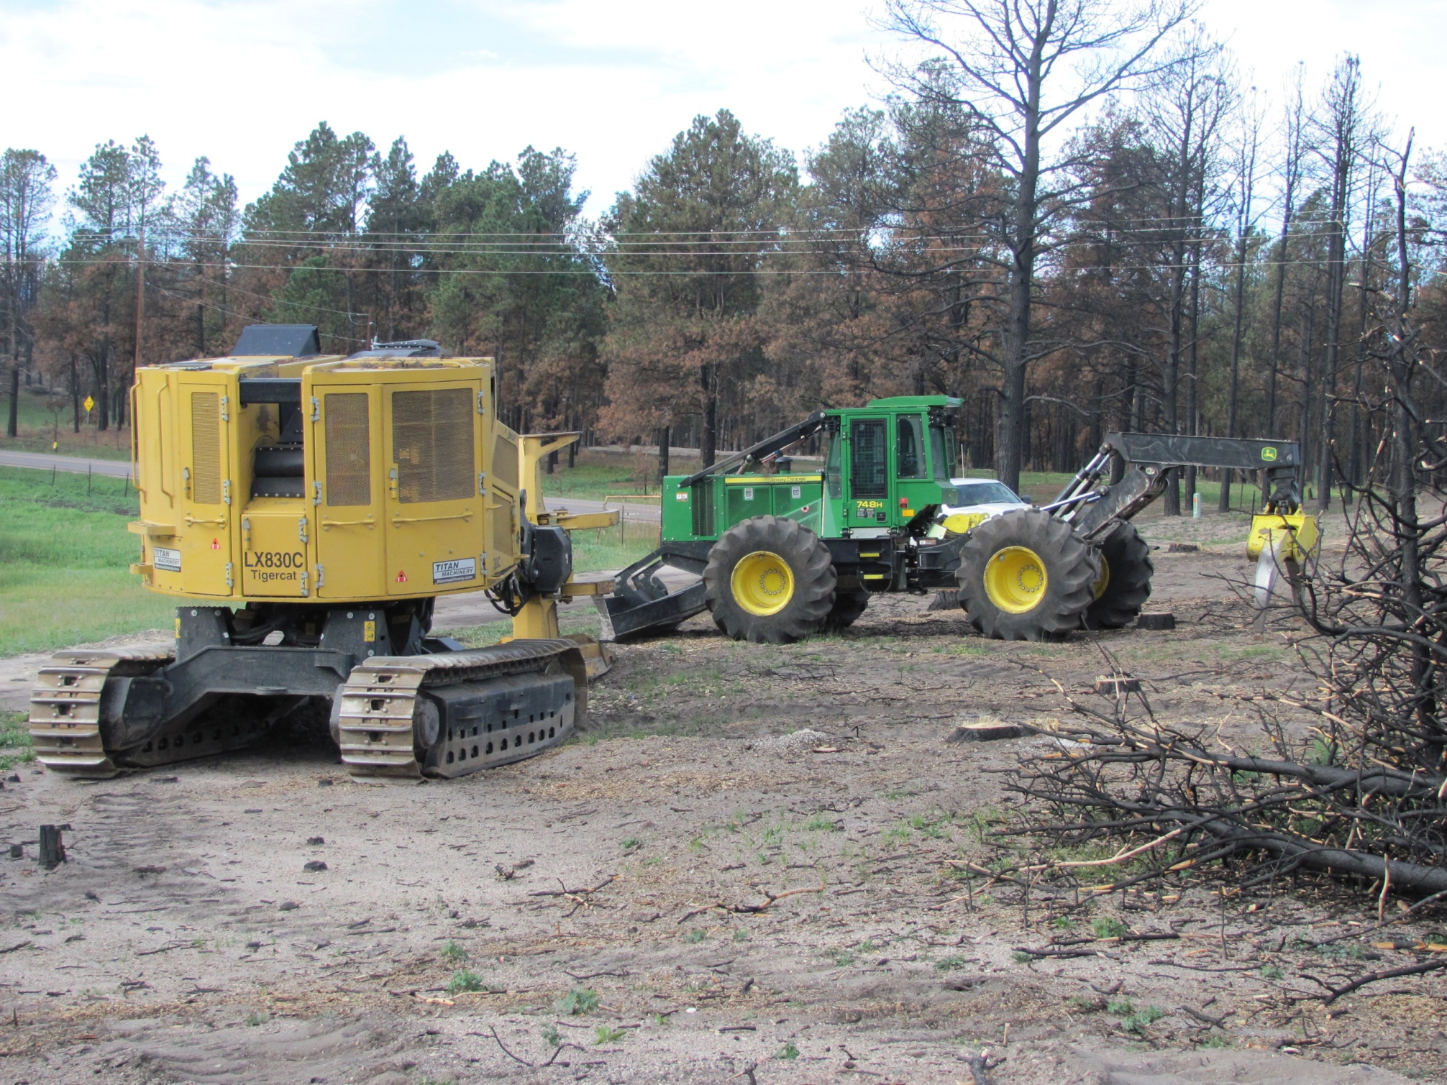
A tracked feller buncher and a
grapple skidder waiting to begin work

Slide 11
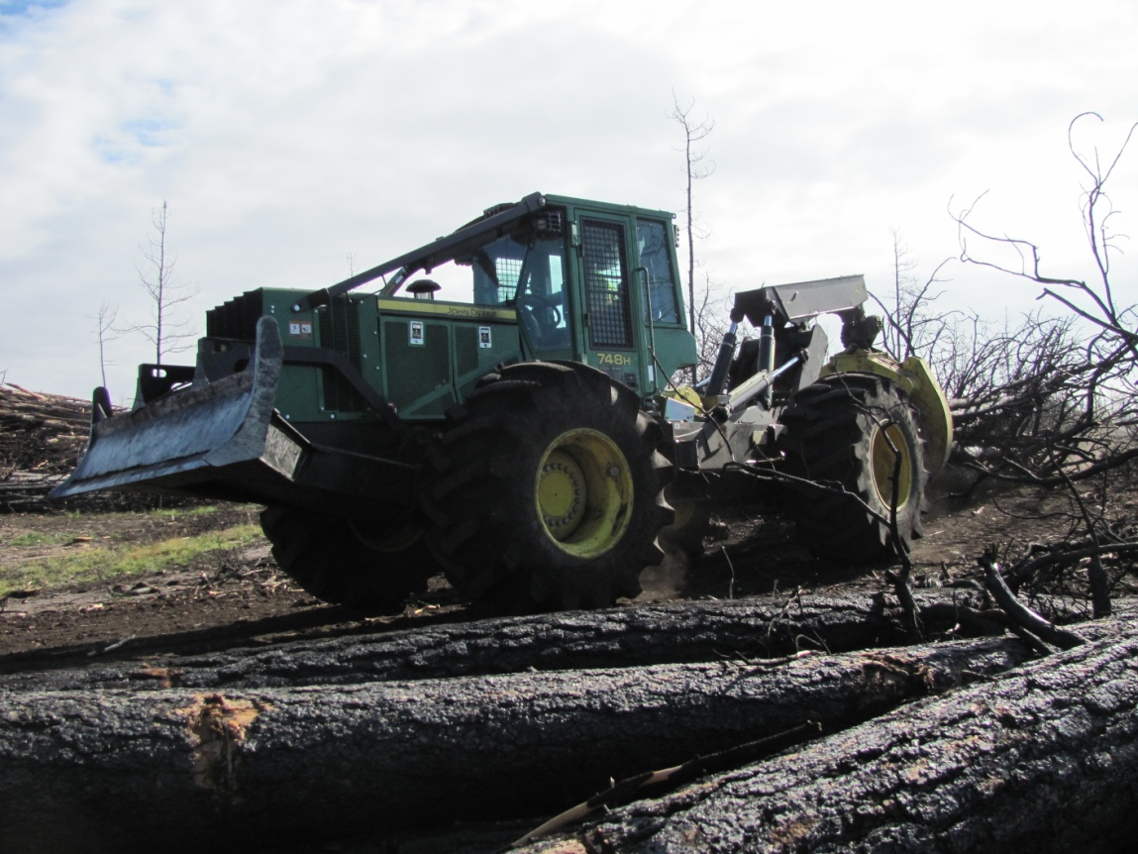
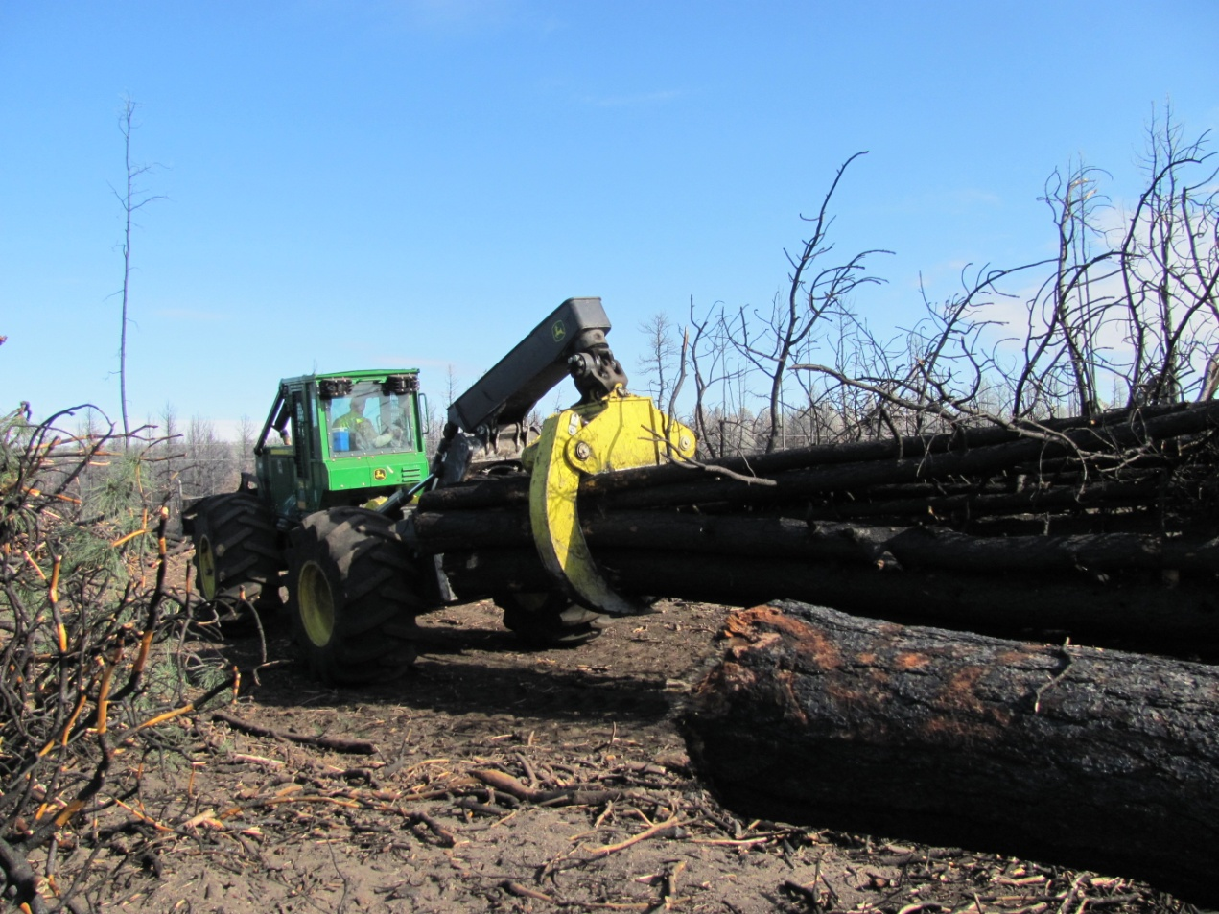
John Deere 748 Grapple Skidders
hard at work

Slide 12
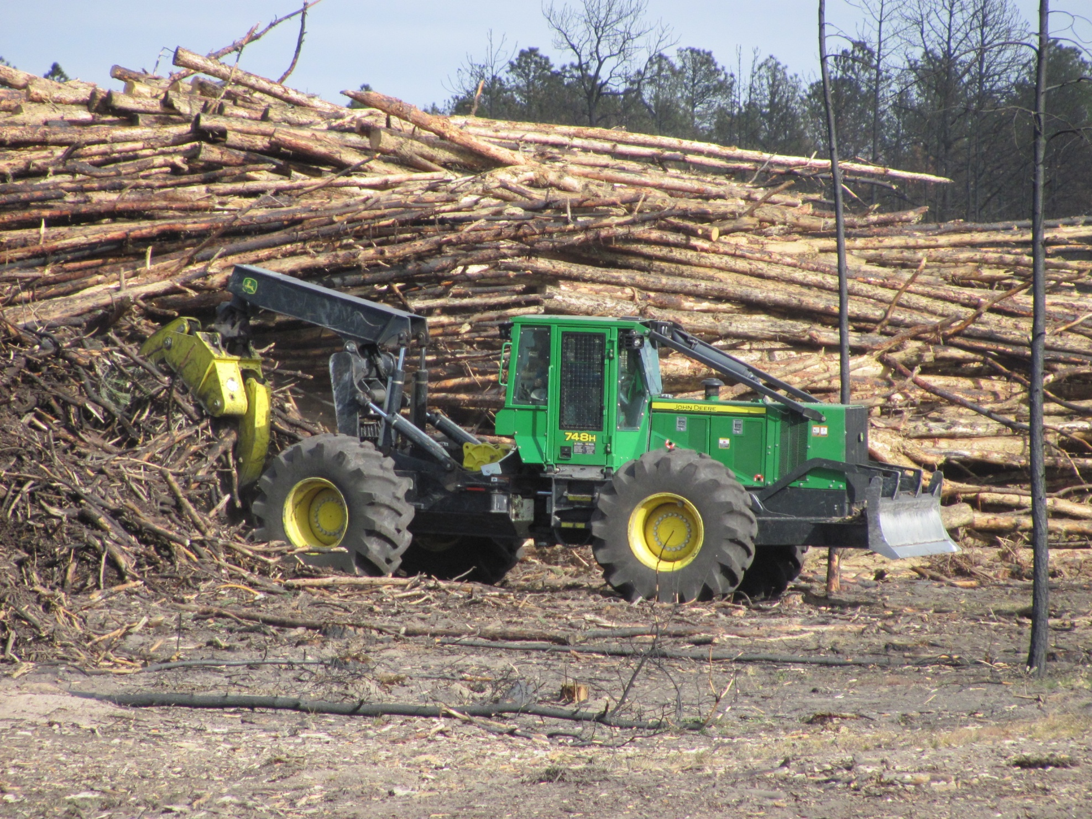
As skidders return to the project area from log landings,
they bring slash and debris with them. This material will
be masticated along with the smaller remaining trees and is
necessary to provide sufficient chip cover for erosion control

Slide 13
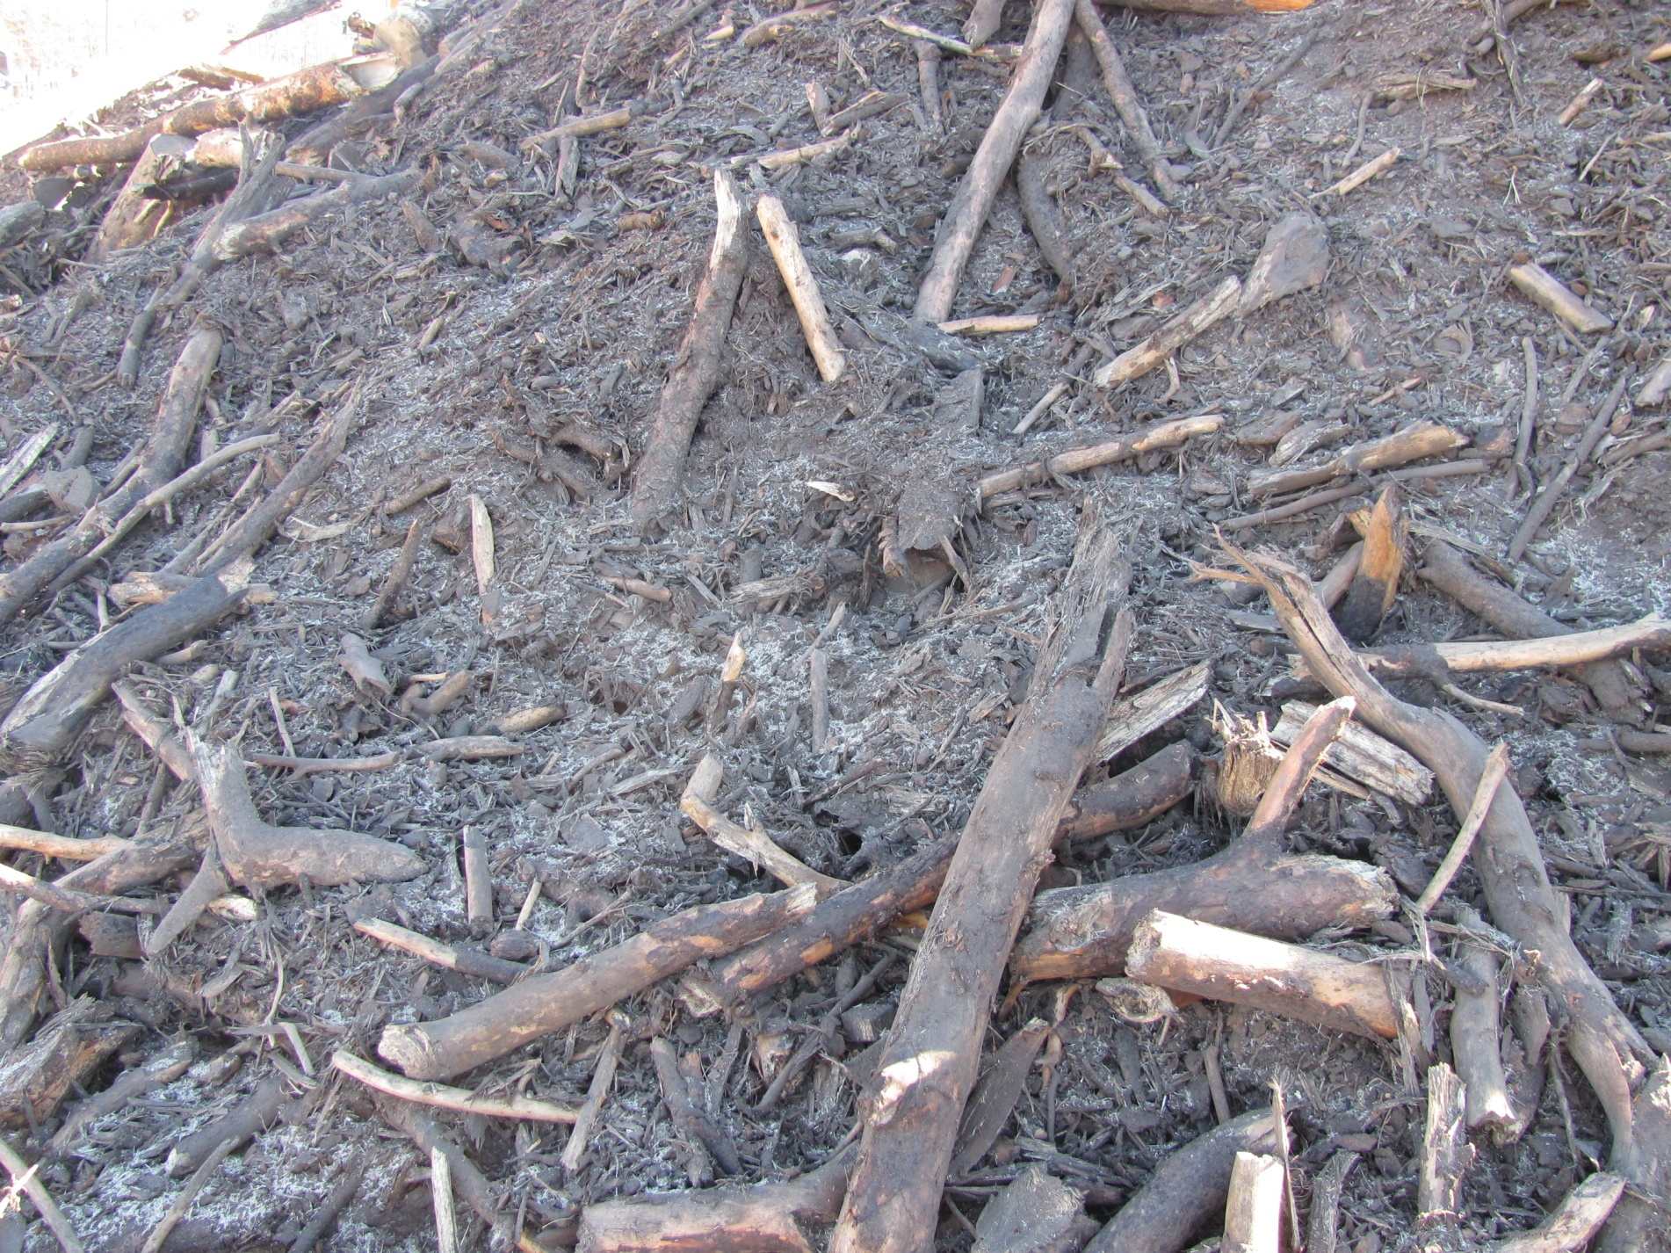
Close-up view of material generated by the flail
and which is hauled back for erosion and restoration purposes.

Slide 14
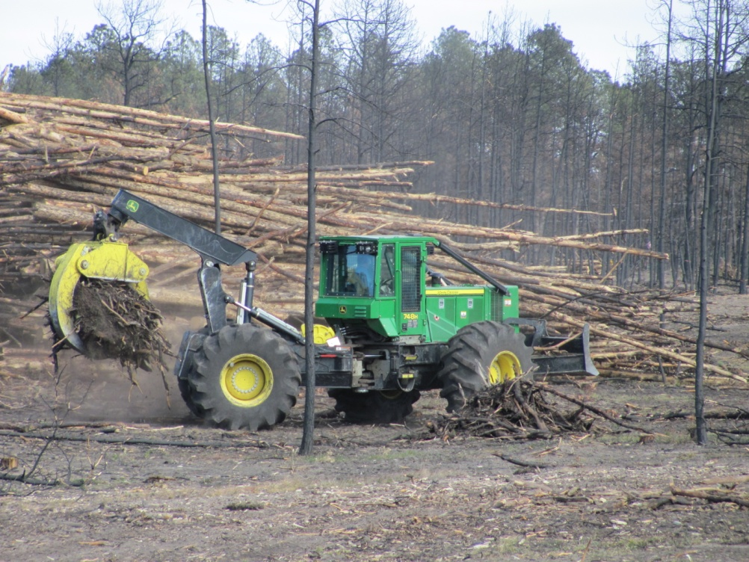
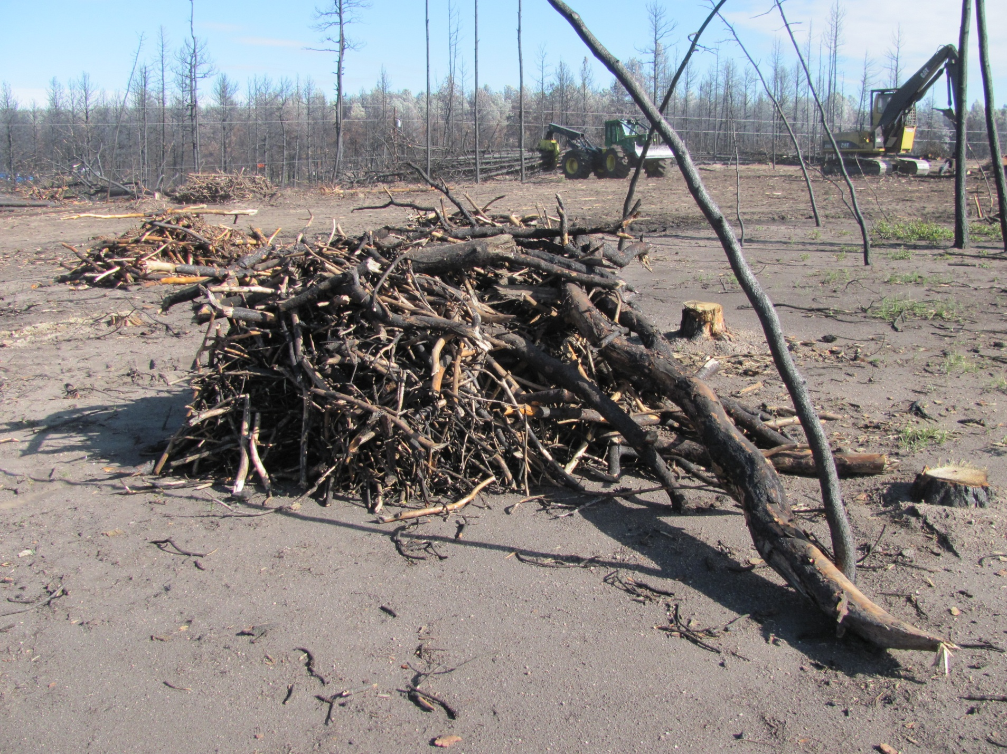

Slide 15
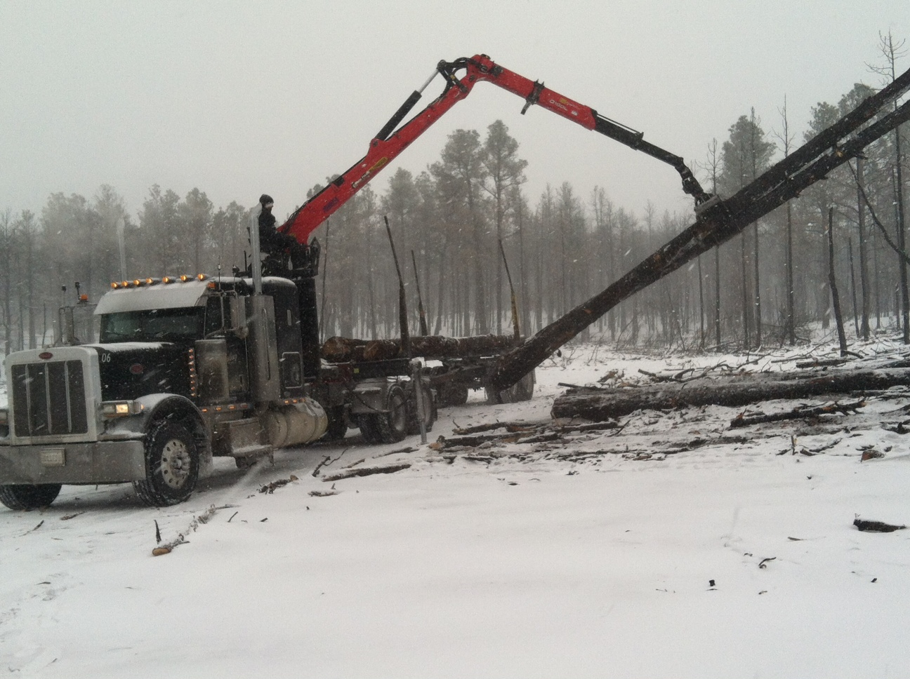
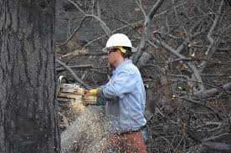
Neighboring properties that could not be
skidded directly to landings were
hand-felled, and hauled to processing
sites by self-loading log trucks.

Slide 16
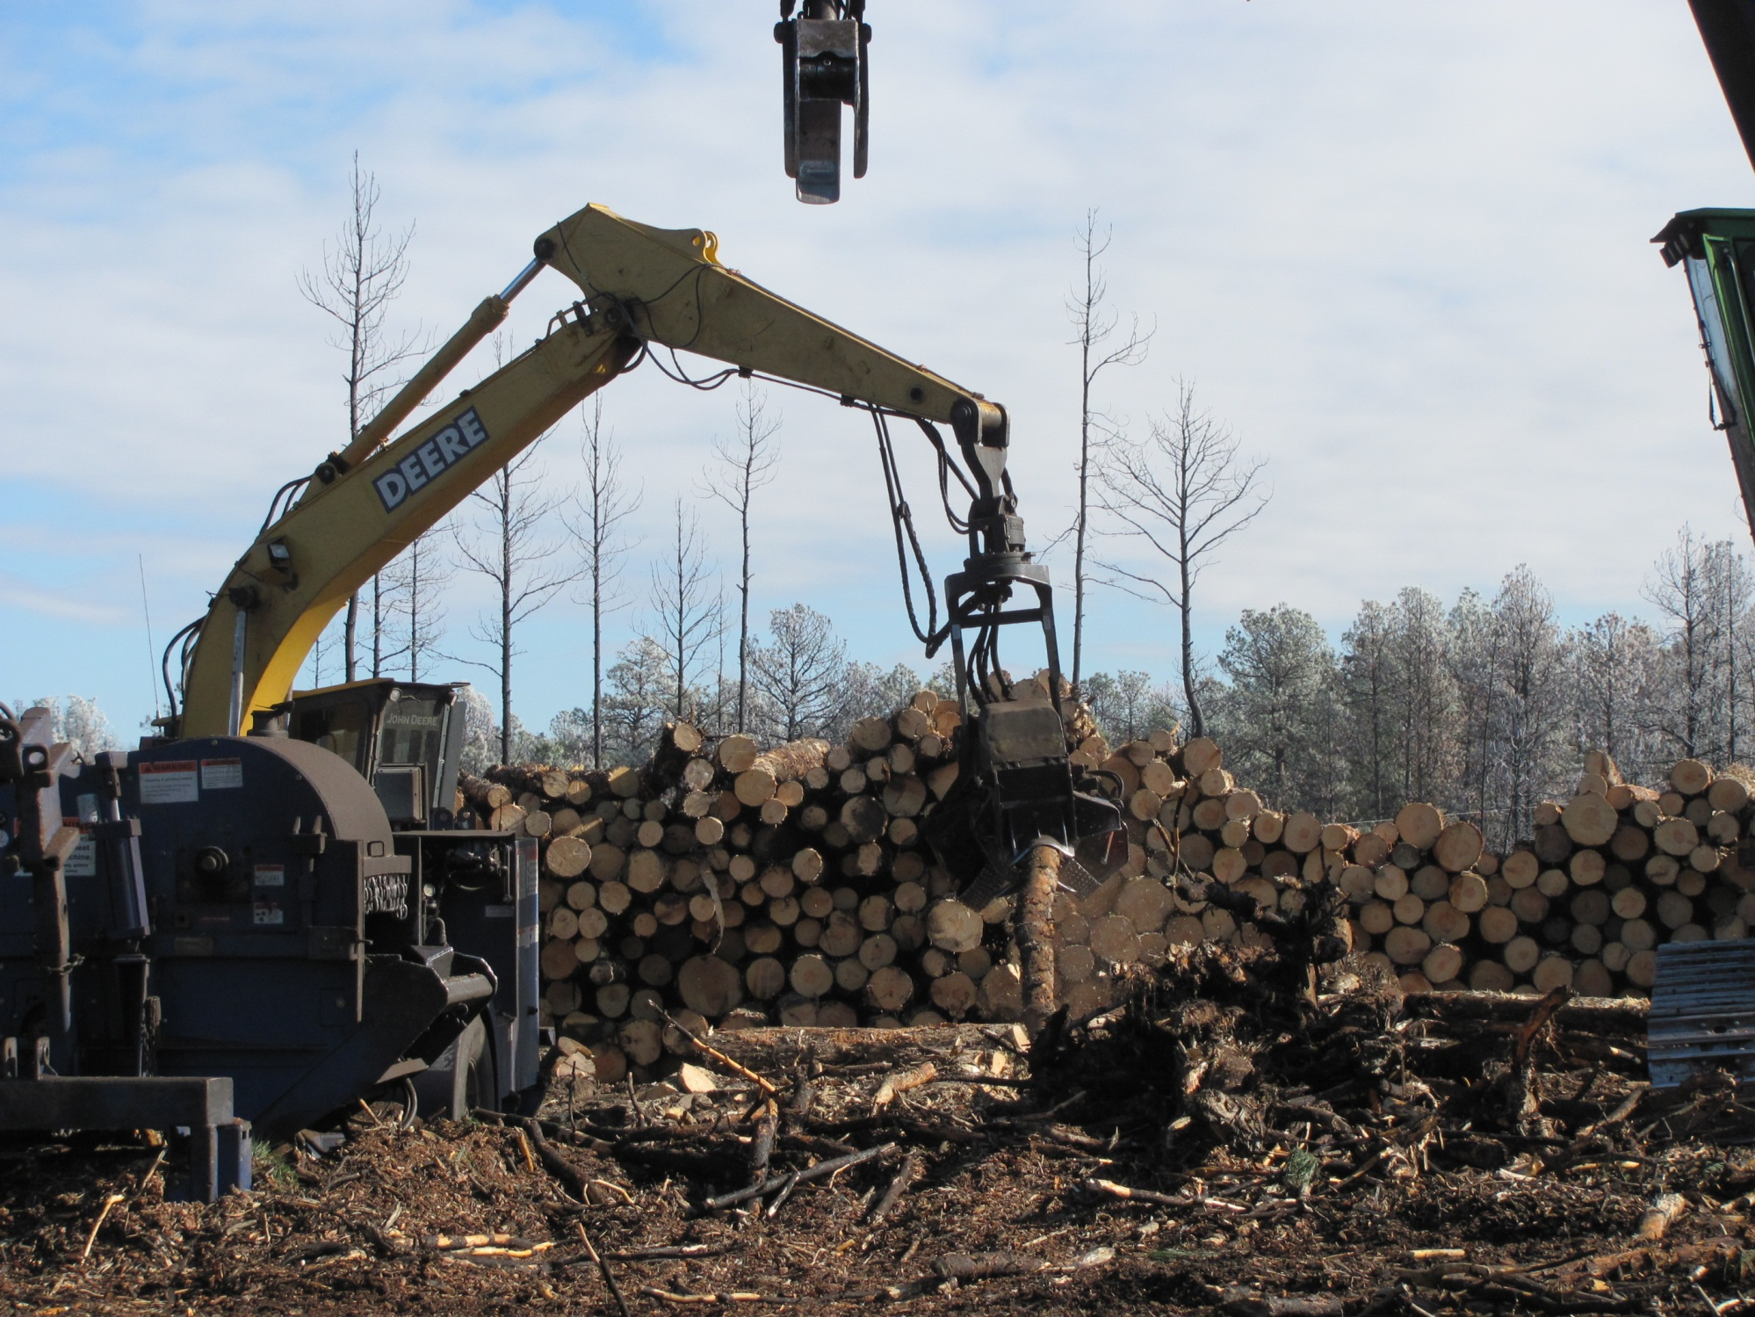
Log Processor delimbs and bucks
merchantable material from logs.
Flail partially delimbs and helps
removed burned bark from logs.

Slide 17
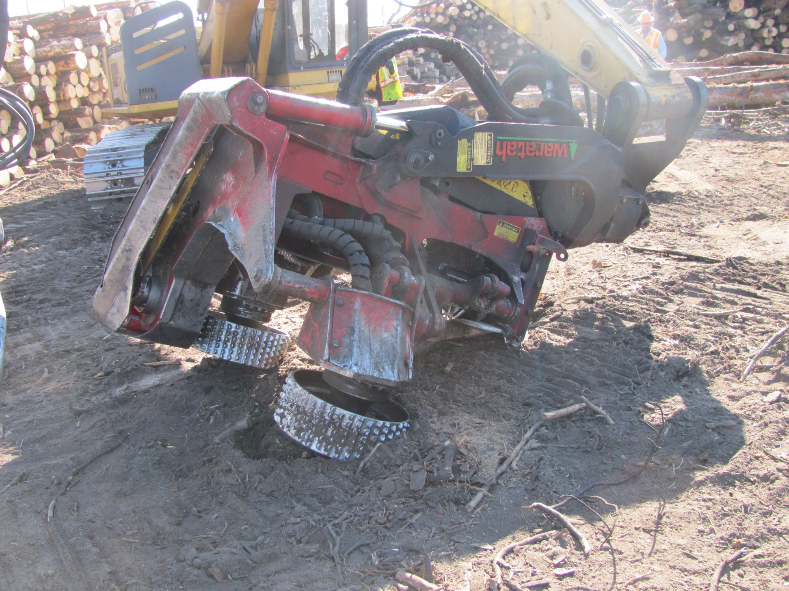
A close-up view of the processing head
that delimbs and bucks logs to
merchantable lengths.

Slide 18
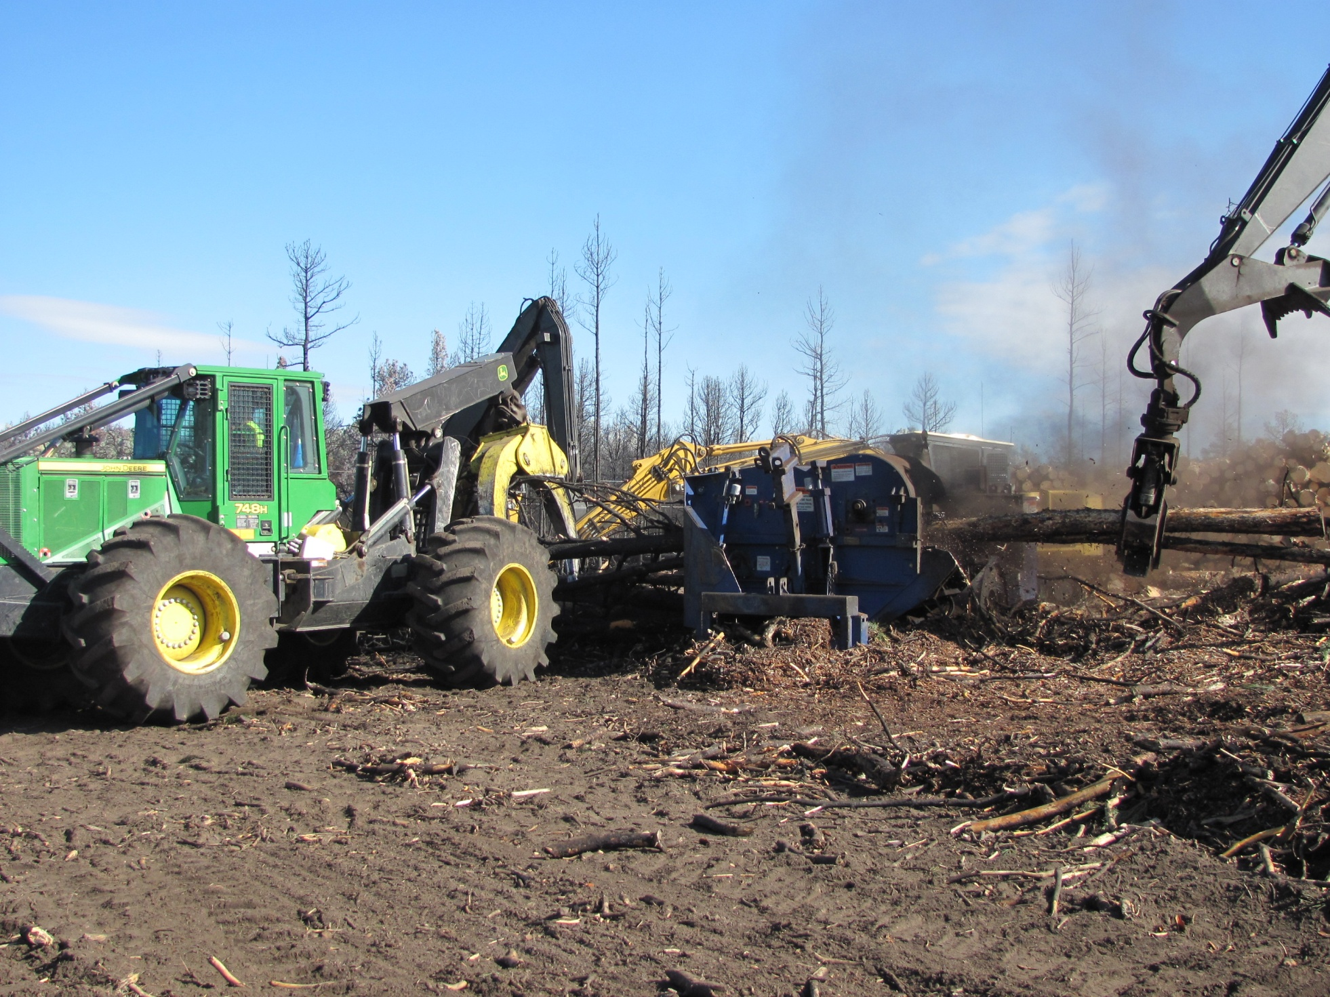
A skidder and the log loader work together to feed
and help pull burned logs through the flail.

Slide 19
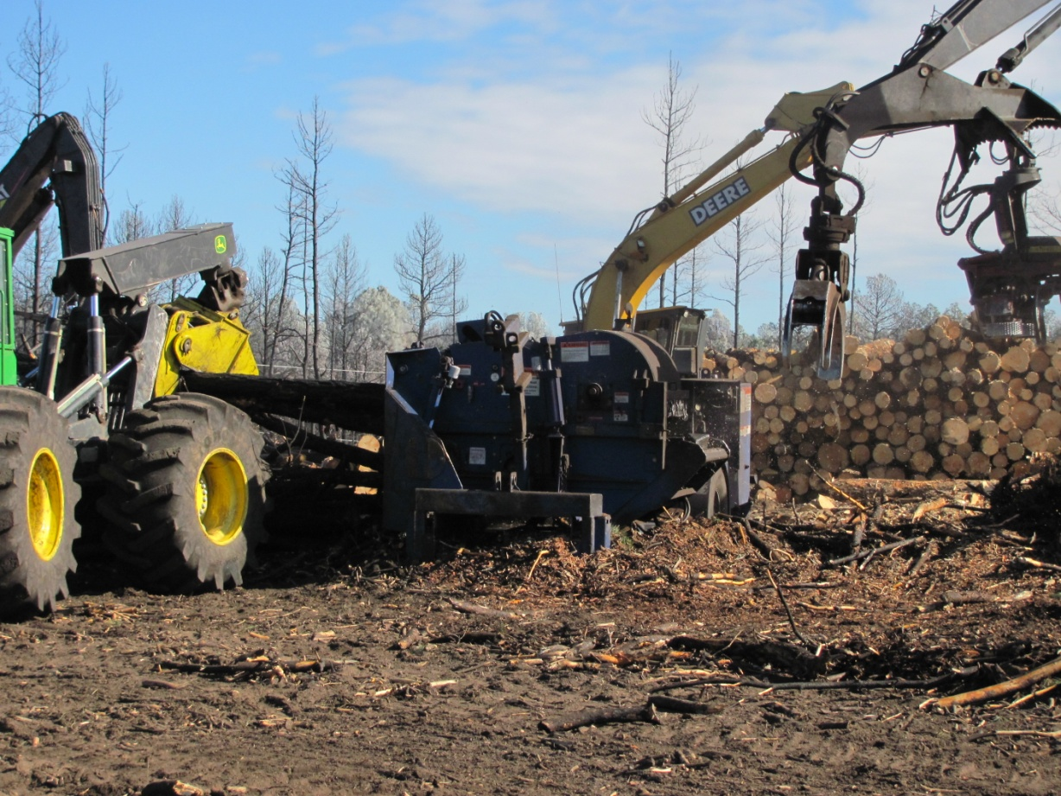
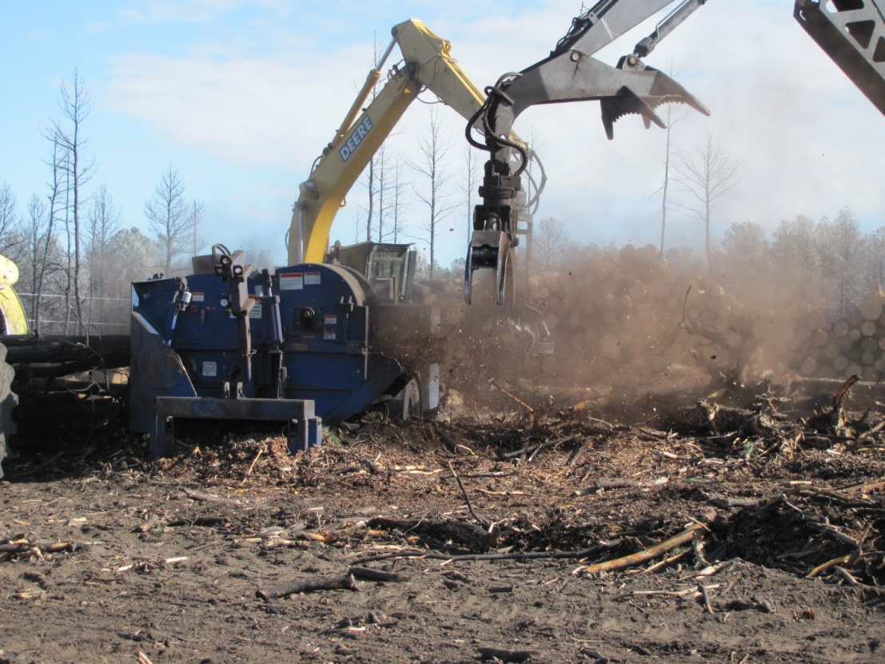

Slide 20
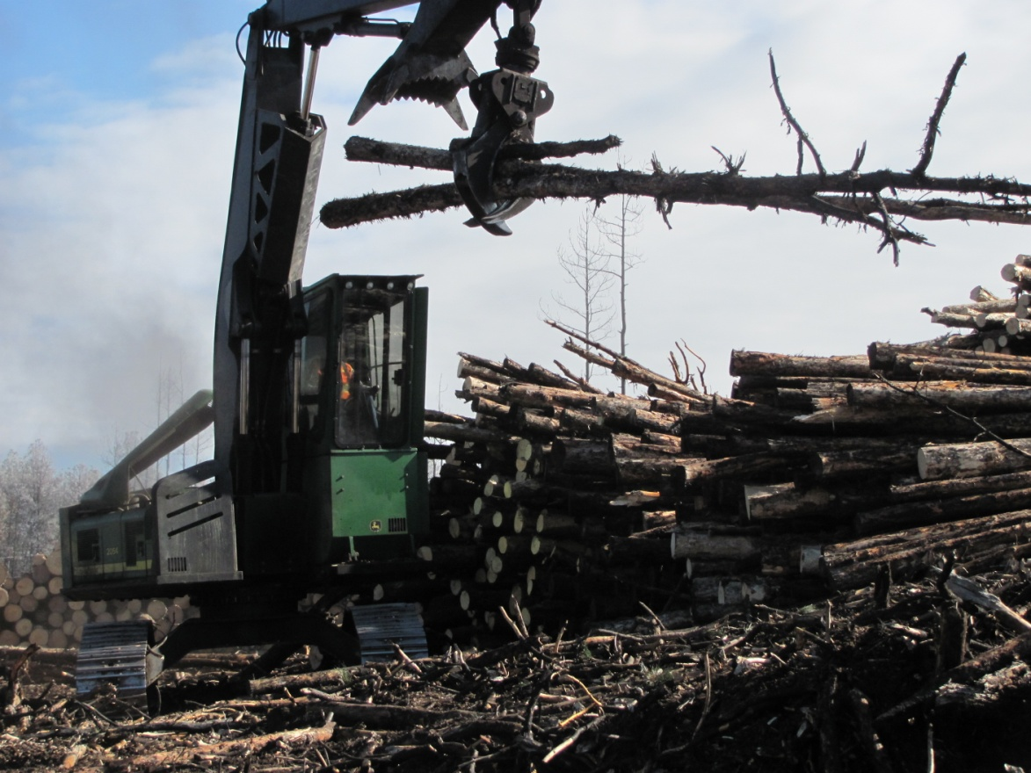
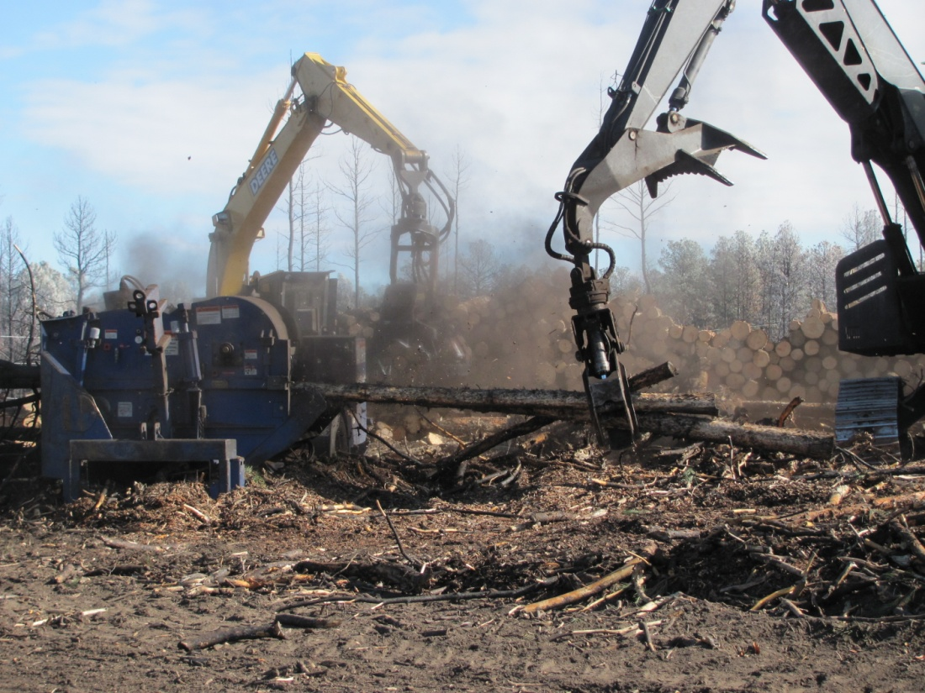
The log loader stacks logs that
will eventually be ground up with
a horizontal grinder for mulch
and “hog fuel” (biomass).
The log loader and log processor work in
well-choreographed movements to sort
logs and manage the log landings.

Slide 21
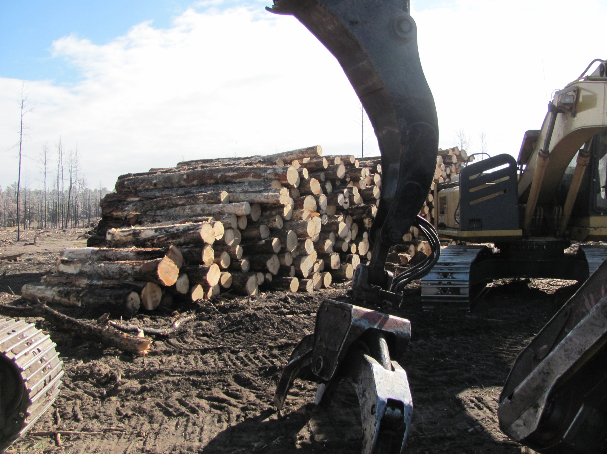
Manufactured sawlogs ready for transport to area mills.

Slide 22
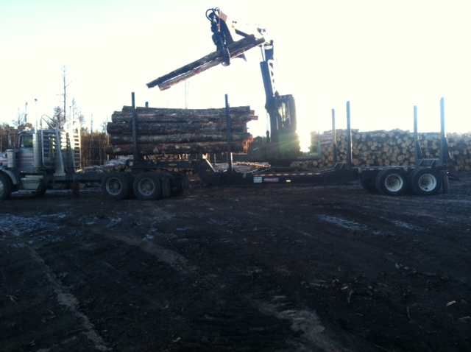
Work begins early:
A log truck using a “hay rack” trailer
being loaded at sunrise.

Slide 23
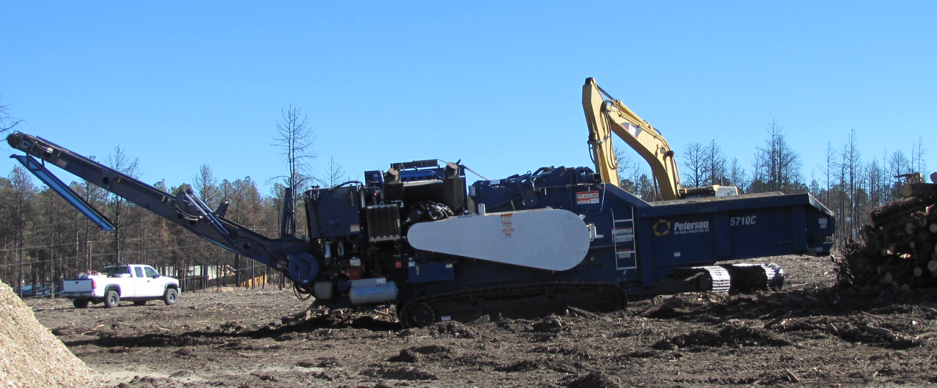
West Range Reclamation’s new Peterson 5710 Horizontal Grinder
is backed into position for grinding. The grinder has tracks and is
self-propelled so it can be “walked” to different landings once
it has been trucked to a job site.

Slide 24
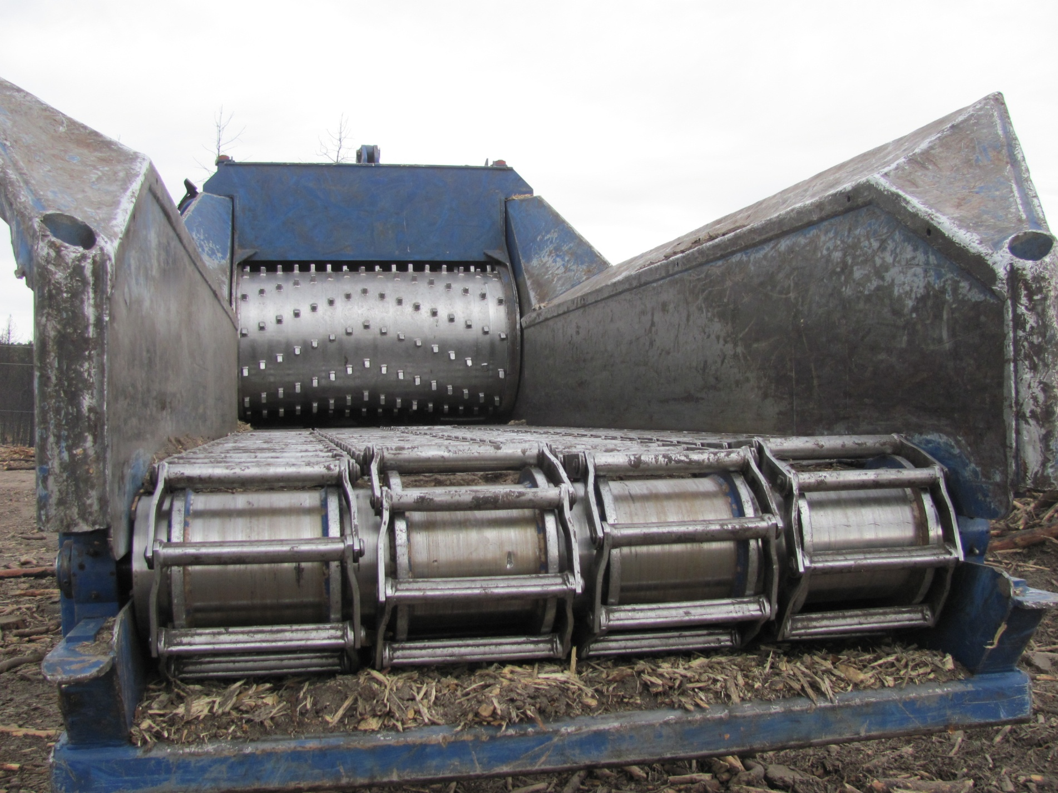
In-feed side of the grinder

Slide 25
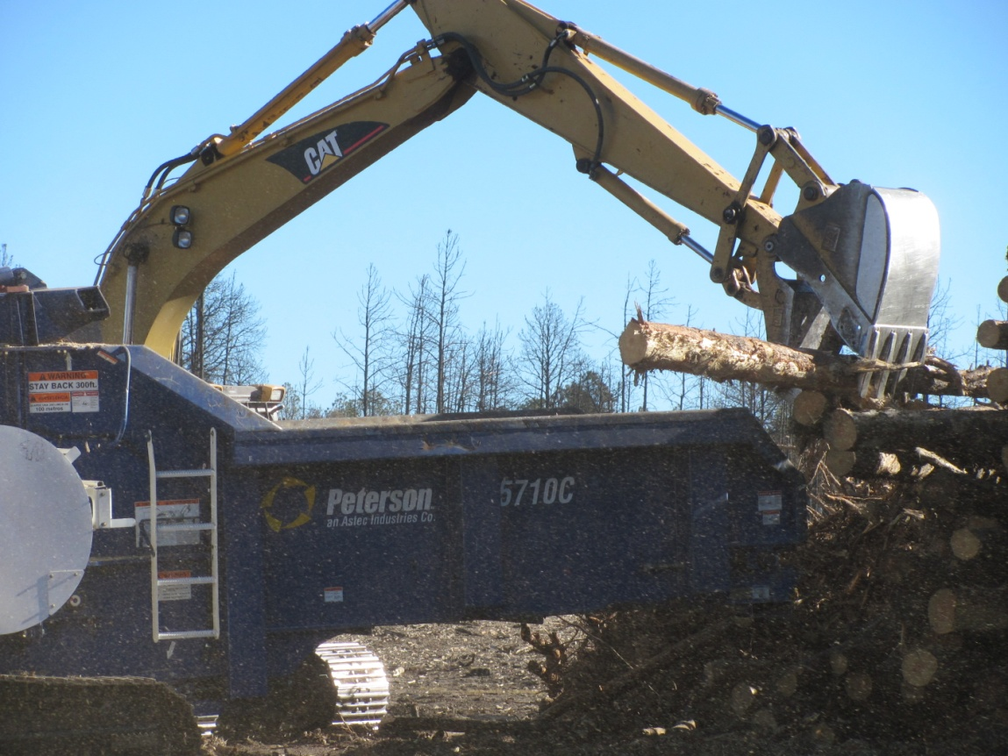
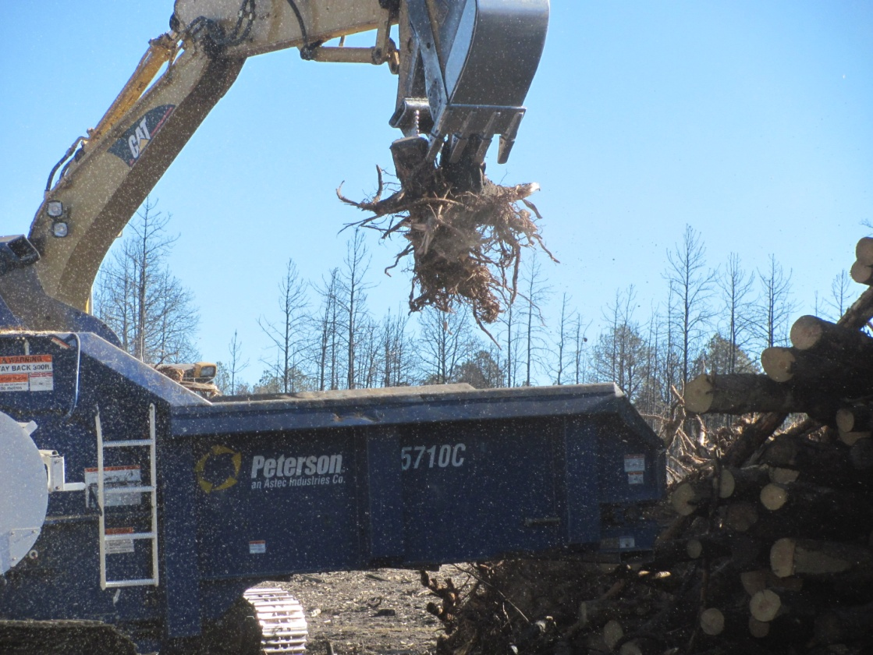
An excavator equipped with a
bucket with a “thumb” loads logs,
stumps and other forest debris into the
horizontal grinder for processing.

Slide 26
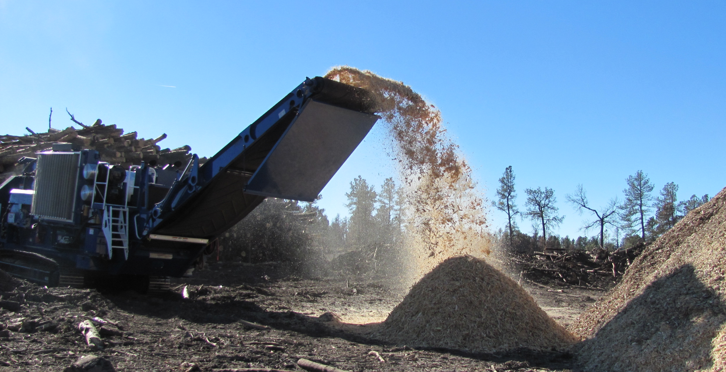
Ground material flows from the end of
the horizontal grinder after processing.

Slide 27
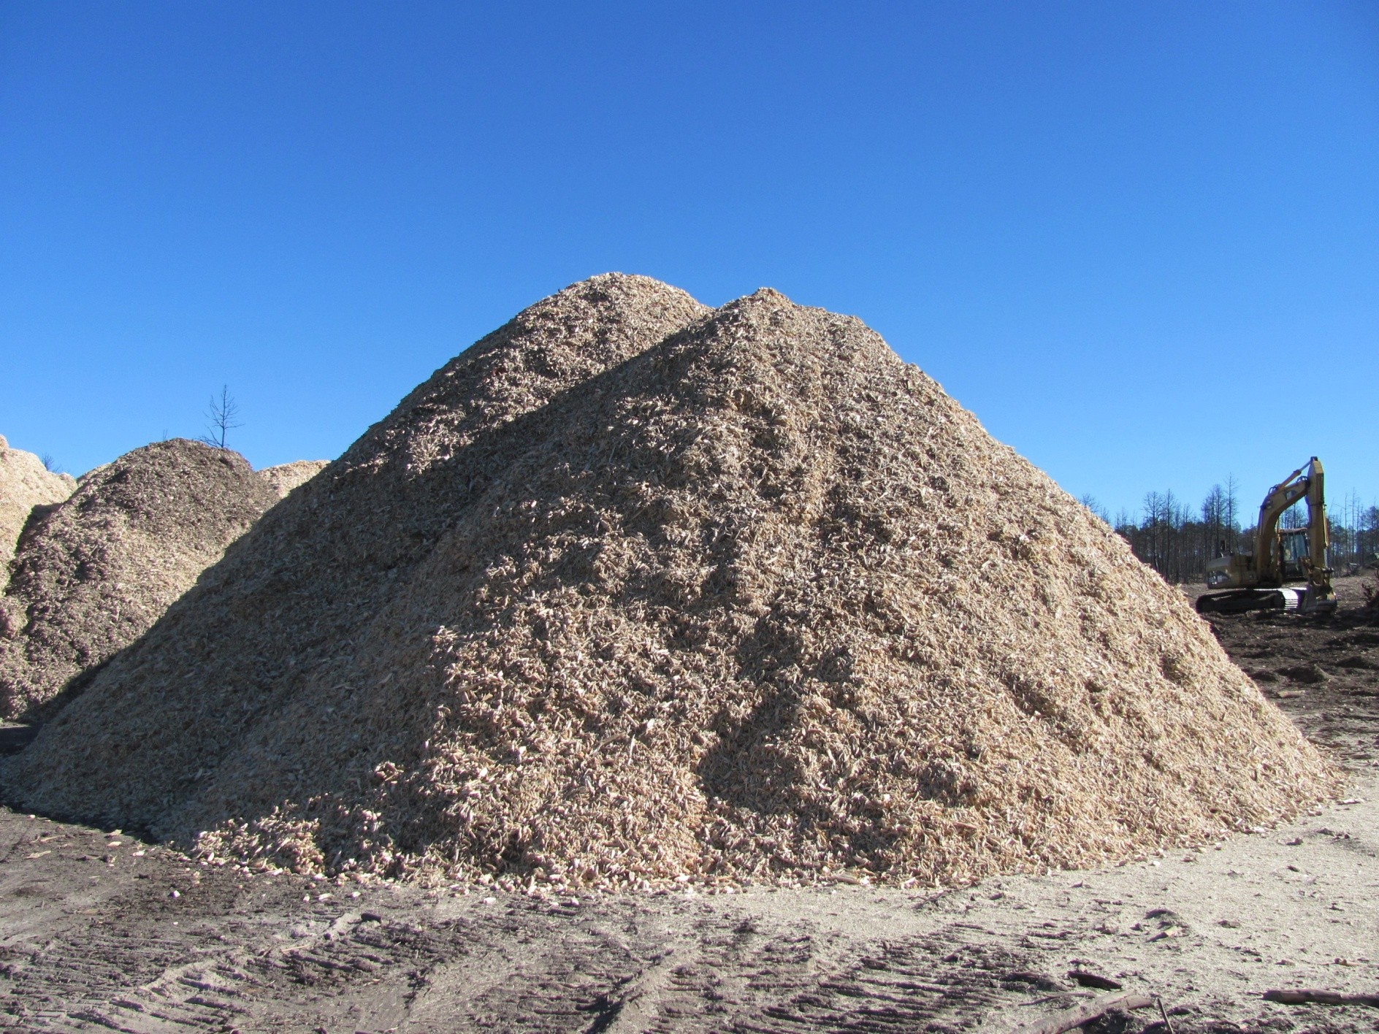
Ground material can be loaded directly into chip vans
or is stockpiled for loading at a later time. For efficiency
WRR tries to keep the grinder working at all times.

Slide 28
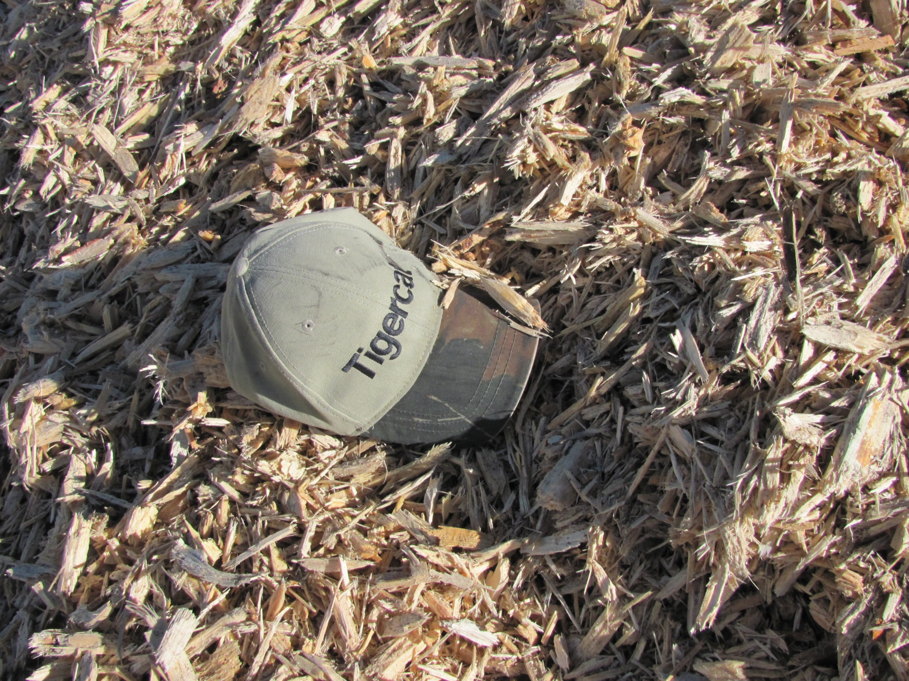
A baseball cap provides a sense of scale for the material coming
directly from the grinder. The material can be “screened” to
sort different sized material for different markets.

Slide 29
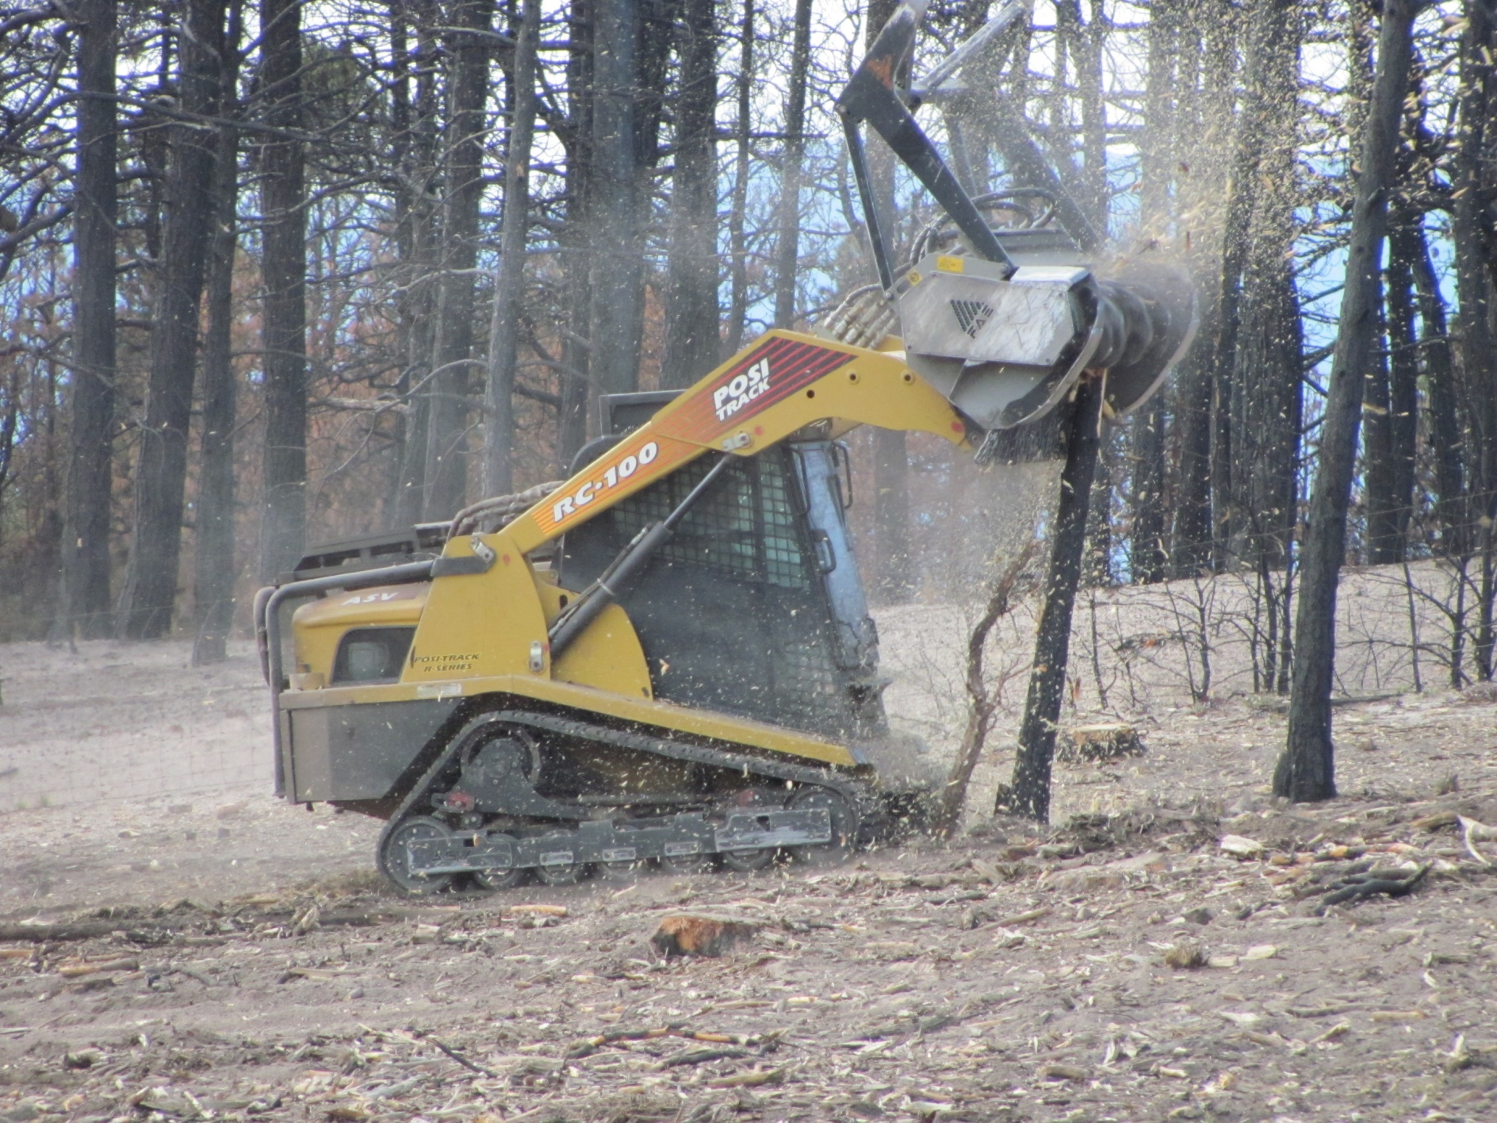
Final Steps: Mastication of remaining
smaller trees and slash piles.

Slide 30
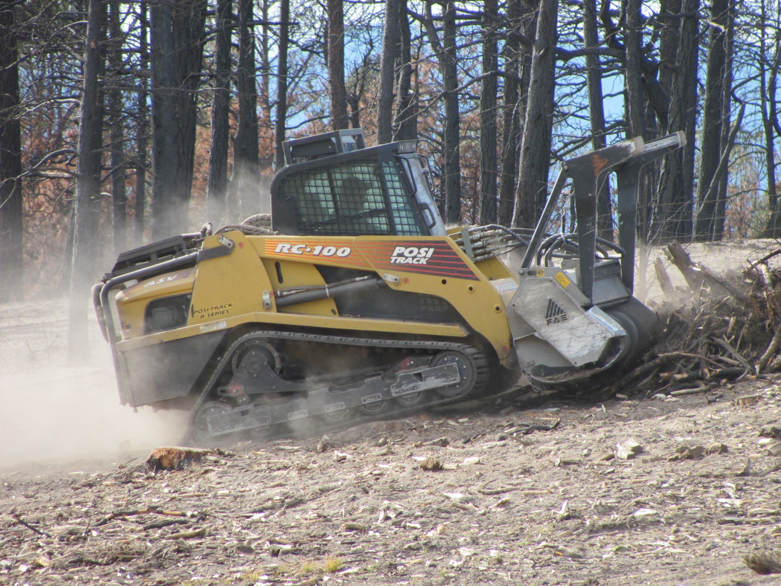
Slash pile mastication

Slide 31
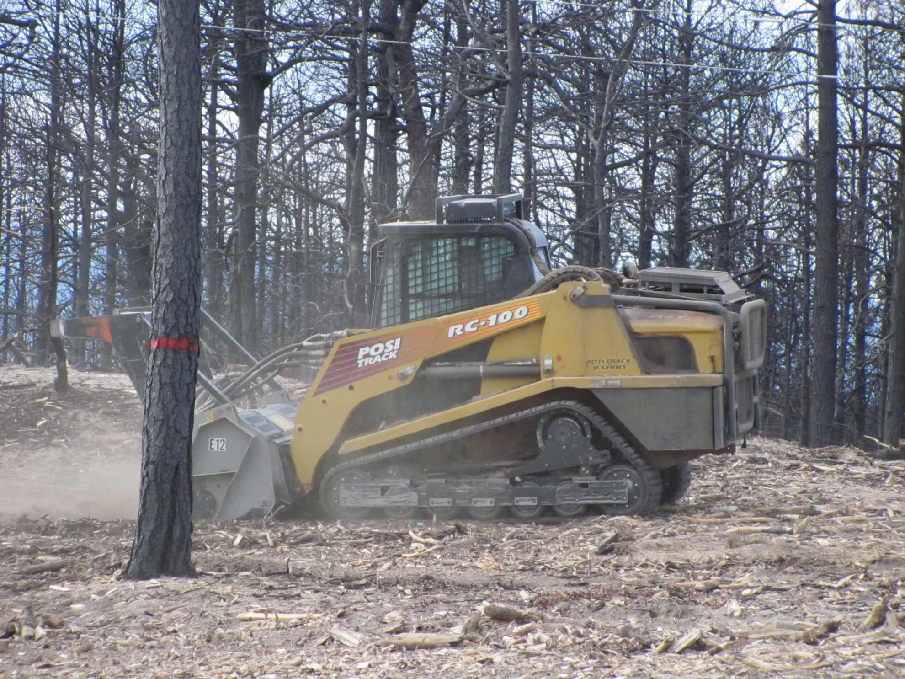
“Fine Grinding” to achieve desired
mulch size and distribution
Tree marked for
retention for wildlife

Slide 32
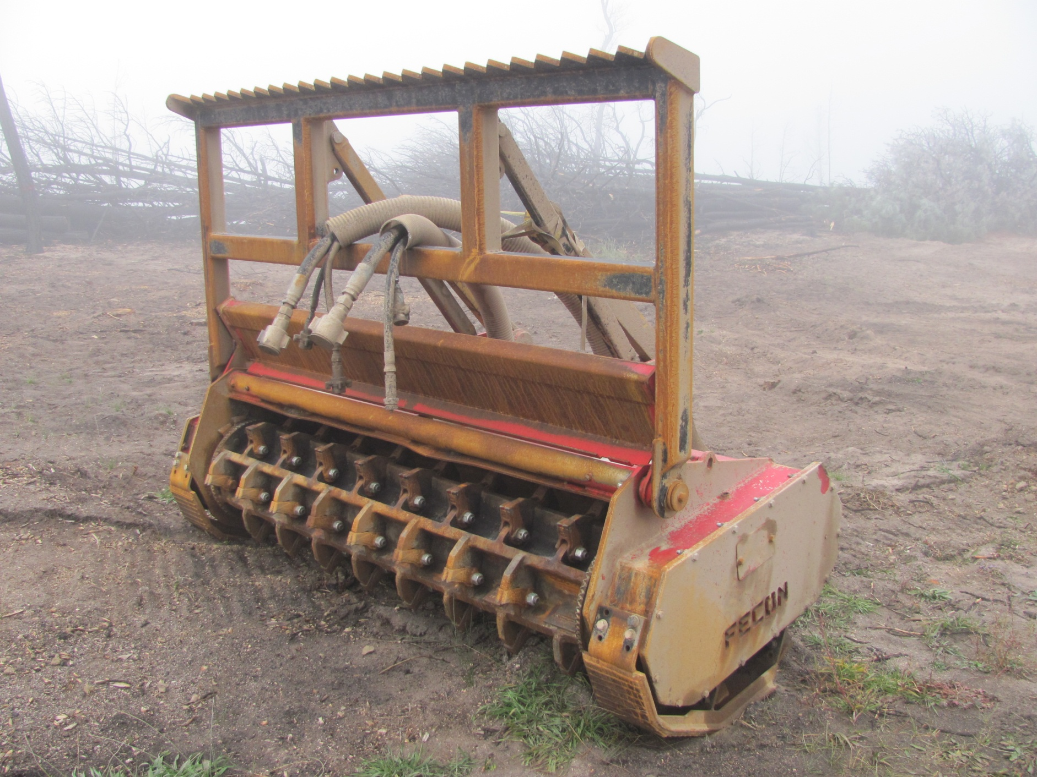
Fecon mastication head ready to be mounted on the
Tigercat 726 rubber-tired carrier upon completion of tree cutting.

Slide 33
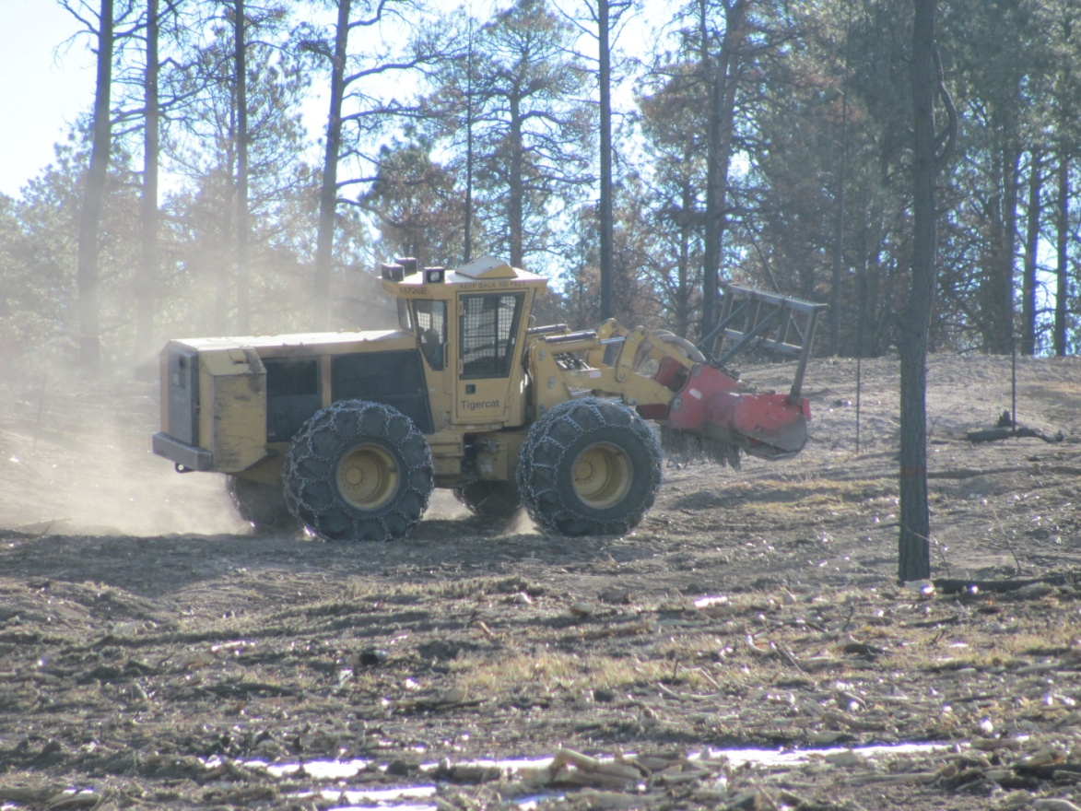
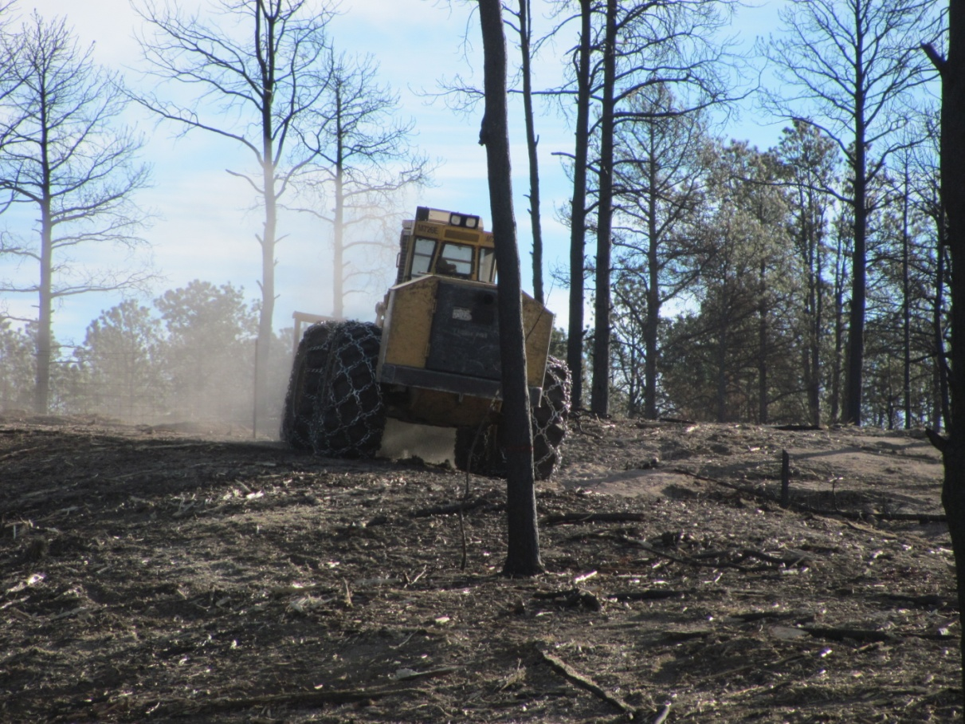
The large masticator at work.

Slide 34
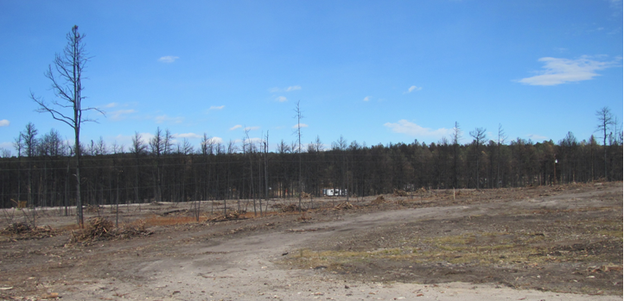
Area waiting
for mastication
Completed Area

Slide 35
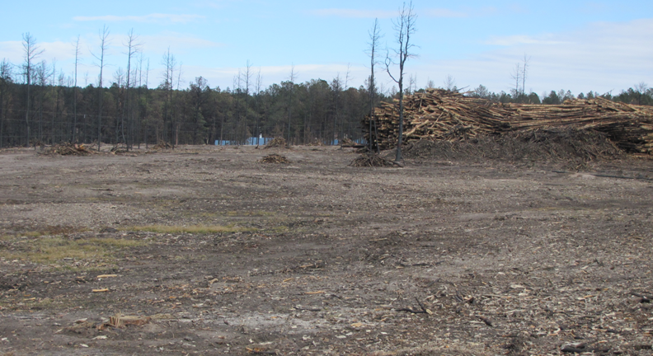
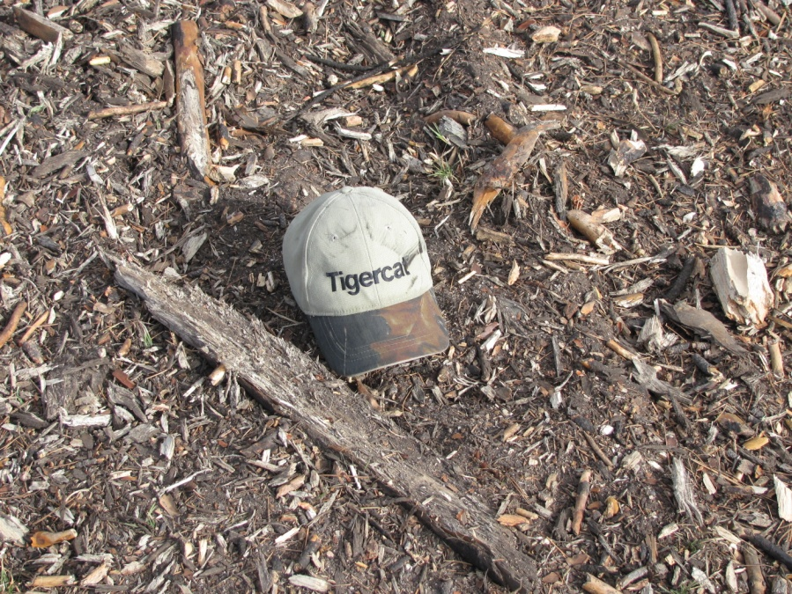
Completed area in foreground (above)
Close-up of masticated material (left)

Slide 36
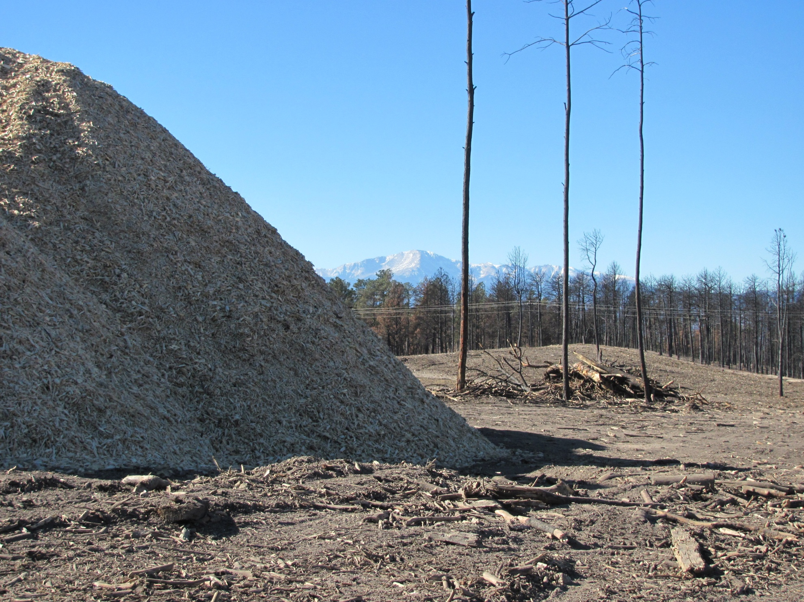
A new view of Pikes Peak has been opened up for the landowner
by the salvage operations conducted on her property.

Slide 37
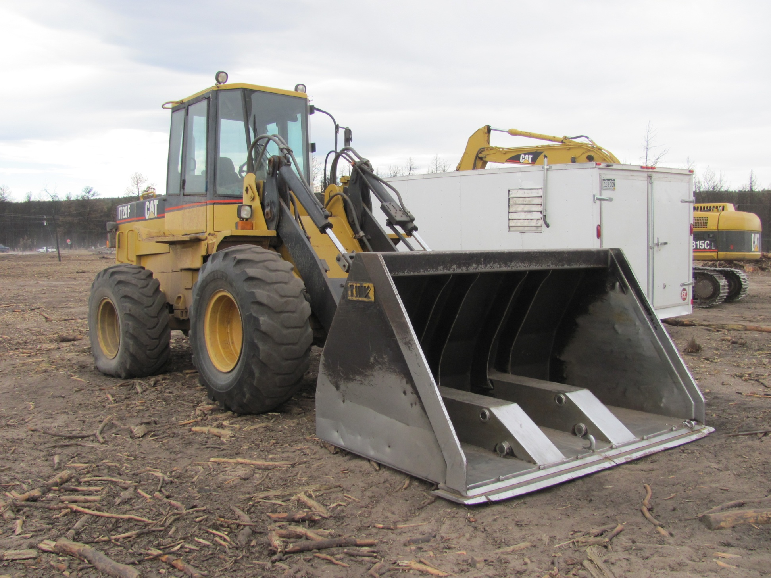
A frontend loader is used to load
chip vans with ground material.

Slide 38
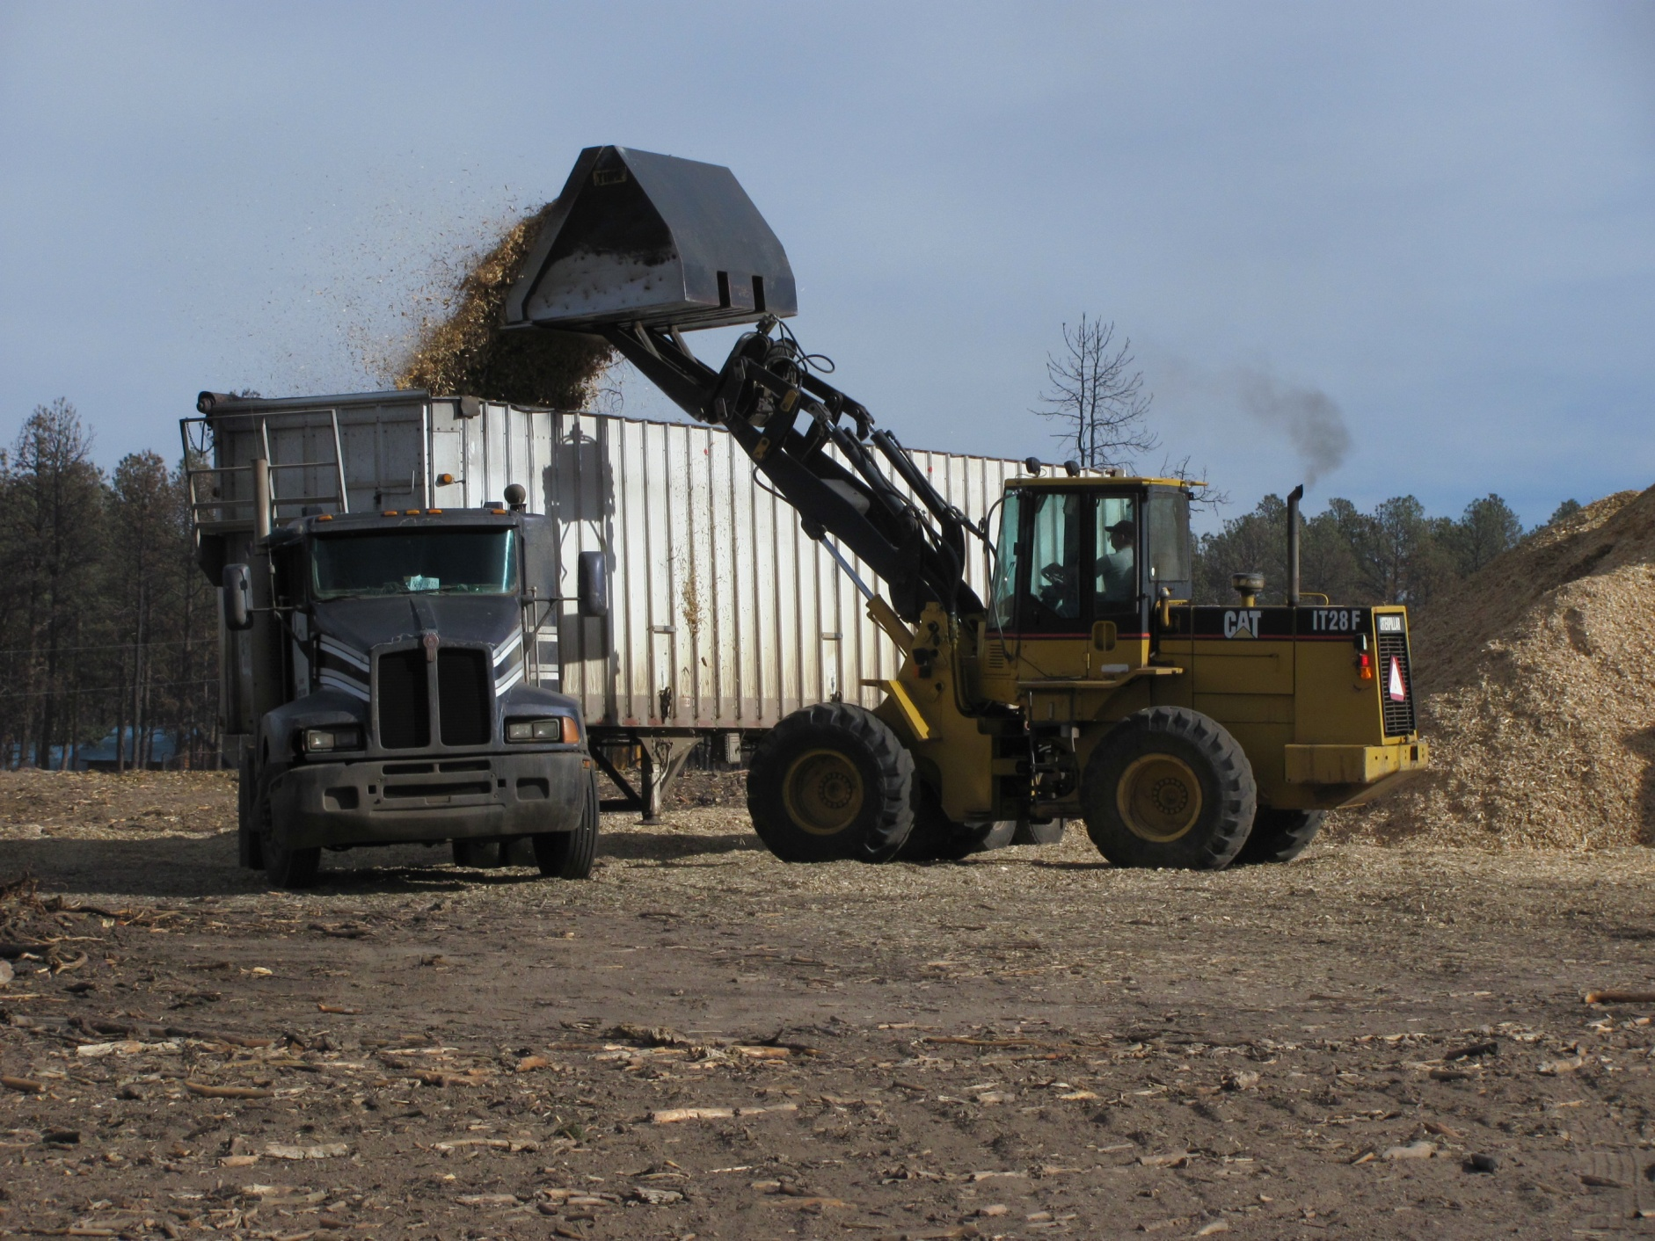
A Chip Van being loaded. 16 -20
bucket loads required to fill the van.

Slide 39
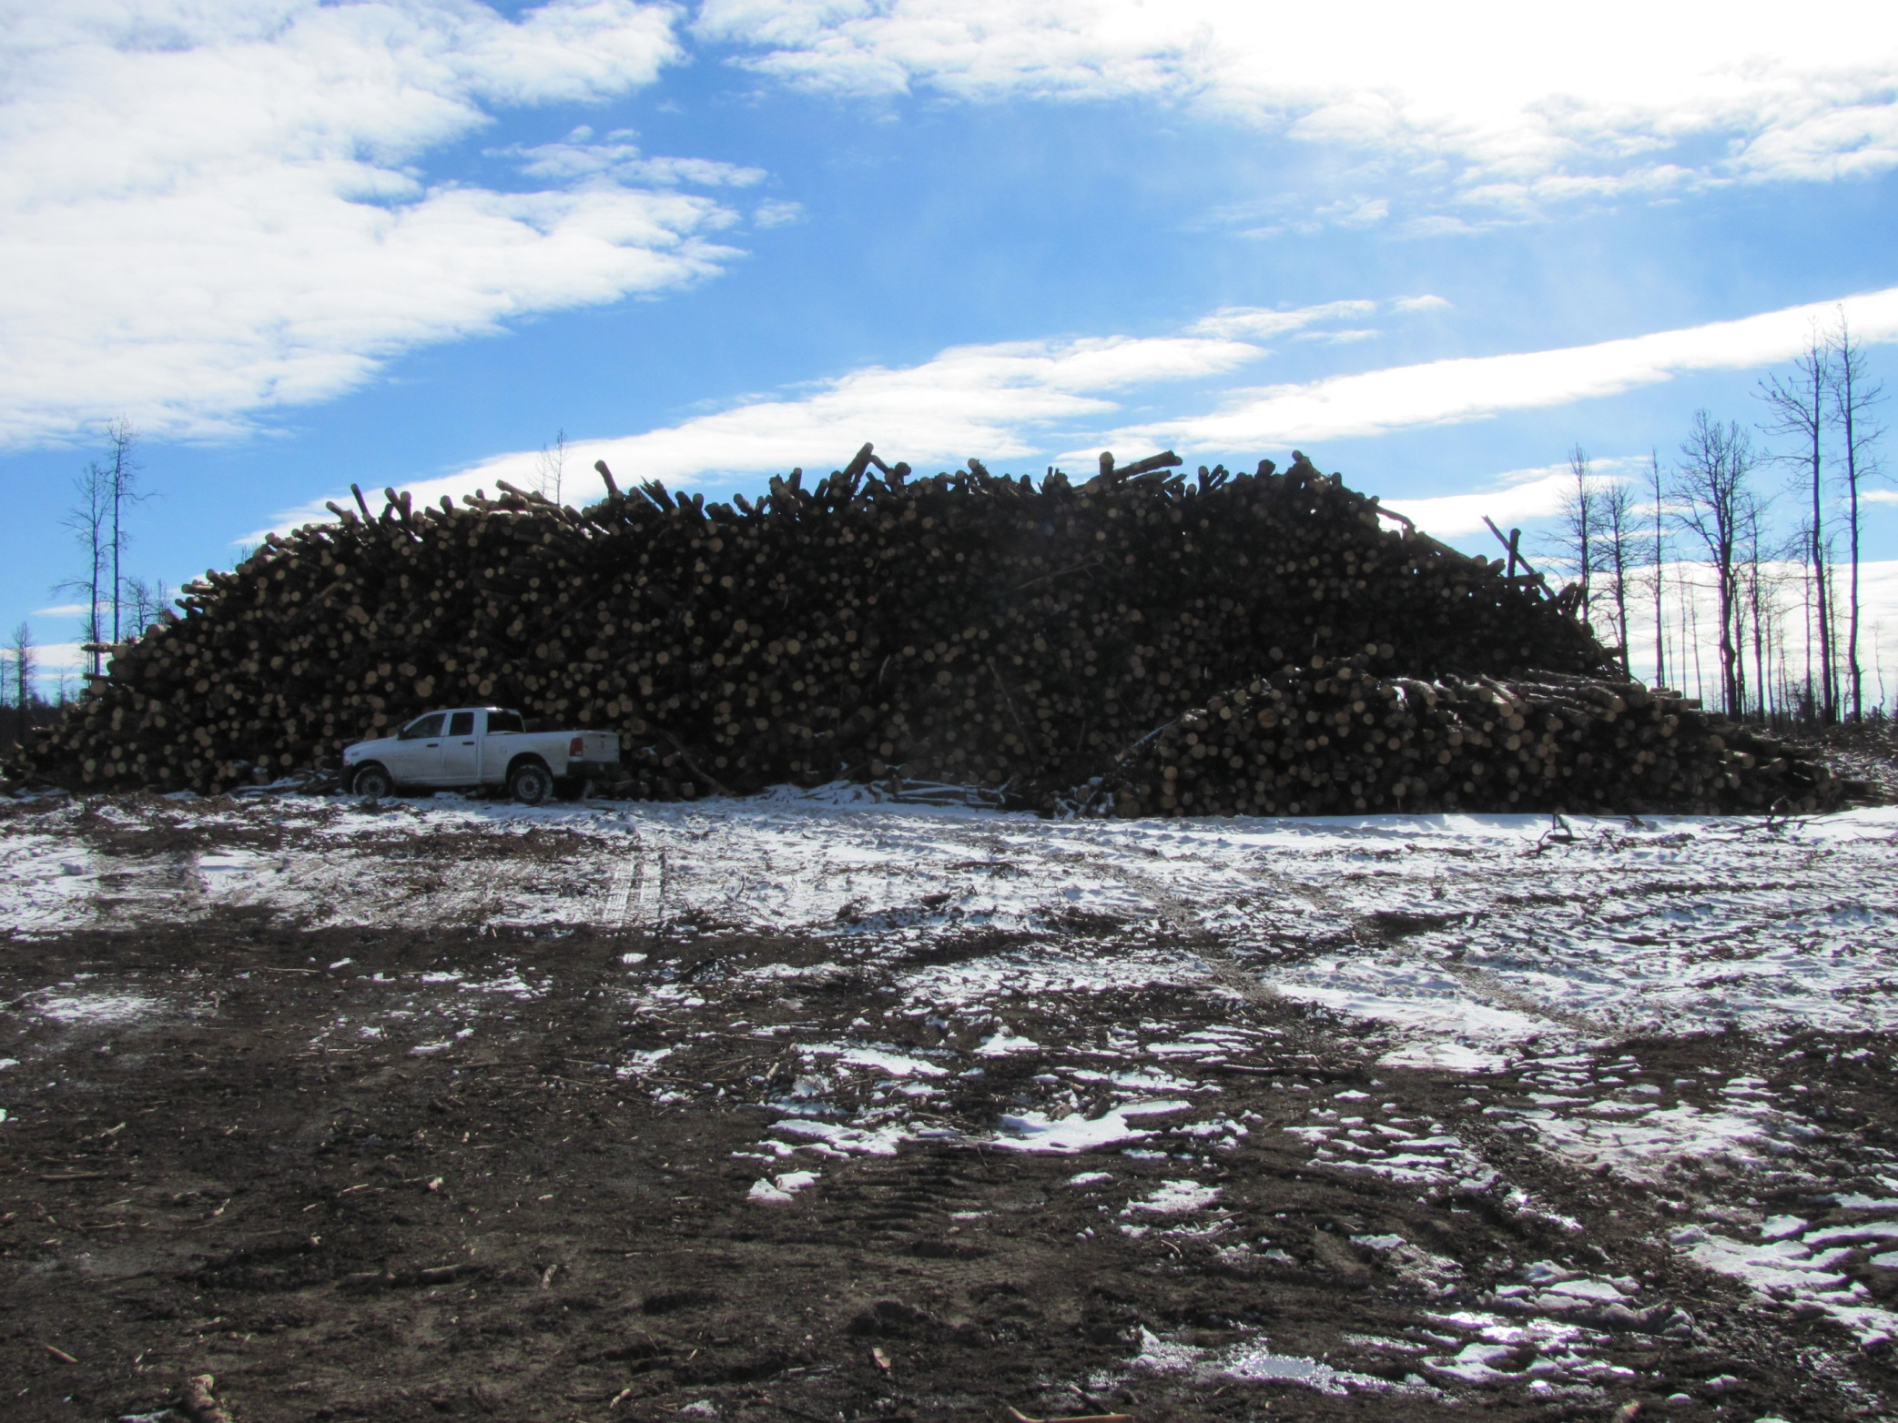
Neighbors Helping Neighbors: Landowners have granted West Range
Reclamation permission to store logs from neighboring properties on their
land for processing. Others have allowed logs to be skidded across their
properties or logs to be decked on and hauled from their properties.
That is the Black Forest Spirit!

Slide 40
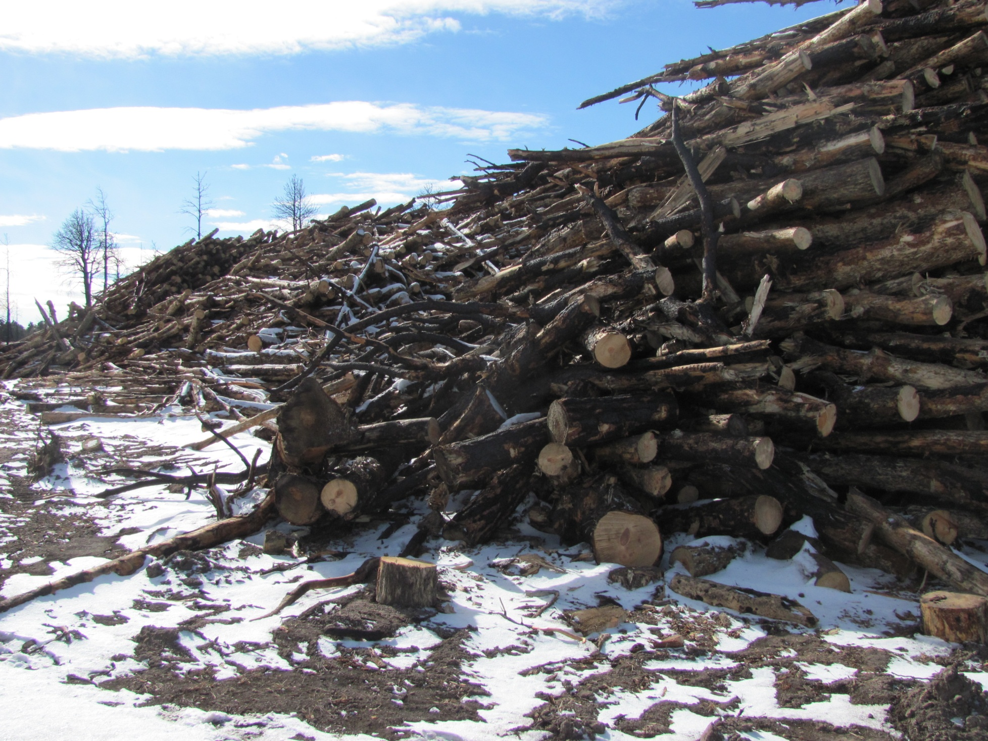
Side view of the log deck shown in the previous slide – 4 layers deep!
This gives some sense of the volume being removed; and realize that
the sawlogs have already been removed from these decks. All of this
material will be ground for mulch products.

Slide 41
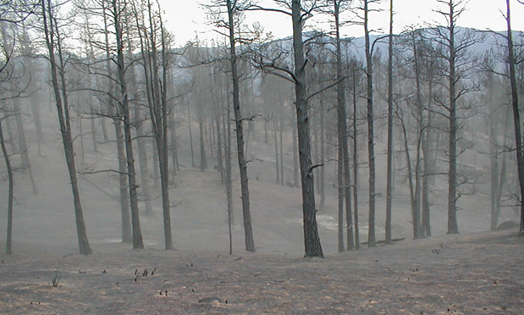
Expected Post Fire Recovery
A High Burned area on Denver Water’s
Cheesman Reservoir Property immediately
after passage of the 2002 Hayman Fire.

Slide 42
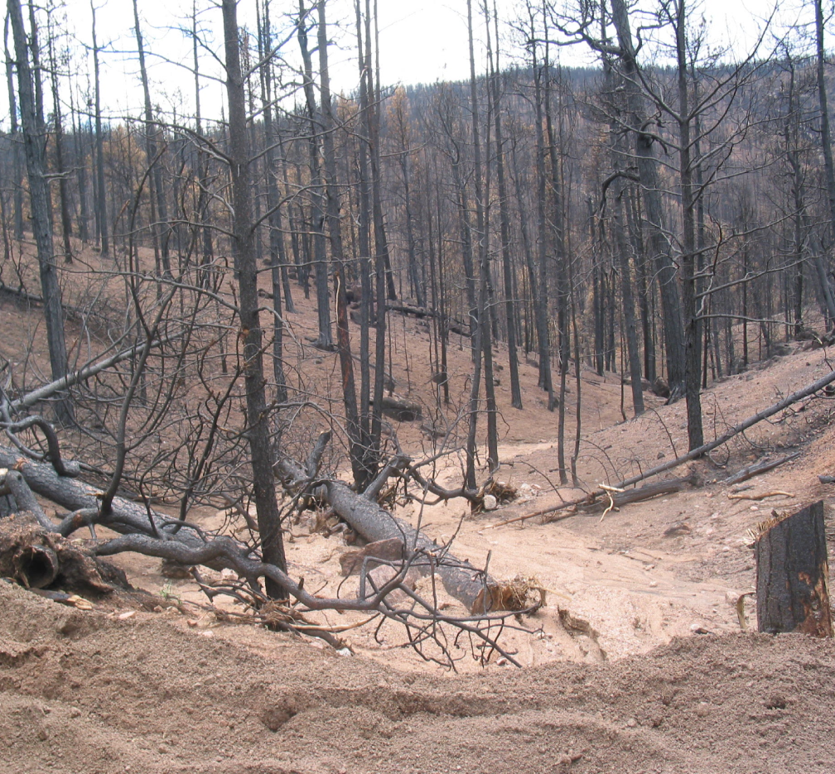
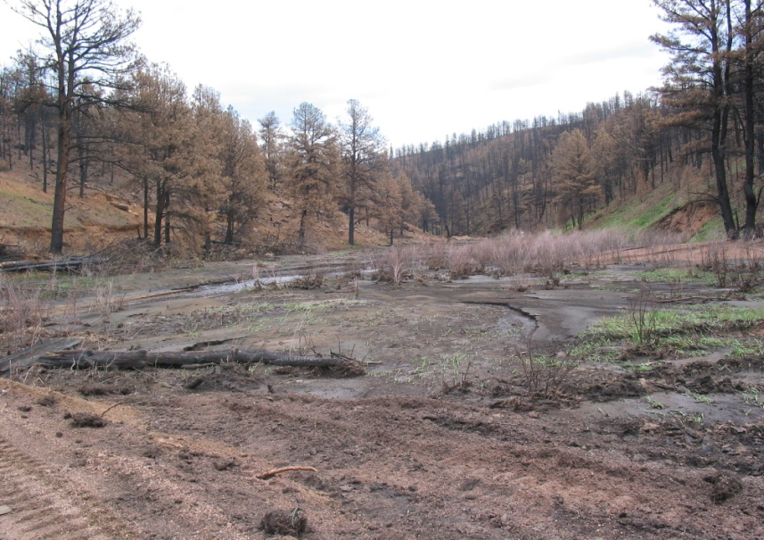
Post-fire erosion and sedimentation
(above and left)
Often, heavy rains and flooding follow intense fires

Slide 43
At Cheesman Reservoir
post-fire mechanical harvesting,
re-seeding, and mastication
were conducted, just as is now
occurring in the Black Forest.
Post-fire harvest at Cheesman Reservoir
(left and above)
Mastication Treatment & grass
seedlings emerging from mulch
(left and below)

Slide 44
West side of reservoir
end of 2003 (first growing season)
Landscape view of west side
June, 2004
In the picture above, note the distinct green islands where mechanical treatments occurred
compared to the steep slopes where only grass seeding occurred.

Slide 45
Grasses are well established and flourishing
at the start of the 3rd growing season

