Slide 1
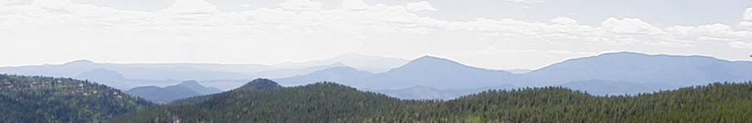
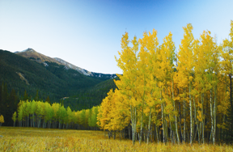

Forest Restoration Grant Program
  Naomi J. Marcus
  Forest Stewardship Coordinator
  July 26, 2013
www.csfs.colostate.edu

Slide 2

For Funding Opportunities…
Visit http://csfs.colostate.edu/pages/funding.html
Contact your local CSFS forester http://csfs.colostate.edu/pages/your-local-forester.html
www.csfs.colostate.edu
Notes:
To find out what sort of landowner assistance programs are available, visit the CSFS website, particularly the funding opportunities webpage where you may access a matrix of programs, some of which the CSFS facilitates the administration.
Matrix will identify the basic items of eligibility, i.e. CWPP or FSMP.
For more specific details→CSFS forester

Slide 3
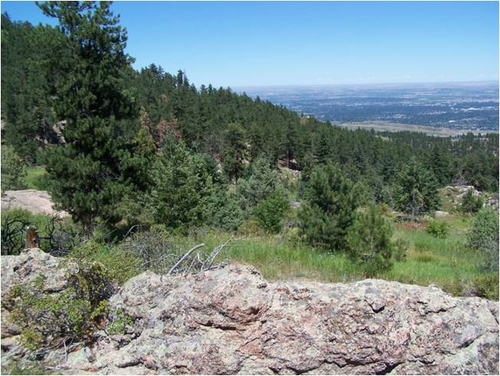
The Program
Demonstrate community-based approach of forest restoration
Collaboration!
HB07-1130
SB08-071
HB09-1199
HB12-1032
www.csfs.colostate.edu
Notes:
Colorado General Assembly makes a strong push with forestry related legislation
2007 (funding CWCB), 2008, 2009 (3 rounds), drop pilot 2012
Operation Account of Severance Tax
Up to $1 million dollars annually starting with SB71-97% to the ground
Encouragement to use youth corps
Advisory panel-1 CSFS, 1 DNR, at least 1 federal land management agency, 2 independent scientists, equal representation from commodity, community and conservation
60/40 cost-share

Slide 4
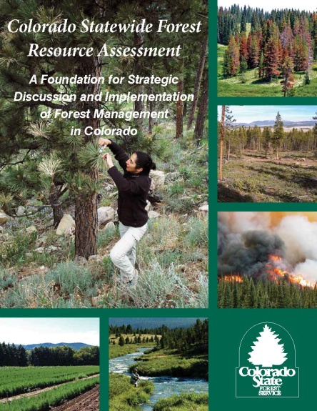
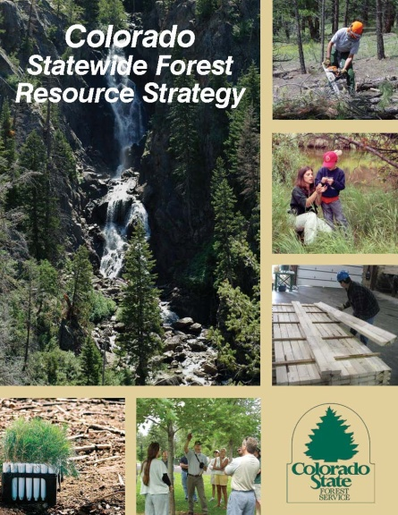
Criteria
Basic eligibility
  60/40
  Location
  CWPP
Forest Action Plan
Colorado Youth Corps
Water Resource Protection
  Multiple objectives
Be specific!
www.csfs.colostate.edu
Notes:
-Anyone can apply as long as they have legal authority to access properties and project areas.
-Firewise Communities/USA
-2008 Farm Bill Directed all state forestry agencies to submit an Assessment and Strategy by June 2010. Companion documents. Firm assessed population and Forest Action Plan resounded with the average person.
Objectives: primary has been water source protection
Add’l objectives: fire risk reduction, retention of large trees, utilization of small diameter wood products

Slide 5
Accomplishments
Anticipate HB09-1199 R3 (17 projects): Awarded $815,365;
Leverage $853,442; 1205 acres
Anticipate HB12-1032 R1 (15 projects): Awarded $973,089;
Leverage $1,476,947; 2057 acres
Legislation | Projects Awarded | Funds Granted | Funds Leveraged | Counties Engaged | Acres Treated
HB07-1130 | 12 | $977,345 | $1,355,004 | 11 | 3115
SB08-071 | 28 | $1,800,000 | $3,500,000 | 13 | 6000
HB09-1199 R1 | 17 | $970,000 | $2,000,000 | 13 | 1500
HB09-1199 R2 | 12 | $1,132,825 | $1,188,629 | 12 | 1482
Notes:
86 projects plus HB1032

Slide 6
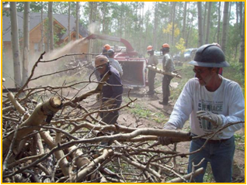
Highlight - Coalition for the Upper South Platte
Awarded funds from HB1130 and SB071
  Teller and Park counties
  ~1600 acres treated
  ~43,000 Volunteer hours
Activities
  Fuel mitigation
  7600 seedlings planted to reduce erosion and improve water quality
  40 cords of firewood was donated to Teller County residents who needed fuel for heating
  50 logs sold to a local saw mill, and revenues for log sales was donated to the non-profit group Help the Needy

Slide 7
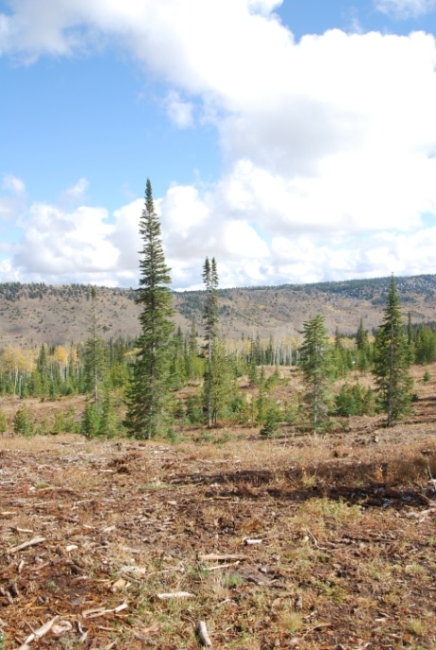
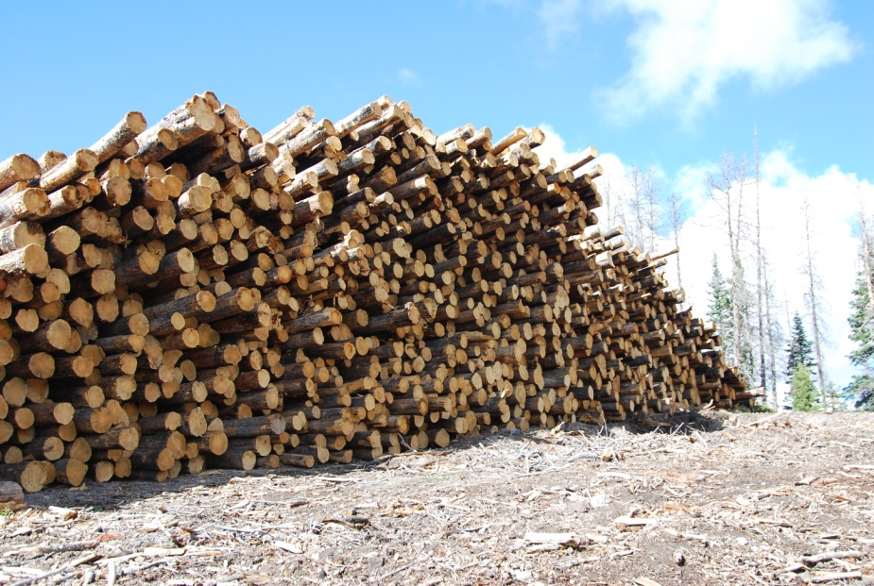
Highlight – Buffalo Creek Ranch
Awarded funds from HB1199 Round One
  Jackson County
  157acres
  Cross-boundary
Activities
  Wood utilization
  Mountain pine beetle response/fire mitigation
Notes:
130 semi truck loads of forest products were harvested and utilized in local and regional markets, including two local pellet mills.

Slide 8
Highlight – Tamarisk Coalition
Awarded funds from HB1199
  Mesa County
  89 acres completed, 86 acres, 65 acres
  Youth Corps
Activities
  Tamarisk and Russian olive eradication
  Native grass seeding
  Willow planting

Slide 9
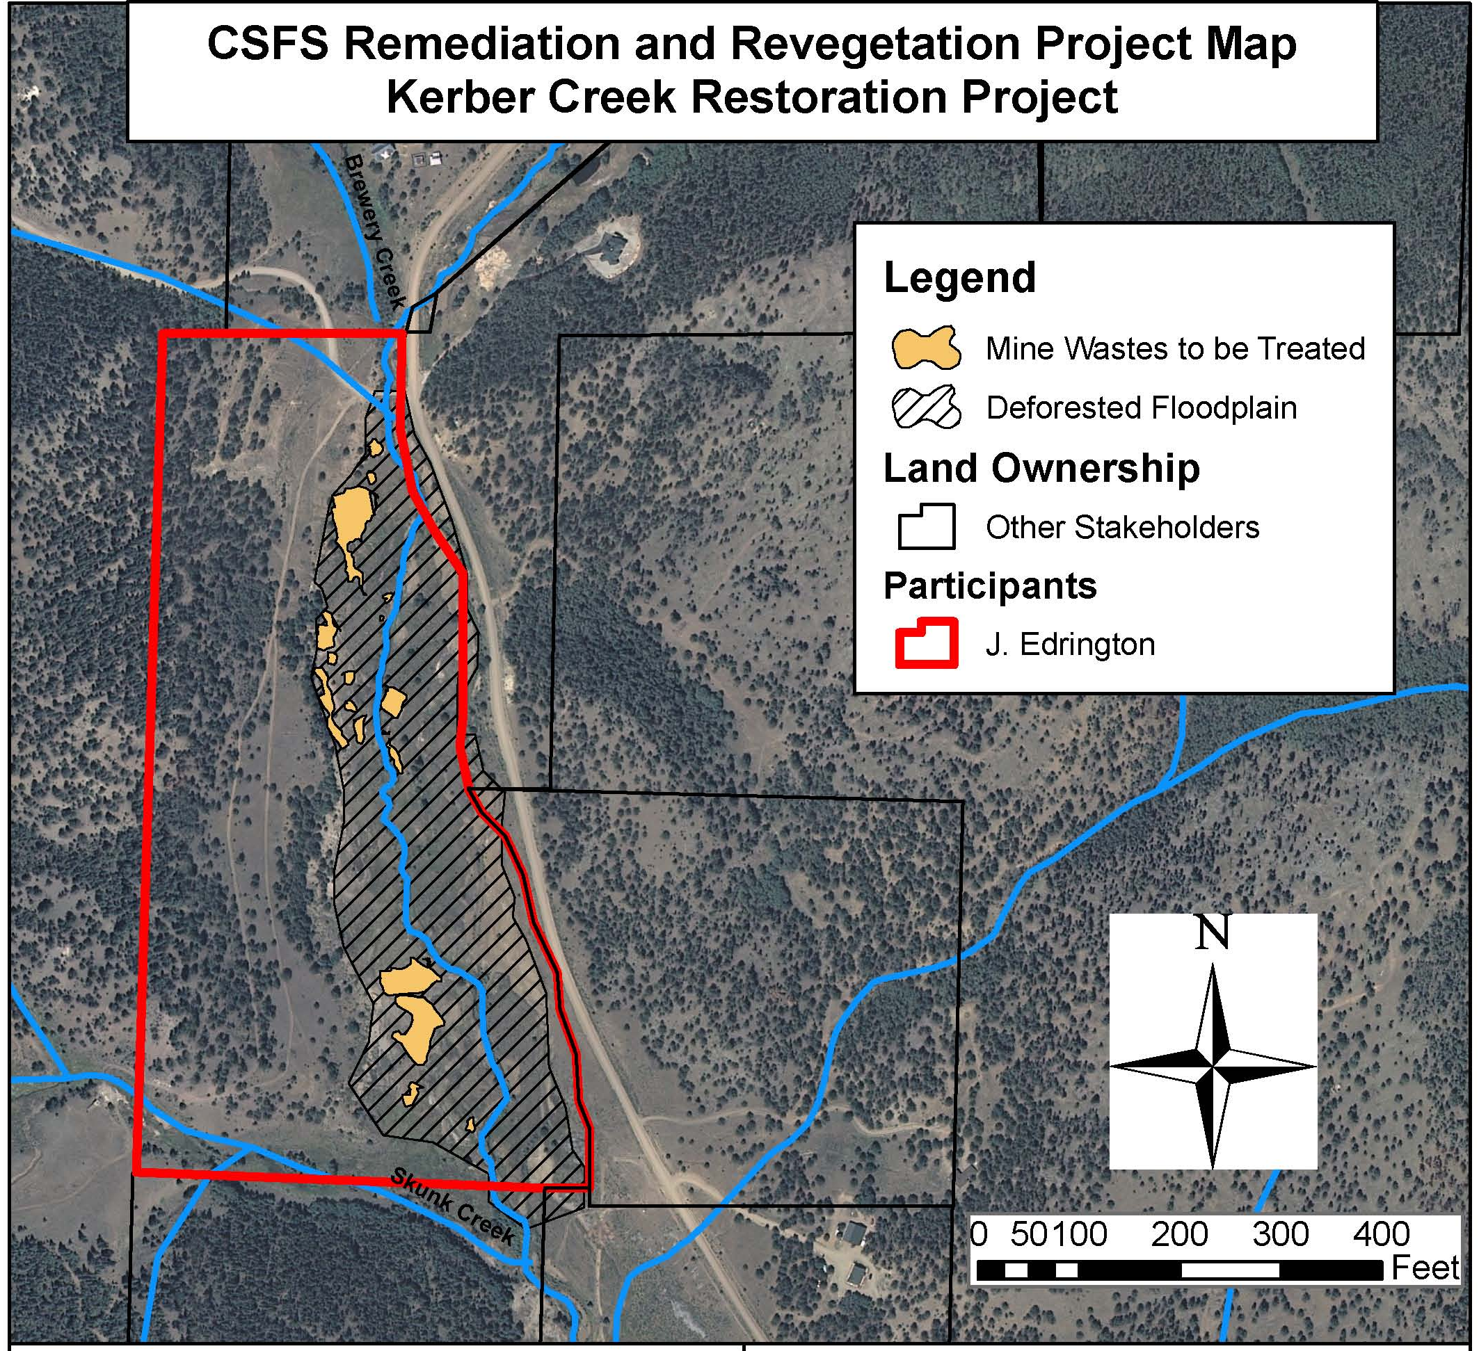
Highlight – Kerber Creek
Awarded funds from HB1199 Round Two
  Saguache County
  Over 2 acres riparian
  restoration
Activities
  Stream stabilization and
  reshaping
  Native seedling planting
Notes:
Remediating 17 mine waste deposits and 30 rock structures
Incorporate lime and limestone soil amendments
Planted willow, alder and cottonwoods
Reshape stream channel-3:1 slope minimum

Slide 10

Applying for a Grant
Request for Proposal released January
Prepare and submit proposal (approx 4-6 weeks) February
District review first-initial screening (1-2 weeks)
State office screening (approx 2 weeks)
Advisory panel review (approx 4 weeks)
Advisory panel discussion (1 day)
Recommendations to the State Forester
Notifications
  Scope of Work
  Funding amount/matching expectations
  Project deadlines
www.csfs.colostate.edu

Slide 11
Questions, Comments, Concerns….
Naomi J. Marcus
naomi.marcus@colostate.edu
970-491-6303
www.csfs.colostate.edu

