Slide 1
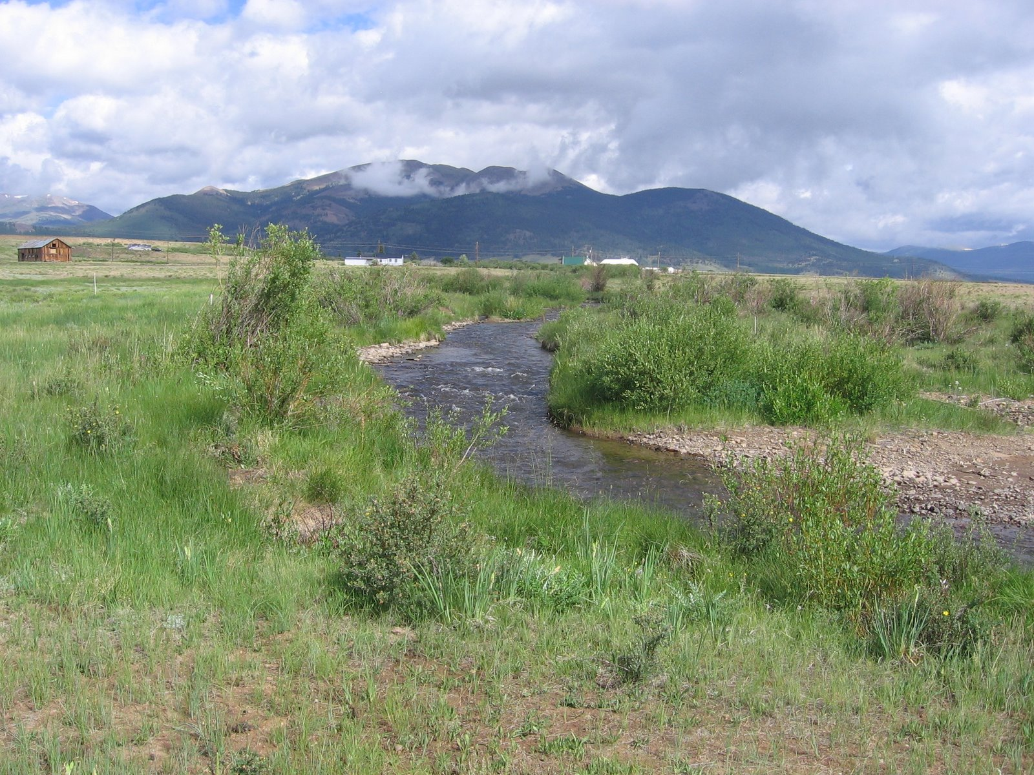

Colorado Water Conservation Board
Watershed Protection and Restoration Program
Chris Sturm
Colorado Water Conservation Board
Stream Restoration Coordinator
303 866 3441
chris.sturm@state.co.us

Slide 2
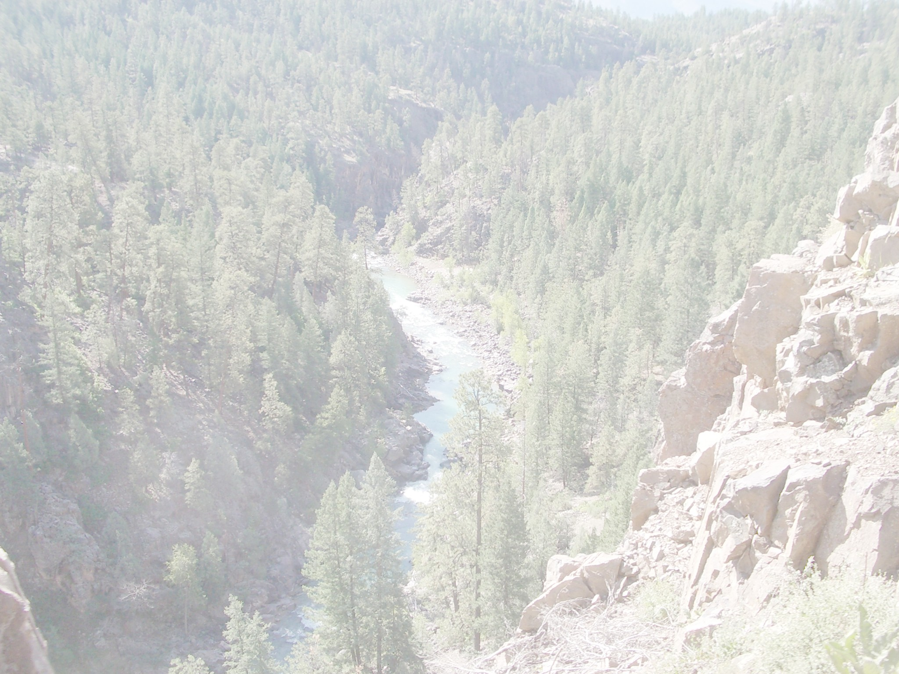
ORGANIZATIONAL CHART
GOVERNOR
DEPARTMENT OF NATURAL RESOURCES
COLORADO WATER
CONSERVATION BOARD
Oil & Gas
Conservation
Commission
State
Land
Board
Division of
Minerals &
Geology
Colorado Parks
& Wildlife
Co. State
Forest
Service
Division of
Water
Resources
SERVICES
Watershed &
Flood Protection
Interstate, Federal
& Water Information
Stream & Lake
Protection
(In-Stream Flows)
Dam Safety
Water Commissioners
Well Inspections
Water Rights
Augmentation Plans
Finance
Section
Water Supply
Planning
http://cwcb.state.co.us

Slide 3
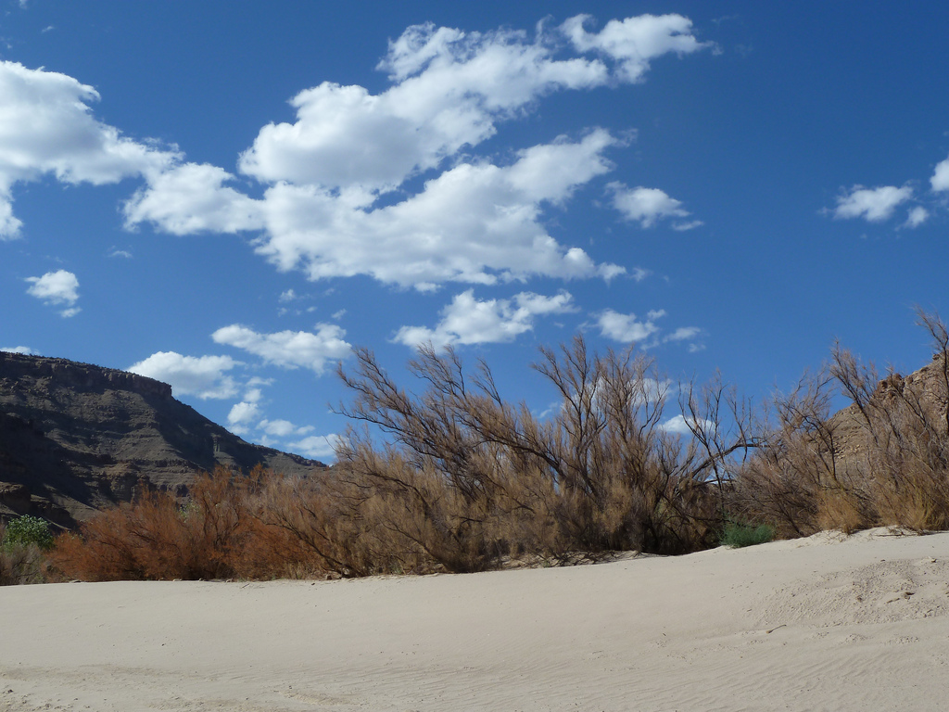

Colorado Water Conservation Board
Watershed & Flood Protection Section
Grant Programs:
Invasive Phreatophyte Control Program (IPCP)
Colorado Watershed Restoration Program (CWRP)
Colorado Healthy Rivers Fund (CHRF)
Fish and Wildlife Resources Fund

Slide 4
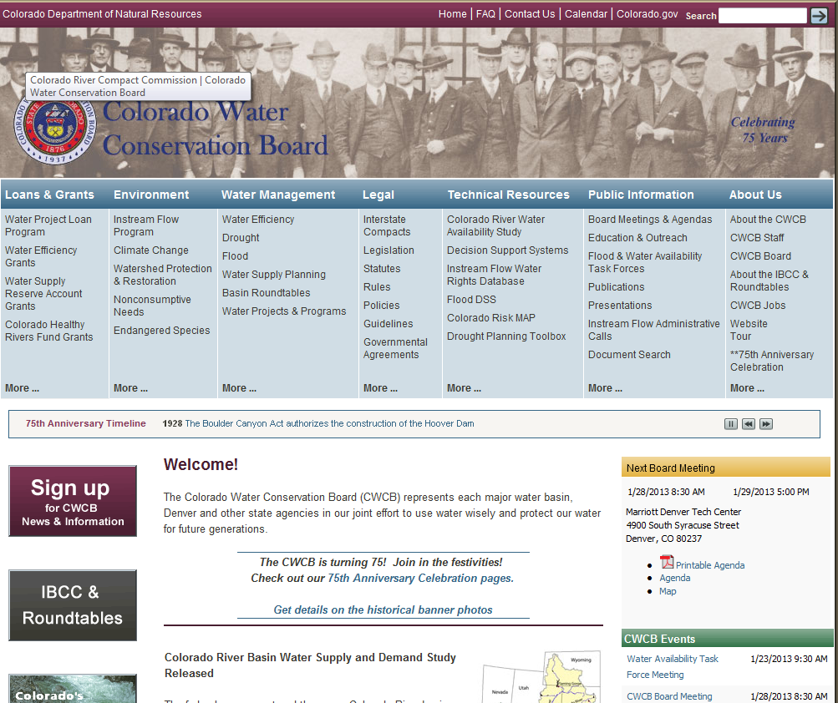
2. CLICK HERE
1. http://cwcb.state.co.us

Slide 5
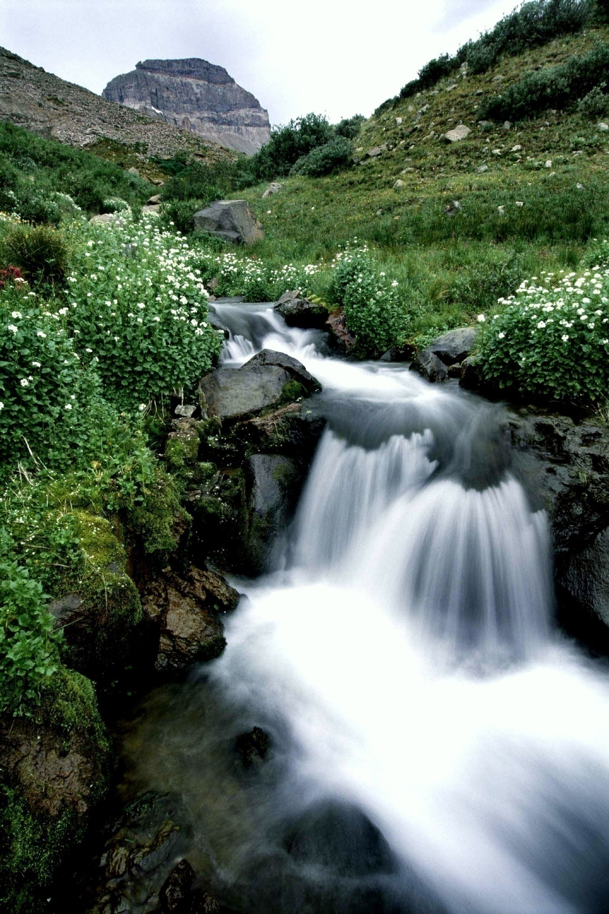
Colorado Watershed Restoration Program
Commitment to collaborative approaches
Commitment to protect and/or restore ecological processes that connect land and water
Broad based involvement and support
Match support (50%)
Photo Courtesy of Travis Reid Watercress Stream Uncompahgre Wilderness www.travisreidphotos.com

Slide 6
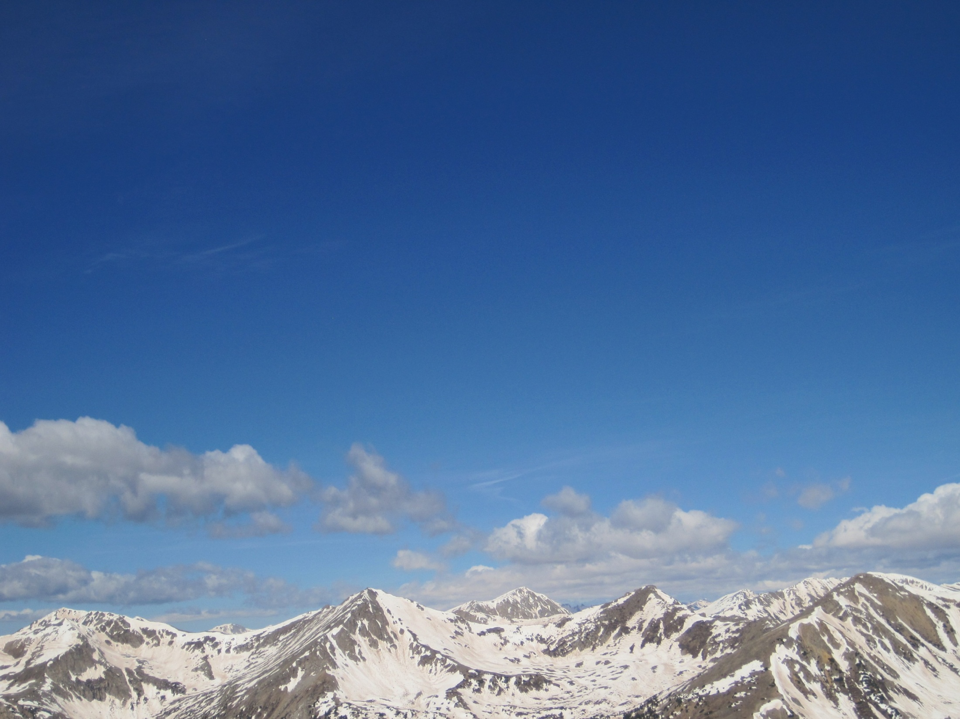
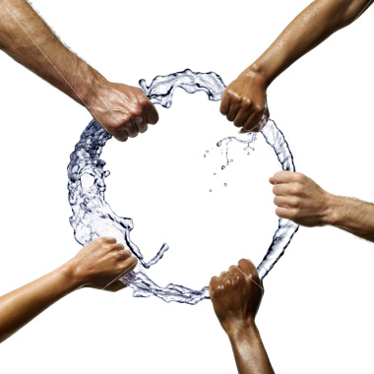
Stakeholders
Land Trust
Farmers/Ranchers
Citizens
Government
Volunteers
Academics
Consultants/
Contractors
Recreation
Funders
Notes:
Smaller projects have merits, but we are interested in watershed wide efforts. Multiple stakeholders bring information from all parts of the watershed. An issue in one location may be caused by something going on in another part of the watershed. The stakeholder process typically catches this.

Slide 7
Colorado Watershed Restoration Program
Timeline
Application Available: July 1
-Due Date: September 30
-Applicant Notification:
December 15
-Grants Awarded:
December 15
-Progress Reports Due: Annually
Photo Courtesy of Travis Reid Watercress Stream Uncompahgre Wilderness www.travisreidphotos.com

Slide 8
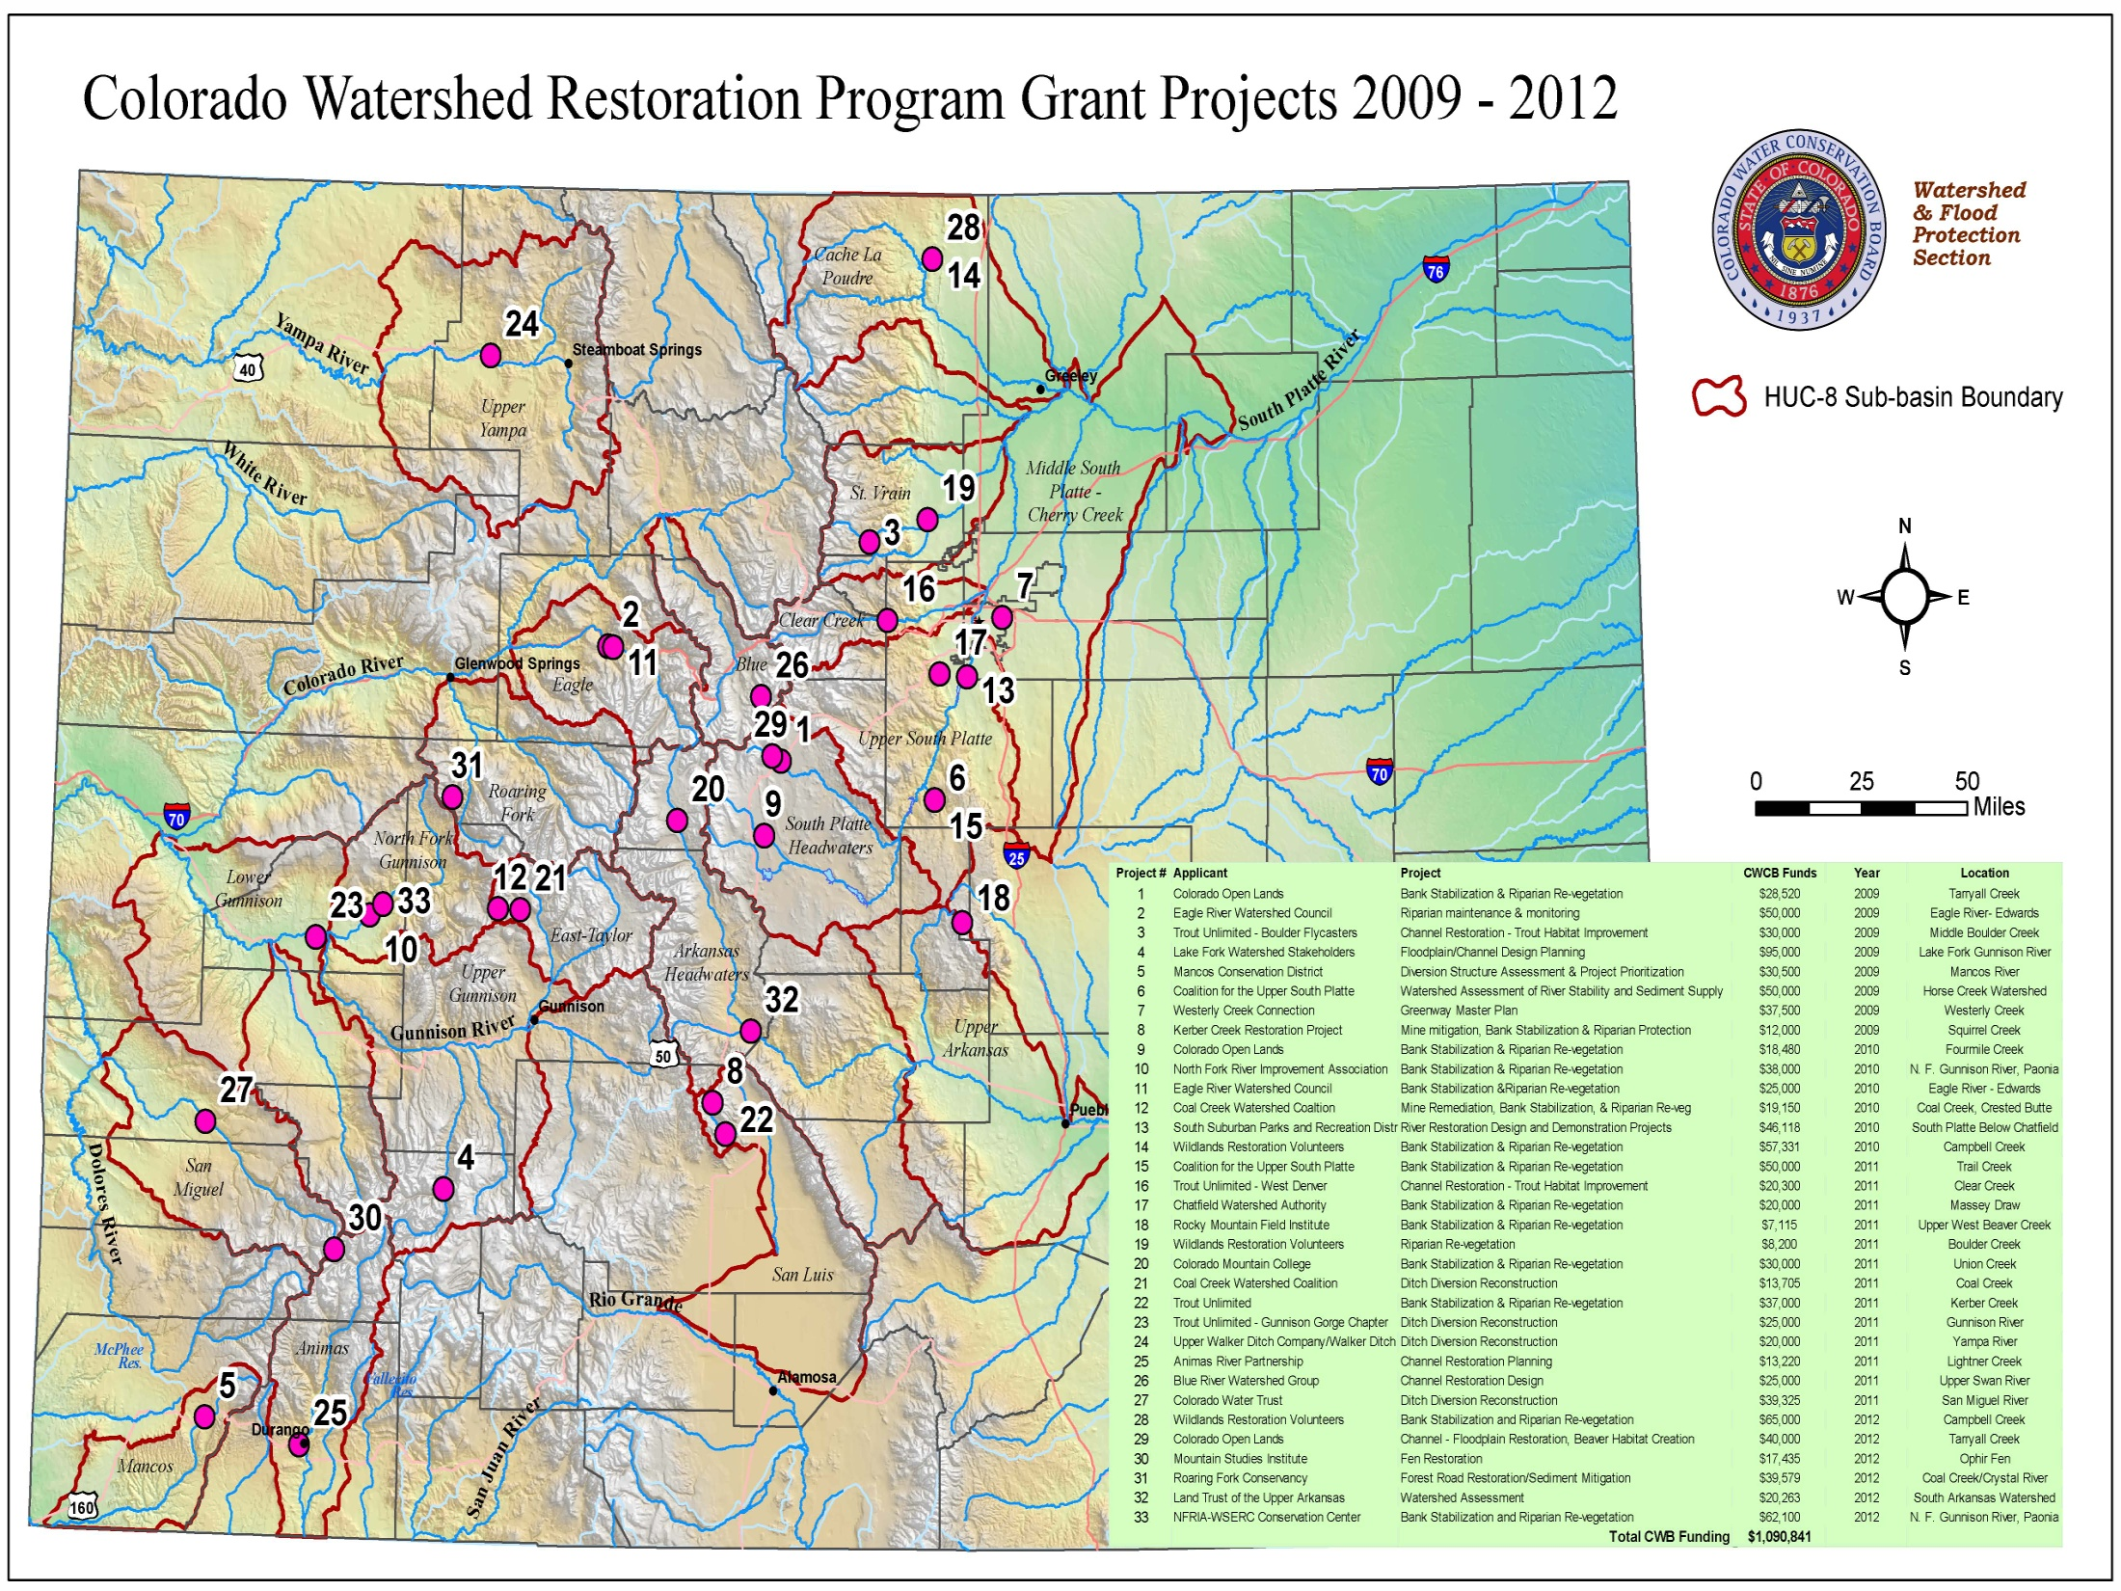

Slide 9
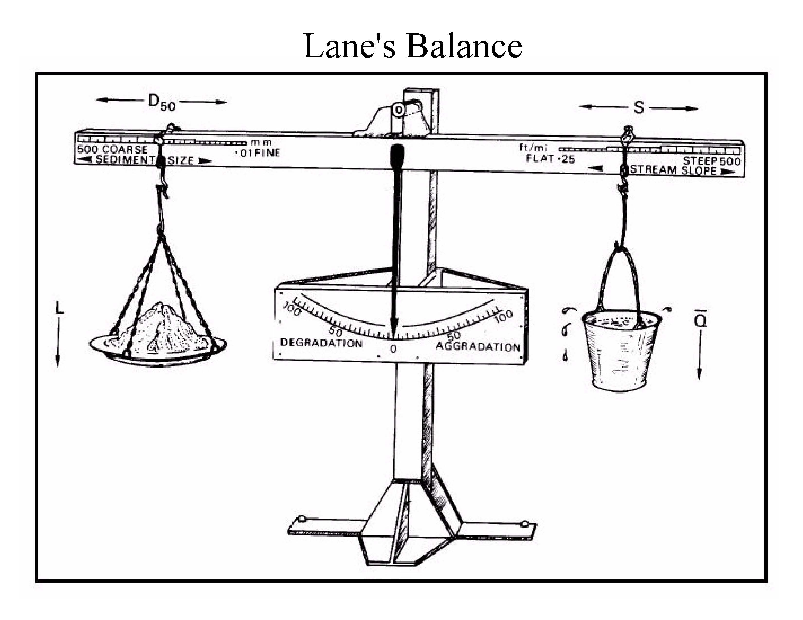
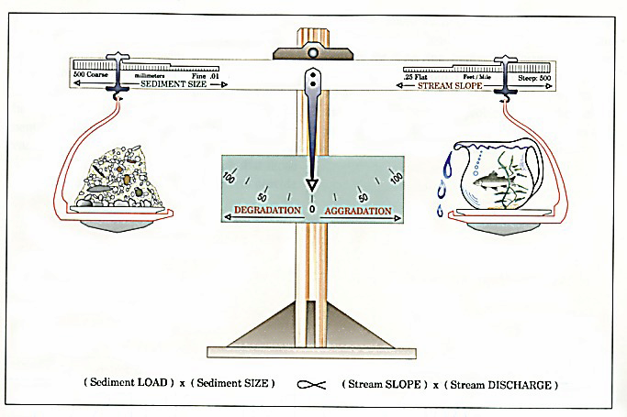
Notes:
Four key variables: Sediment Size, Sediment Supply, Slope, Discharge
River is more than water. River is water and earth. It moves both from the mountains to the sea (or downstream res.)
Changes in one w/o a response from others will lead to disequilibrium, i.e. undesirable channel form
Increase in sediment supply with no other changes will decrease slope and increase aggradation.
Decrease in Q will increase sediment size and aggradation
Natural System – adjustments to one result in balance from the other.
Dynamic equilibrium – balance rocking back and forth

Slide 10
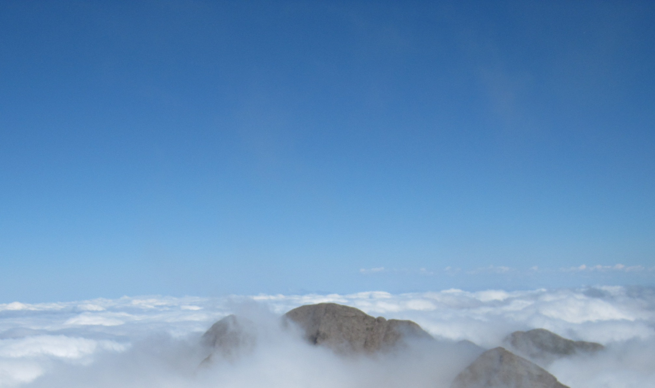
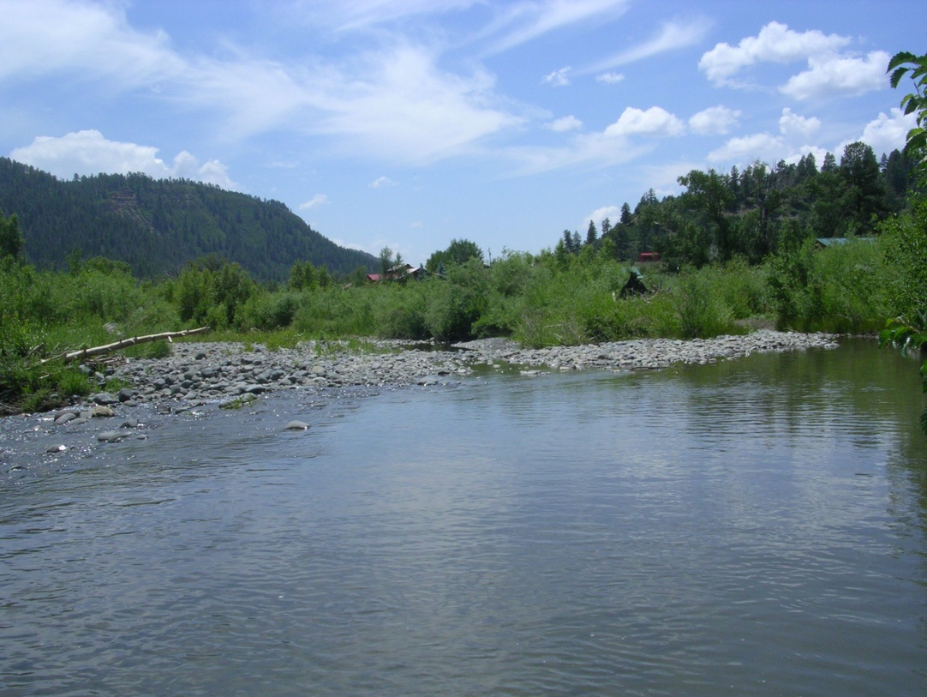
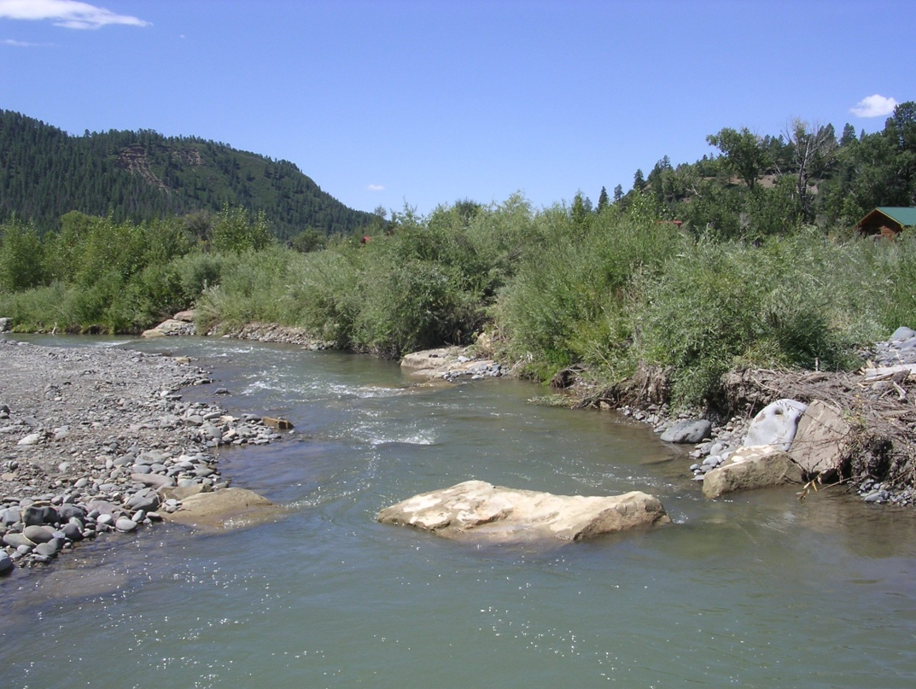
Before: Over wide, braided into 3 channels
AFTER: Single channel with rock bank protection and habitat rock
Notes:
Upstream diversion sluiced gravel/cobble. Lack of bankful events to transport material. Large flood event entrained excess substrate. Result – depositional area that subsequently braided.

Slide 11
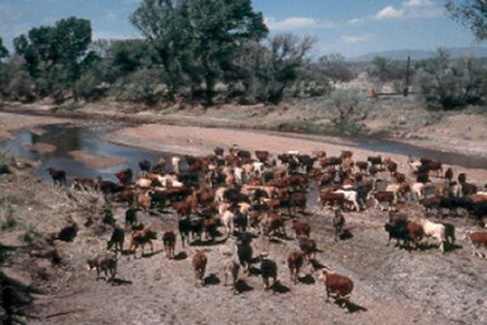
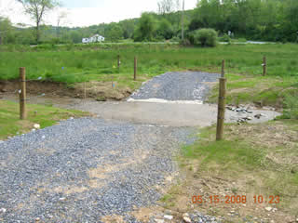
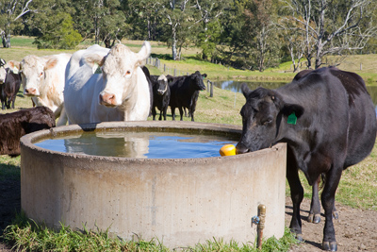
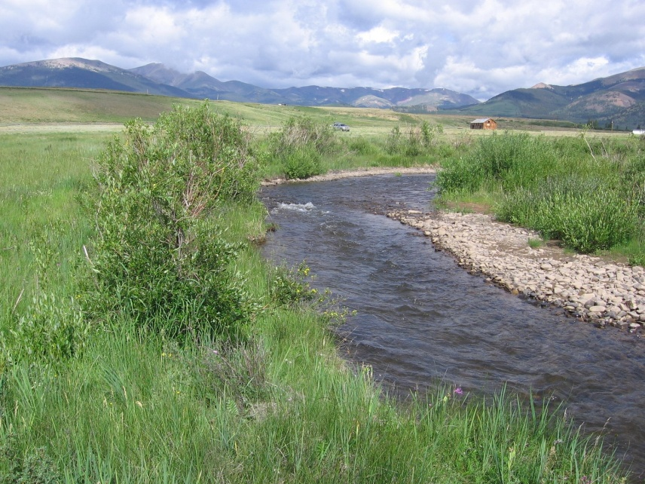
Notes:
Problem – solution Why is the stream wide, devoid of vegetation, and aggrading sediment?

Slide 12
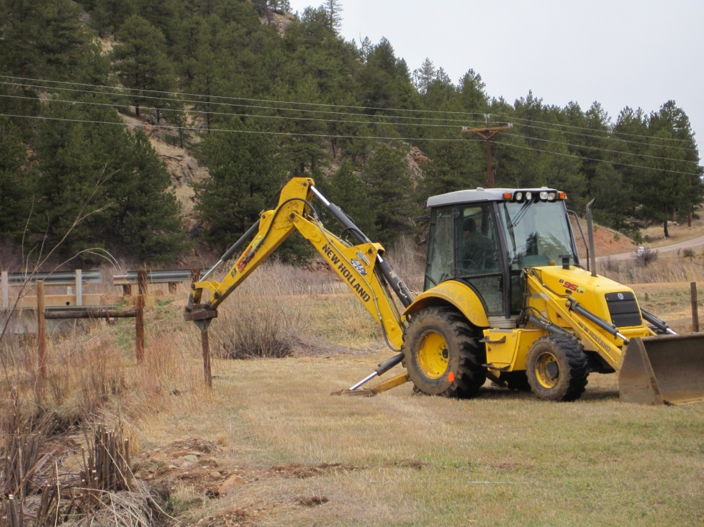
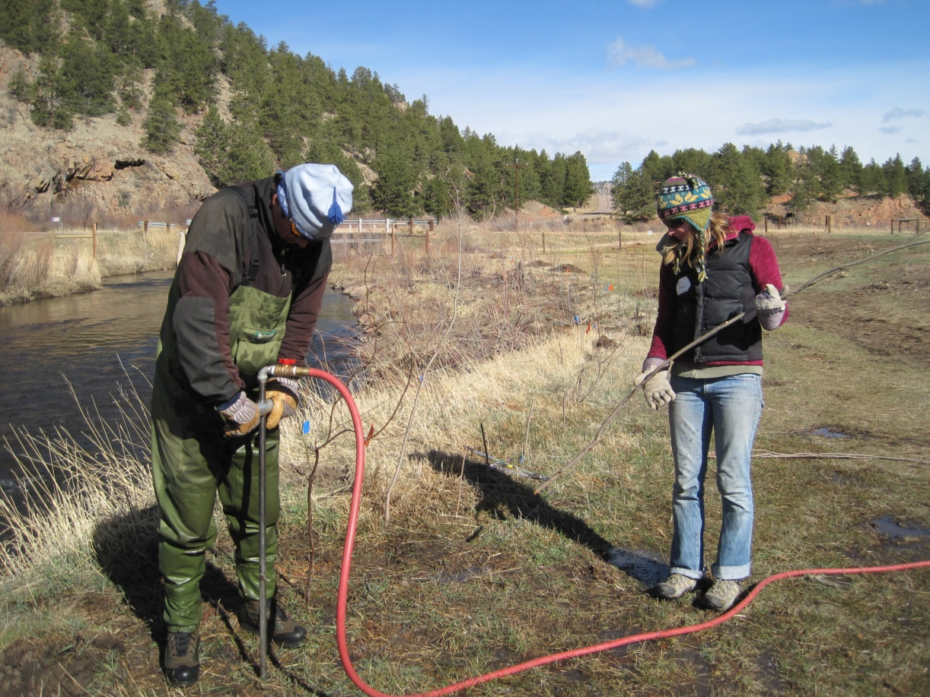
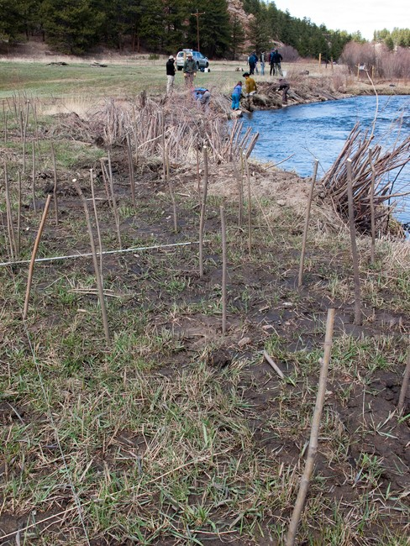
Notes:
Partnership – COL easement, rancher (alternative watering area), WRV, Park County, MRP
Funding – CWRP

Slide 13
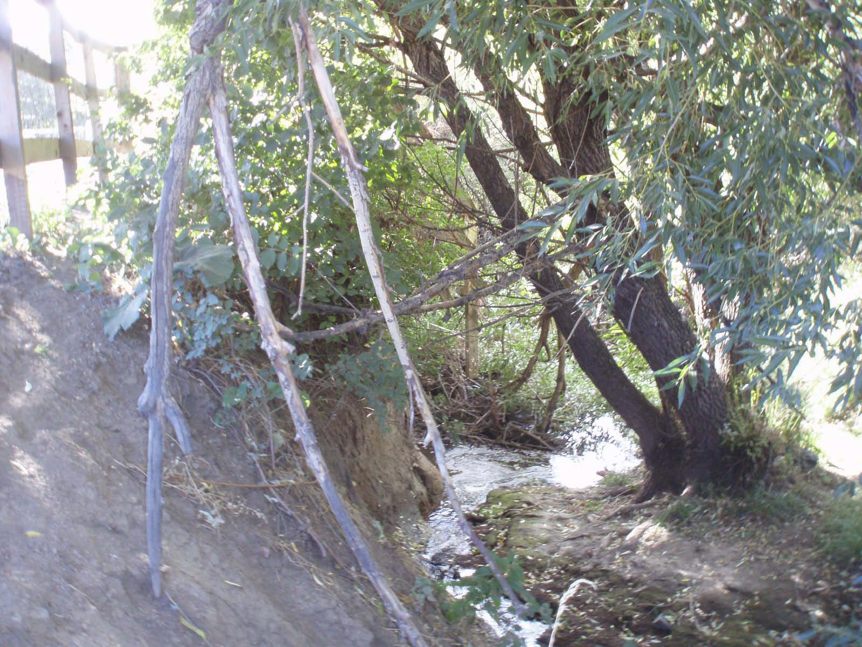
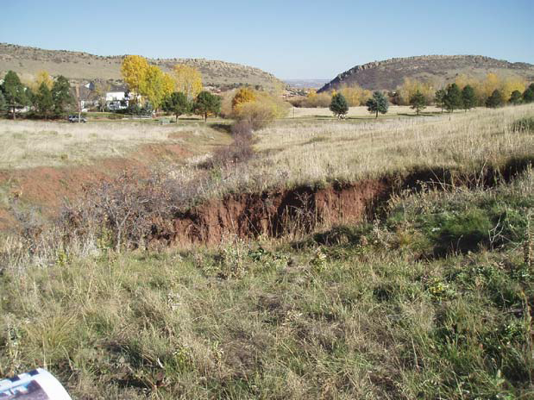
North Massey Draw at
Ken-Caryl Ranch

Slide 14
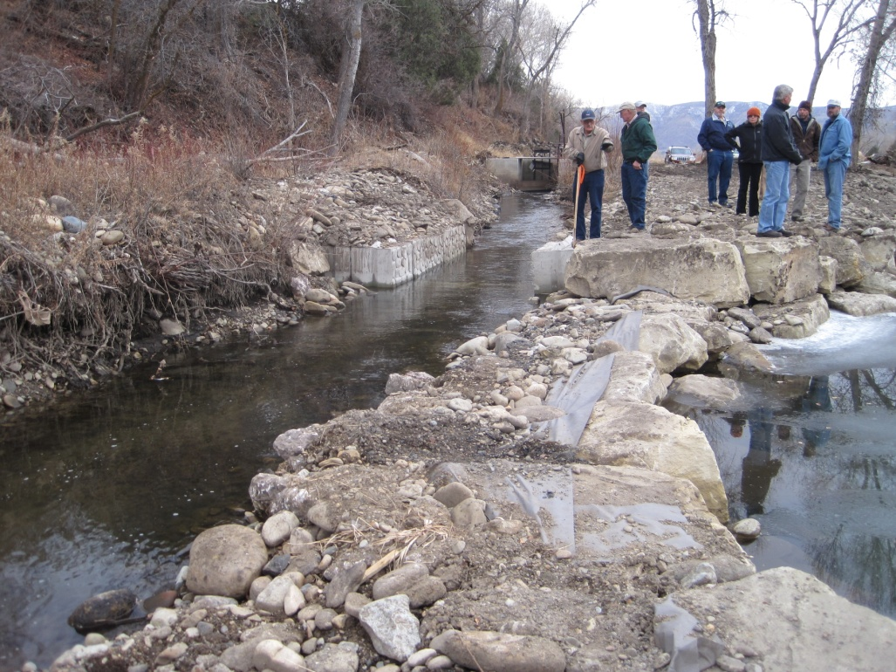
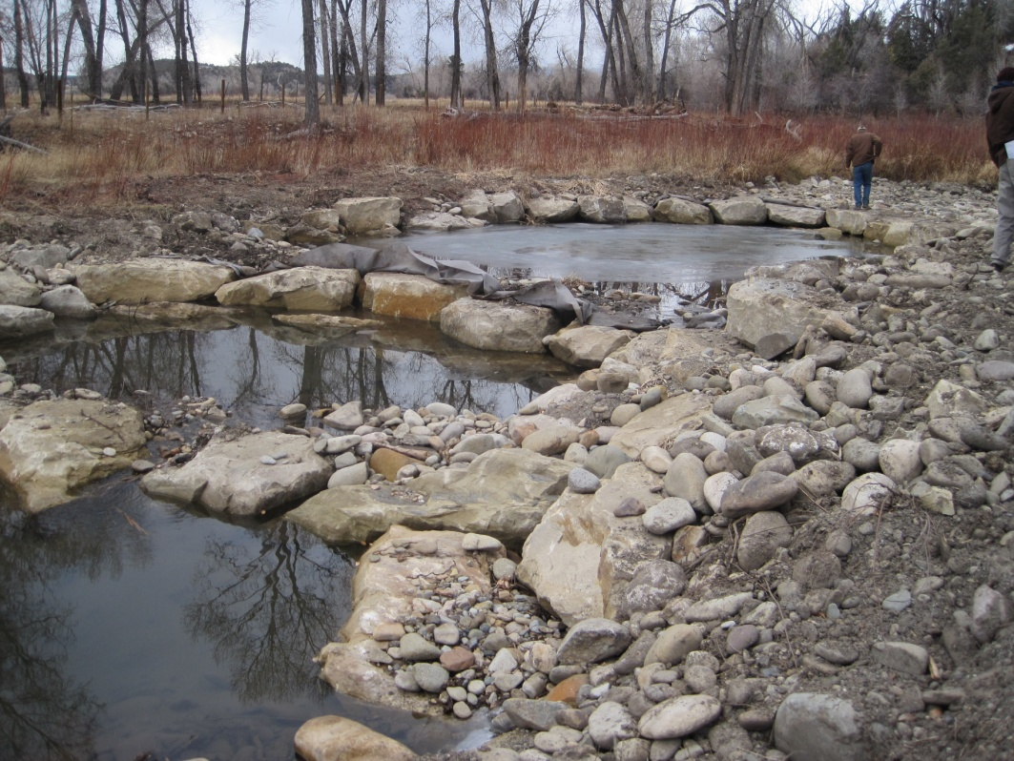
Beaver Ditch Diversion Reconstruction
Notes:
New structure reconnects river channel with floodplain. Also provides pool habitat (critical for winter low flow periods).
Funding sources – CWRP, WSRA, SEV – 3 phases – Ditch Assessment, Diversion Design, Construction

Slide 15
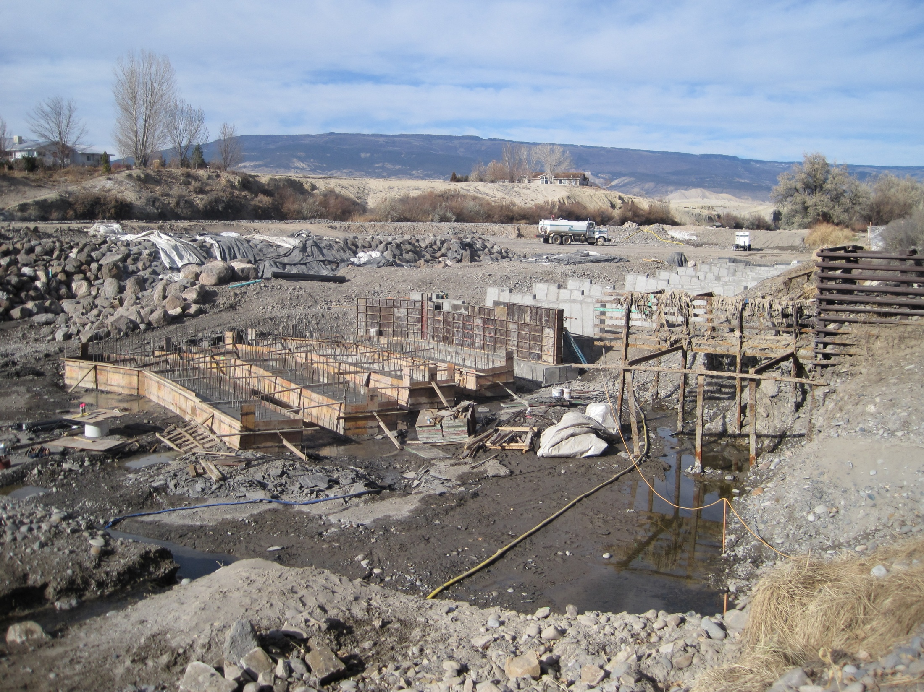
Hartland Diversion
Dam Reconstruction
Notes:
May be adequate flows to protect environment through ISF or otherwise, but channel barriers prevent int.eractions amongst fish meta-populations
Funding Sources – FWRF, WSRA

Slide 16
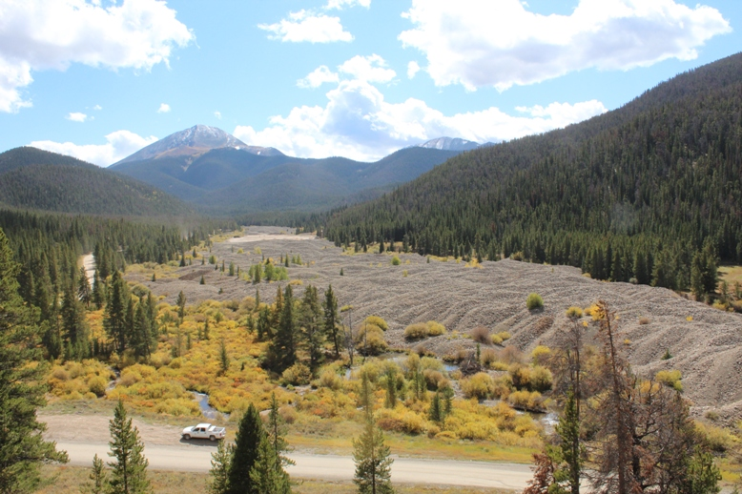
Swan River Restoration Site
Notes:
Mining legacy, no longer mine gravel/cobble this way. Material to be removed. Channel and Floodplain will be constructed.
Who’s problem is it? Everyone in the watershed, including mining company.
Funding – CWRP (feasibility study), WSRA (25% design and cost est), next step – Design/build - $ Construction?

Slide 17
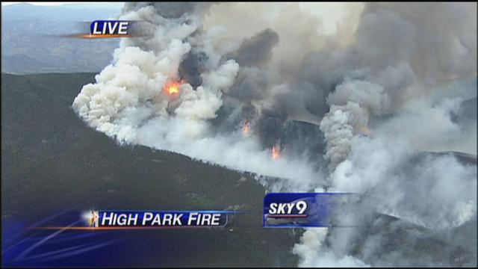
Notes:
City of Greeley slide. Flight reference with High Park - Descending into belzebub’s cauldron

Slide 18
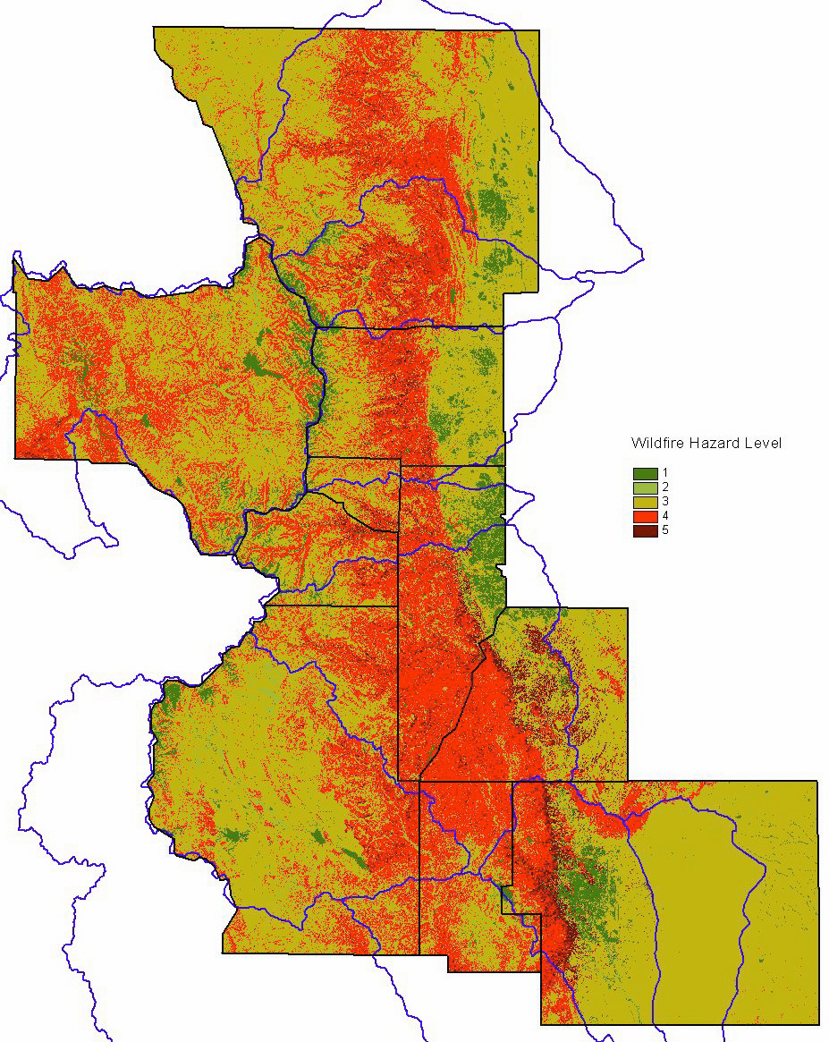
Watershed Wildfire Protection Group -
“Protection Critical Watersheds in Colorado from Wildfire: A Technical Approach to Watershed Assessment and Prioritization”
Composite Hazard Ranking:
Wildfire Hazard
Flooding/Debris Flow Risk
Soil Erodibility
Final Watershed Prioritization:
Combines Composite Ranking
+
Water Uses Ranking (uses SWAP data)
Notes:
Wildfire Hazard – data from CSFS, including fuel hazard, disturbance regime, aspect, slope
Flooding/Debris Flow – slope, road density indicators of ruggedness
Soil Erodibility – slope + K factor (inherent susceptibility of soil to erosion)
NEED to drill down into smaller units to further prioritize within basins (HUC – 8 or 4th level, basin level).
Ideas for the future! NEPA, pre construction sediment retention designs

Slide 19
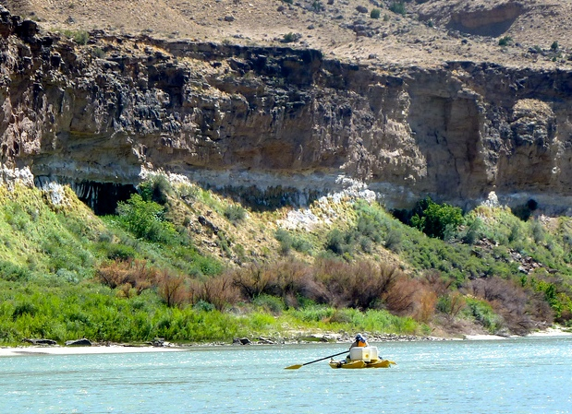
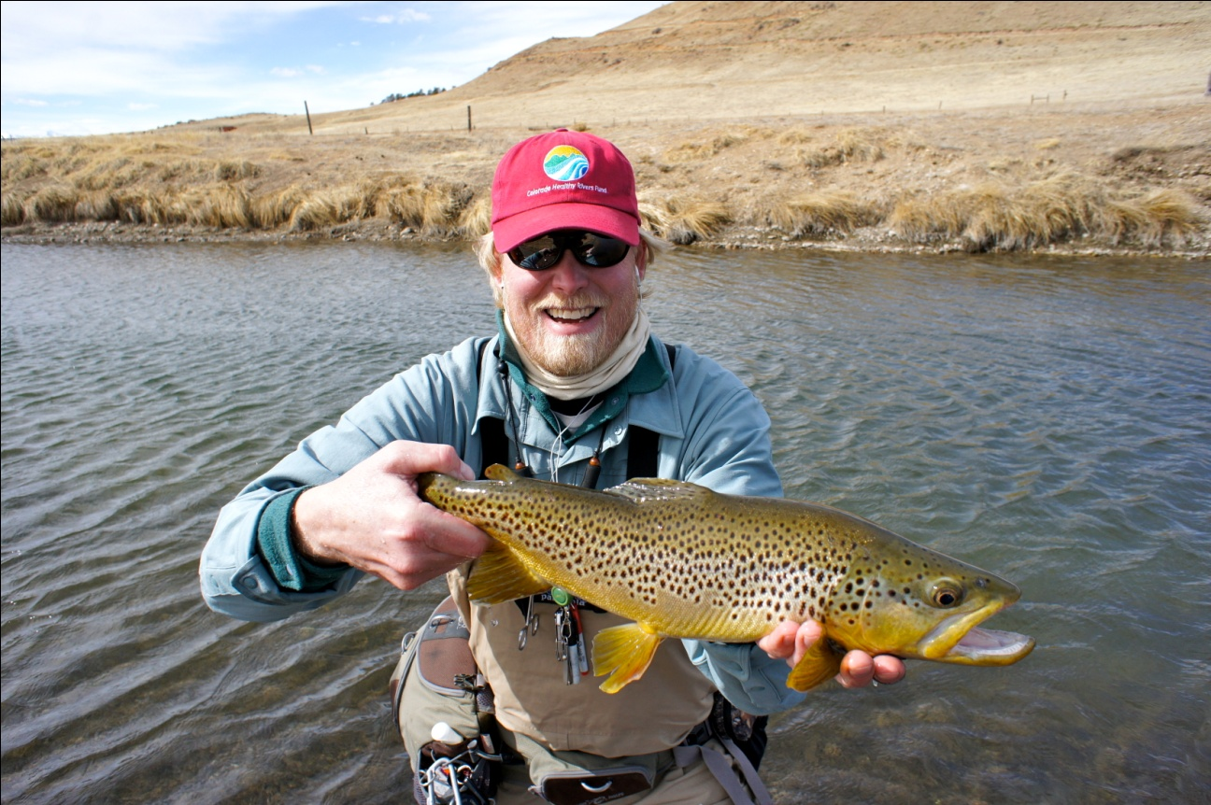
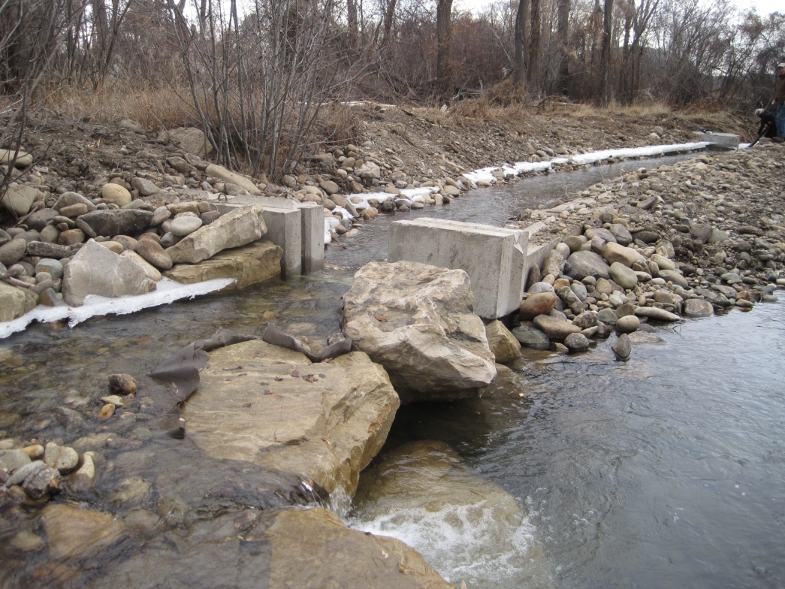
More Information
@ cwcb.state.co.us
or email
chris.sturm@state.co.us

