Slide 1
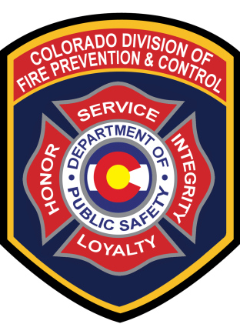
Division of Fire Prevention & Control
COLORADO DEPARTMENT OF PUBLIC SAFETY

Slide 2
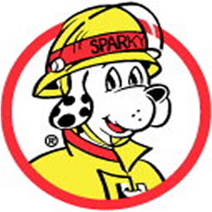
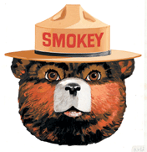
Question . . .
What do you get if you cross Sparky with Smokey?
COLORADO DEPARTMENT OF PUBLIC SAFETY

Slide 3
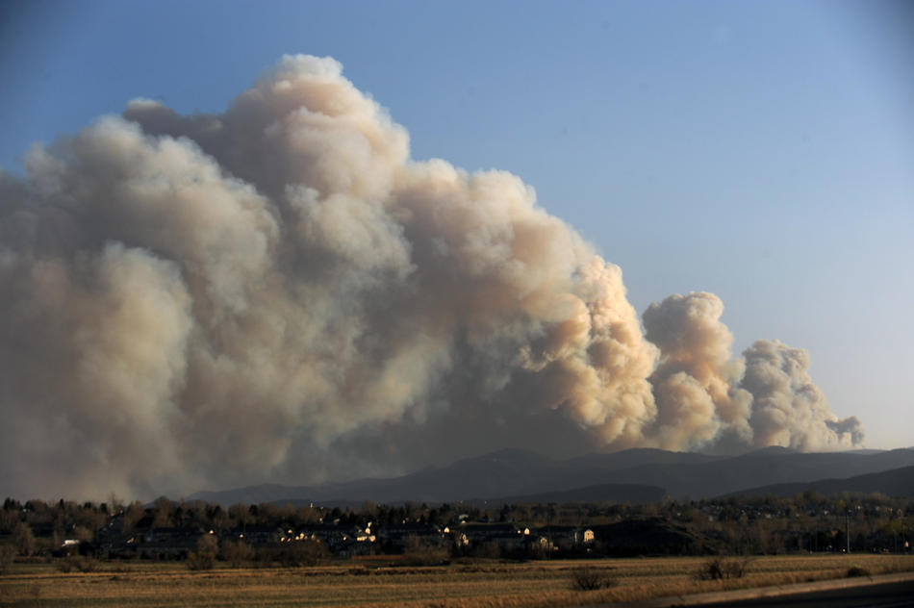

“Out of the Ashes”
Colorado Division of Fire Prevention & Control
COLORADO DEPARTMENT OF PUBLIC SAFETY
Notes:
Throughout history much of the legislation that is drafted and passed into law is as the result of tragedy. Such is the case of the legislation that created the Division of Fire Prevention and Control (DFPC). HB12-1283 created the Division of Fire Prevention and Control from the former Division of Fire Safety and transfers the fire responsibilities from CSU/Colorado State Forest Service (CSFS). This session will examine how the transition of wildland fire programs was accomplished during time of crisis, will look at the current organization, and services of the DFPC, and will offer a glimpse into the future of the programs and services of the DFPC.

Slide 4
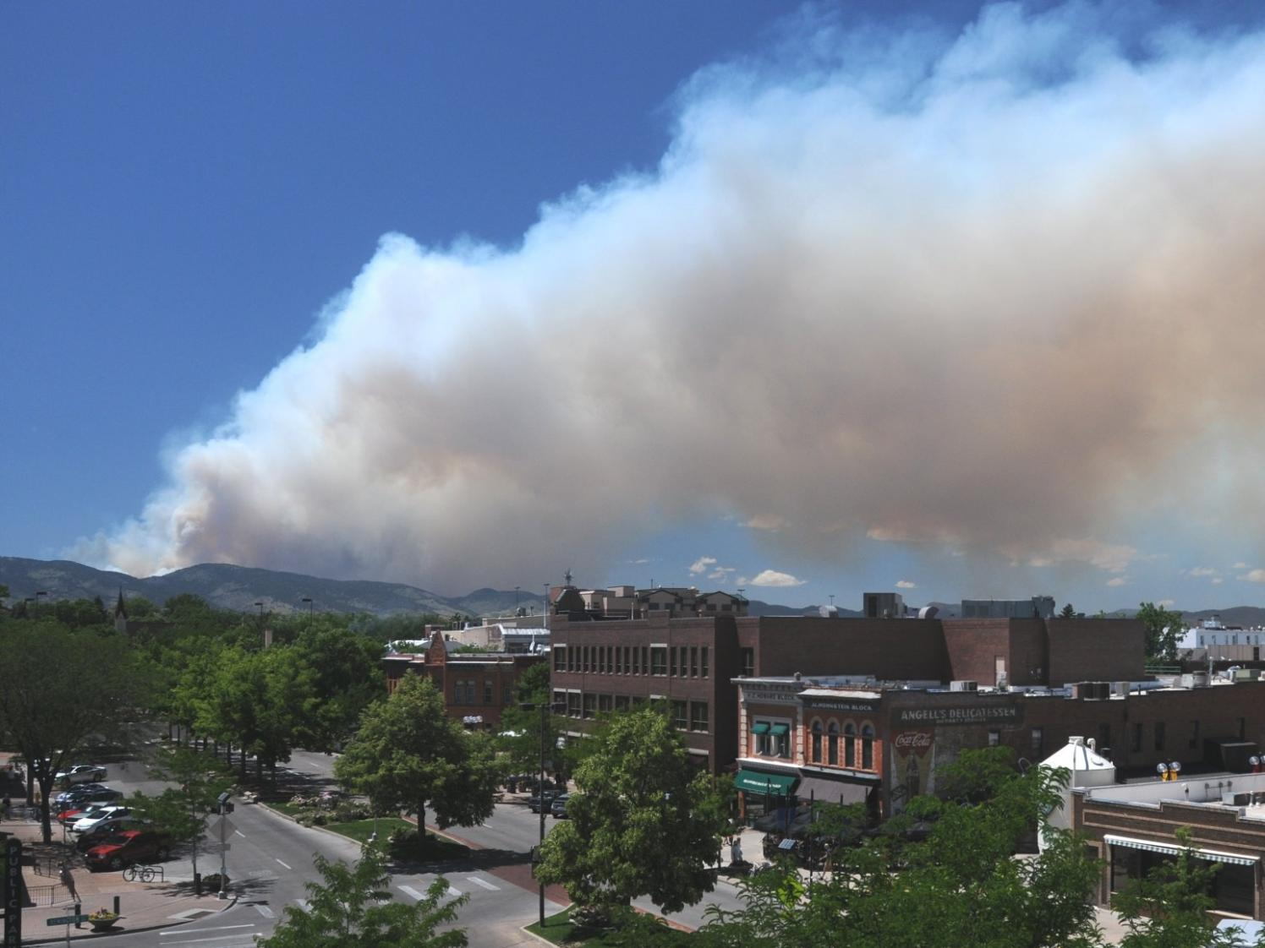
Transformational Leadership in Crisis
"To be effective in crisis conditions, the leaders must be transformational …. transforming crises into challenges"

Slide 5
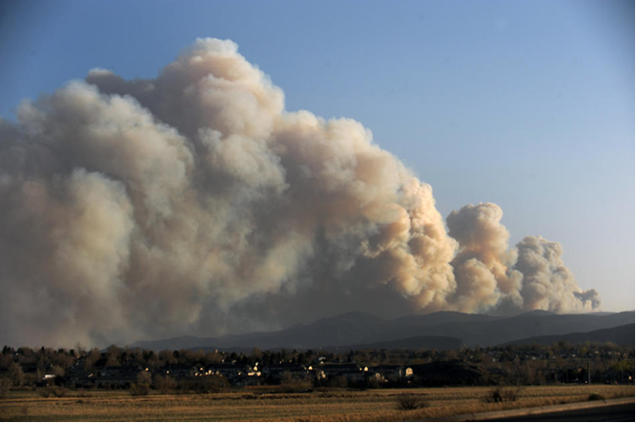
SB09-020 Wildland Fire Chain of Command
The Environment
Lower North Fork Fire
Burned 4,140 acres
24 structures destroyed
3 civilian deaths
Caused by escape of a prescribed fire
Fire Leadership Challenge 2012
Notes:
On March 26, 2012, a wildfire fire occurred in the foothills of Jefferson County, Colorado. This fire, called the Lower North Fork fire, burned for a week and resulted in the tragic deaths of three people and the loss of 24 structures and the scorching of 4,140 acres in a populated area near Conifer, Colorado.

Slide 6
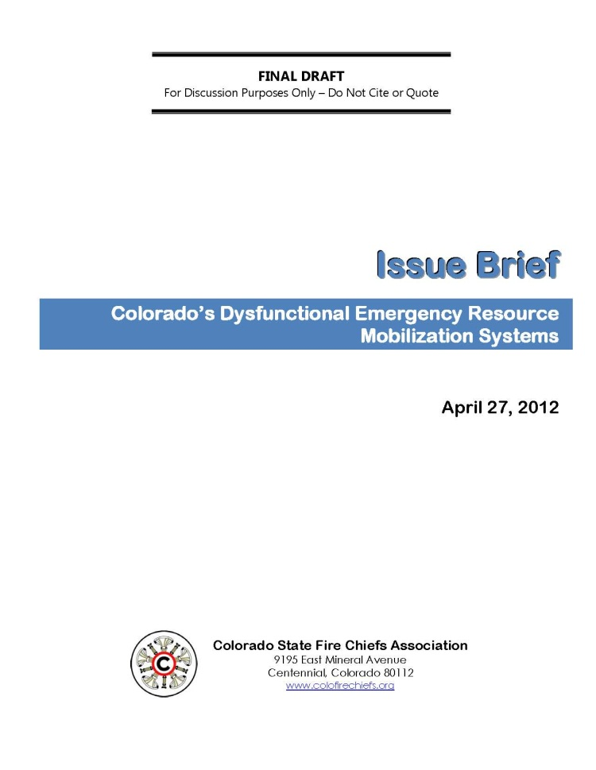

CSFCA Issue Brief on Resource Mobilization
The Issue Brief recommended:
Implement a single statewide plan for the mobilization and deployment of resources for all-hazard emergency response.
The fire functions of CSFS be transferred to an Executive Branch Agency.
Wildland fire should not be treated as a standalone hazard.
COLORADO DEPARTMENT OF PUBLIC SAFETY

Slide 7
CSFCA Issue Brief on Resource Mobilization
The State should evaluate how it uses the federal Interagency Dispatch System.
The IA Dispatch Centers should have common protocols and procedures for the mobilization of resources.
Ensure communications interoperability to support effective interagency response to major incidents.
COLORADO DEPARTMENT OF PUBLIC SAFETY

Slide 8
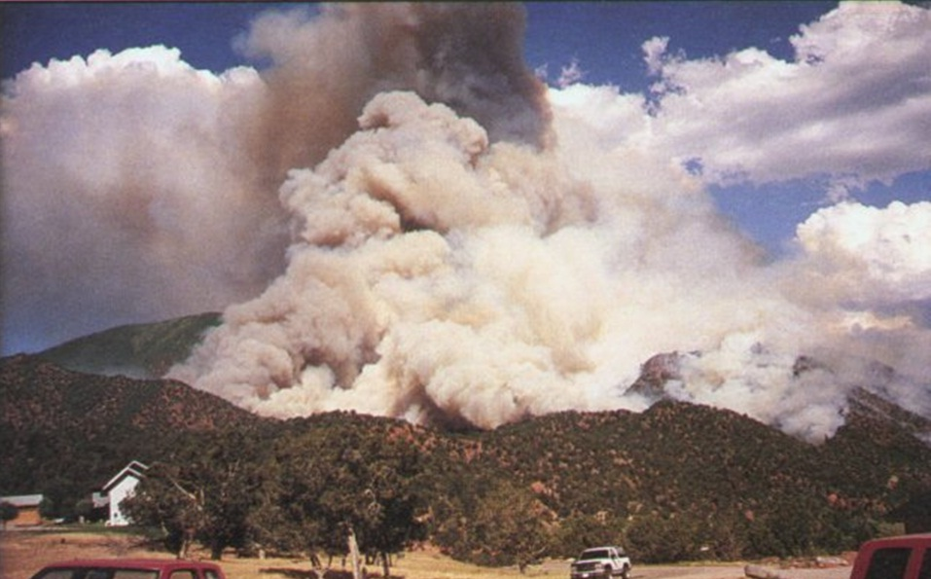
South Canyon Fire
July 2 – July 11, 1994
Burned 2,115 acres
14 firefighters killed
Caused by lightning
Notes:
Subsequent to the blow-up of the South Canyon Fire on July 6, 1994, the Colorado Division of Fire Safety (DFS) was requested by the Incident Commander to secure ten, Type 1 Engines for structural protection. These engines had previously been requested through the National Interagency Wildland Fire Dispatch System, but the order was still pending some six hours later. Since DFS did not have a resource database, individual phone calls had to be placed to 18 different fire departments to obtain the needed engines. In addition, because there was no statewide mutual aid plan, most of the departments contacted had to obtain permission before they could dispatch the engines. This process took nearly two hours, and it took in excess of four hours for these engines to arrive on the incident.

Slide 9
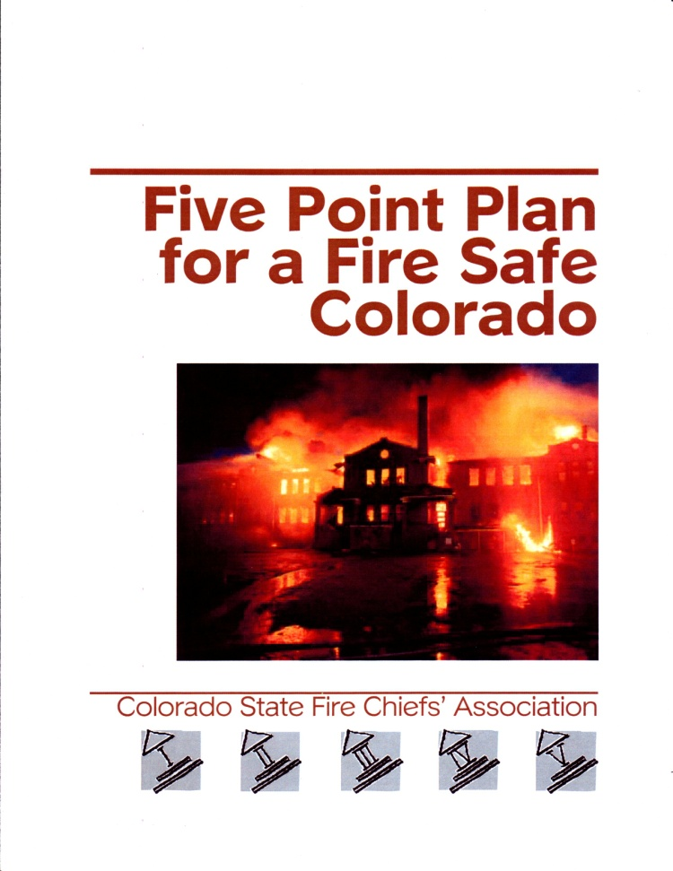
Five Point Plan for a Fire Safe Colorado
The Five Point Plan recommended:
the State develop an effective statewide resource mobilization plan
one state agency be assigned the leadership role in fire protection.
Consolidate all fire safety activities administered by the various state agencies
COLORADO DEPARTMENT OF PUBLIC SAFETY
Notes:
In 1997, the Colorado State Fire Chiefs Association published its “Five Point Plan for a Fire Safe Colorado” which was written in order to assist the legislature, the executive branch and other stakeholders to formulate and execute public policy on the topic of fire protection in Colorado.

Slide 10
Efforts to Change Colorado Fire Policy
Policy Papers
A Five Point Plan for a Fire Safe Colorado (1997)
“The CSFCA recommends the consolidation of all fire safety activities administered by the various state agencies”
“Wildland Urban Interface Issues – A Fire Service Perspective” presented to the Interim Committee on Wildfire Issues in Wildland-Urban Interface Areas (August 2008)
Issue Brief: Colorado State Forest Service – Indirect Cost Assessment (December 2009)
Issue Brief: Colorado’s Dysfunctional Emergency
Resource Mobilization Systems (April 2012)
COLORADO DEPARTMENT OF PUBLIC SAFETY
Notes:
In 1997, the Colorado State Fire Chiefs Association published its “Five Point Plan for a Fire Safe Colorado” which was written in order to assist the legislature, the executive branch and other stakeholders to formulate and execute public policy on the topic of fire protection in Colorado.

Slide 11
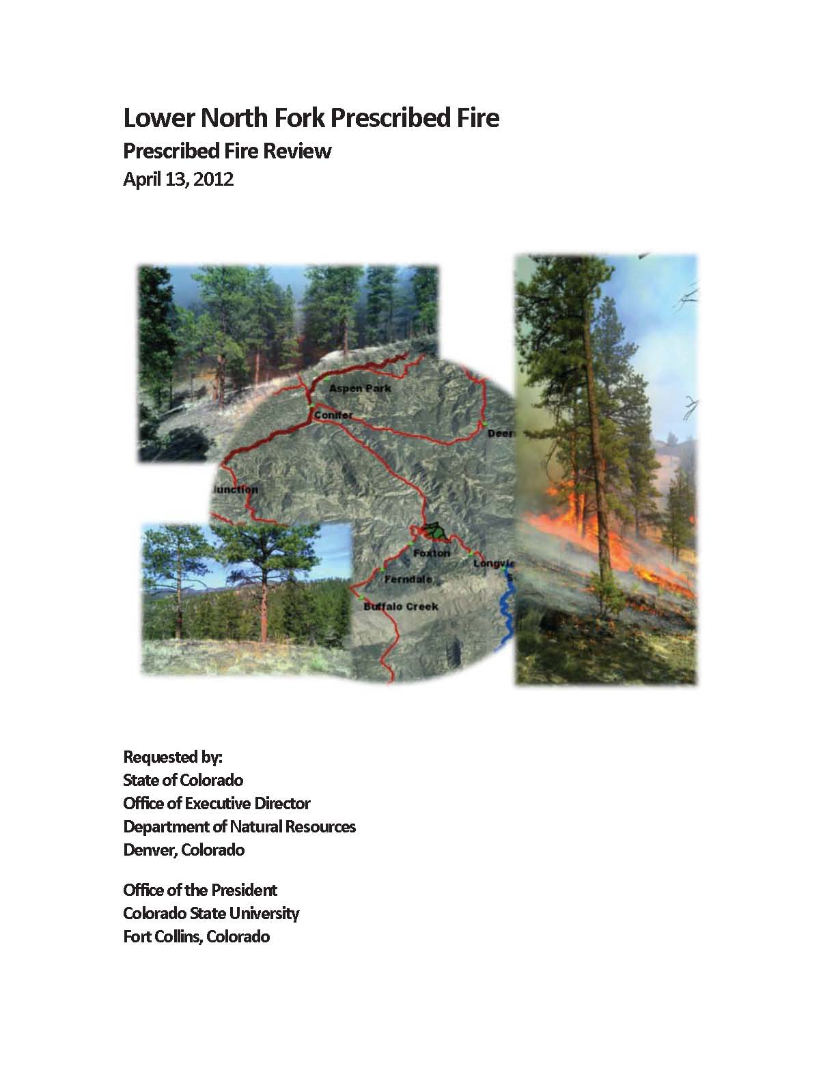
Lower North Fork Rx Fire Review (Bass Report)
The Review Team found that four factors contributed to the escape:
A rapidly escalating wind event with persisting hot spots at the interior of the burn area was the catalyst that set the outcome in motion. Spot fires at multiple locations quickly exceeded the capacity of the patrol crew.
COLORADO DEPARTMENT OF PUBLIC SAFETY

Slide 12
Lower North Fork Rx Fire Review (Bass Report)
Other factors :
Unburned fuel and residual heat in the burn unit at the time of the wind event.
200 foot mop-up buffer was insufficient.
Weather and fire behavior projections failed to predict the circumstances that occurred.
COLORADO DEPARTMENT OF PUBLIC SAFETY

Slide 13
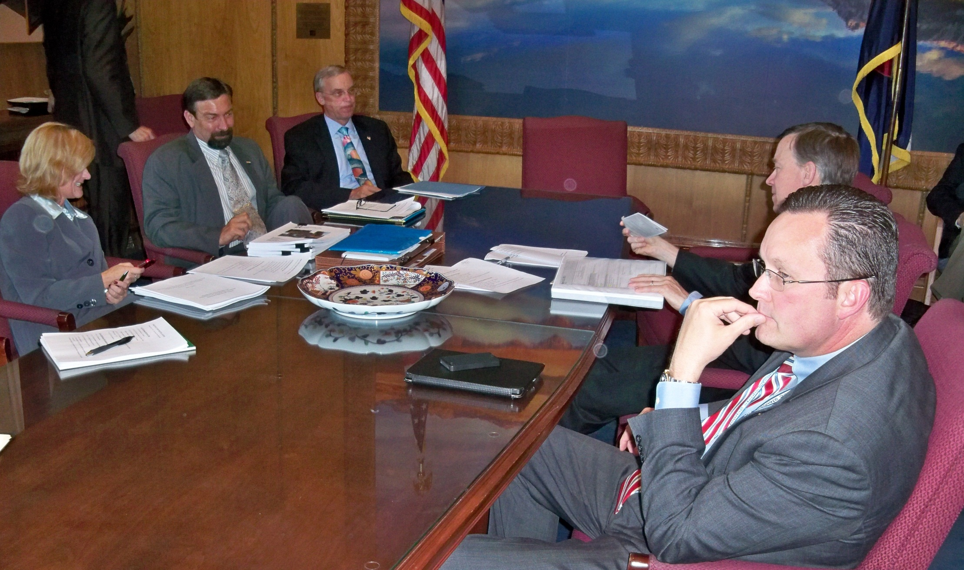
SB09-020 Wildland Fire Chain of Command
The Environment
Governor’s Review Team
Fire Leadership Challenge 2012
Notes:
As a result of the Lower North Fork Fire, Governor John Hickenlooper and Colorado State University President Tony Frank requested a thorough examination of the state’s emergency response capabilities. The team was directed to review the structure of the emergency coordination between the State Forest Service and the Division of Emergency Management—and their processes and communication systems—in order to improve the state’s response to fires and protect people and property.

Slide 14
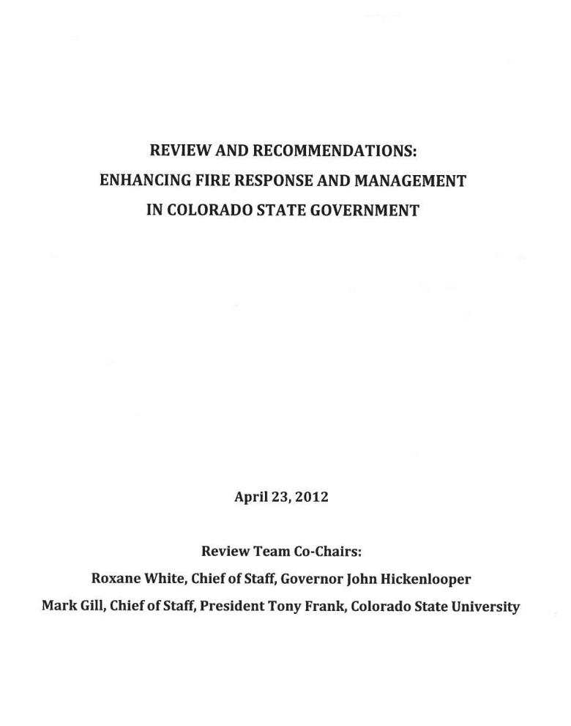
Governor’s Review Team Report
The Governor’s Review Team recommended:
that the prescribed fire and wildfire management portions of the CSFS be moved into the CDPS (Division of Fire Safety), and DOLA’s Division of Emergency Management be moved into the CDPS (Division of Homeland Security).
COLORADO DEPARTMENT OF PUBLIC SAFETY
Notes:
After careful analysis, the review team recommended that the prescribed fire and wildfire management portions of the Colorado State Forest Service (CSFS) in CSU be moved into the Division of Fire Safety, within the Colorado Department of Public Safety (CDPS), and the Division of Emergency Management (DEM), within the Department of Local Affairs (DOLA), be moved into the CDPS.

Slide 15
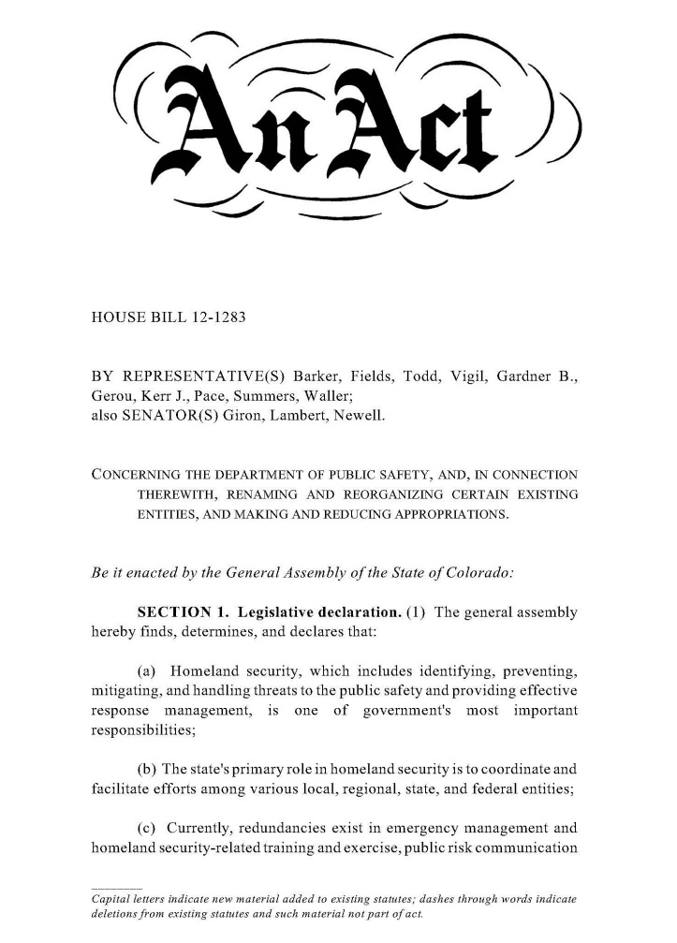
House Bill 12-1283
HB12-1283 creates the Division of Fire Prevention and Control in the Department of Public Safety from the former Division of Fire Safety and transfers the fire responsibilities from CSU/Colorado State Forest Service.
Signed by Gov. Hickenlooper on June 4, 2012
COLORADO DEPARTMENT OF PUBLIC SAFETY
Notes:
This reorganization was codified in HB12-1283, Concerning the Department of Public Safety, and, in Connection Therewith, Renaming and Reorganizing Certain Existing Entities, and Making and Reducing Appropriations. The purpose of HB12-1283 is to enhance Colorado's ability to prepare for and respond to fire and other emergencies by creating a single point of authority for fire and consolidating the State's homeland security and emergency management functions in the CDPS.
HB12-1283, which was signed by Gov. Hickenlooper on June 4, 2012, created the Division of Fire Prevention and Control (DFPC) from the former Division of Fire Safety and transferring the fire responsibilities from CSU/CSFS effective July 1, 2012.

Slide 16
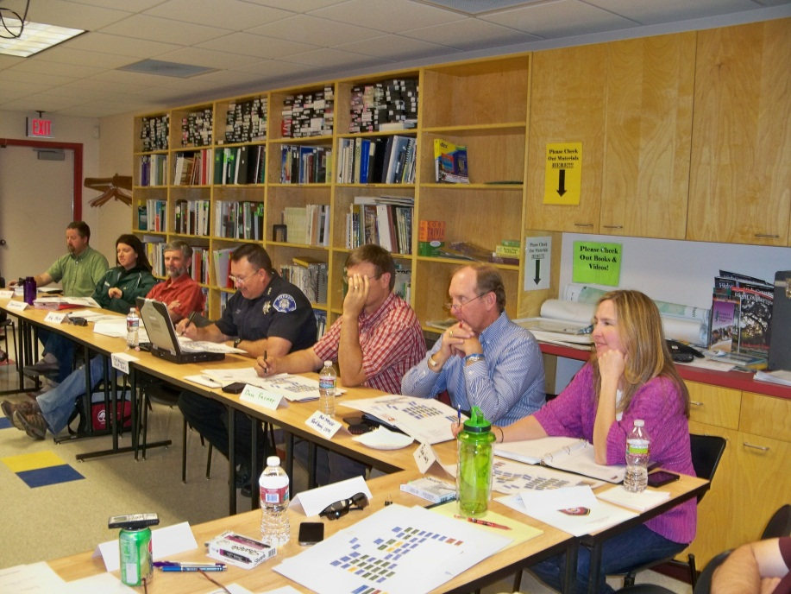
Transition Advisory Committee
COLORADO DEPARTMENT OF PUBLIC SAFETY
Notes:
To accomplish the orderly transfer of responsibilities from CSU/CSFS, a Transition Advisory Committees (TAC) was established from employees of the two agencies and representatives of federal, state, local and private sector stakeholder organizations.
The inaugural meeting of the TAC was held on May 25, 2012 at the CSFS facilities on the CSU Foothills Campus in Fort Collins. At this meeting the TAC embarked on the historic task of creating a new model of “Cooperative Fire Protection” in Colorado, by taking this organization, born from the ashes of tragedy, and guiding its transformation.

Slide 17
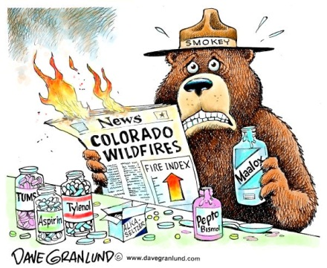
Notes:
Over the course of the next several weeks, during one of the worst wildland fire seasons in Colorado's history, the TAC and its subcommittees met many times to make recommendations concerning the transition. The principal goal of the TAC during this time was to ensure that when the transition occurred on July 1st, the new organization was capable of fulfilling the state's responsibilities with respect to wildland fires, to assist with fires that exceed local capabilities.

Slide 18
Relevant State Statutes
• 24-1-128.6 – Creation of DFPC and OEM within the DPS
• 24-33.5-1201 – Creation of WFMS in DFPC
• 24-33.5-1217 – 24-33.5-1226 Duties for fires
• 24-33.5-1218 – Cooperation w/ Governmental units (USFS, DOI, counties)
• 24-33.5-1219 – Duty of Sheriff to report fires
COLORADO DEPARTMENT OF PUBLIC SAFETY

Slide 19
Relevant State Statutes
• 24-33.5-1220 – Funds available (EFF)
• 24-33.5-1221 – State responsibility determined
• 24-33.5-1223 – Sheriff to enforce w/ DFPC
• 24-33.5-1224 – Limitation of state responsibility (no firefighter obligates the state for payment
• 24-33.5-1226 – WERF
COLORADO DEPARTMENT OF PUBLIC SAFETY

Slide 20
Agreements
Incident Specific Agreements (Delegations, Cost Share, etc.)
Local Mutual Aid Agreements
CRRFs
MOUs
W
E
R
F
Annual Operating Plans
EFF Agreement
CSFS #108
MAC Groups
Agreement for Cooperative Wildfire
Protection in YOUR County
CSFS #109
Colorado Interagency Cooperative Fire Management Agreement
COLORADO DEPARTMENT OF PUBLIC SAFETY

Slide 21
Agreements
Colorado Interagency Cooperative Fire Management Agreement
Links DFPC to federal agencies
Establishes Rocky Mountain Coordinating Group (RMCG)
  provides general oversight for interagency wildland fire activities
DFPC to act as the coordinator for county and local fire departments
Requires annual operating plans.
COLORADO DEPARTMENT OF PUBLIC SAFETY

Slide 22
Agreements
Agreement for Cooperative Wildfire Protection (CSFS #108) in YOUR County:
Links the State and the county
Establishes DFPC as the link between county and federal agencies.
References an annual operating plan.
Addresses organizing, equipping, training, prevention, detection, suppression, fire reporting, etc.
COLORADO DEPARTMENT OF PUBLIC SAFETY

Slide 23
Agreements
“Intergovernmental Agreement for Participation in the Colorado Emergency Fire Fund” (CSFS #109):
Purpose: establishes “the County’s basis for participation in the Emergency Fire Fund to provide payments from the County to the Fund; and describes the conditions under which the Emergency Fire Fund will be managed.”
COLORADO DEPARTMENT OF PUBLIC SAFETY

Slide 24
Agreements
Annual Operating Plans:
Provide standard operating procedures and agency responsibilities for wildfire suppression.
Updated by May 1st of each year.
Are not a cost share agreement.
Plan between the county, state (DFPC), and the federal land management agencies.
COLORADO DEPARTMENT OF PUBLIC SAFETY

Slide 25
Agreements
Annual Operating Plans:
Includes all federal partners, county, CSFS
Agency roles and responsibilities
Well defined mutual aid period
Emergency Fire Fund (EFF)
Resource ordering protocol
Cost reimbursement/billing procedures and guidelines
Updated annually
Much, much more!
COLORADO DEPARTMENT OF PUBLIC SAFETY

Slide 26
Division of Fire Prevention & Control
Mission
The mission of the Colorado Division of Fire Prevention and Control is to safeguard those that live, work, learn and play in Colorado, by reducing threats to lives, property and the environment. The Division safeguards the public through: fire prevention and code enforcement; wildfire preparedness, response, suppression, coordination, and management; training and certification; public information and education; and technical assistance to local governments.
COLORADO DEPARTMENT OF PUBLIC SAFETY

Slide 27
Improving the State’s Response to Wildfires
Immediate Actions Taken to Improve the State’s Response to Wildfires:
Establish the State Emergency Operations Line as the new “point of contact for counties to report wildland fires and/or request assistance (303-279-8855).
Upon request, communications personnel will notify the appropriate Regional FMO or the Area FMO if the Regional FMO is not available.
The closest available resource capable of providing technical assistance and support to local agencies and facilitate the EFF assessment and application process will be dispatched.
COLORADO DEPARTMENT OF PUBLIC SAFETY
Notes:
The State of Colorado Emergency Operations Line is the new “point of contact for counties to report wildland fires and/or request assistance with wildland fires, the Wildfire Emergency Response Fund, or for assistance with Emergency Fire Fund (EFF) analysis or designation”
Upon request, the on-duty communications personnel of the Colorado Department of Public Safety will dispatch the closest available resource that is capable of providing rapid technical assistance and support to local agencies and facilitate the Emergency Fire Fund (EFF) assessment and application process. In addition to providing technical assistance and support to local authorities, the individuals will be qualified to assist in the completion of severity assessments on wildfires and assisting in the identification of resource needs, developing assumption of duty forms, completing delegations of authority, negotiating and signing cost share agreements, and providing direction and oversight to assigned Incident Management Teams.

Slide 28
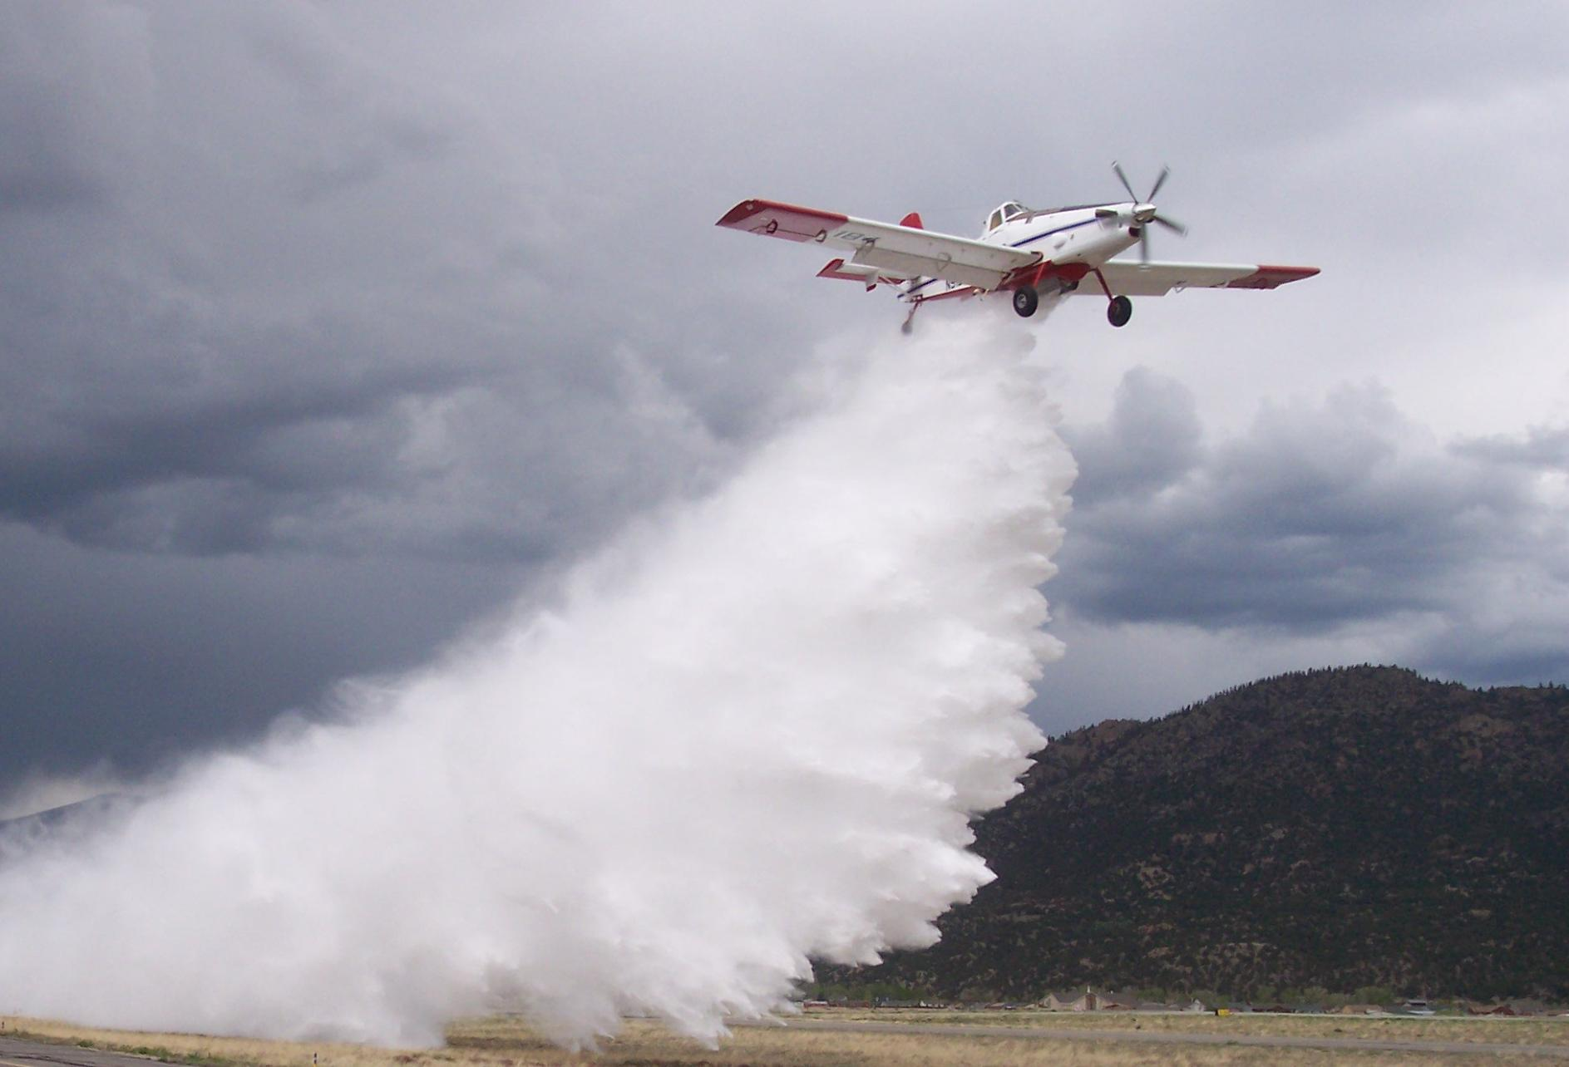
Improving the State’s Response to Wildfires
Governor approved Division’s request to double WERF to provide for 2 hours of rotor time; first 2 air tanker drops; or 4 hand crew days.
Prepositioned State Engines and crews in Northwest Colorado on “severity assignment” during a period of high wildfire incidence.
COLORADO DEPARTMENT OF PUBLIC SAFETY
Notes:
The State of Colorado Emergency Operations Line is the new “point of contact for counties to report wildland fires and/or request assistance with wildland fires, the Wildfire Emergency Response Fund, or for assistance with Emergency Fire Fund (EFF) analysis or designation”
Upon request, the on-duty communications personnel of the Colorado Department of Public Safety will dispatch the closest available resource that is capable of providing rapid technical assistance and support to local agencies and facilitate the Emergency Fire Fund (EFF) assessment and application process. In addition to providing technical assistance and support to local authorities, the individuals will be qualified to assist in the completion of severity assessments on wildfires and assisting in the identification of resource needs, developing assumption of duty forms, completing delegations of authority, negotiating and signing cost share agreements, and providing direction and oversight to assigned Incident Management Teams.

Slide 29
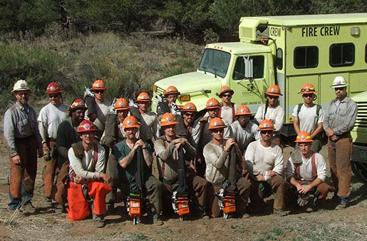
Improving the State’s Response to Wildfires
Financially supported the addition of a 4th State Wildland Inmate Fire Team (SWIFT) crews, housed at Rifle Correctional Center.
In a partnership with the Colorado Wildland Fire and Incident Management Academy, the Colorado National Guard, and the Governor's Office, provided basic wildland firefighter training to 112 members of the COANG.
COLORADO DEPARTMENT OF PUBLIC SAFETY
Notes:
The State of Colorado Emergency Operations Line is the new “point of contact for counties to report wildland fires and/or request assistance with wildland fires, the Wildfire Emergency Response Fund, or for assistance with Emergency Fire Fund (EFF) analysis or designation”
Upon request, the on-duty communications personnel of the Colorado Department of Public Safety will dispatch the closest available resource that is capable of providing rapid technical assistance and support to local agencies and facilitate the Emergency Fire Fund (EFF) assessment and application process. In addition to providing technical assistance and support to local authorities, the individuals will be qualified to assist in the completion of severity assessments on wildfires and assisting in the identification of resource needs, developing assumption of duty forms, completing delegations of authority, negotiating and signing cost share agreements, and providing direction and oversight to assigned Incident Management Teams.

Slide 30
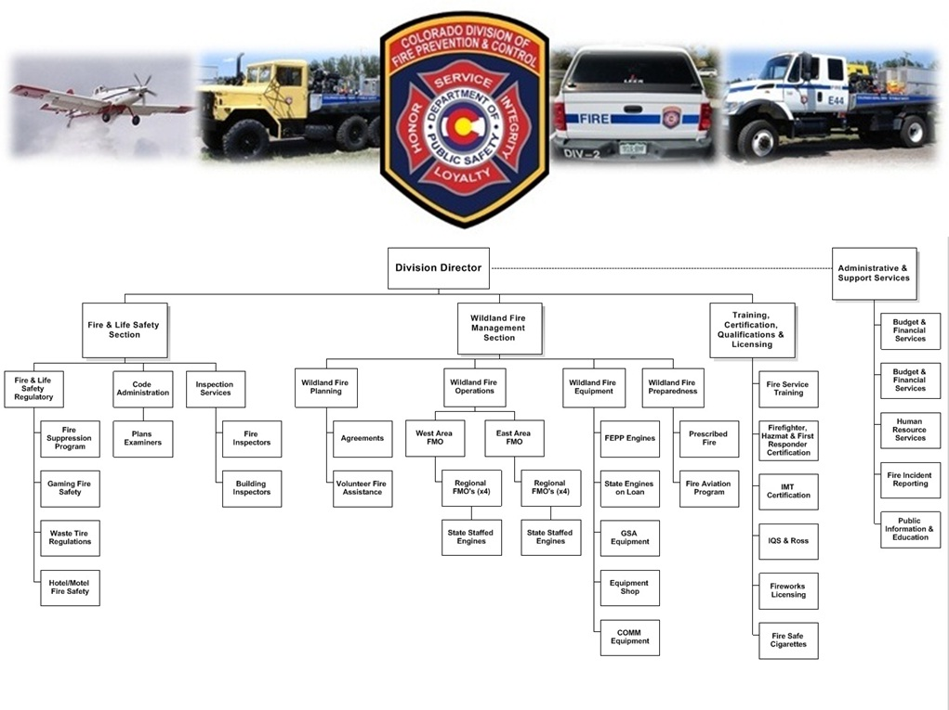
"Safeguarding those that live, work, learn and play in Colorado"

Slide 31
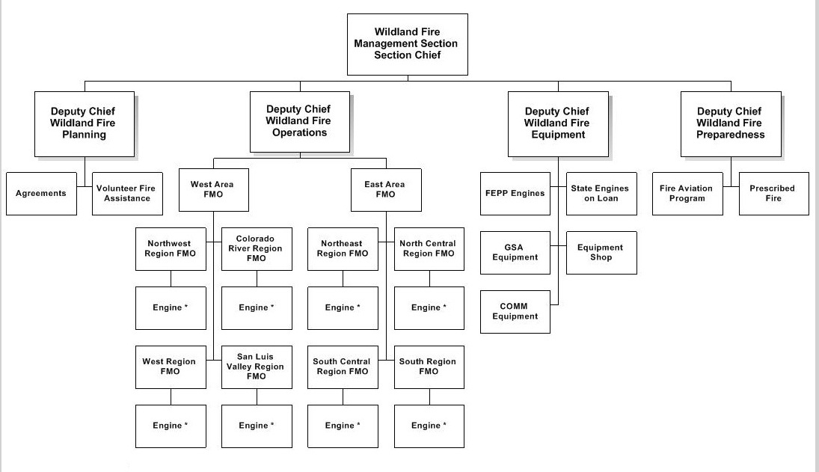

Division of Fire Prevention & Control
Wildland Fire Management Section
Fire Leadership Challenge 2012

Slide 32
Division of Fire Prevention & Control
Wildland Fire Management Section
COLORADO DEPARTMENT OF PUBLIC SAFETY

Slide 33
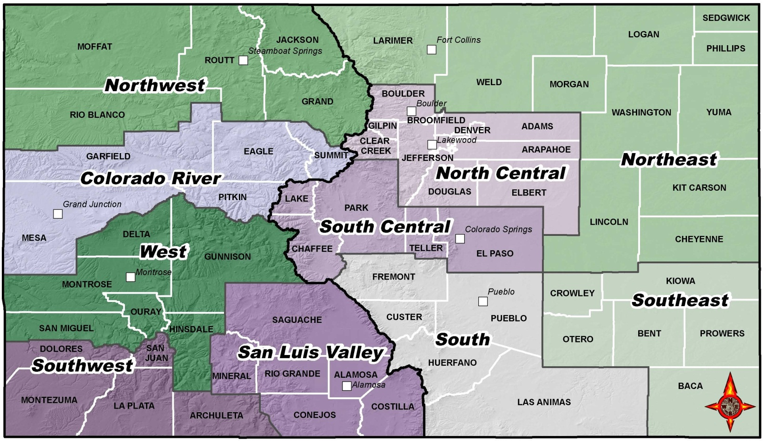
Division of Fire Prevention & Control
Fire Management Regions
Fire Leadership Challenge 2012

Slide 34
Emergency Fire Fund (EFF)
This fund, established in 1967 by some counties that recognized that some wildfires may exceed the counties’ resources and abilities to manage. Participation in the EFF is voluntary. A ten-person committee comprising county commissioners, sheriffs, fire chiefs, and the DFPC Director oversees the administration of the fund.
Currently, 43 Colorado counties and the Denver Water Board contribute to EFF.
COLORADO DEPARTMENT OF PUBLIC SAFETY

Slide 35
Emergency Fire Fund (EFF)
2012 EFF Fires through November 29th . . .
Number of EFF Fires: 16
EFF that was Available – 2012 Assessments: $1 million
Estimated Suppression Costs that will be funded by EO: $46 million
Estimated Amount that will be Reimbursed for FMAG Fires: 4 fires, $28.3 million
COLORADO DEPARTMENT OF PUBLIC SAFETY

Slide 36
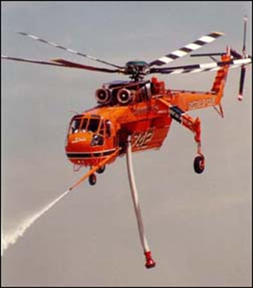
Wildfire Emergency Response
Fund (WERF)
The fund reimburses a fire department or county for the first retardant load, first hour of helicopter use or 2 days of hand crew use on state and private land initial attack fires at the request of the county sheriff, municipal fire chief, or fire protection district.
COLORADO DEPARTMENT OF PUBLIC SAFETY
Notes:
The goal is reduced suppression costs by attacking fires quickly to keep them small.

Slide 37
Wildfire Emergency Response
Fund (WERF)
2012 WERF Usage through November 29th . . .
Number of Fires where WERF was used: 52
Estimated WERF Expenditures: $920,871
Beginning Fund Balance, January 1: $340,000
In the “Typical" Year, less than $200,000 is Expended from the Fund
Enhanced WERF was Implemented effective July 18th and used on 19 fires ($534,200)
COLORADO DEPARTMENT OF PUBLIC SAFETY

Slide 38
Mutual Aid Agreements & Annual Operating Plans
Each year, federal land fire agencies, DFPC, and counties will meet to reach agreement on the sharing of firefighters and equipment if wildfires exceed a particular jurisdiction’s resources. The intent of mutual aid is for all fire suppression agencies to work as a team, avoid duplication, and suppress wildfires efficiently. The Annual Operating Plan defines the limits of interagency cooperation and contains a mobilization plan that identifies the location and availability of firefighters and equipment.
COLORADO DEPARTMENT OF PUBLIC SAFETY

Slide 39


Wildfire Qualifications
DFPC manages the state-wide Incident Qualifications System (IQS) program.
DFPC transfers personnel from IQSweb to the Resource Ordering and Status System (ROSS).
COLORADO DEPARTMENT OF PUBLIC SAFETY

Slide 40
Wildfire Qualifications
IQS and ROSS statistics as of 2/26/2013:
- IQS: 193 Colorado agencies
- IQS: 6,390 Colorado personnel
- ROSS: 4,310 Colorado personnel uploaded from IQS to ROSS
COLORADO DEPARTMENT OF PUBLIC SAFETY

Slide 41
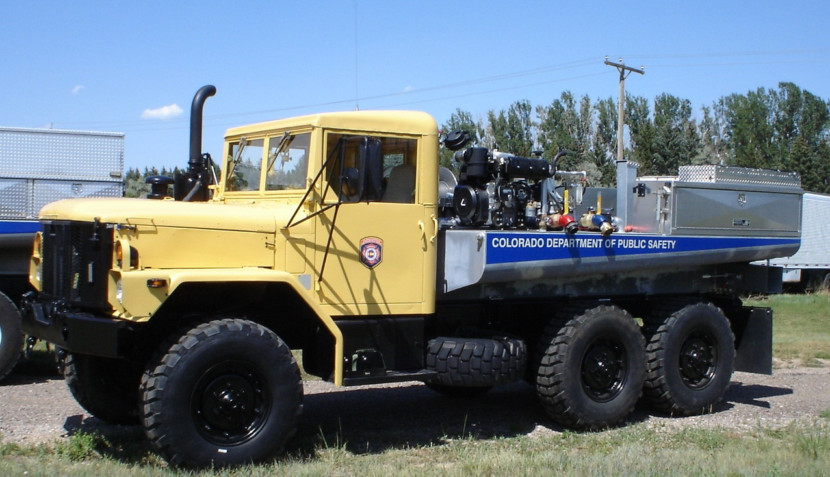
Federal Excess Property
Program (FEPP)
Special District Association of Colorado
2012 Conference

Slide 42
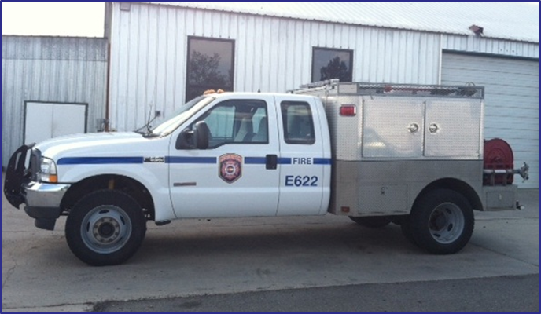
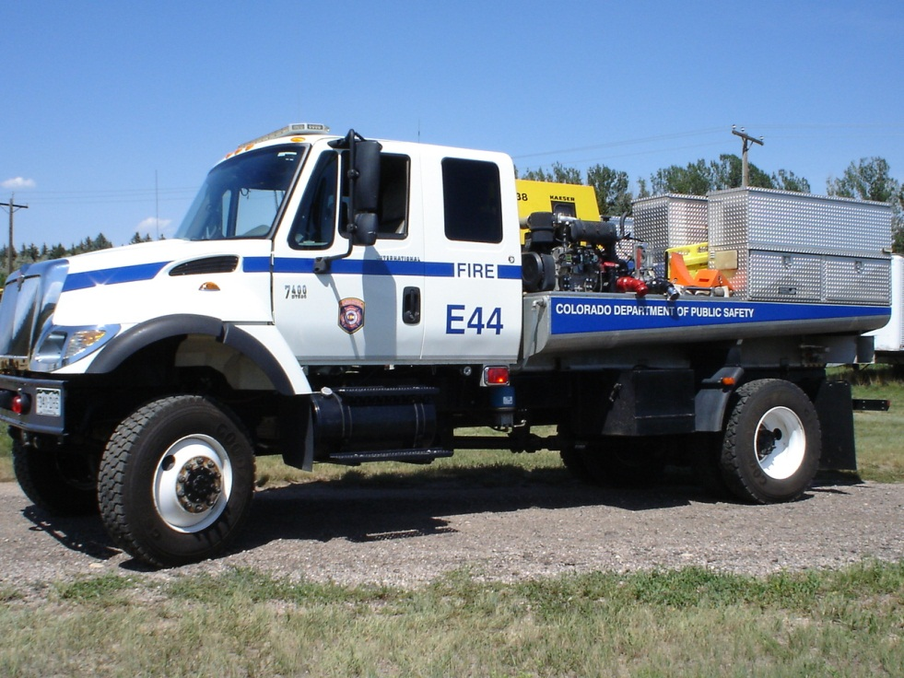
DFPC Engines
5 –Type 4 Engines
11 – Type 6 Wildland Engines
COLORADO DEPARTMENT OF PUBLIC SAFETY

Slide 43
Volunteer Fire Assistance (VFA) Program
2012 Volunteer Fire Assistance Grants . . .
Number of Fire Depts. Receiving Awards: 122
Amount Awarded for Equipment: $387,660.68
Amount Awarded for Training: $46,248.55
Average Awarded per Department: $3,506.50
Total VFA Awards: $427,792.97
COLORADO DEPARTMENT OF PUBLIC SAFETY

Slide 44
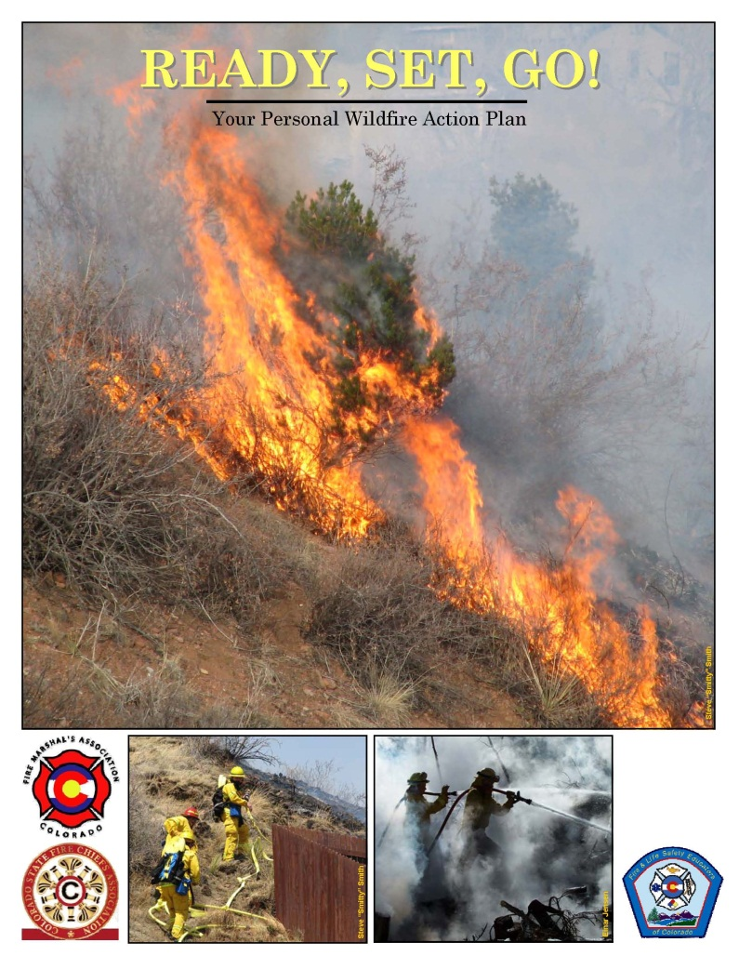
Ready, Set, Go!
Ready, Set, Go!
Encourages citizens to take personal responsibility and prepare long before the threat of a wildfire so their home is ready in case of a fire and they have an emergency plan in effect so they may evacuate if requested.
COLORADO DEPARTMENT OF PUBLIC SAFETY

Slide 45
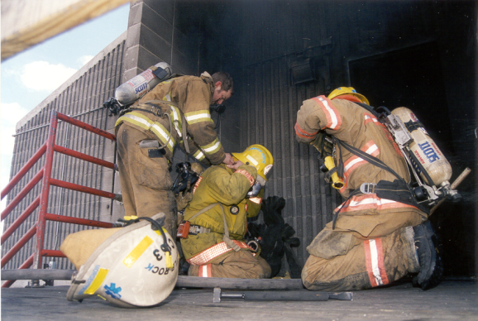
Firefighter, Hazardous Materials Responder & First Responder Certification
Establish and maintain valid procedures that measure specific levels of knowledge and abilities consistent with national professional competency standards.
COLORADO DEPARTMENT OF PUBLIC SAFETY

Slide 46
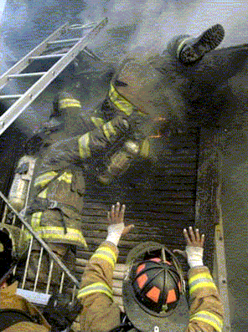
Fire Service Education & Training
Increase the level of preparedness and proficiency of Colorado firefighters and to reduce the incidence of firefighter line-of-duty deaths and injuries.
COLORADO DEPARTMENT OF PUBLIC SAFETY

Slide 47
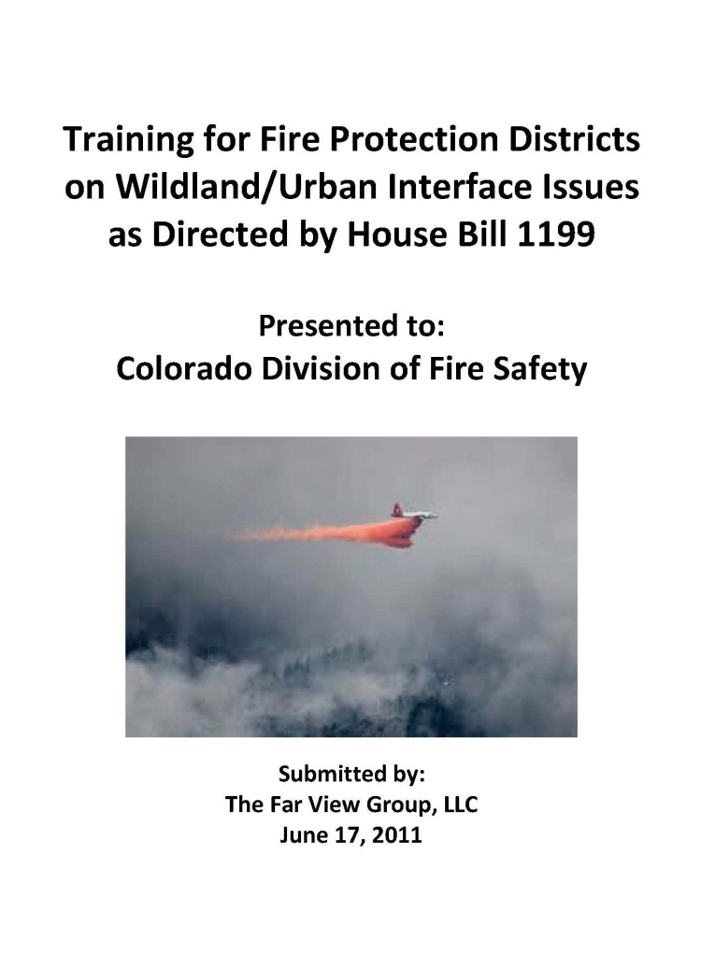
Training for Fire Protection
District Directors
HB09-1199 . . .
Training sessions held: 8
Fire Districts participated: 46
Fire District Board members participated: 92
Fire Chiefs attended: 25
COLORADO DEPARTMENT OF PUBLIC SAFETY

Slide 48
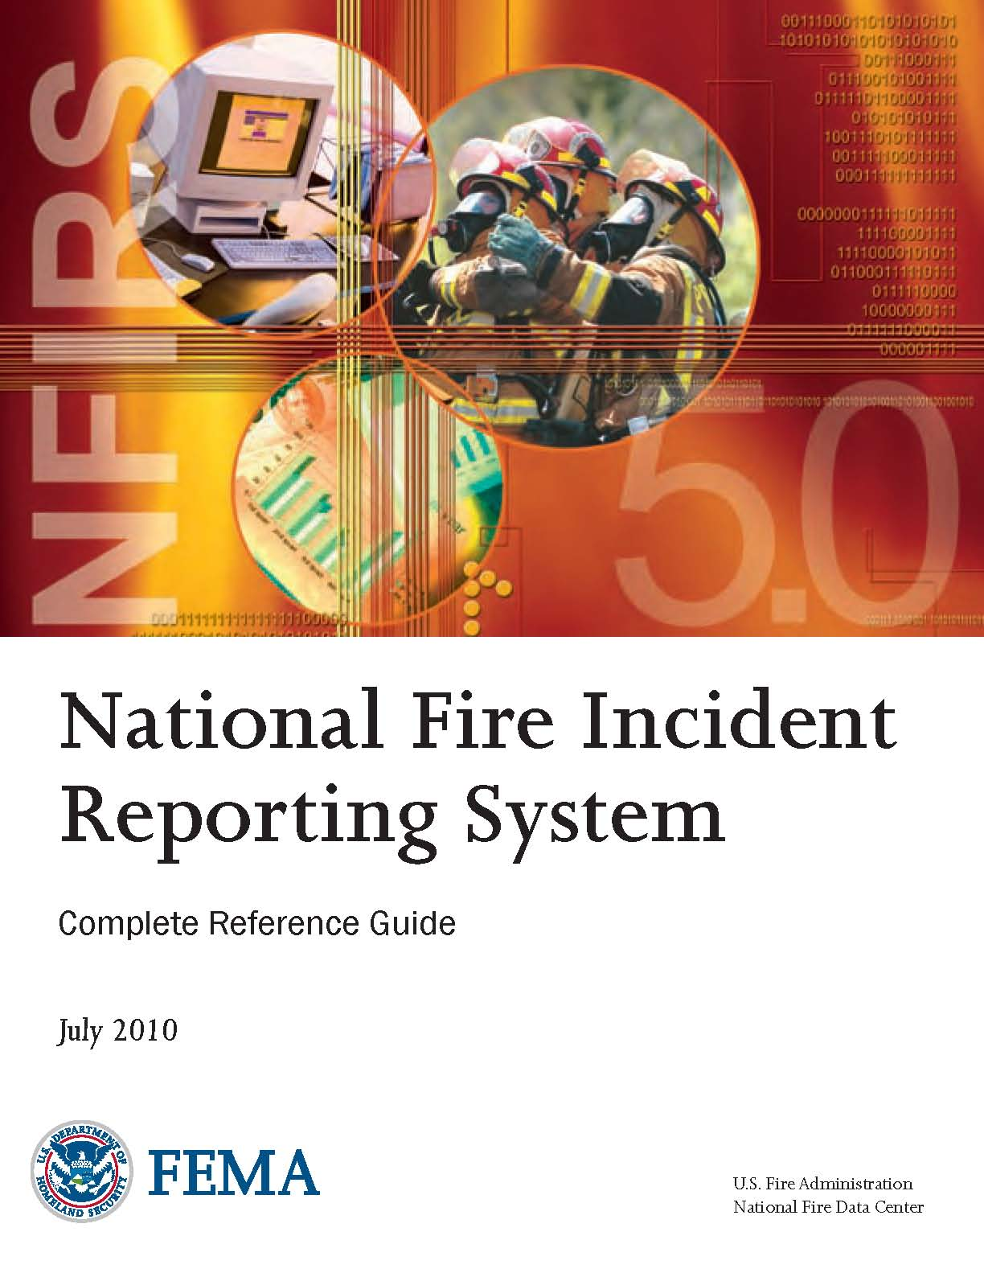
Colorado Incident Reporting System
To identify Colorado's fire problems, in terms of the rate and cause of fires and fire-related deaths and injuries, so that federal, state and local fire prevention efforts can focus on solutions to the problems.
COLORADO DEPARTMENT OF PUBLIC SAFETY

Slide 49
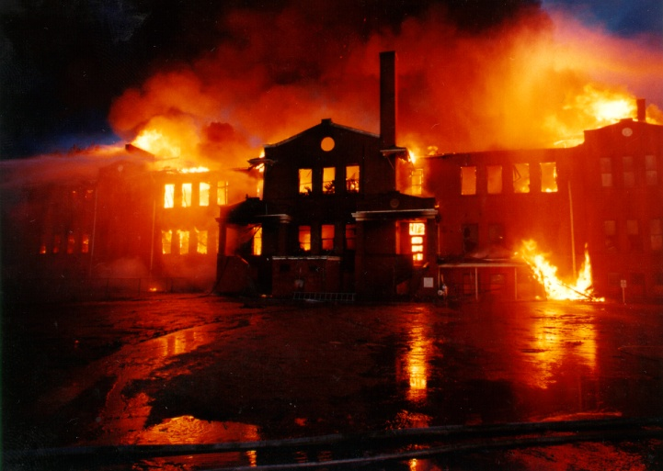
Public School Safety Program
To ensure that new and existing public school buildings are constructed and maintained according to the currently adopted codes and standards in order to provide for the safety of students, staff and visitors.
COLORADO DEPARTMENT OF PUBLIC SAFETY

Slide 50
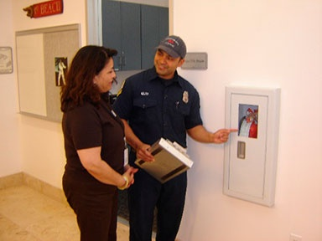
Limited Gaming Program
Establish and enforce minimum standards of fire and life safety in Colorado's limited gaming establishments in order to reduce the risk of fire, fire related injuries, deaths and property loss in these facilities.
COLORADO DEPARTMENT OF PUBLIC SAFETY

Slide 51
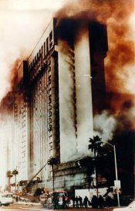
Hotel and Motel Fire Safety Act
To fulfill the State's responsibilities under the federal Hotel and Motel Fire Safety Act of 1990
COLORADO DEPARTMENT OF PUBLIC SAFETY

Slide 52
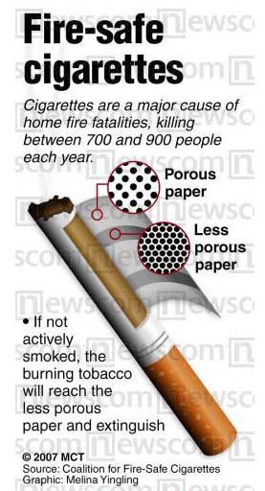
Reduced Ignition Propensity Cigarette Program
All cigarettes sold or offered for sale in Colorado must meet the same criteria for reduced ignition propensity cigarettes as in New York State. This law, which went into effect on July 31, 2009 is designed to limit the risk that cigarettes will ignite upholstered furniture, mattresses, household furnishings or other combustible material and result in fewer fire deaths, injuries and property loss from fires caused by cigarettes.
COLORADO DEPARTMENT OF PUBLIC SAFETY

Slide 53
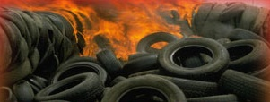
Waste Tire Fire Safety Program
The Division of Fire Prevention and Control shall ensure that Waste Tire Facilities in Colorado meet the minimum standards set forth in the codes that have been adopted by the Division.
COLORADO DEPARTMENT OF PUBLIC SAFETY

Slide 54
Technical Assistance
Assist units of local government in defining and developing solutions to local fire safety problems and to propose and implement solutions to fire safety-related problems that are common to local, state and federal governmental units.
COLORADO DEPARTMENT OF PUBLIC SAFETY

Slide 55
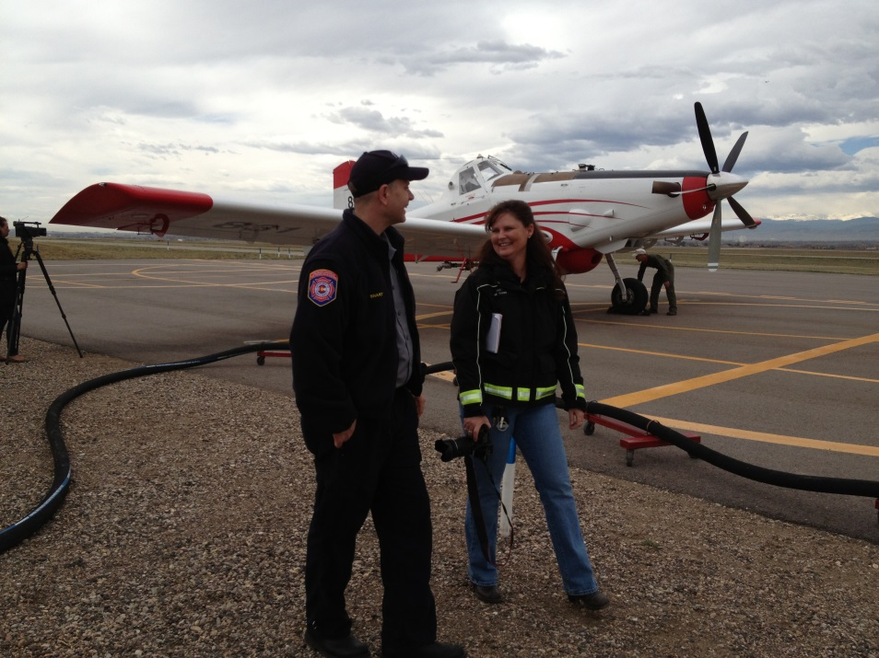
Fire Aviation Program
CSFS historically has had a contract for three SEATs during fire season.
DFPC is looking to diversify aviation program
COLORADO DEPARTMENT OF PUBLIC SAFETY

Slide 56
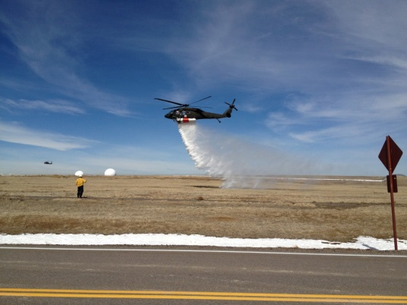
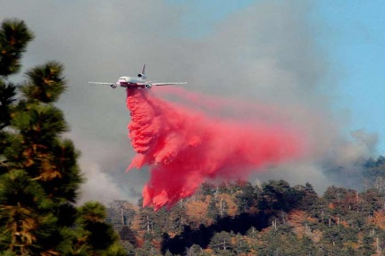
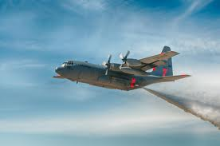
Fire Aviation Program
Diversification includes:
Increased Interagency communication and partnerships
Education
  Tanker 10 Presentation
  MAFFS Presentation
  SEAT trainings
Streamlining access to CONG resources
  Hoist resources
  Training
COLORADO DEPARTMENT OF PUBLIC SAFETY

Slide 57
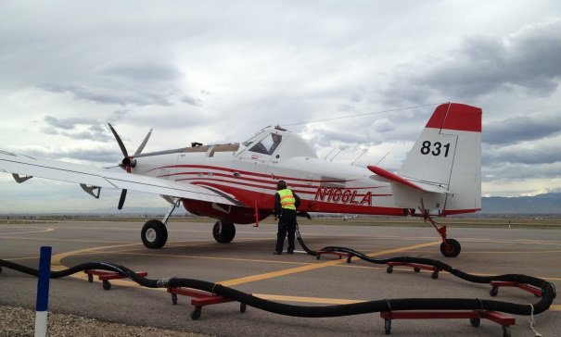
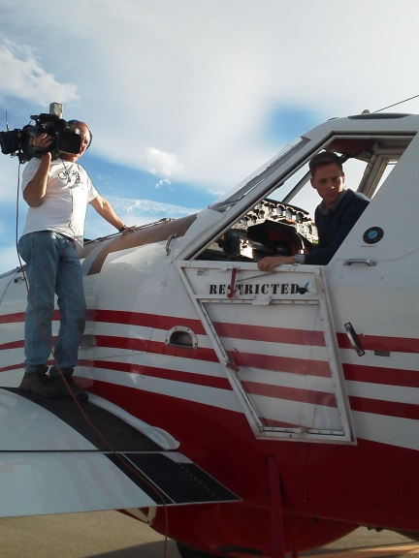
Fire Aviation Program-SEAT
SEAT
2 SEATs 120 Day Exclusive Use Contract
Staffing
Expand Media Relations
Expand Loader Training-”Blue Card”
COLORADO DEPARTMENT OF PUBLIC SAFETY

Slide 58
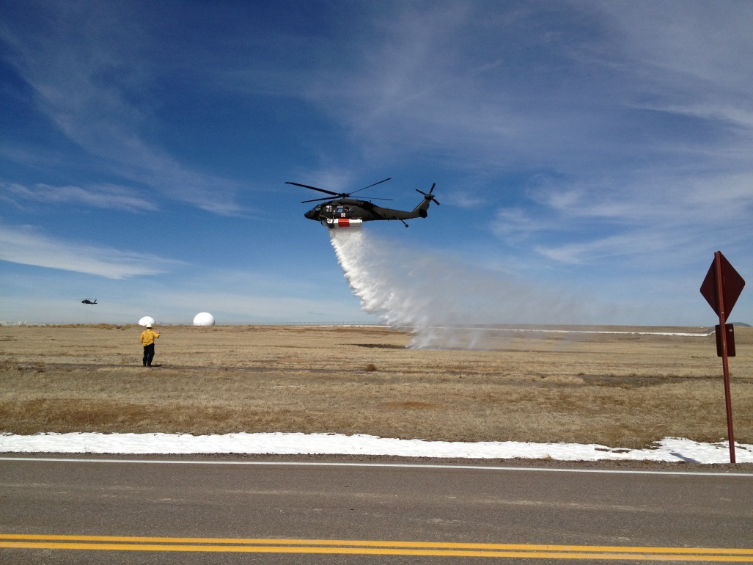
Fire Aviation Program-CONG
Colorado National Guard
Process for “qualifications”
Working with Fed partners
Training
Streamlining ability to mobilize
Hoist
COLORADO DEPARTMENT OF PUBLIC SAFETY

Slide 59
Fire Aviation Program-Legislation
Senate Bill 13-245
Colorado Firefighting Air Corps
Senators: King (Grand Junction) Jahn (Wheatridge)
Requires DFPC to establishe and maintain the CO Firefighting Air Corps
No appropriations established
Prior to April 1, 2014 DFPC must submit a report exploring the efficacy of the “Corps”
COLORADO DEPARTMENT OF PUBLIC SAFETY

Slide 60
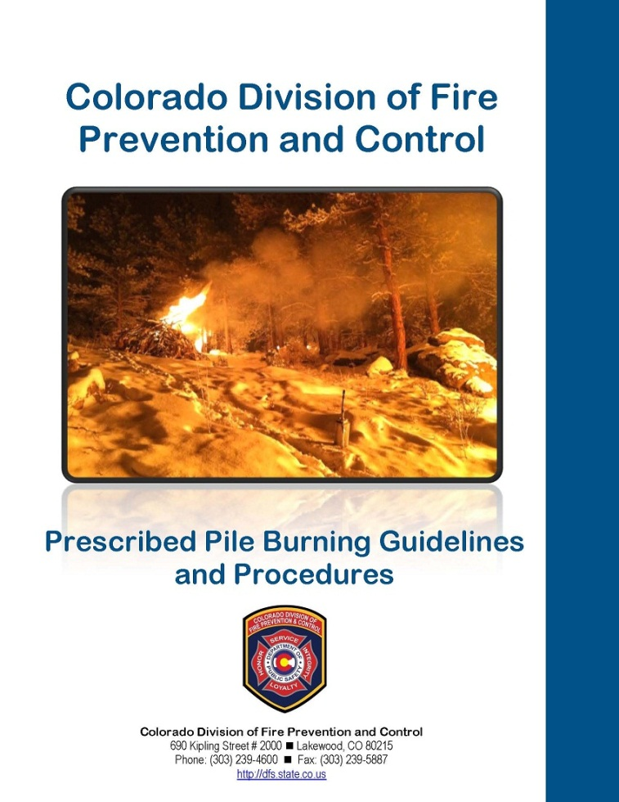
Prescribed Fire Program-LNF to present
March 2012- Governor suspends the use of State prescribed fire.
February 2013- Governor issues Executive Order allowing the use of pile burning. DFPC issues preliminary Pile Burning Guidelines
May 2013- Governor signs Senate Bill 13-083
COLORADO DEPARTMENT OF PUBLIC SAFETY

Slide 61
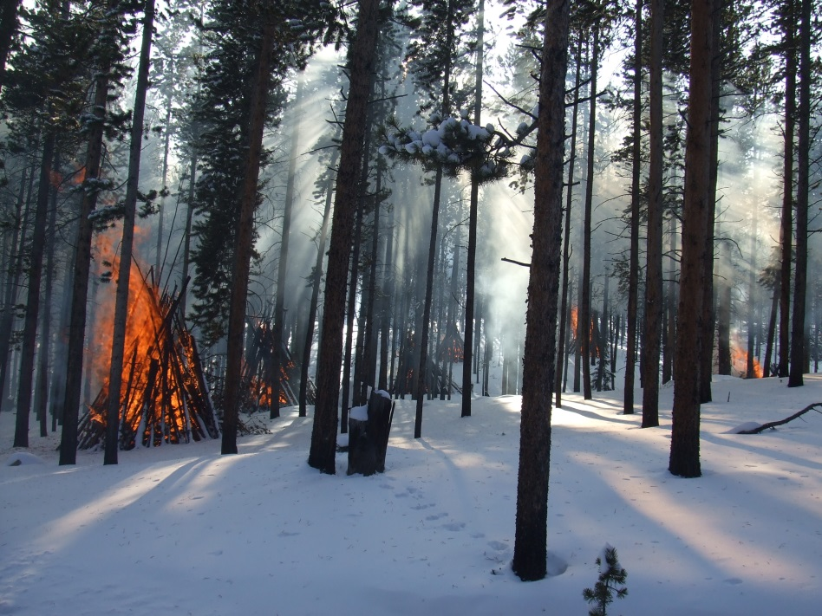
Prescribed Fire Program-Pile Plan
Preliminary Pile Burning Guidelines:
Fortified template
Plan valid for 3 years
Must be reviewed 30 days prior
Fortified notifications
Snow minimum 6 “
Dec 1 – March 15 timeframe
RXB3 minimums
Patrol and monitoring requirements
Escape procedures/definitions
COLORADO DEPARTMENT OF PUBLIC SAFETY

Slide 62
Prescribed Fire Program-Legislation
Senate Bill 13-083
Colorado Prescribed Burning Act
Senators Roberts(Durango) Nicholson (Gilpin County)
Provides limited liability
Provides ability to collect fees
Requires DFPC to:
Implement a prescribed burning program
Establish training standards
Establish Certified Burner Program
Etc
COLORADO DEPARTMENT OF PUBLIC SAFETY

Slide 63
Prescribed Fire Program-Certified Burner
State & Private Forestry, $300,000 Grant obtained via CSFS
Advertised and closed May 27th- 8 candidates
Basic framework outlined:
  Partners
  General curriculum
COLORADO DEPARTMENT OF PUBLIC SAFETY

Slide 64
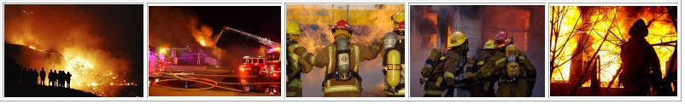
The Future
Every program will undergo an efficiency and effectiveness review involving stakeholders . . .
Focus Groups
Advisory Board/Committee Review
LEAN Process
COLORADO DEPARTMENT OF PUBLIC SAFETY

Slide 65
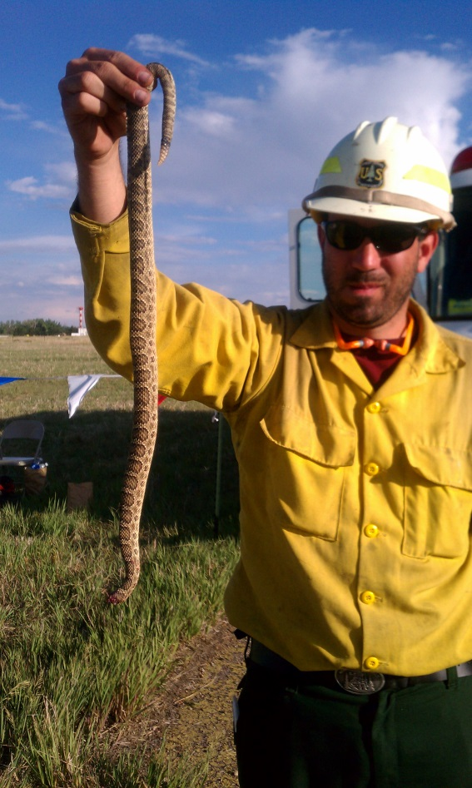
Questions?
COLORADO DEPARTMENT OF PUBLIC SAFETY

